Slide 1

Analog and Digital Final Presentation
Presented By:
Thomas Mindenhall
Matthew Lenz

Slide 2
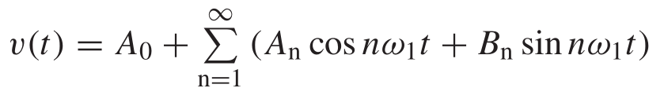


Building Our Signal
Two Forms:
Quadrature Form -
Exponential Form -

Slide 3
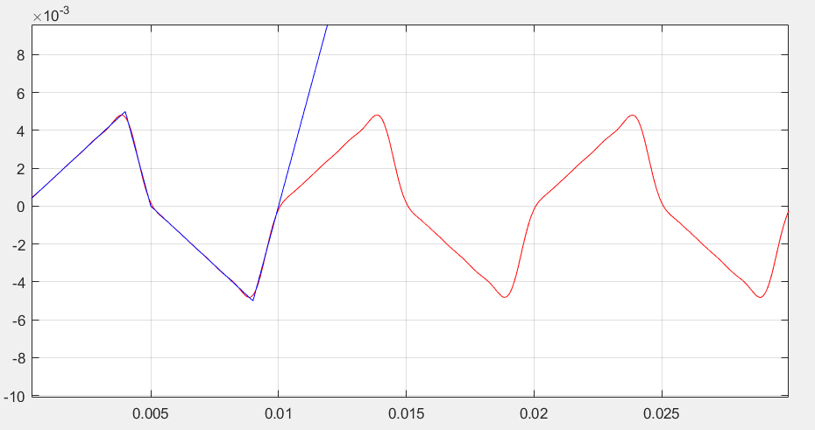
Quadrature Signal

Slide 4
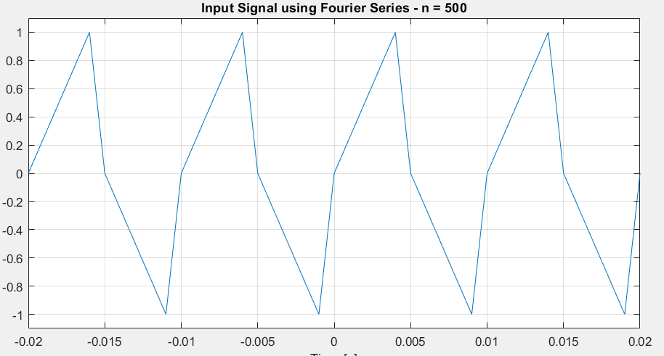
Exponential Form

Slide 5
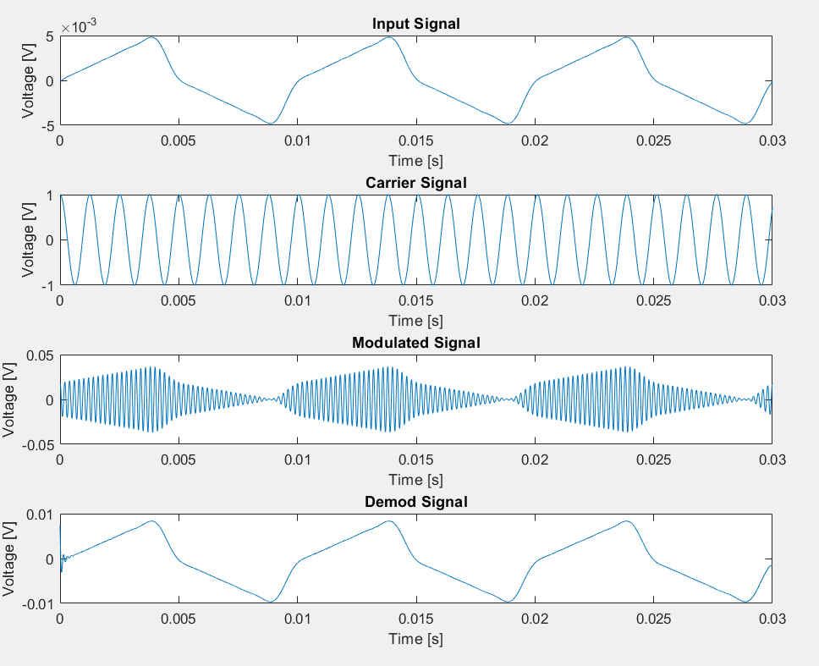
Analog Mod: Amplitude Modulation

Slide 6
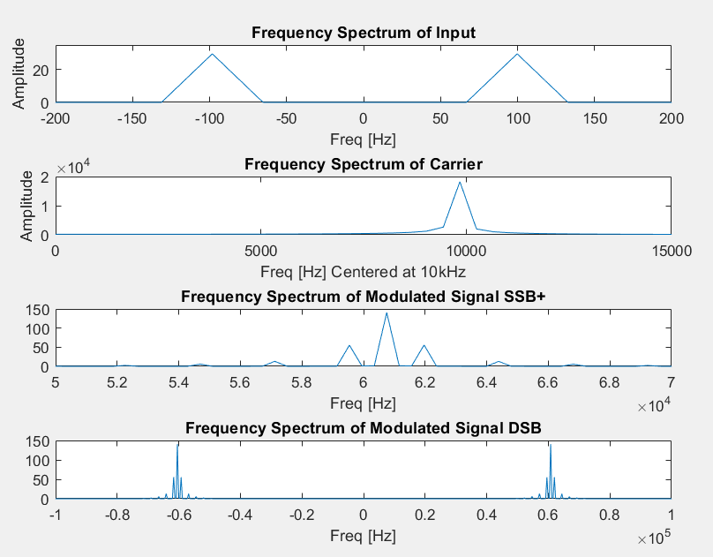
Analog Mod: Amplitude Modulation

Slide 7
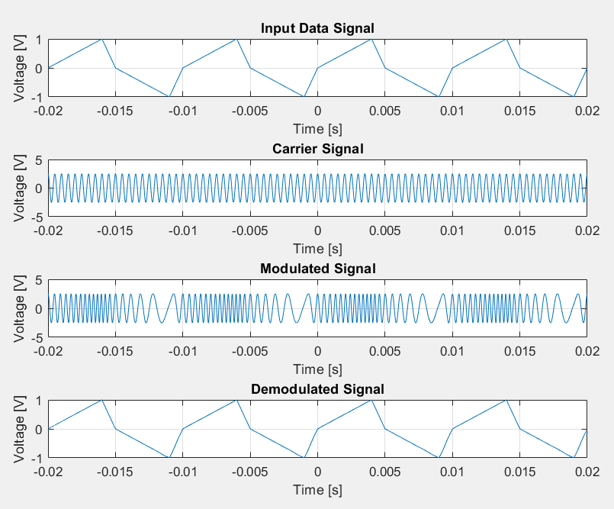
Analog Mod: Frequency Modulation

Slide 8
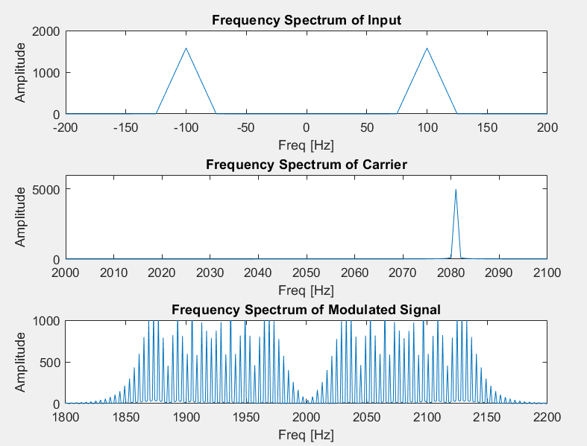
Analog Mod: Frequency Modulation

Slide 9
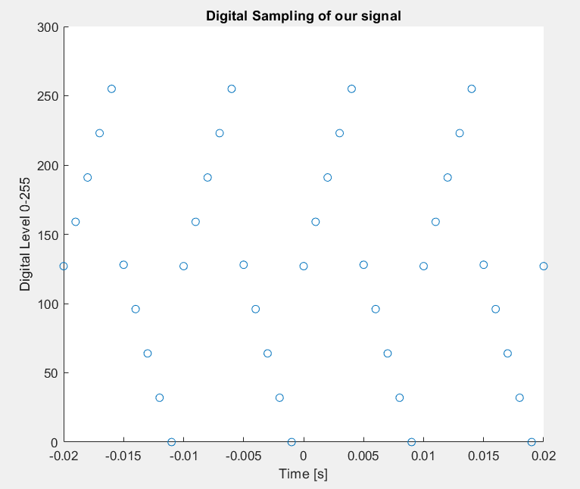
Digital Mod:
Digitization

Slide 10
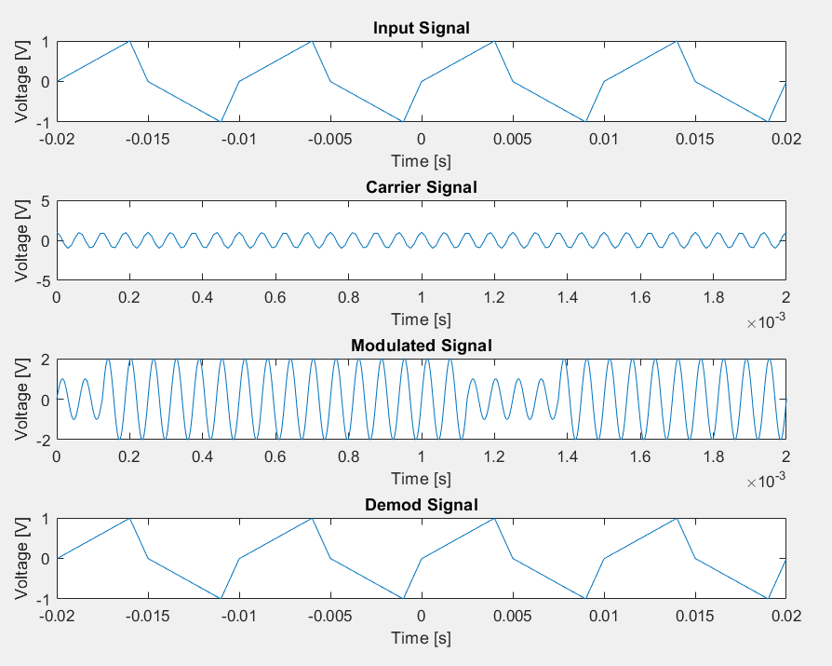
Digital Mod: ASK
Amplitude Shift Key

Slide 11
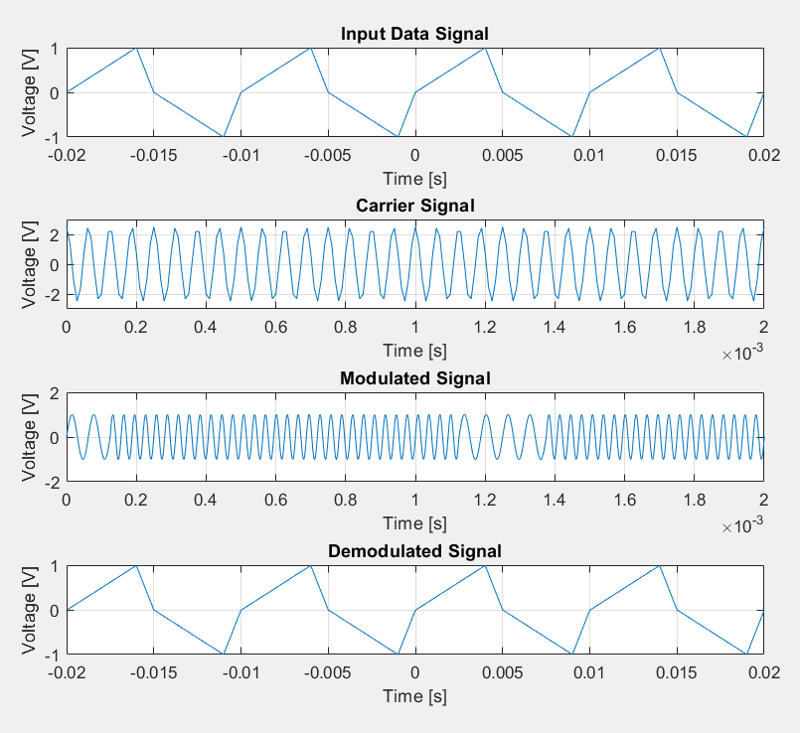
Digital Mod: FSK
Frequency Shift Key

Slide 12
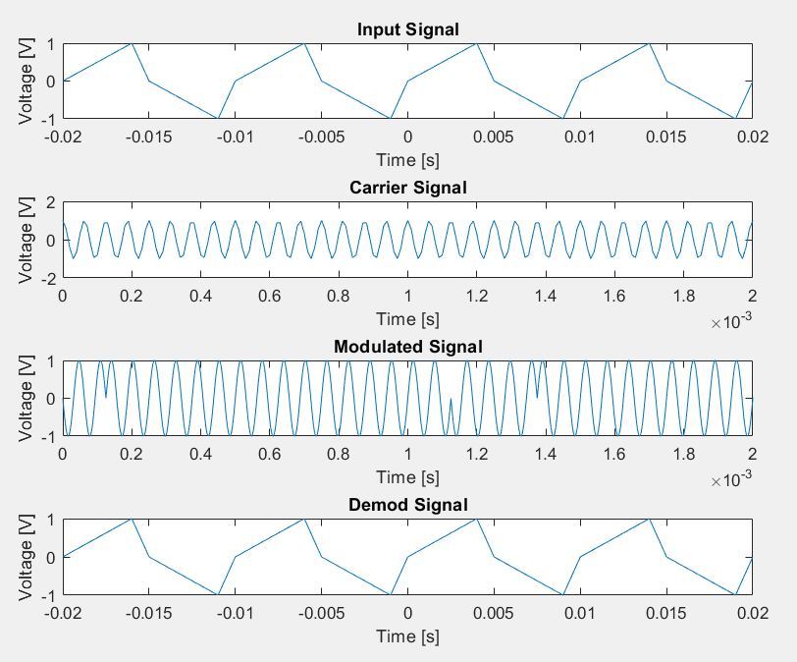
Digital Mod: BPSK
Binary Phase Shift Key

Slide 13
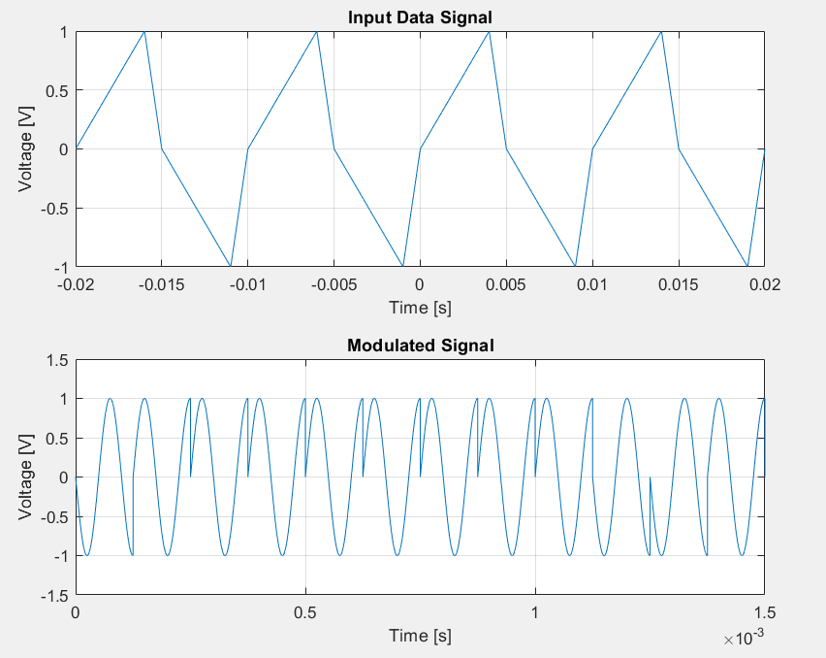
BONUS!
Quadriphase Shift Keying

Slide 14
References
Student: Austin Fagen
Faculty: Prof. Khalid Kuwairi
Faculty: Dr. Shelly Dyer
Author: Sheikh Mukhtar Hussin (MathWorks)

Slide 15
Questions?

