Slide 1
GIT
Introduction to Git

Slide 2
Learning Objective
At the end of the session you will understand
What is Version Control System?
Git and its commands
Introduction to GitHub

Slide 3

What is a Version Control System?
It is also known as Revision control System or Source Control Management(SCM) tools
Is a category of software tool that tracks and manages changes to software code
It is about managing multiple versions of documents, programs, web sites, etc.
Almost all “real” projects use some kind of version control
Essential for team projects, but also very useful for individual projects

Slide 4
What is a Version Control System?
Helps software teams work faster and smarter.
Useful for DevOps teams since they help them to reduce development time and increase successful deployments.
Well known VCS include CVS, Subversion(SVN), Mercurial, and Git

Slide 5
Why Version Control system is Important?
For working by yourself:
Gives you a “time machine” for going back to earlier versions
Gives you great support for different versions (standalone, web app, etc.) of the same basic project
For working with others:
Greatly simplifies concurrent work, merging changes
For getting an internship or job:
Any company with a clue uses some kind of version control
Companies without a clue are bad places to work

Slide 6
Benefits of the Version Control System
Efficient Collaboration
Better Communication and Assistance
Reduce possibilities of Errors
Contribute from anywhere irrespective of the different geographical locations
Helps in recovery in case of any disaster or contingent situation
Informs us about Who, What, When, Why changes have been made

Slide 7
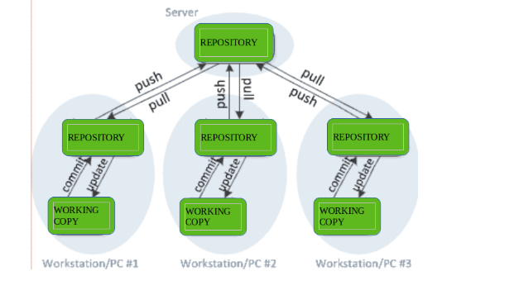
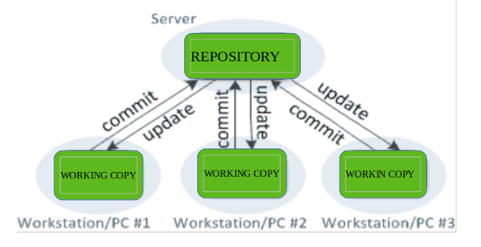
Types of Version Control Systems
i)Centralized Version Control System ii)Distributed Version Control System

Slide 8


What is Git?
The most widely used modern distributed version control system
Git is an open source project developed in 2005 by Linus Torvalds.
Designed for performance, security and flexibility
Latest version is 2.40 released in March 2023
No centralized connectivity is needed
Powerful and easy branching with easy to merge

Slide 9
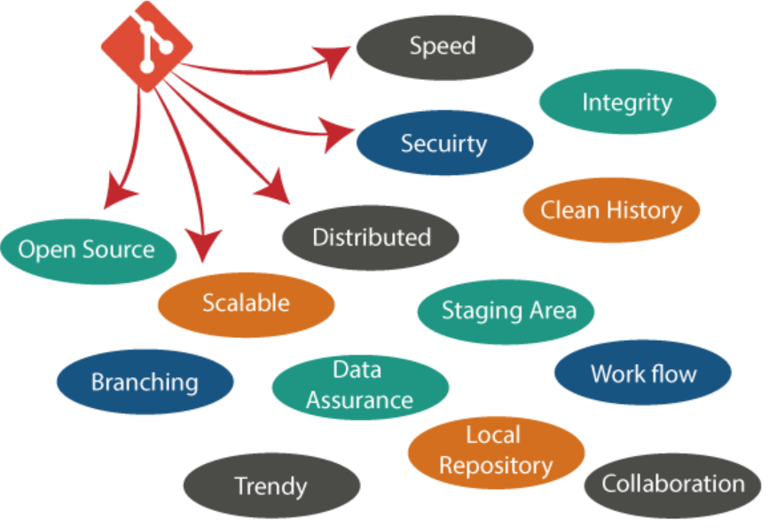
Why Git?

Slide 10
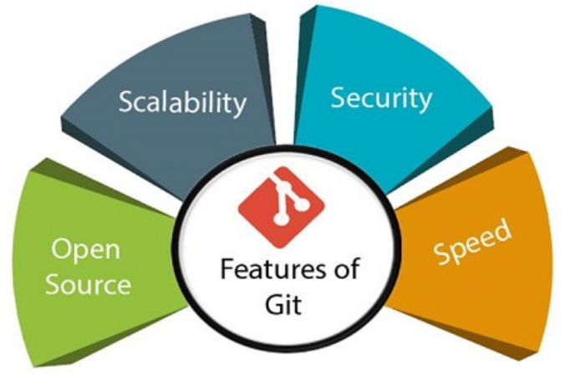
Advantages of GIT
Performance
Security
Compatible
Non Linear/Branching
Light weight
Speed, Scalability

Slide 11
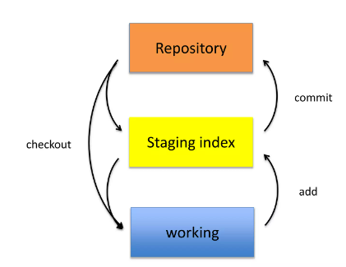
What is a Repo?
“Repo” = Repository
Usually used to organize a single project
Repos can contain
folder and files,
images,
videos,
spreadsheets and
datasets-anything your project needs

Slide 12


Git workflow
1.Initialize a new project in a directory
git init
2.Add every change that has been made to the directory
git add .
3.Commit the changes to repo
git commit –m “important message here”

Slide 13
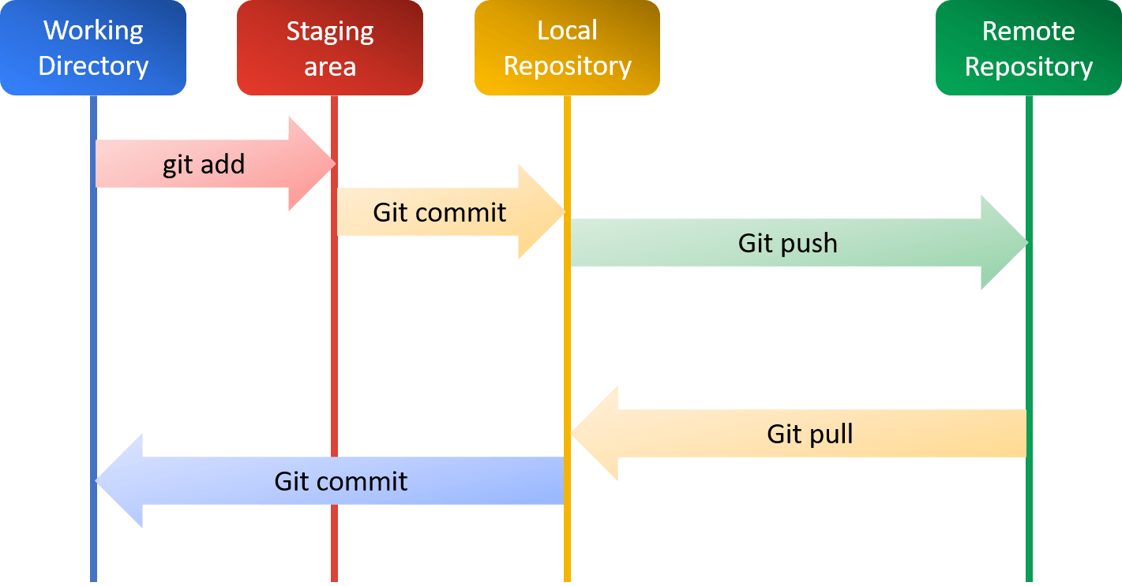
GIT workflow

Slide 14
Git Basic Commands
Command | Description
git init | Create new local Repository
git add . | Stage all changes
git reset | For unstaging a file
git status | List all new/modified files to be commited
git log | List version history of current branch
git commit -m "<message>" | Commit staged changes to local repository
git push | push local commits to remote repository
git clone <url> | Clone existing remote repository
git pull | Download and merge commits from remote repository

Slide 15

Git Branching
Lightweight movable pointers for different commits
By default the branch name is called Master
Represents an independent line of development.
Any number of branches can be created, merged or deleted
Merging of branches is easy

Slide 16
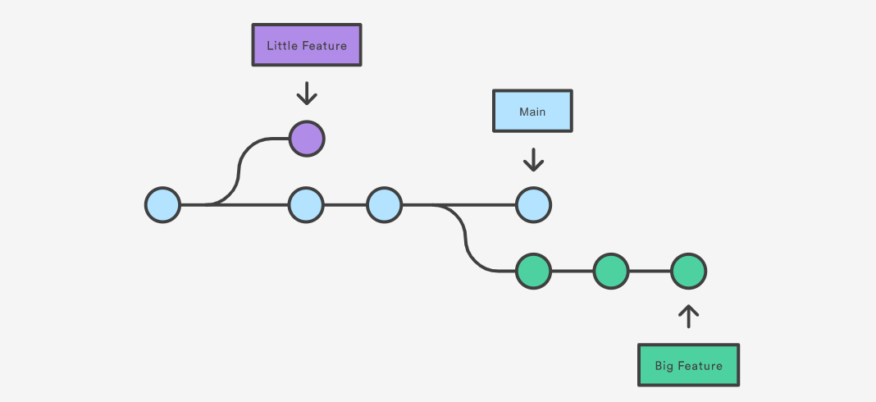
Git Branching

Slide 17
Git Merging
A process of combining the recent changes from several branches into a single new commit that will be on all those branches.
Merging takes your branch changes and implements them into the main branch
Merging is the complement of branching in version control
Ways of Merging include
Fast Forward Merge and
Three way Merge
Merge conflict may occur when Git is unable to automatically resolve differences in code between two commits

Slide 18

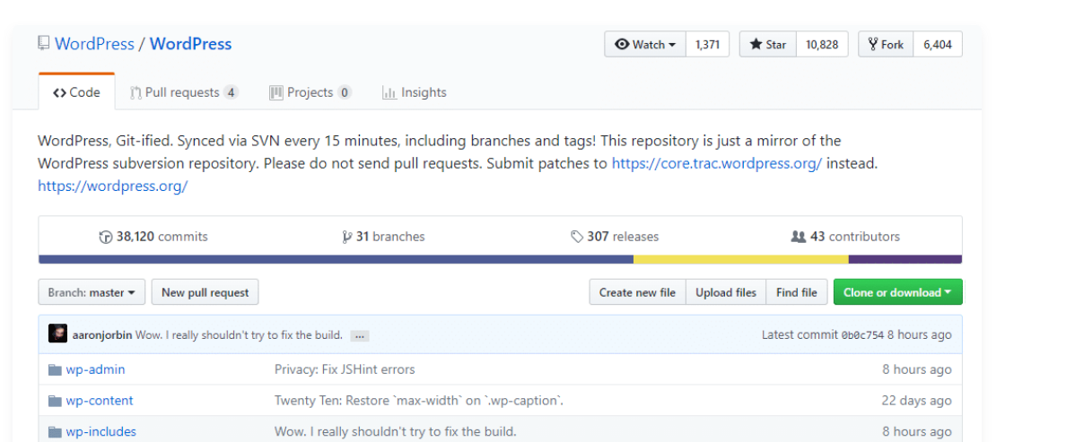
GitHub
Is an Online hosting service for Git repositories
Anyone can sign up and host a public code repository for free
Ability to collaborate with other developers from any location.
GitHub’s interface is user-friendly so even novice coders can take advantage of Git
Sample GitHub Interface
Notes:
Without GitHub, using Git generally requires a bit more technical savvy and use of the command line.
GitHub is so user-friendly, though, that some people even use GitHub to manage other types of projects – like writing books.

Slide 19
Git v/s GitHub contd..
S.No. | Git | GitHub
1 | Git is a software & Version Control tool | GitHub is a service, focussed on centralized source code hosting
2 | Git is a command-line tool | GitHub is a graphical user interface
3 | Git is installed locally on the system | GitHub is hosted on the web
4 | Git is maintained by linux. | GitHub is maintained by Microsoft.
5 | Git is focused on version control and code sharing. | GitHub is focused on centralized source code hosting.

Slide 20
Keep Points Discussed
Introduction to Version Control System
Difference between centralized and Distributed VCN
Basics of Git
Git Commands
Introduction to GitHub

