Slide 1
ORH128
Documentation v1
John Hermiz
09/27/17

Slide 2
Overview
The objective of this document is to describe the features and details needed to operate the ORH128 board

Slide 3
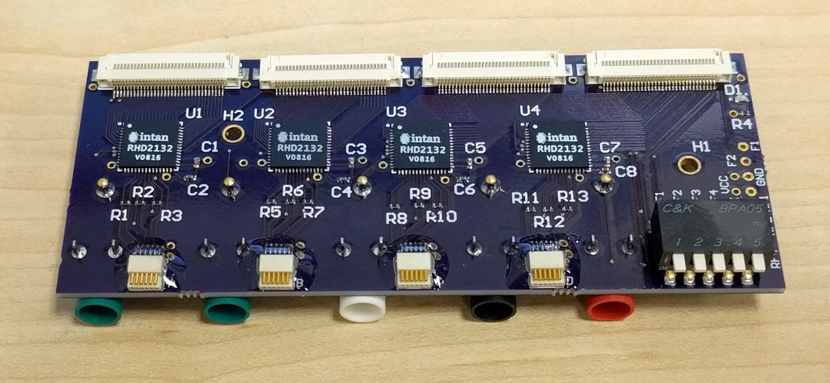
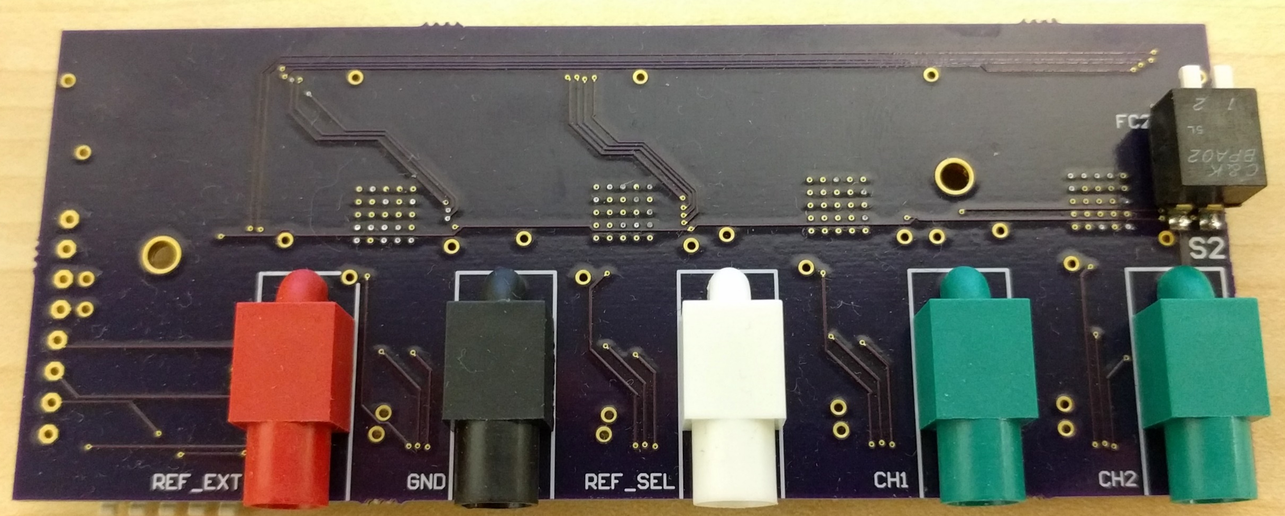
What is the ORH128?
ORH128 Board
It is a headstage that can record up to 128 channels of bio-potentials.
It uses a uni-polar configuration for recording signals.
That is all the signals are recorded with respect to 1 reference
There are several options for reference
It features four 32-channel Intan RHD2132 ASICs
RHD2132
Front Side
Back Side

Slide 4
Inputs
Zif Connector
Apply the bio-potentials to a ribbon cable, which mates with the zif connector
Auxiliary channels
Two auxiliary channels are provided. These signals can be applied to the green touch proof connectors on the back side.
Note the switches on the back side will need to be configured so that they are passed through to the amplifier
Reference and Ground
External reference and ground can be supplied to the headstage. Use the red touch proof for external reference and black for ground

Slide 5
Outputs
SPI Outputs
The digital outputs from the amplifer chip (RHD2132) are sent through the 12-pin omnetics connector.
For more details on how to communicate to RHD2132, please see Intan documentation.
Most users do not need to worry about this.
Reference and Ground
The selected reference can be measured by connecting the white touch proof.
Again, ground can be accessed via the black touch proof

Slide 6
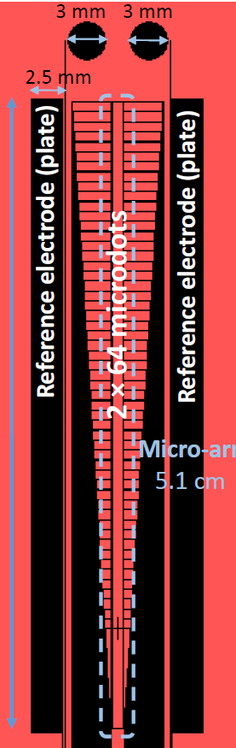
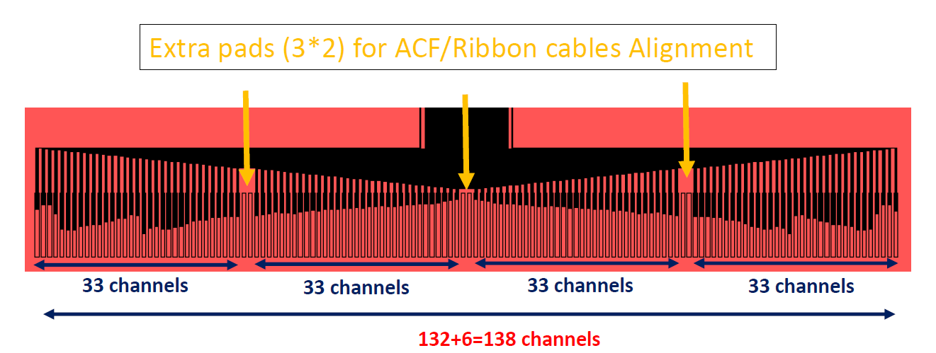
Reference Switch
Ref
Ref
To select which reference to use, configure the switches on the front side to the desired position.
The up position means that the nodes are open and the down position means that the nodes are connected.
Reference Switch Block
Pin # | Position | Description
1 | Down | Z1 to reference
2 | Down | Z2 to reference
3 | Down | Z131 to reference
4 | Down | Z132 to reference
5 | Down | External reference to reference
Z1, Z2
Z131, Z132
Pin: 1 2 3 4 5
Note: “reference” = REF_SEL, and “external_reference” = REF_EXT

Slide 7
Auxiliary Switch
The auxiliary switch block allows the user to connect external channels to the amplifier via the green touch proofs
Pin # | Position | Description
1 | Down | CH1 to amplifier
2 | Down | CH2 to amplifier
Pin: 2 1
Pin # | Position | Description
1 | Up | Z3 to amplifier
2 | Up | Z4 to amplifier
CH1
CH2

Slide 8
Electrode Map
REF2
REF3
L1
R1
L2
R2
REF1
L3
R3
REF4
See spreadsheet for detailed mapping
REF1
REF2
REF3
REF4
L1
L64
R64
R1
RHD2132
Ports:
A
B
C
D
L62
R62
L63
R63
L64
R64

Slide 9
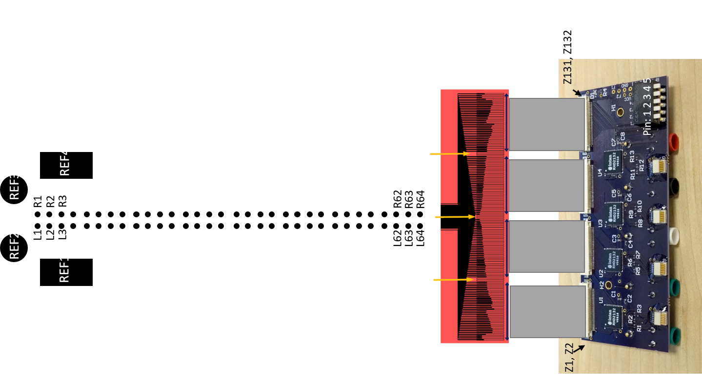
Origin

