Slide 1


MAZE GAME
By Kukuruz

Slide 2
Our team
Scrum Trainer
Todor Georgiev Zafirov 10b
Front-End
Teodora Nikolaeva Kompanska 10a
Back-End
Ivan Dyankov Staev 10v
Back-End
Marieta Petkova Stoycheva 10g
QA
Daniel Kalinov Kolev 10g

Slide 3
Stages of realization
FIRST STAGE –
PLANNING
Second stage –
realization
Third stage –
presentation

Slide 4







Programs we used

Slide 5

Our goal

Slide 6
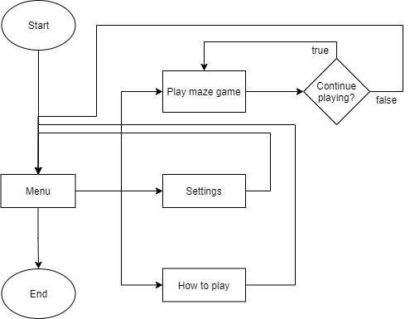
Flowchart

Slide 7
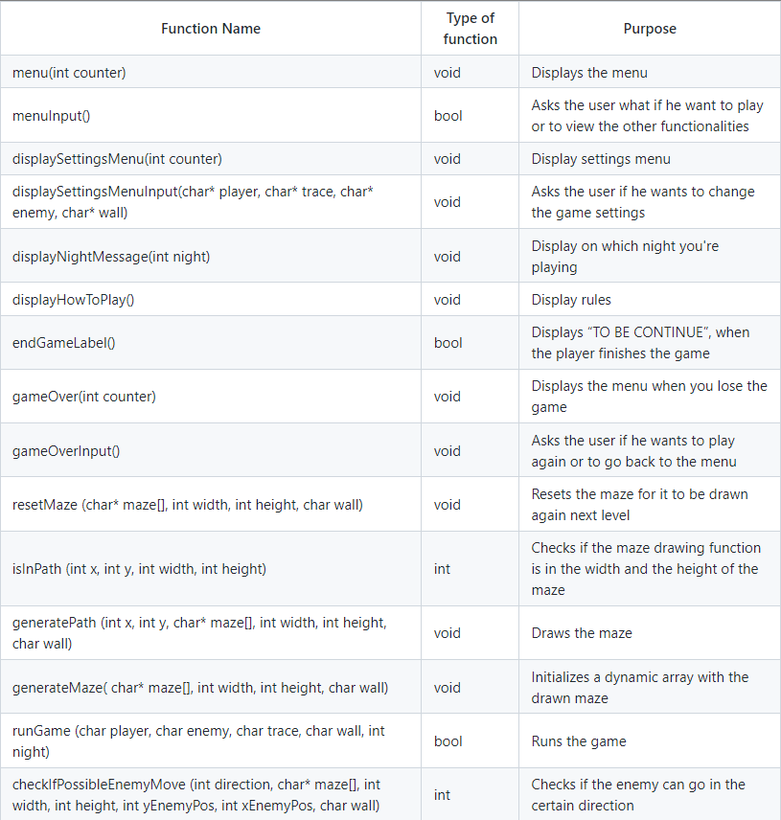
Functions we used

Slide 8
THE GAME

Slide 9
Thank you for your attention!

