Slide 1


Slide 2
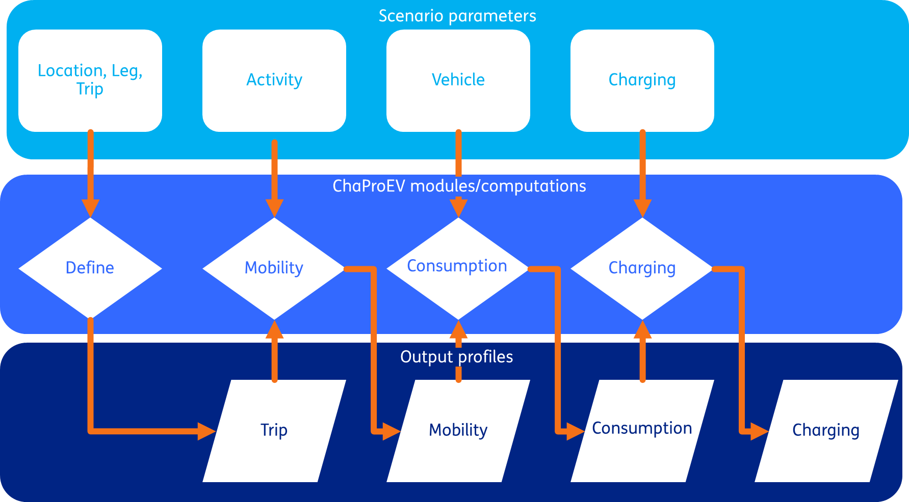
Structure of ChaProEV

Slide 3
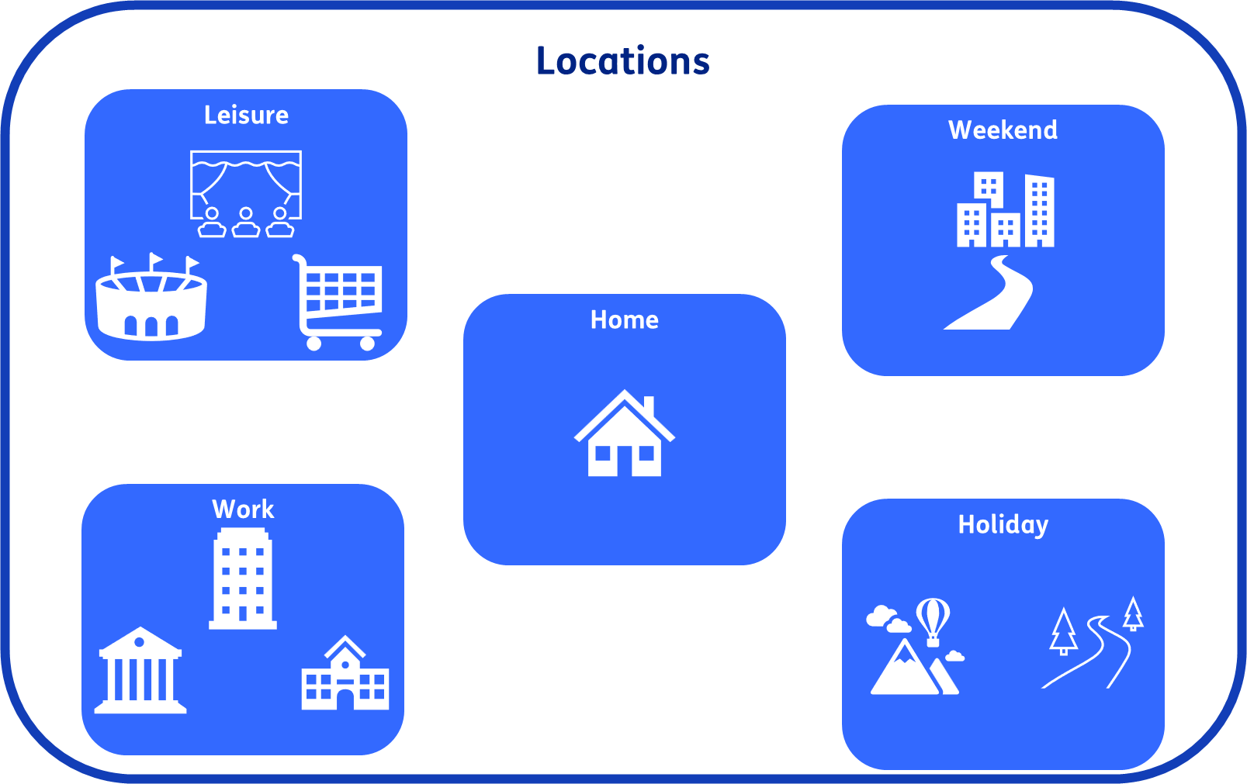

Slide 4








Legs

Slide 5
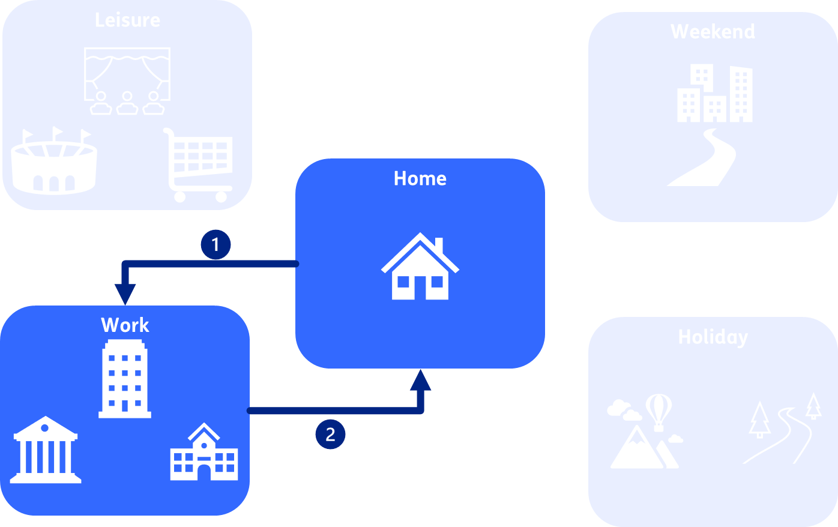
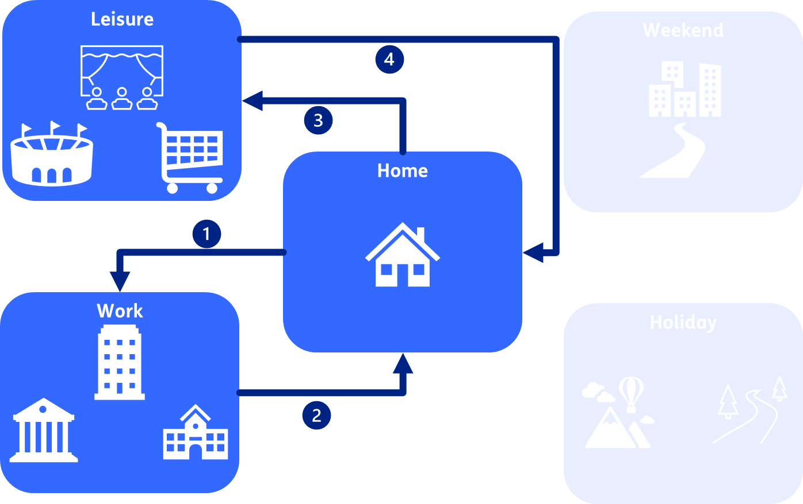
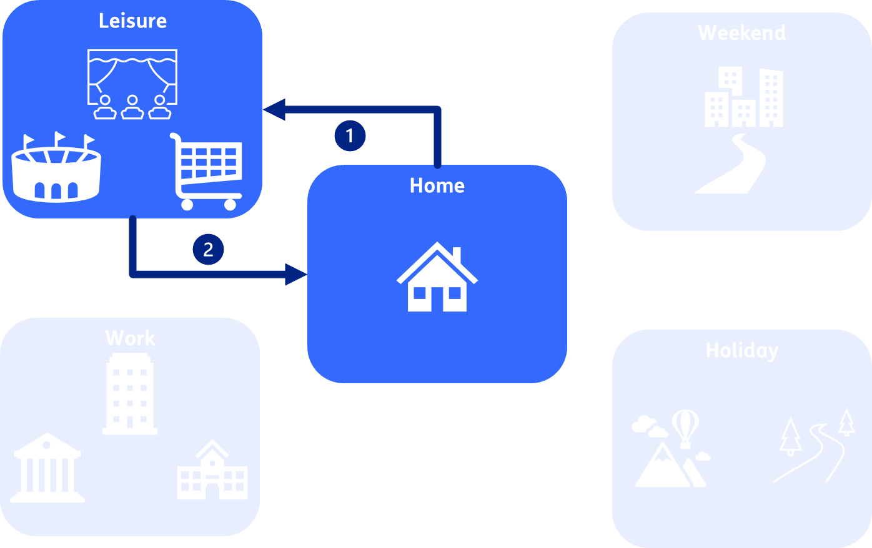
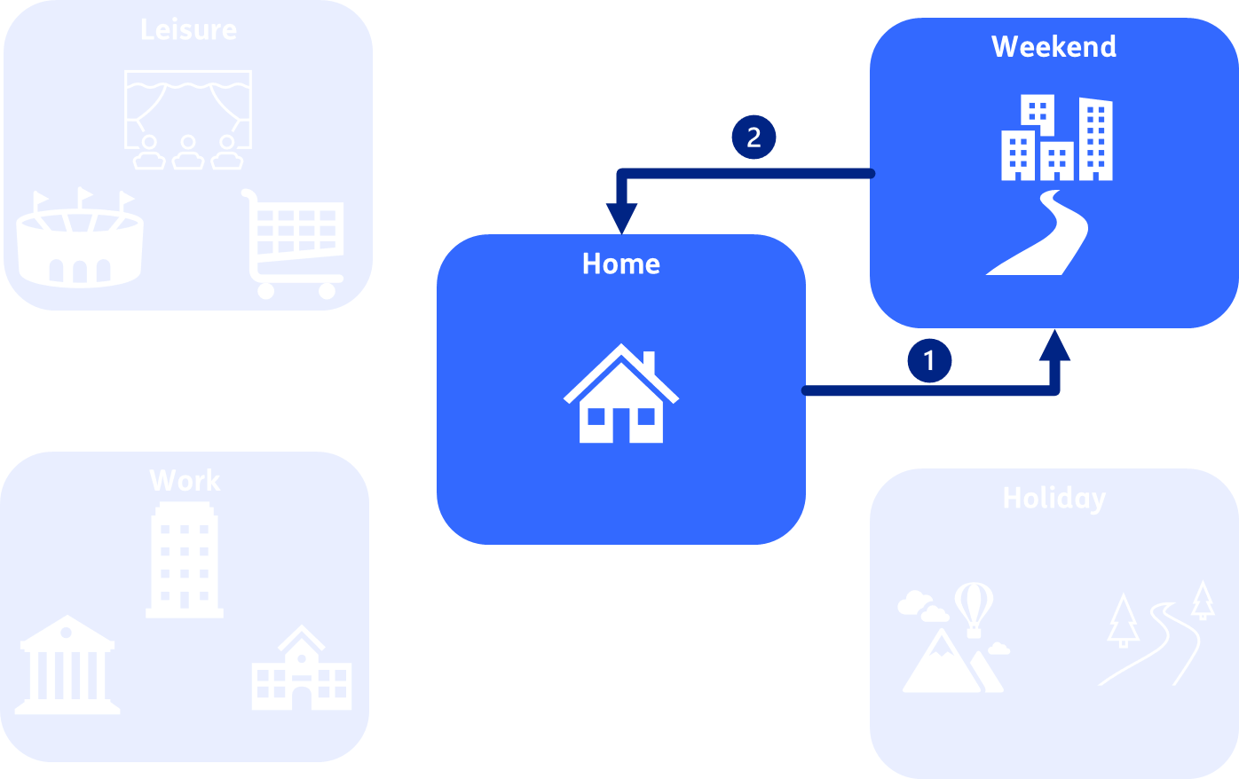
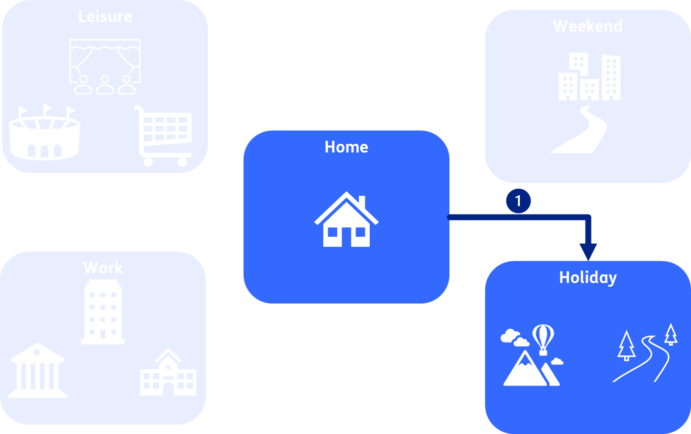
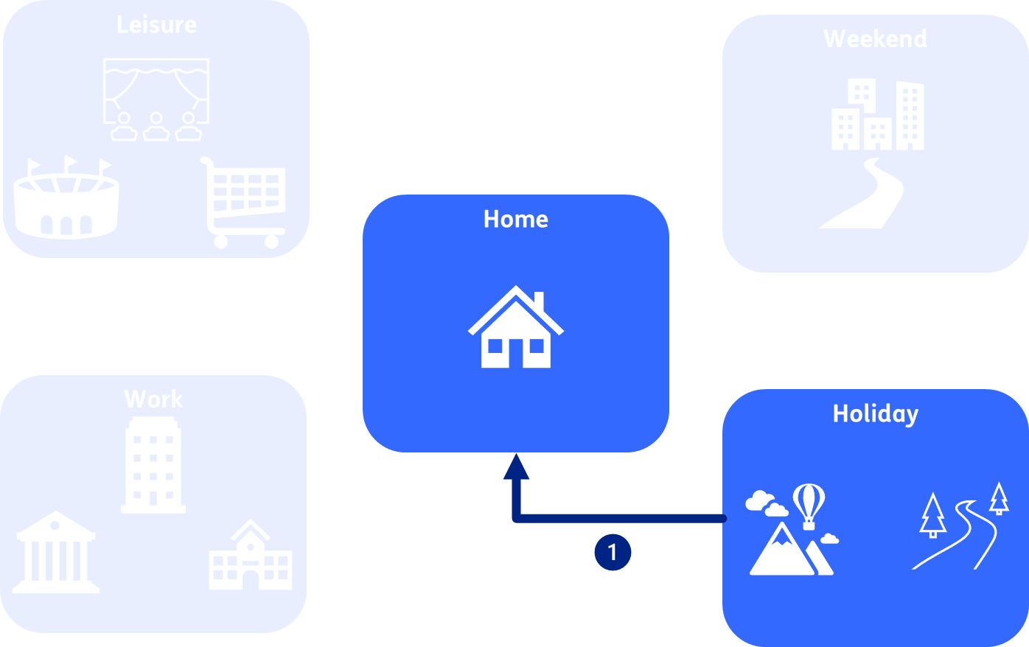
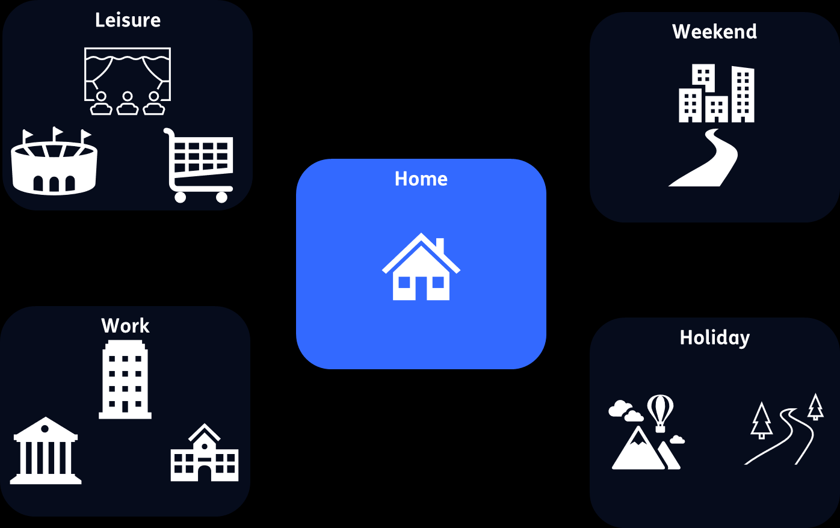
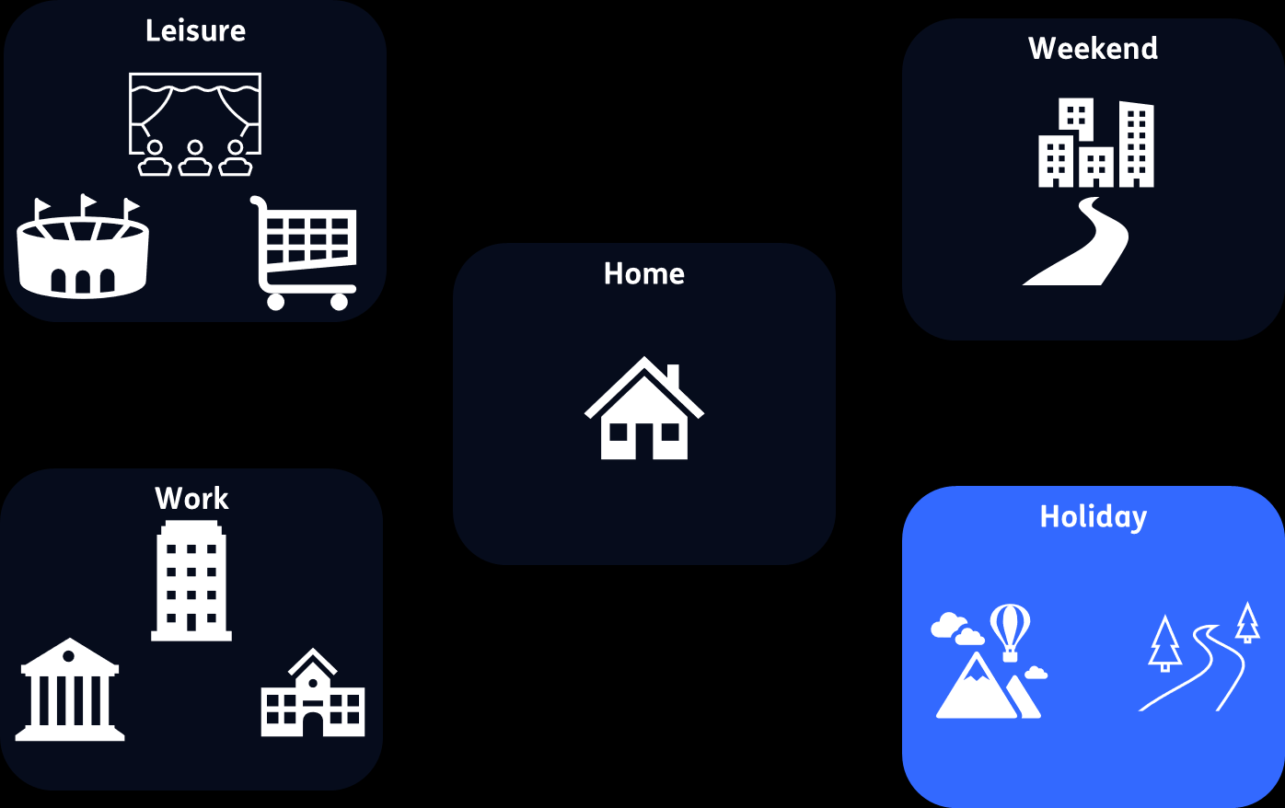
Trips
Commute to work
Commute to work and leisure
Leisure only
Weekend trip
Holiday outward
Holiday back
Stay put home
Stay out holiday

Slide 6
What ChaProEV can bring to OPERA
Output profiles per location type and time unit (hour)
Boundary conditions for optimisation
Demand for next leg (from network/to vehicles) (kWh)
Available power to vehicles/from network (kW)
Effective discharging efficiency
Baseline/ unmanaged charging profile
% connected
Available discharge power from vehicles/to network (kW)
Effective charging efficiency

Slide 7
ChaProEV availability
Source code
Library
https://github.com/TNO/ChaProEV
https://pypi.org/project/ChaProEV/
Understand how the model works
Add scenario files and call functions within your model or independently

Slide 9
Running ChaProEV
Theme name
Place text here
Case study
Country characteristics
Urbanisation/ population density types
Map these to NUTS via population density
Can swap in a more detailed model if available/desired
Can swap in a more detailed model if available/desired
Scenario
Vehicle
Location
Legs
Trips
Calendar
Mobility matrix
Amounts of departures/arrivals
(Weighted) distances
Durations
Consumption
Per hour, day, week, month, year
Per energy carrier
Charging
Per vehicle/from network
Per location
Per hour, day, week, month, year

Slide 10
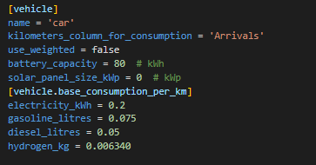
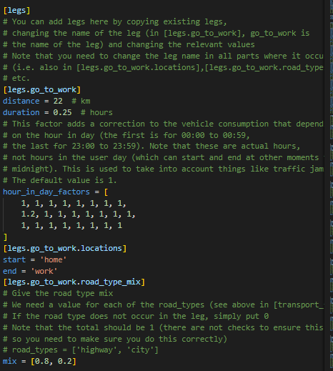
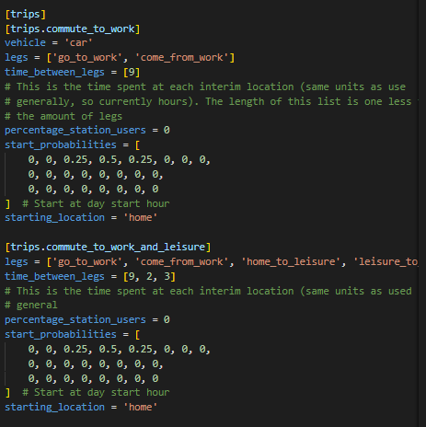
Scenario parameters
Theme name
Place text here

Slide 11
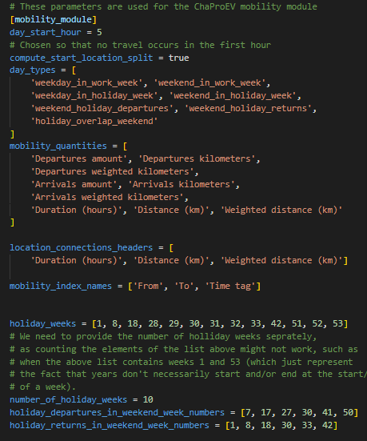
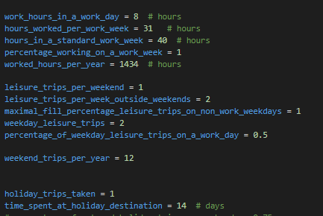
Scenario parameters
Theme name
Place text here

Slide 12
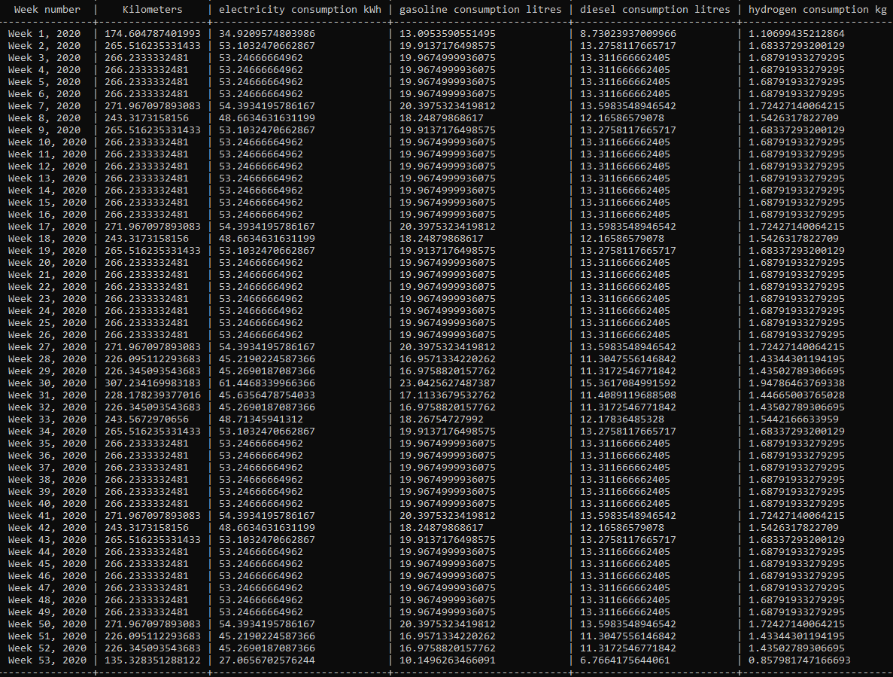
Consumption table
Theme name
Place text here

Slide 13
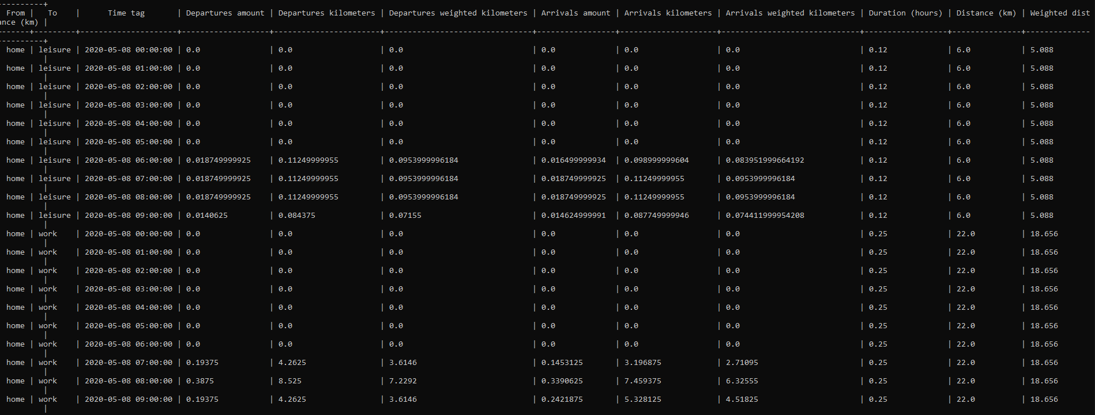
Mobility matrix
Theme name
Place text here

Slide 14
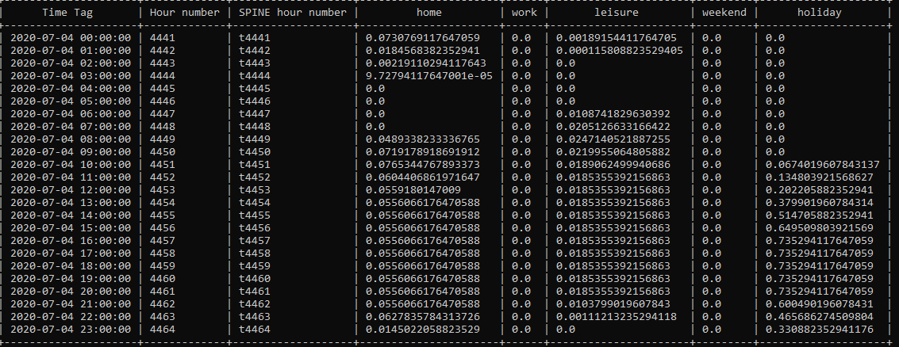
Charge from network
Theme name
Place text here

Slide 15
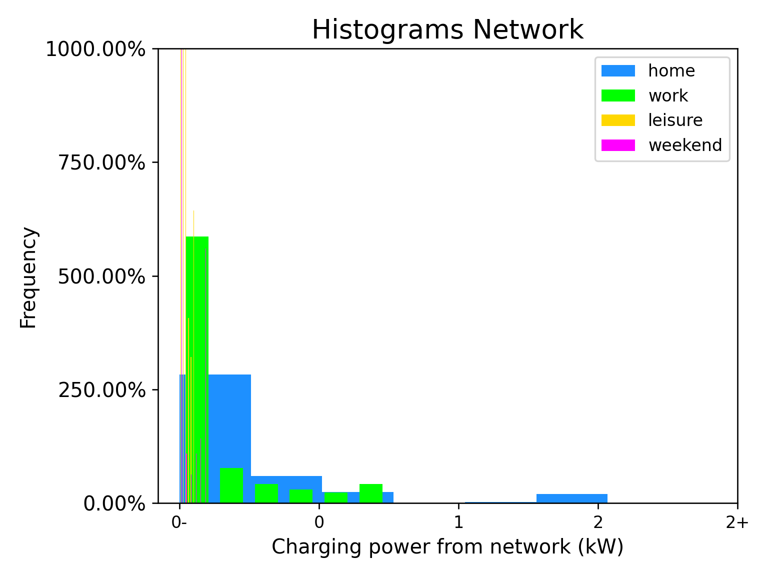
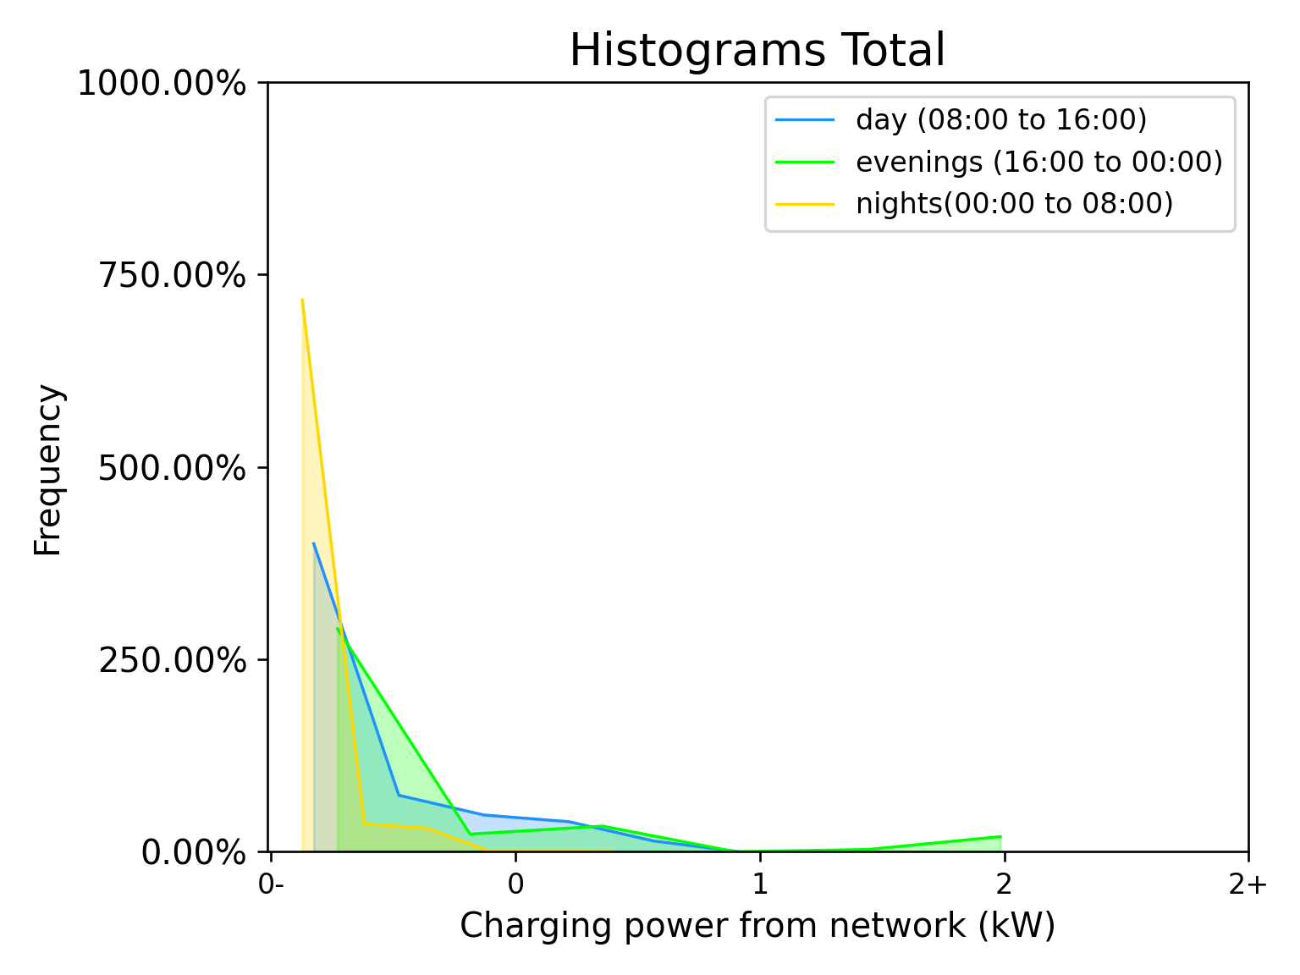
Visualize charge with histograms
Location type
Day parts

Slide 16
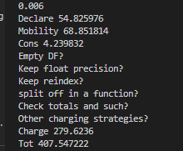

Slide 17
Scenario parameters
Location, Leg, Trip
Activity
Vehicle
Charging
ChaProEV modules/computations
Define
Mobility
Charging
Consumption
Output profiles
Trip
Mobility
Charging
Consumption

Slide 18










Locations
Leisure
Weekend
Home
Work
Holiday

Slide 19
Legs

Slide 20
Trips
Commute to work
Commute to work and leisure
Leisure only
Weekend trip
Holiday outward
Holiday back
Stay put home
Stay out holiday

Slide 21
Legs
Leisure
Weekend
Home
Work
Holiday

Slide 22
Home
Work

Slide 23
Home
Leisure

Slide 24
Home
Weekend

Slide 25
Home
Holiday

Slide 26
Home
Work
Work
Home

Slide 27
Home
Leisure
Leisure
Home

Slide 28
Home
Weekend
Weekend
Home

Slide 29
Home
Holiday
Holiday
Home

Slide 30




Theme name
Trips
Place text here
Leisure
Weekend
Home
Work
Holiday

Slide 31
Leisure
Weekend
Home
Work
Holiday

Slide 32
Leisure
Weekend
Home
Work
Holiday

Slide 33
Leisure
Weekend
Home
Work
Holiday

Slide 34
Theme name
Legs
Place text here
Leisure
Weekend
Home
Work
Holiday

Slide 35
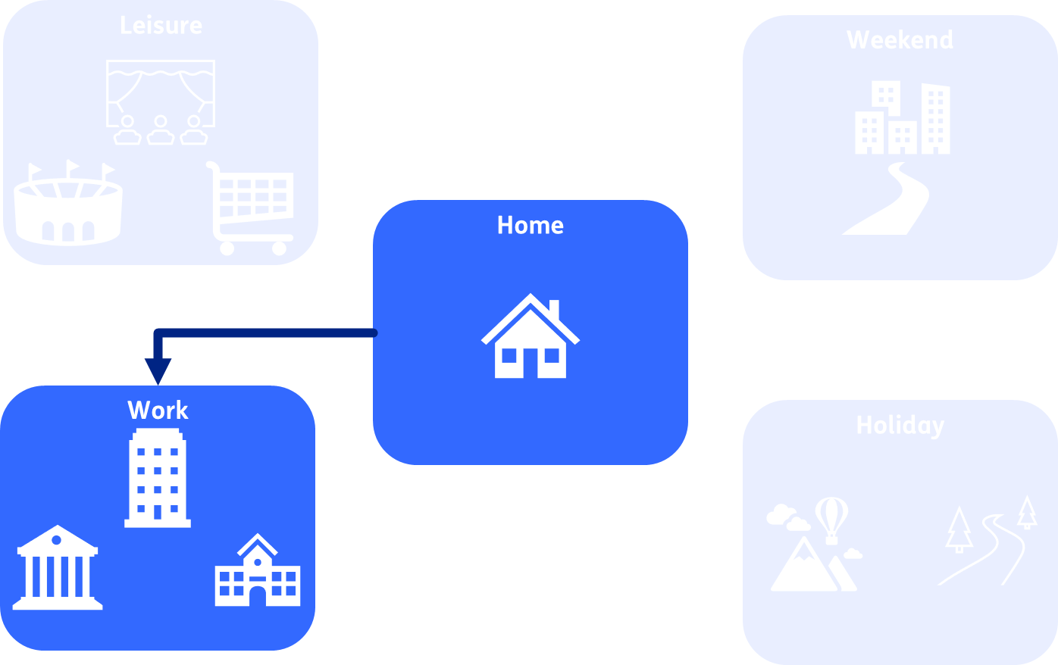
Theme name
Legs
Place text here

Slide 36










Place a title here
Theme name
Place text here

Slide 37






Place a title here
Theme name
Place text here
Work
Holiday
Home
Leisure

