Slide 1


Slide 2
ChaProEV availability
Source code
Library
https://github.com/TNO/ChaProEV
https://pypi.org/project/ChaProEV/
Understand how the model works
Add scenario files and call functions within your model or independently

Slide 3
Running ChaProEV
Theme name
Place text here
Case study
Country characteristics
Urbanisation/ population density types
Map these to NUTS via population density
Can swap in a more detailed model if available/desired
Can swap in a more detailed model if available/desired
Scenario
Vehicle
Location
Legs
Trips
Calendar
Mobility matrix
Amounts of departures/arrivals
(Weighted) distances
Durations
Consumption
Per hour, day, week, month, year
Per energy carrier
Charging
Per vehicle/from network
Per location
Per hour, day, week, month, year

Slide 4
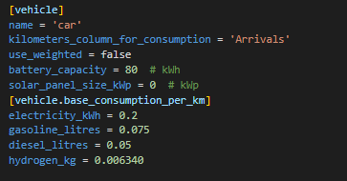
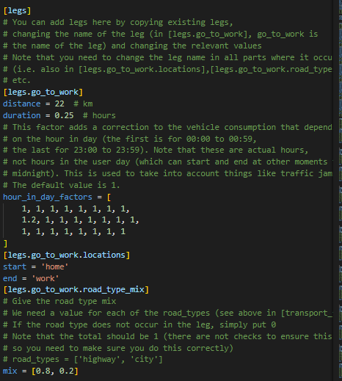
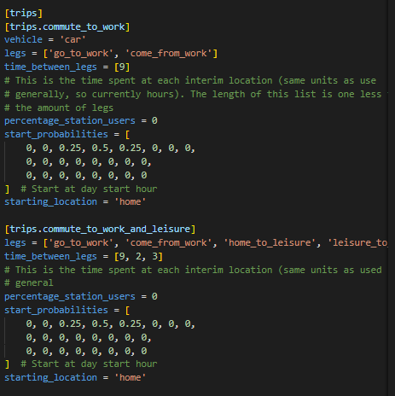
Scenario parameters
Theme name
Place text here

Slide 5
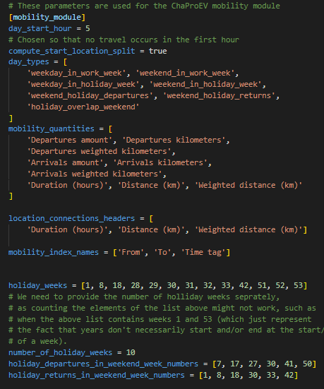
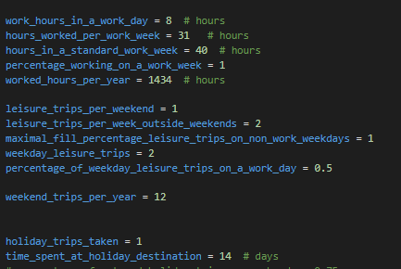
Scenario parameters
Theme name
Place text here

Slide 6
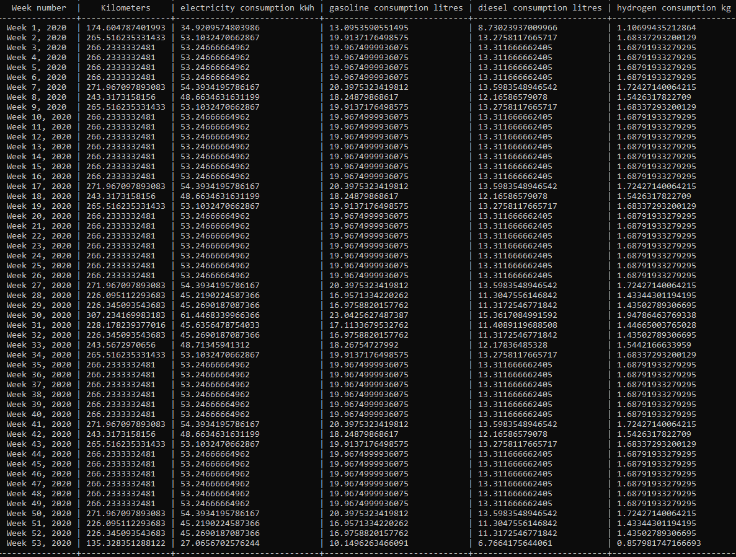
Consumption table
Theme name
Place text here

Slide 7
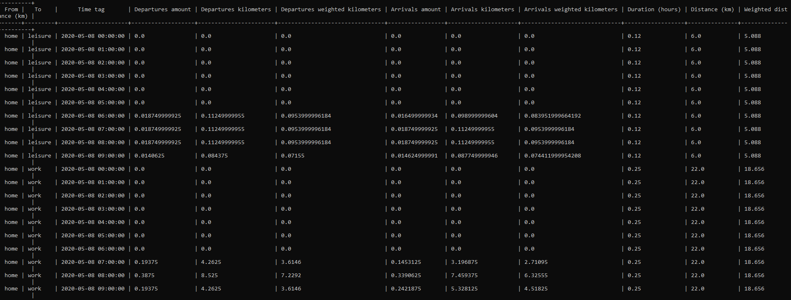
Mobility matrix
Theme name
Place text here

Slide 8
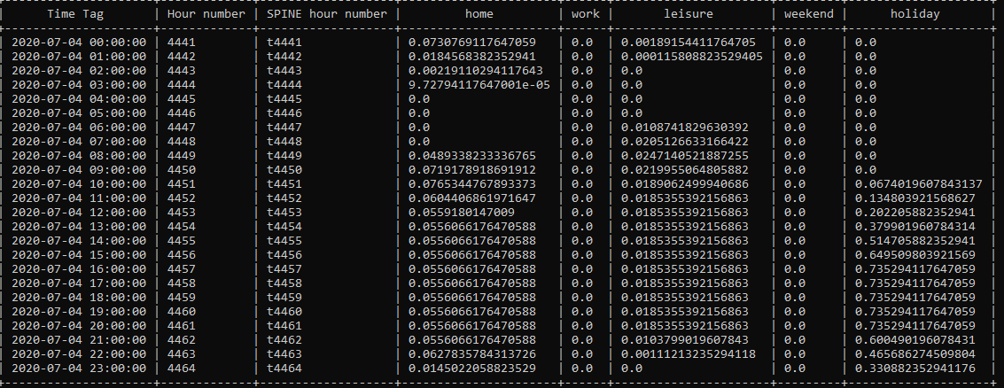
Charge from network
Theme name
Place text here

Slide 9
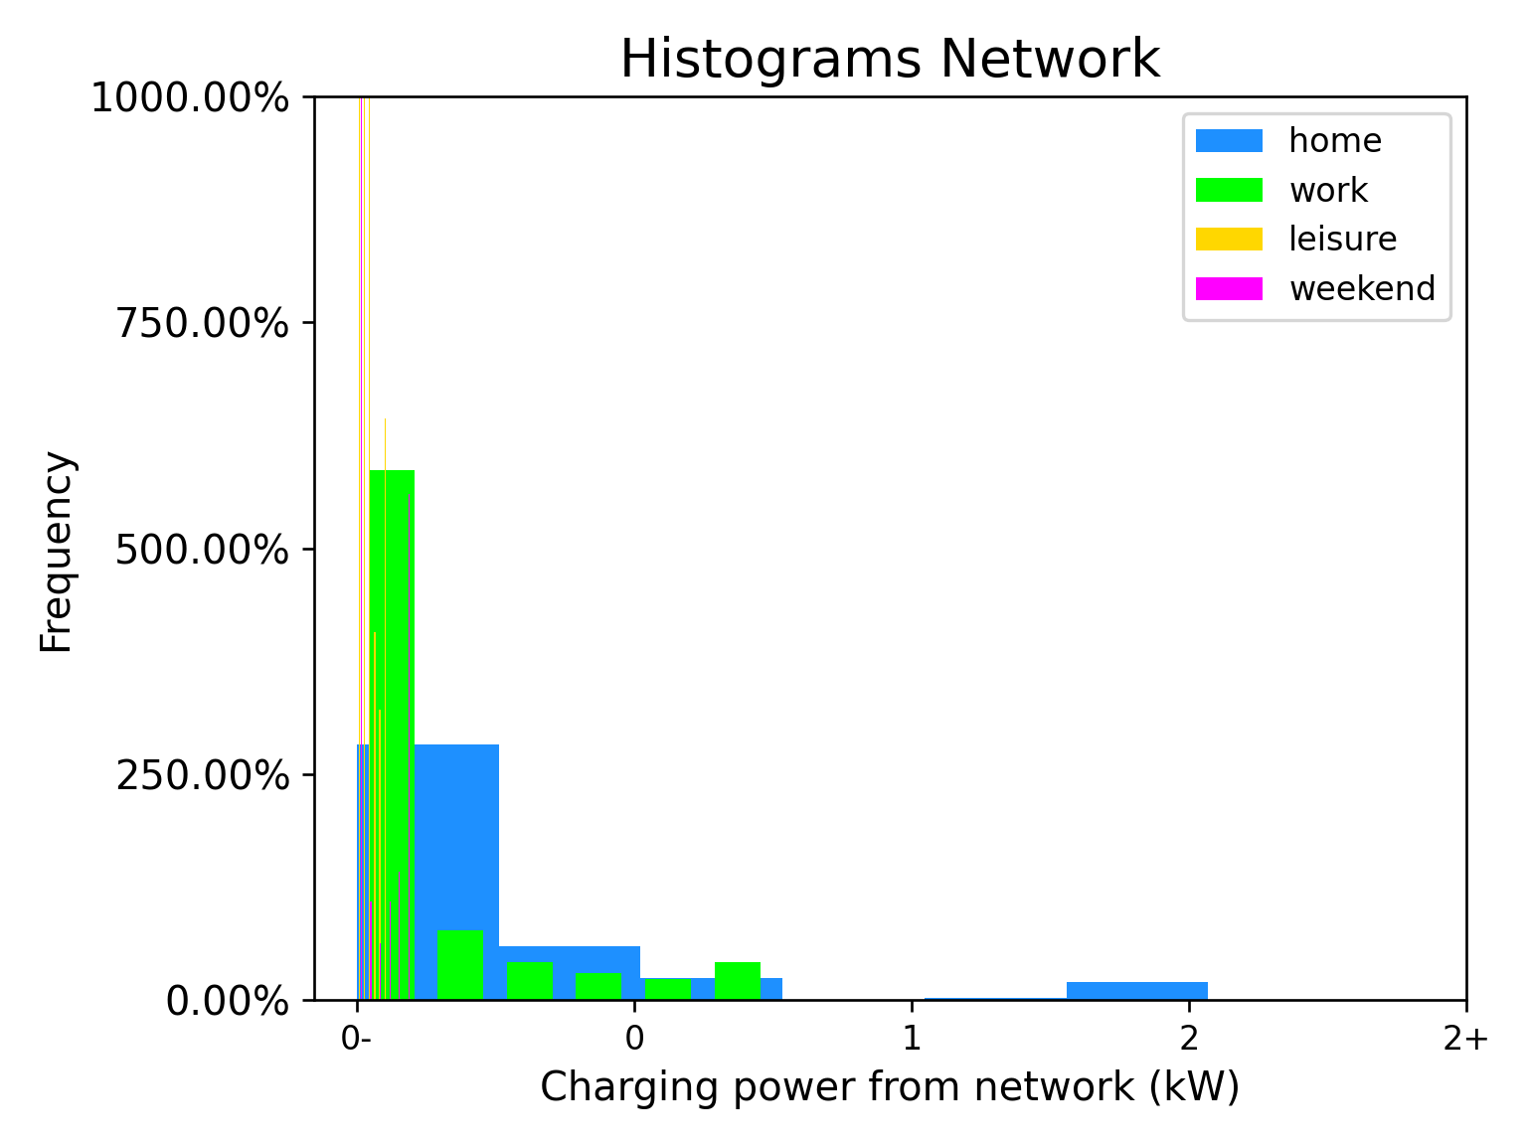
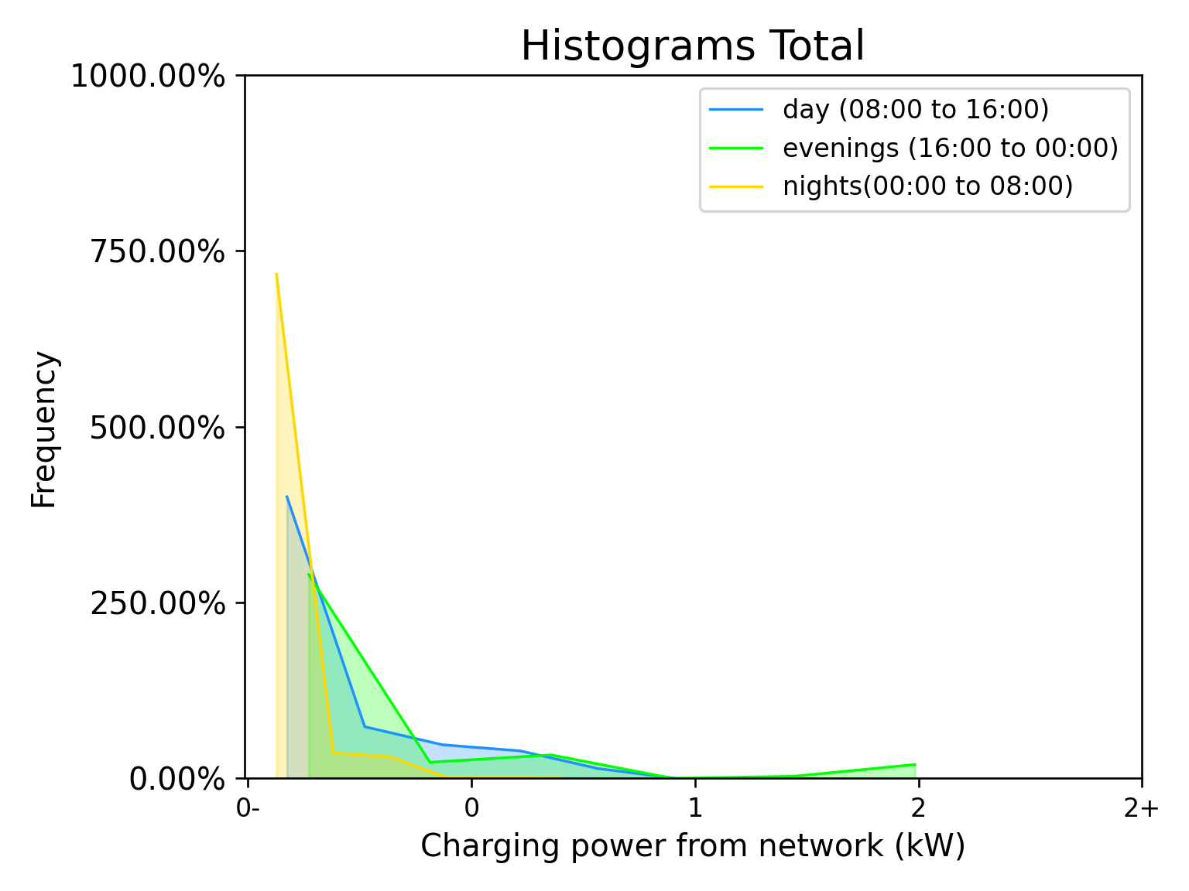
Visualize charge with histograms
Location type
Day parts

Slide 10
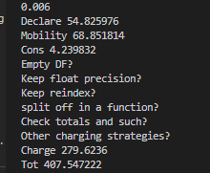

Slide 11
Scenario parameters
Location, Leg, Trip
Activity
Vehicle
Charging
ChaProEV modules/computations
Define
Mobility
Charging
Consumption
Output profiles
Trip
Mobility
Charging
Consumption

Slide 12










Locations
Leisure
Weekend
Home
Work
Holiday

Slide 13








Legs

Slide 14
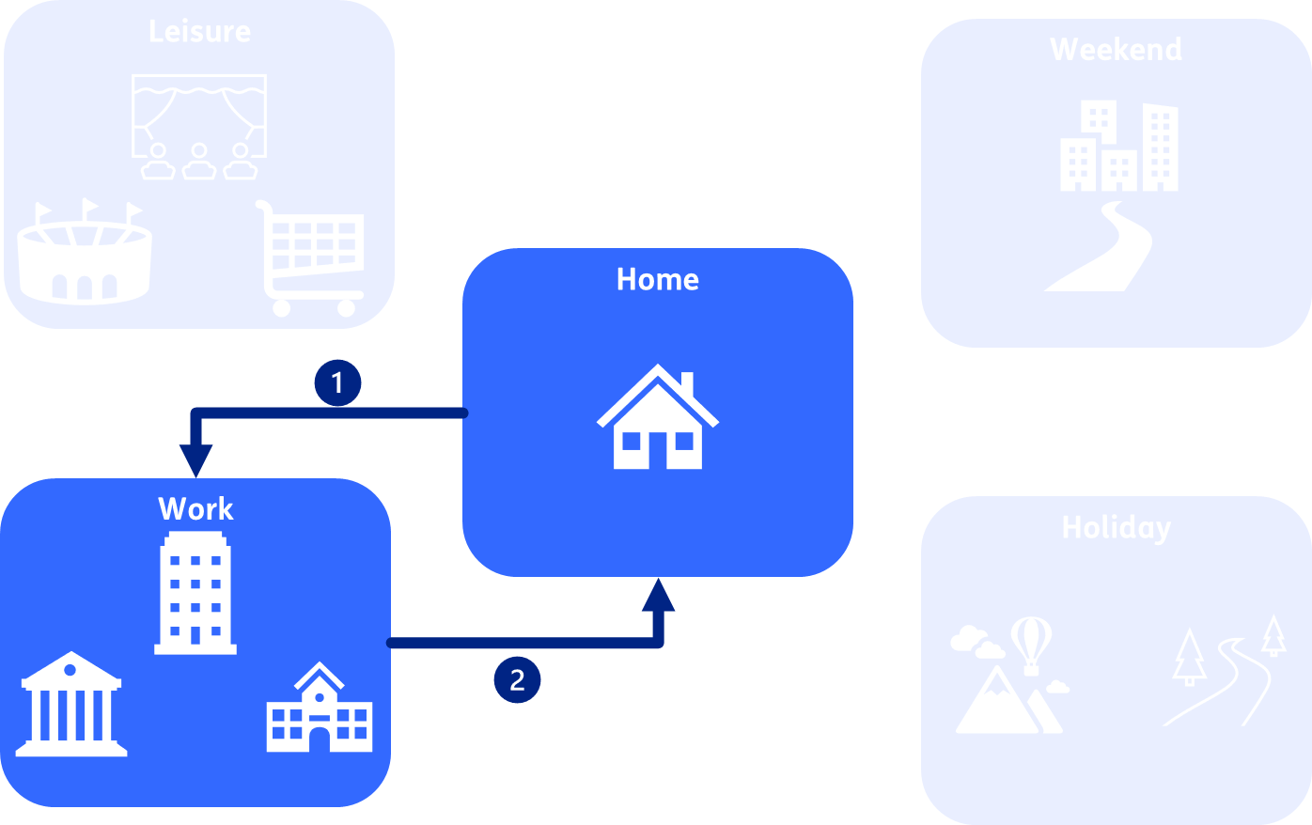
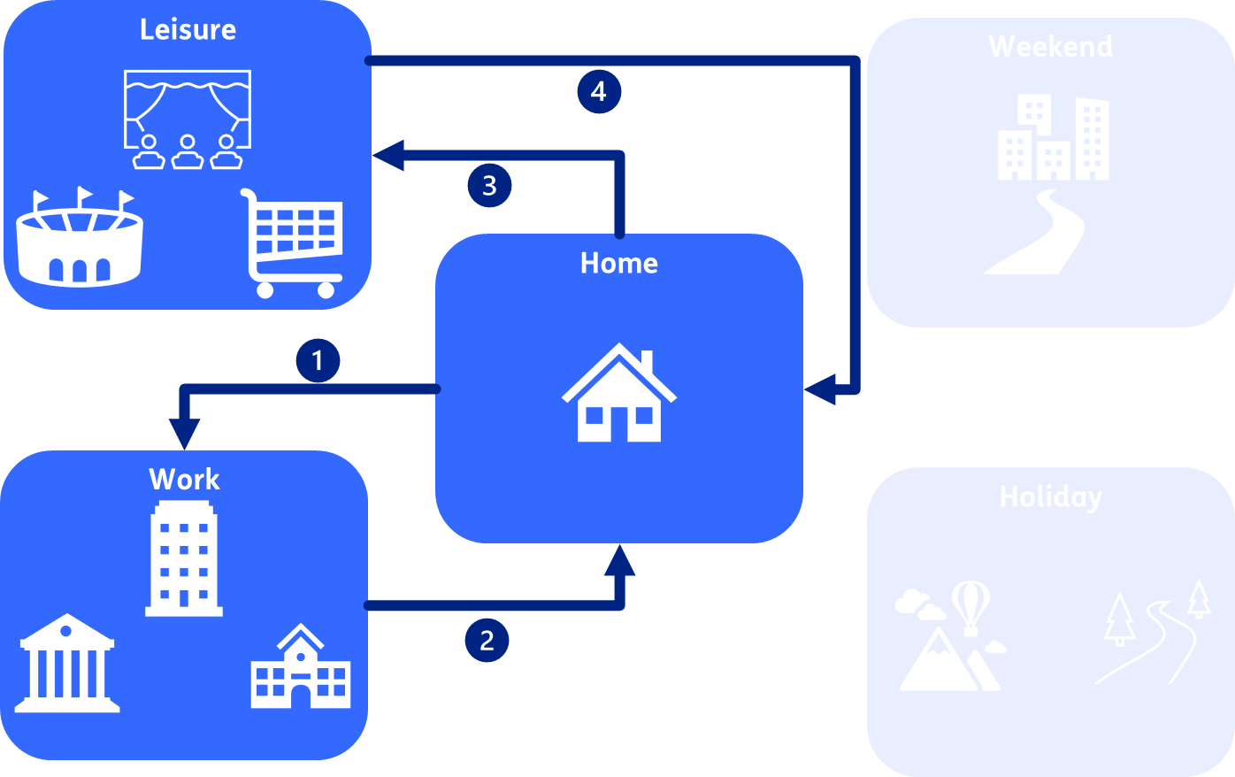
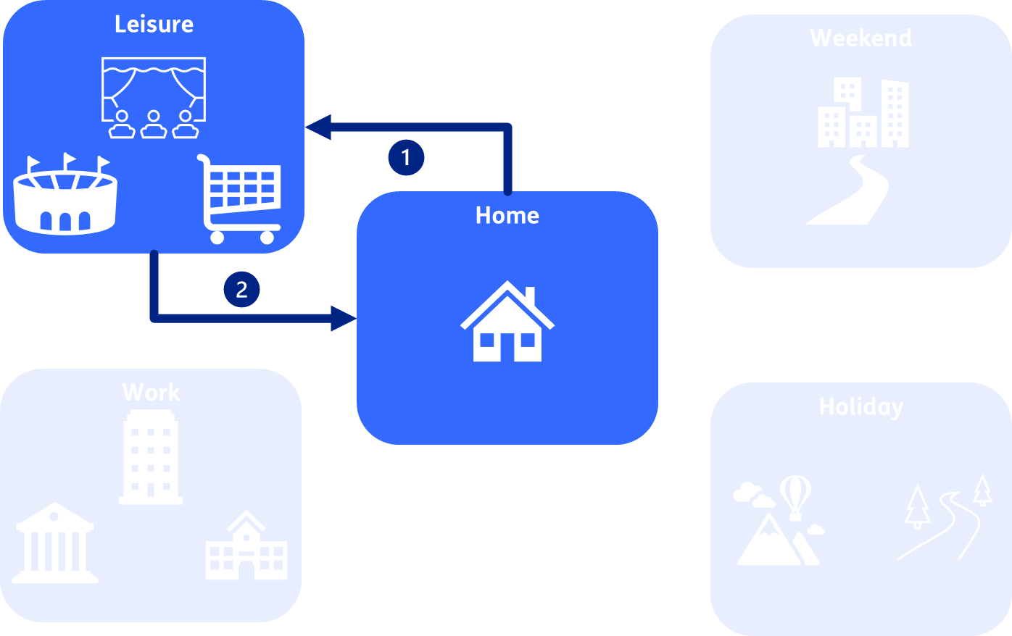
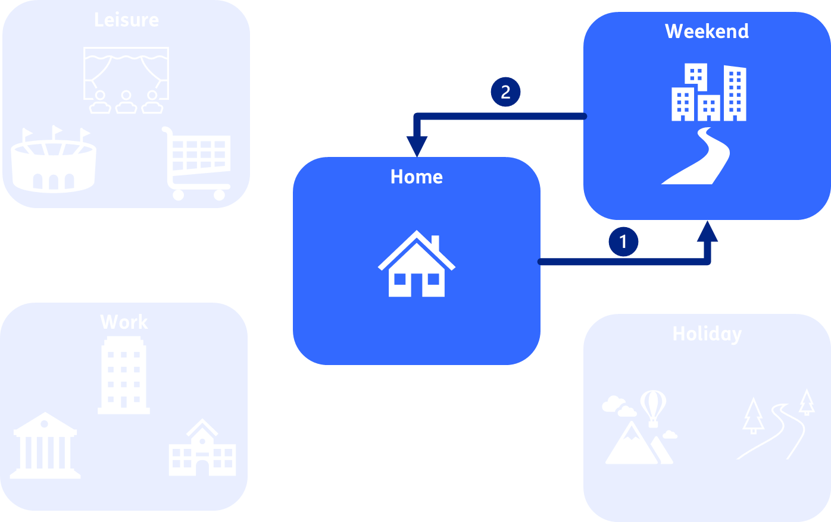
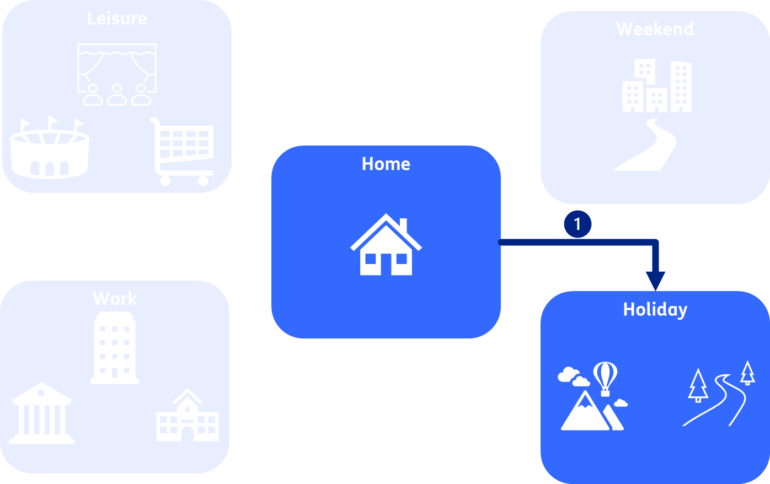
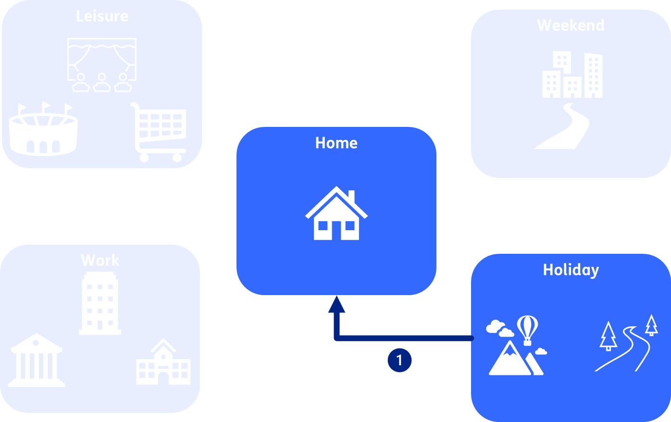
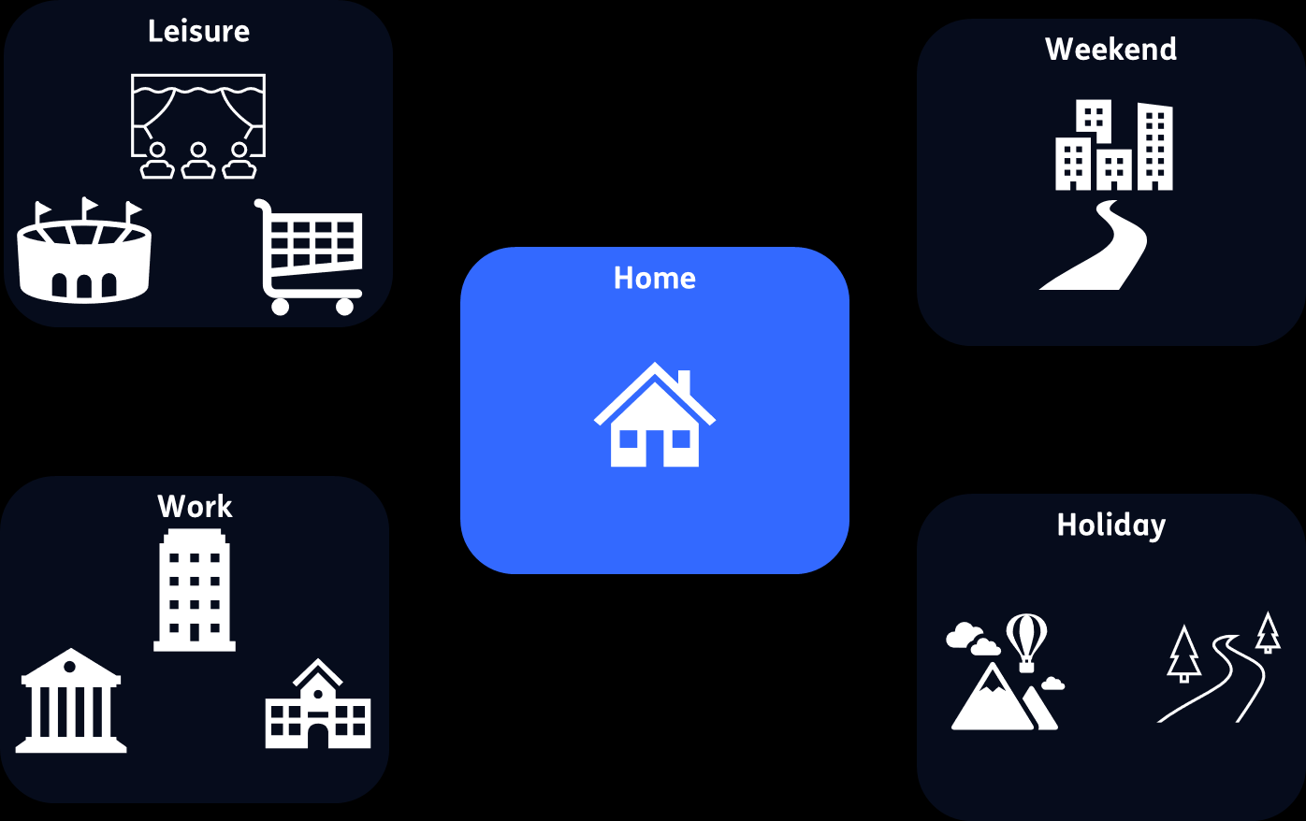
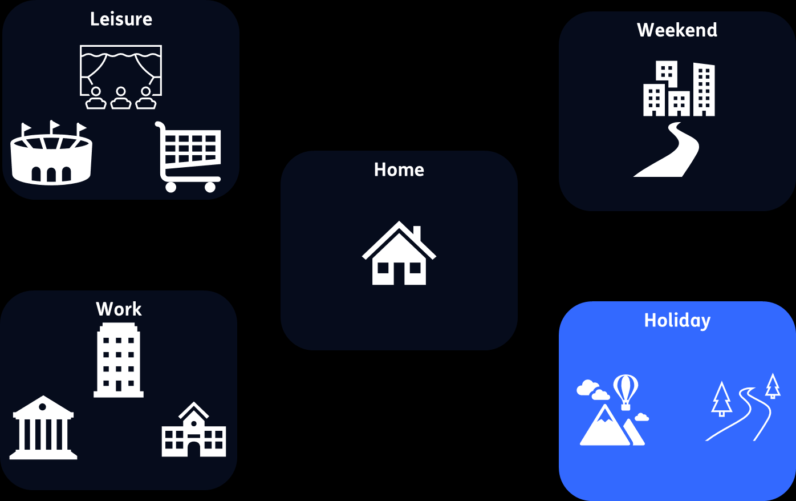
Trips
Commute to work
Commute to work and leisure
Leisure only
Weekend trip
Holiday outward
Holiday back
Stay put home
Stay out holiday

Slide 15
Legs
Leisure
Weekend
Home
Work
Holiday

Slide 16
Home
Work

Slide 17
Home
Leisure

Slide 18
Home
Weekend

Slide 19
Home
Holiday

Slide 20
Home
Work
Work
Home

Slide 21
Home
Leisure
Leisure
Home

Slide 22
Home
Weekend
Weekend
Home

Slide 23
Home
Holiday
Holiday
Home

Slide 24




Theme name
Trips
Place text here
Leisure
Weekend
Home
Work
Holiday

Slide 25
Leisure
Weekend
Home
Work
Holiday

Slide 26
Leisure
Weekend
Home
Work
Holiday

Slide 27
Leisure
Weekend
Home
Work
Holiday

Slide 28
Theme name
Legs
Place text here
Leisure
Weekend
Home
Work
Holiday

Slide 29
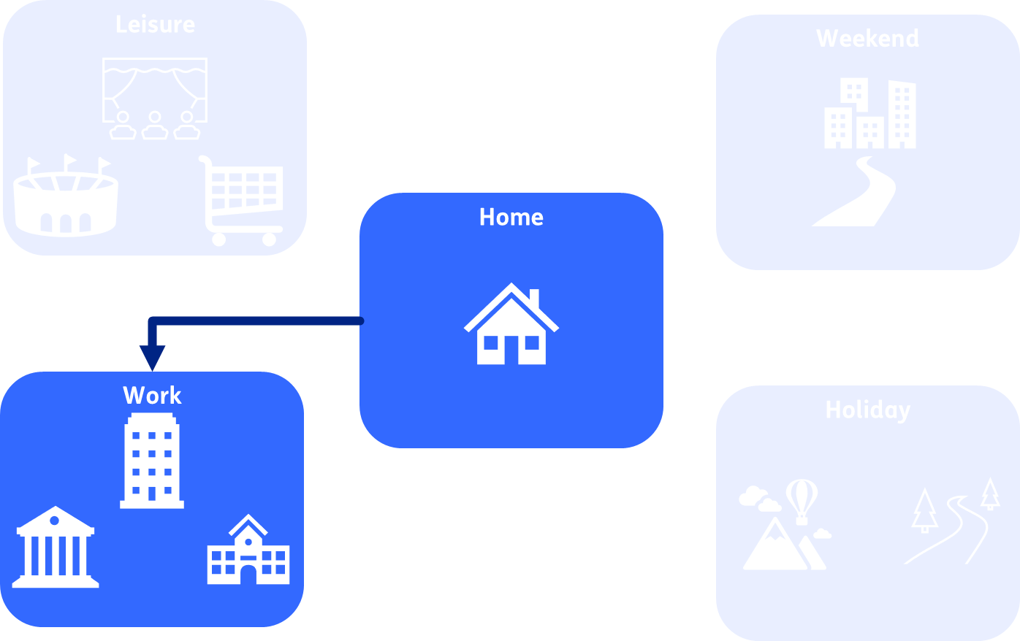
Theme name
Legs
Place text here

Slide 30










Place a title here
Theme name
Place text here

Slide 31






Place a title here
Theme name
Place text here
Work
Holiday
Home
Leisure

