Slide 1
Locations
Leisure
Weekend
Home
Work
Holiday

Slide 3
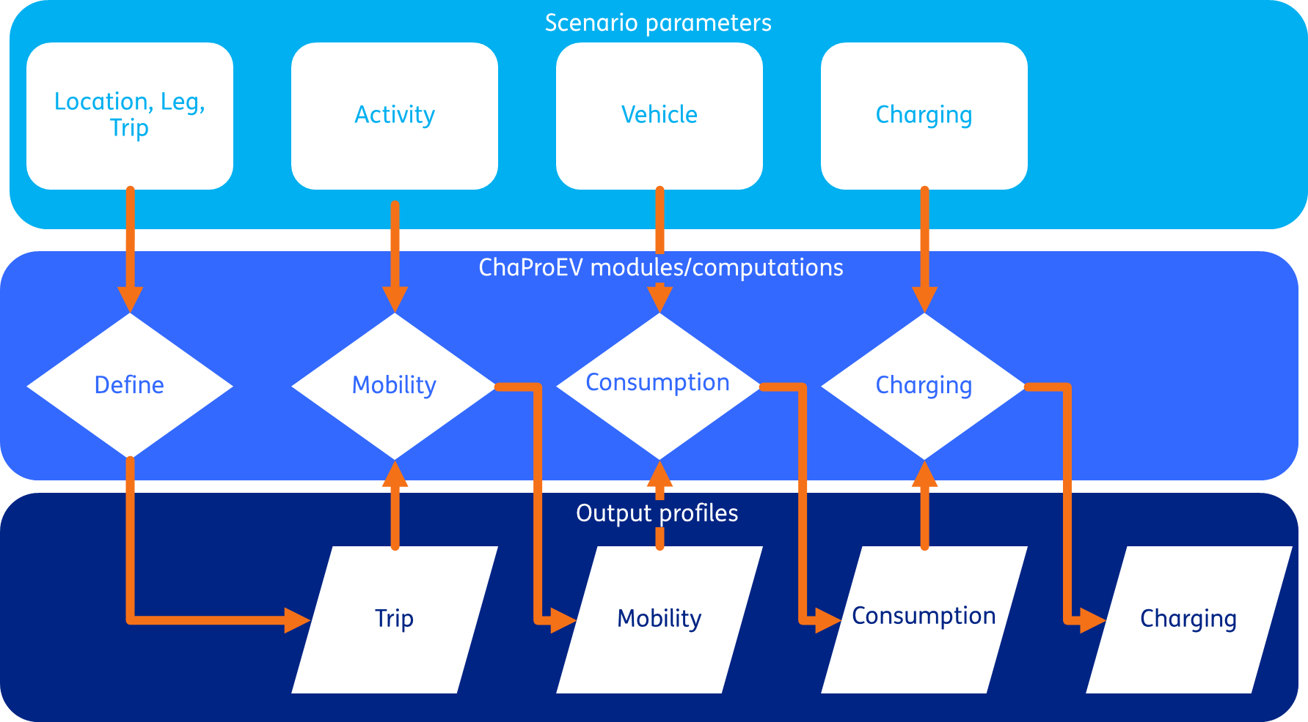
Structure of ChaProEV

Slide 4
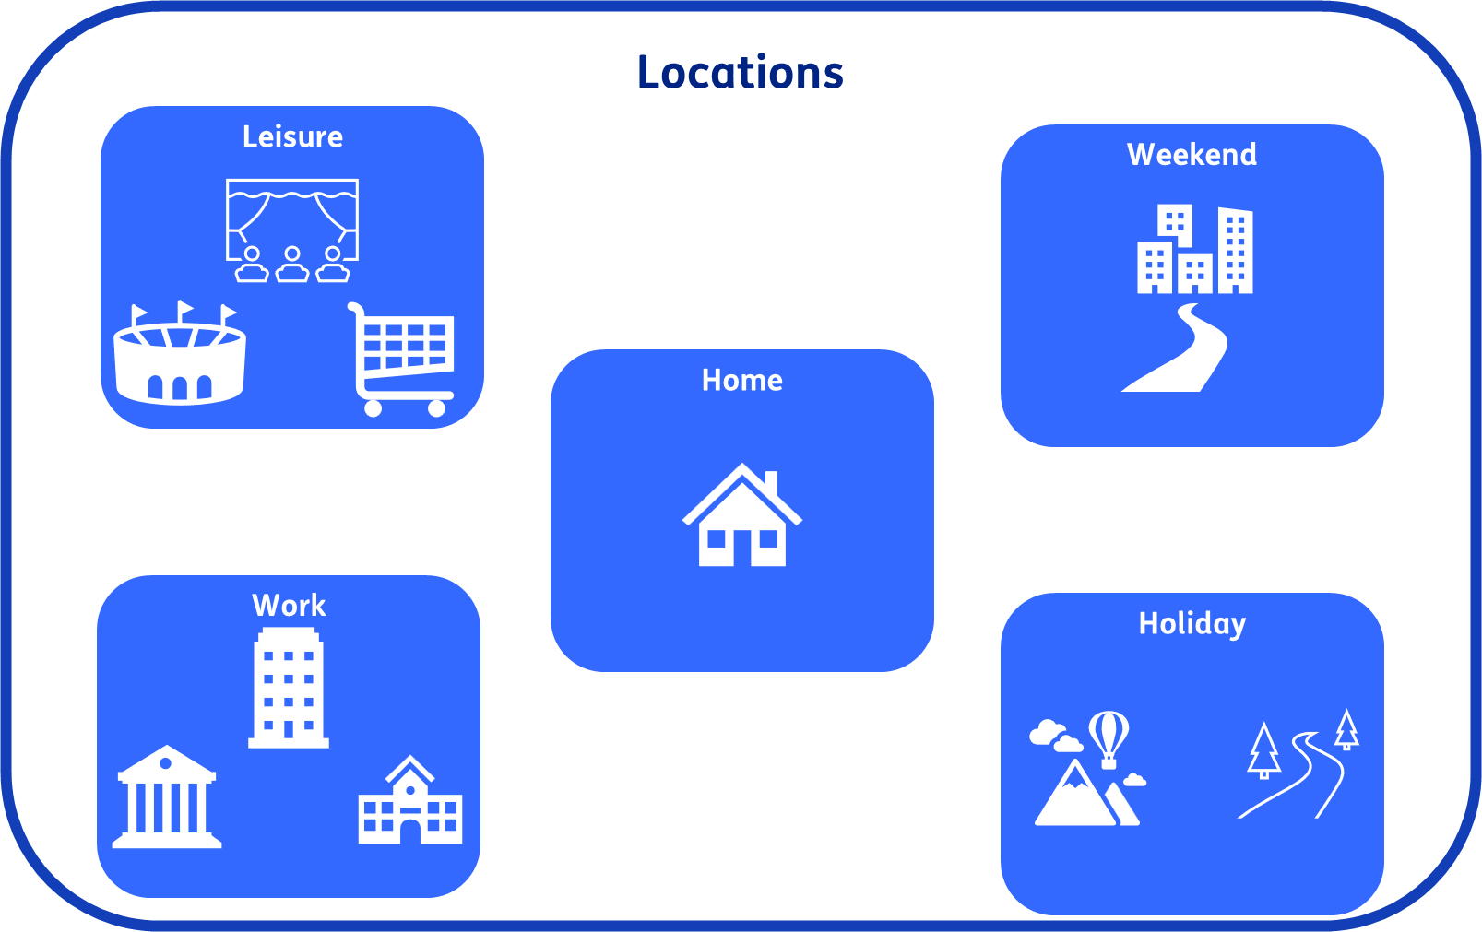

Slide 5








Legs

Slide 6
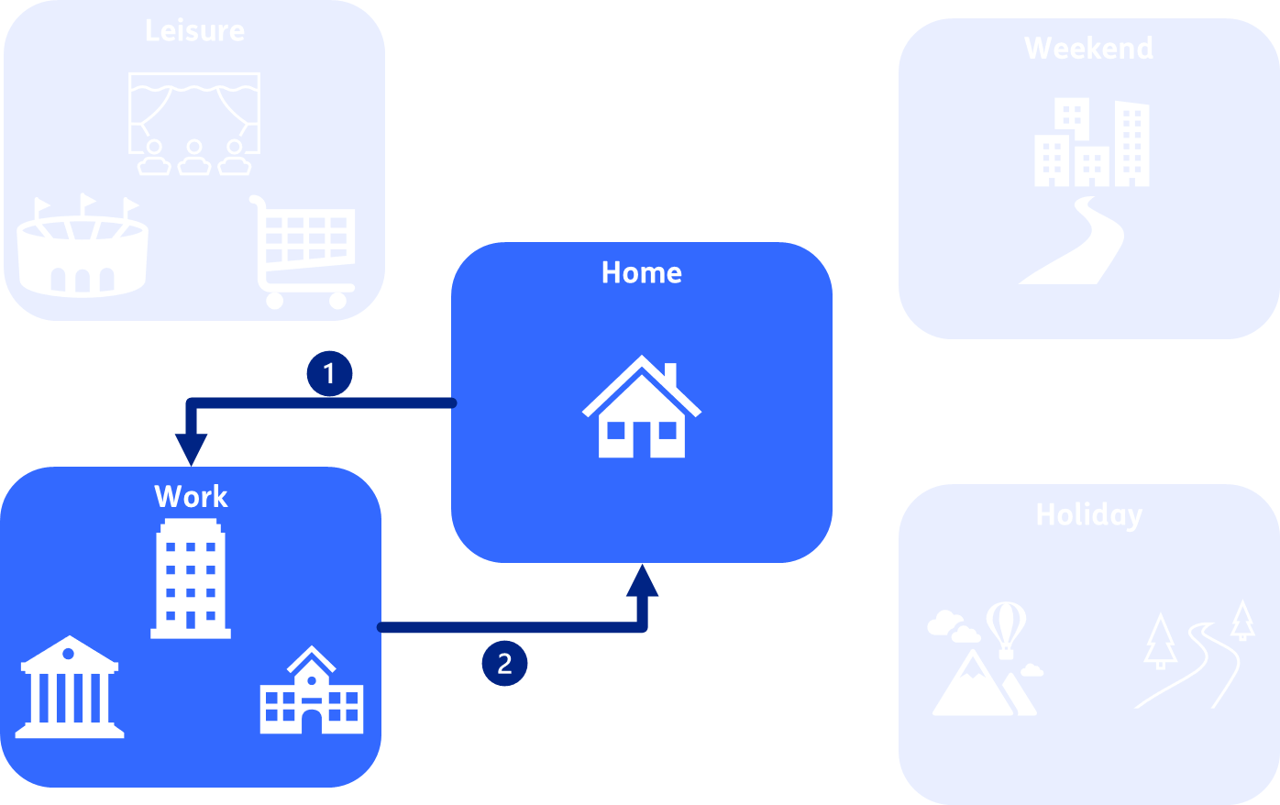
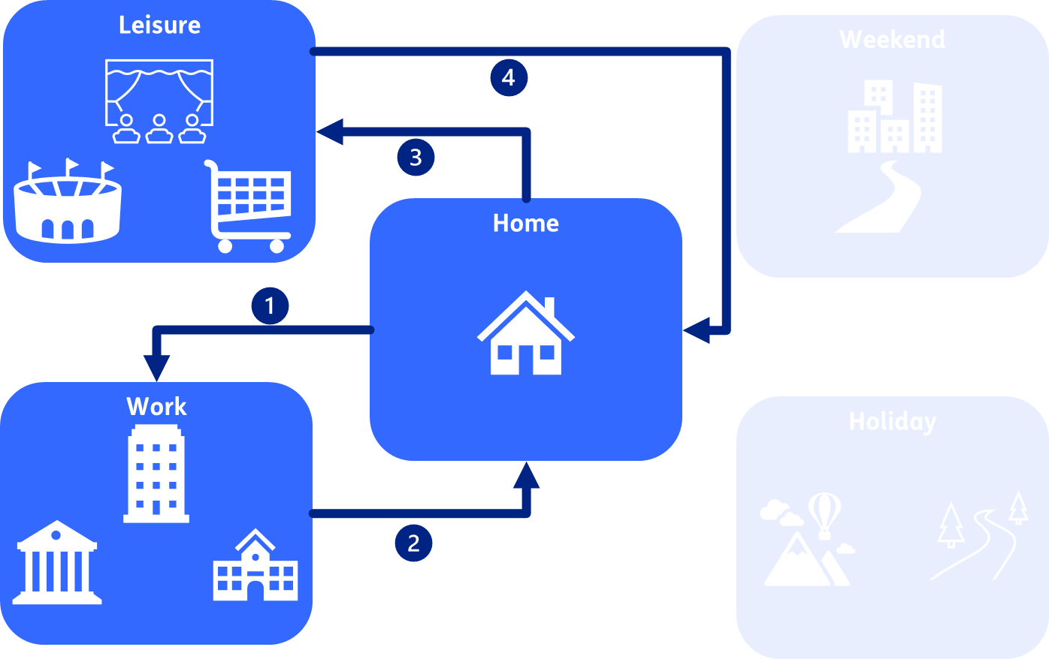
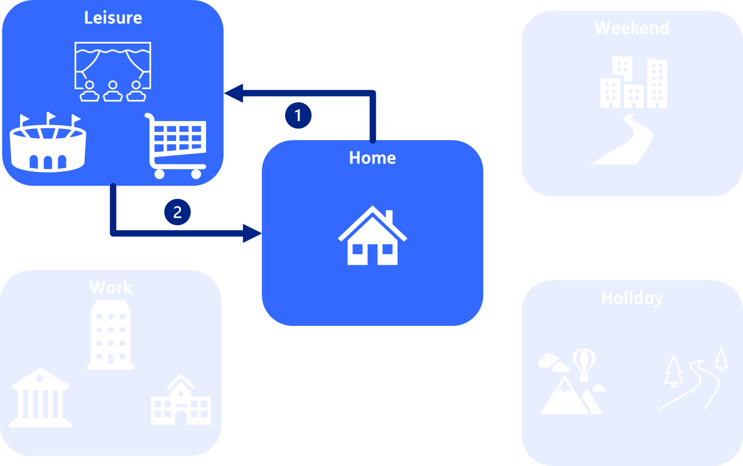
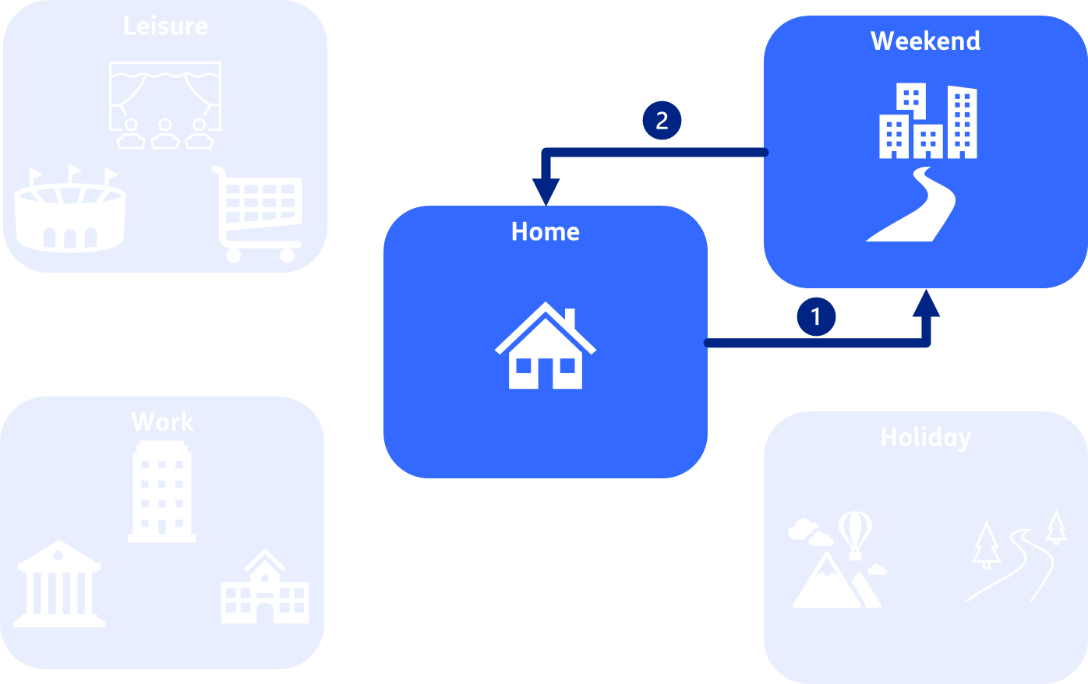
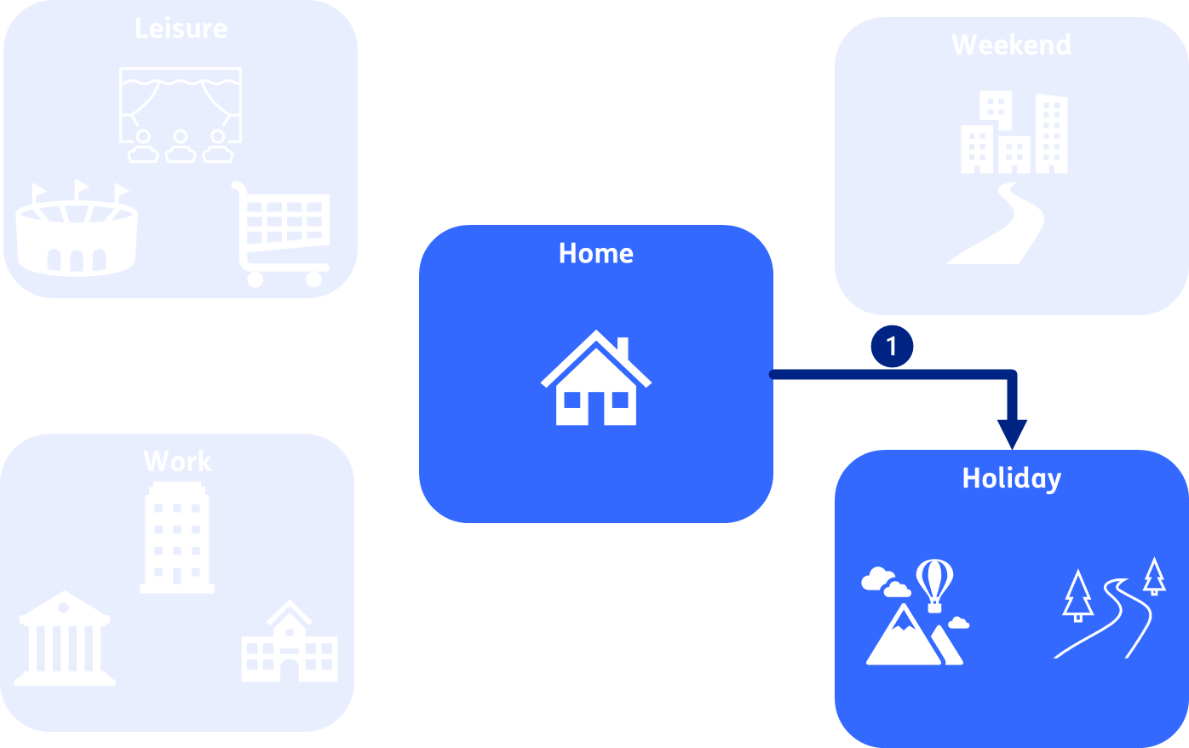
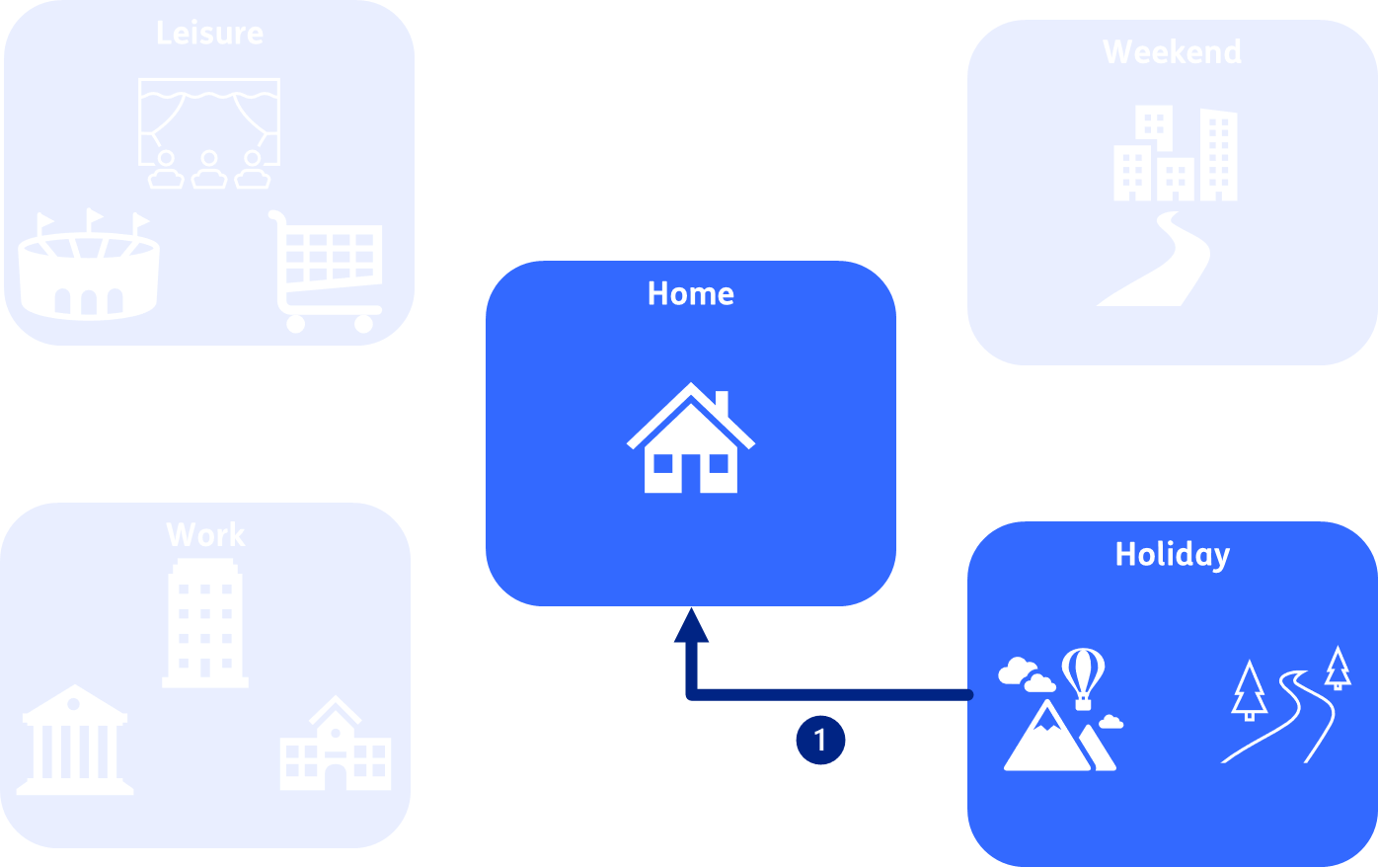
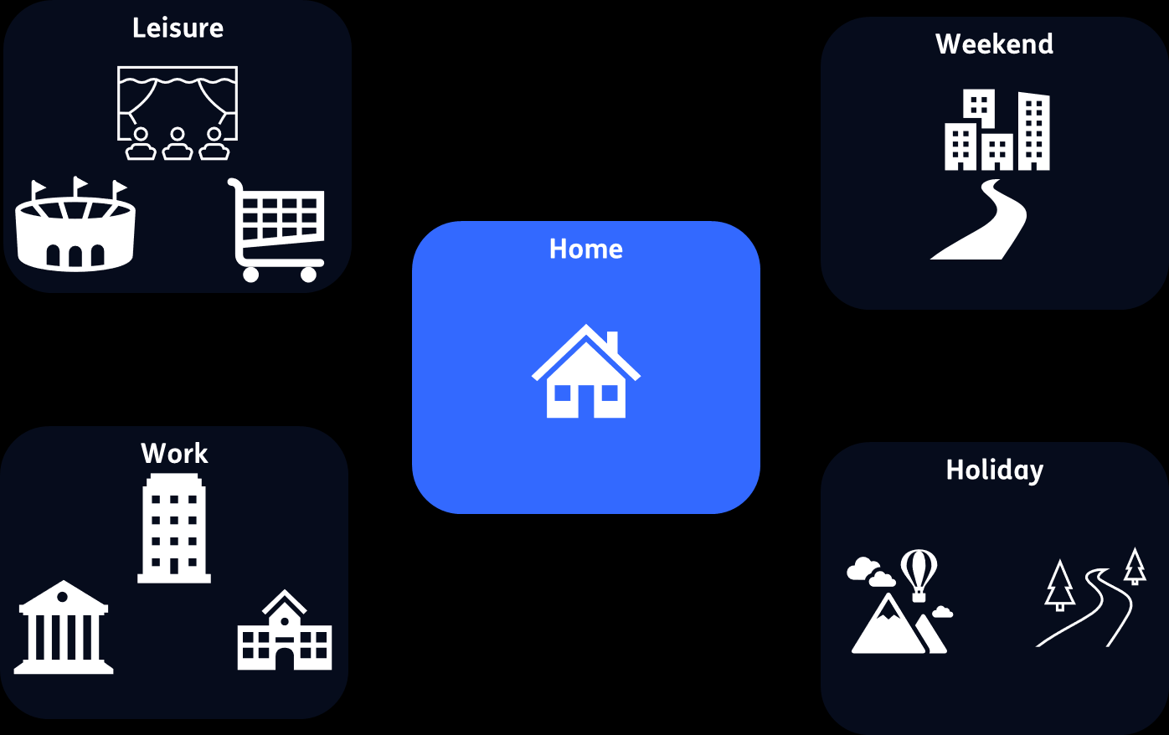
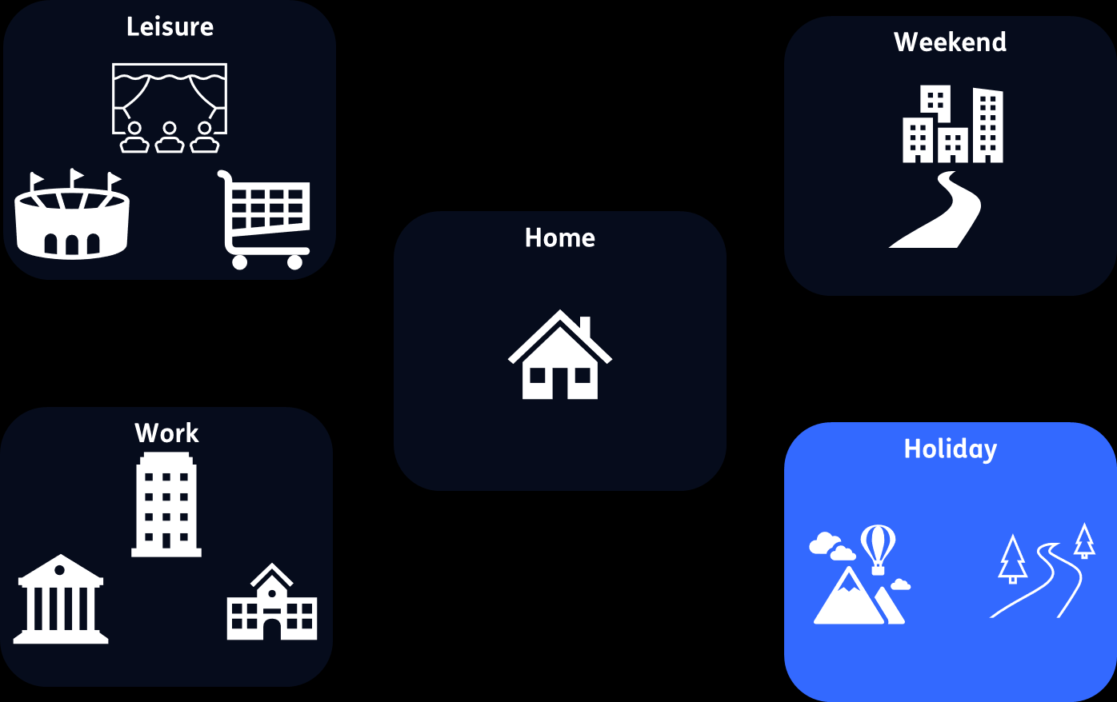
Trips
Commute to work
Commute to work and leisure
Leisure only
Weekend trip
Holiday outward
Holiday back
Stay put home
Stay out holiday

Slide 7
What ChaProEV can bring to OPERA
Output profiles per location type and time unit (hour)
Boundary conditions for optimisation
Demand for next leg (from network/to vehicles) (kWh)
Available power to vehicles/from network (kW)
Effective discharging efficiency
Baseline/ unmanaged charging profile
% connected
Available discharge power from vehicles/to network (kW)
Effective charging efficiency

Slide 8
ChaProEV availability
Source code
Library
https://github.com/TNO/ChaProEV
https://pypi.org/project/ChaProEV/
Understand how the model works
Add scenario files and call functions within your model or independently

Slide 9
Inputs/outputs (base profiles)

Slide 10
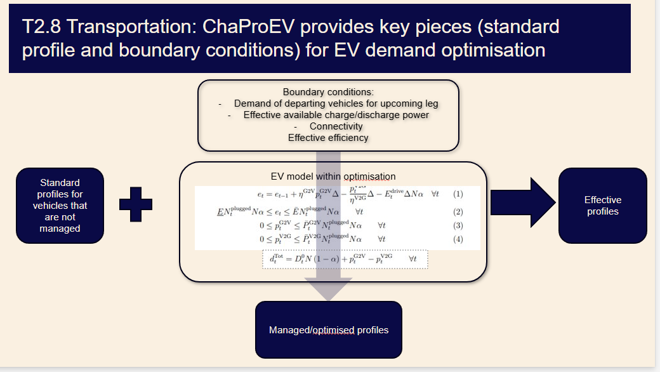
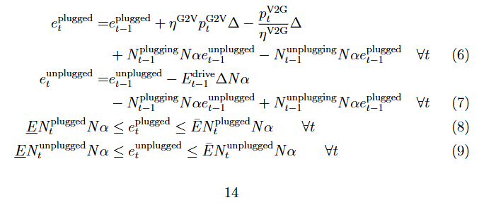
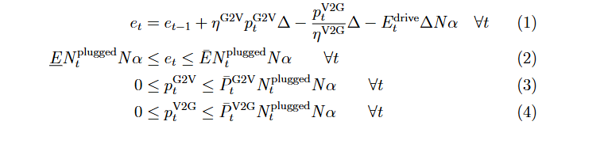
Base profiles+boundary conditions and optimisation models
ChaProEV provides two key elements to optimisation models. It provides them with standard referemce charging profiles. These profiles can be assigned to the portion of vehicles that are not managed by operators and charge with a fixed profile. For vehicles that are managed, ChaProEV provides key boundary conditions that form the basis of an EV model (which essentially tells the optimisation model how much charge it must provide to vehicles (via the demand of departing vehicles for the upcoming leg/journey that they are about to undertake), and how much it can maximally charge/discharge (based on the connectivity (amount of connected vehicles), the effective charging power (the former, combined with the charging/discharging power at their location), and the effective efficiency (how much of that power actually goes to vehicles). This is essentiallywhat the displayed equations say and what the optimisation model can use.

Slide 12
Running ChaProEV
Theme name
Place text here
Case study
Country characteristics
Urbanisation/ population density types
Map these to NUTS via population density
Can swap in a more detailed model if available/desired
Can swap in a more detailed model if available/desired
Scenario
Vehicle
Location
Legs
Trips
Calendar
Mobility matrix
Amounts of departures/arrivals
(Weighted) distances
Durations
Consumption
Per hour, day, week, month, year
Per energy carrier
Charging
Per vehicle/from network
Per location
Per hour, day, week, month, year

Slide 13
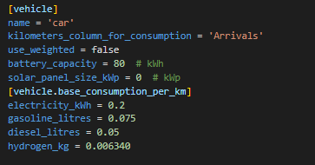
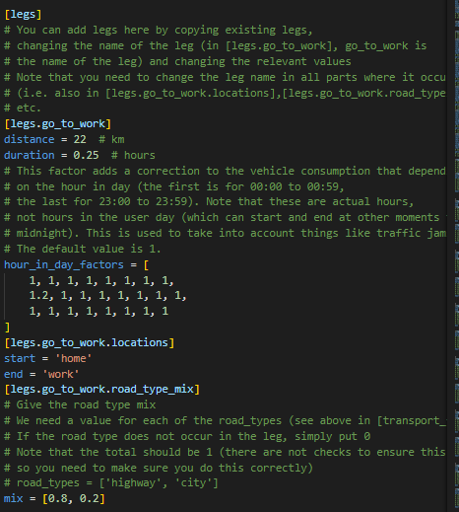
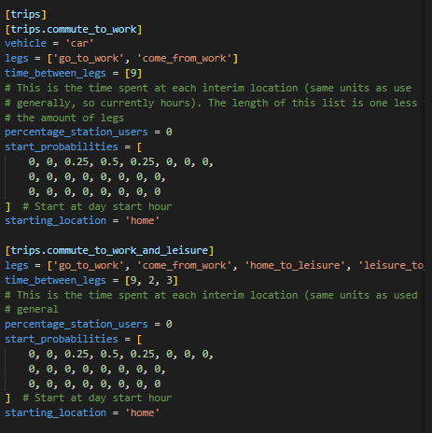
Scenario parameters
Theme name
Place text here

Slide 14
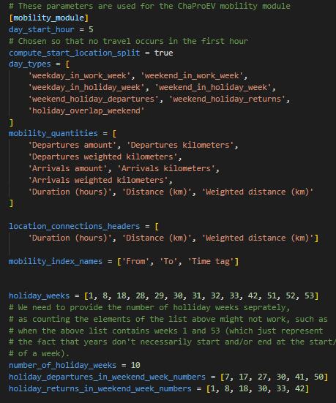
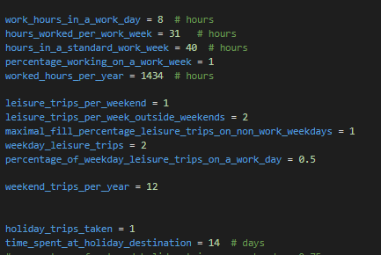
Scenario parameters
Theme name
Place text here

Slide 15
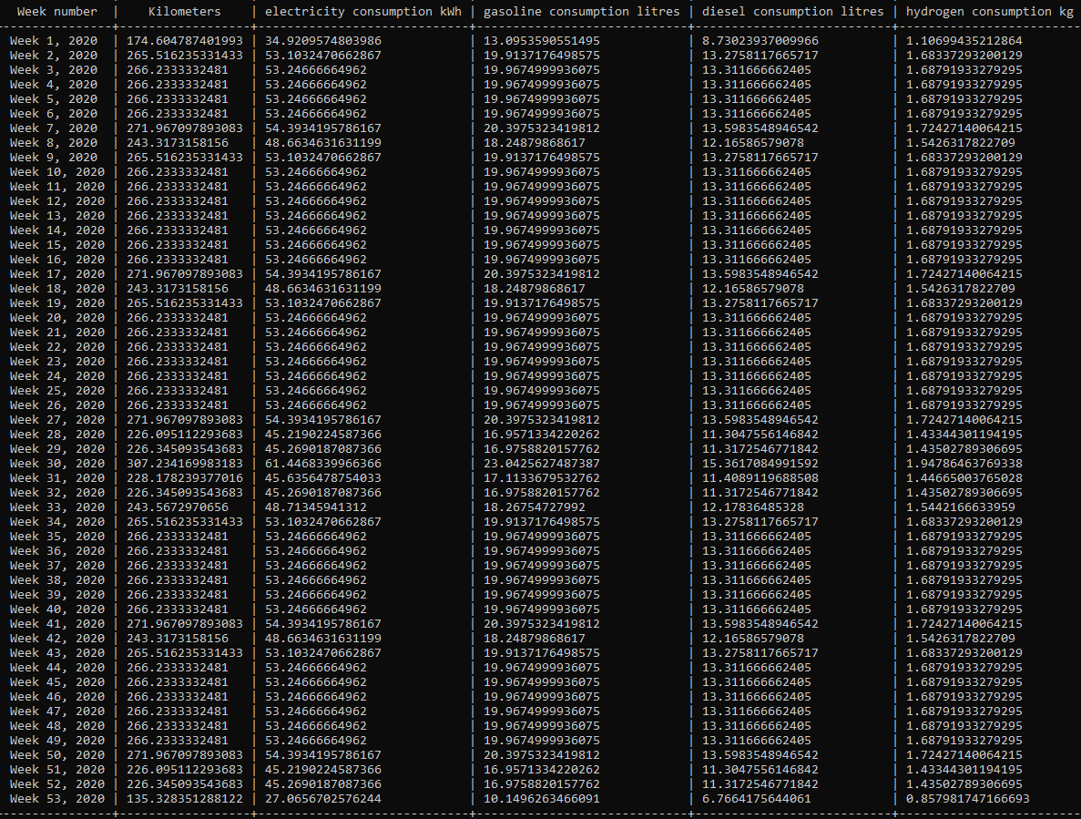
Consumption table
Theme name
Place text here

Slide 16
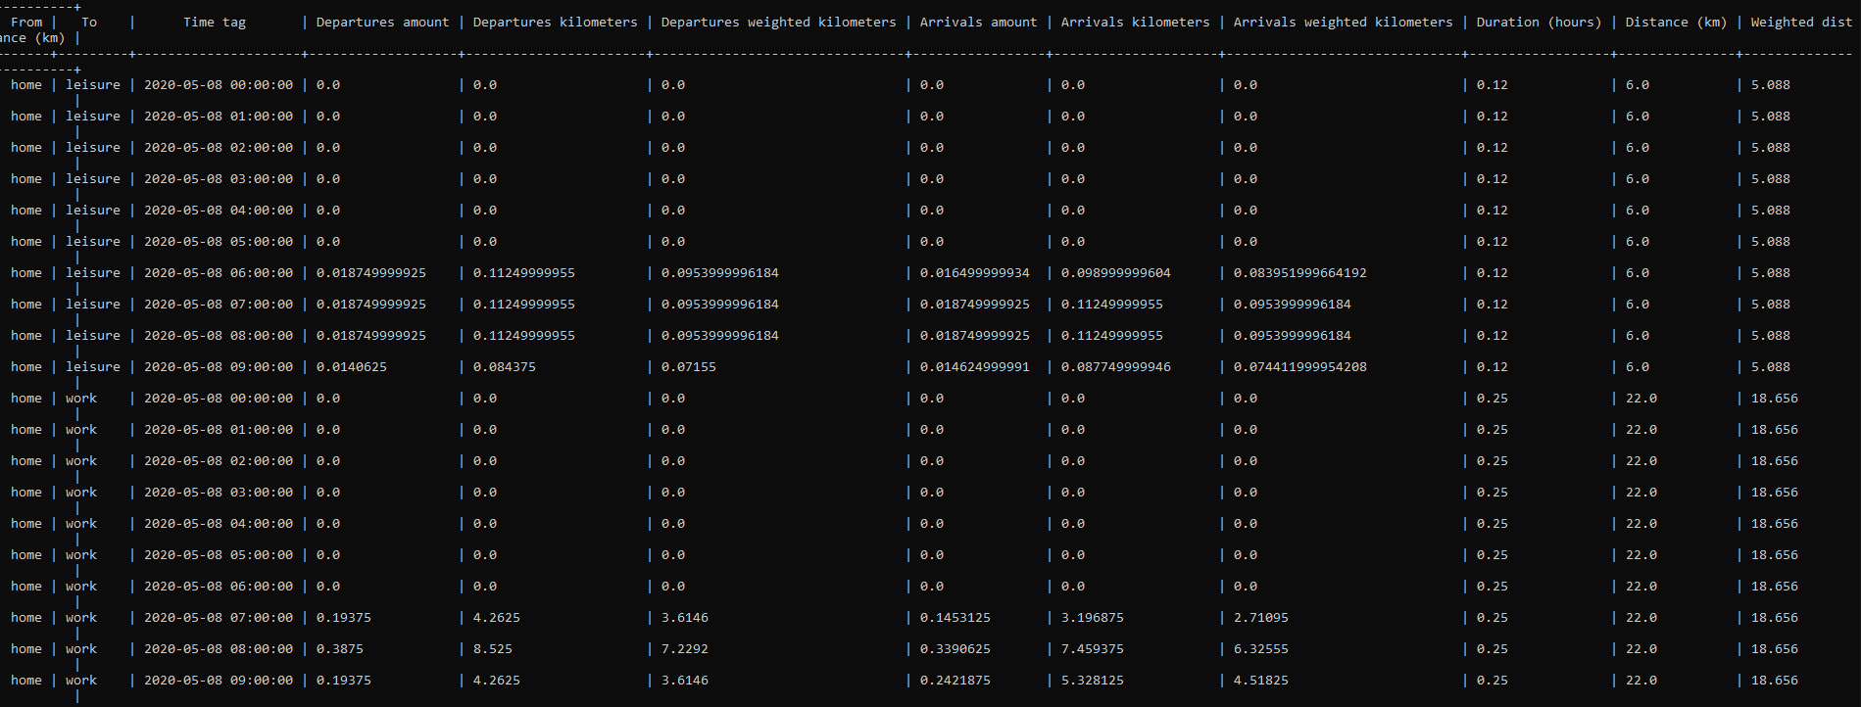
Mobility matrix
Theme name
Place text here

Slide 17
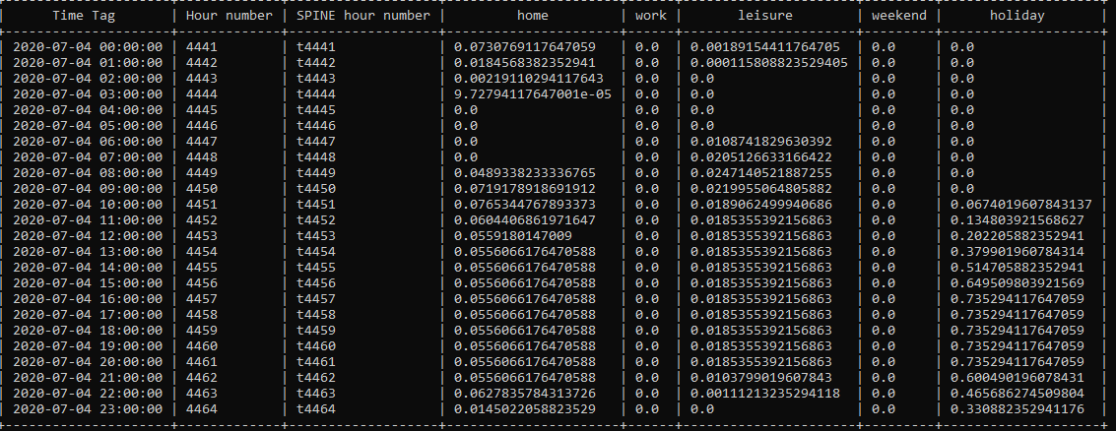
Charge from network
Theme name
Place text here

Slide 18
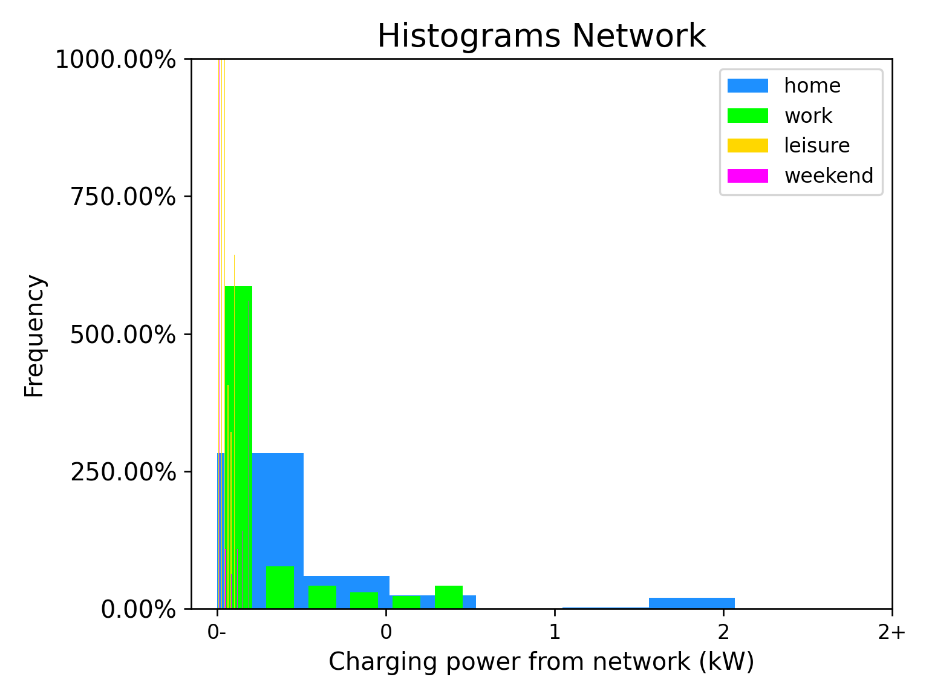
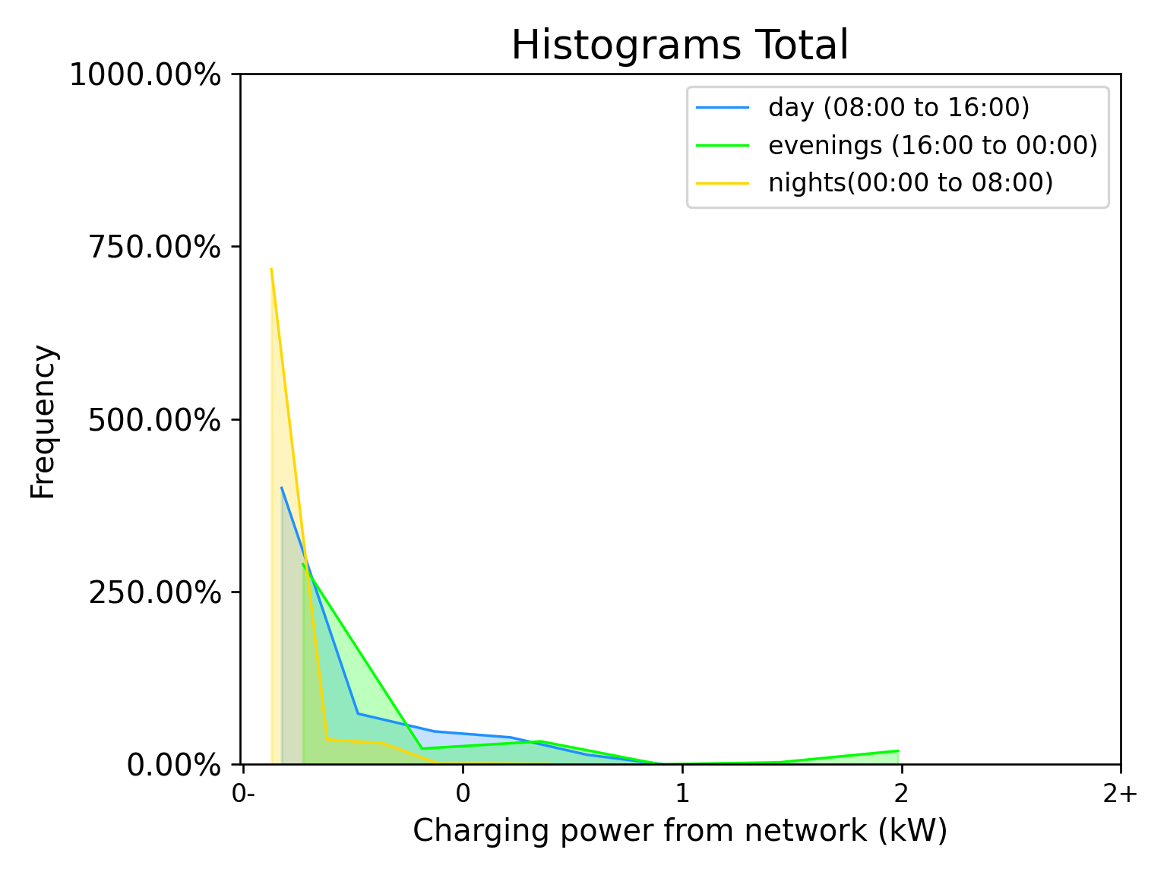
Visualize charge with histograms
Location type
Day parts

Slide 19
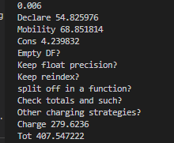

Slide 20
Scenario parameters
Location, Leg, Trip
Activity
Vehicle
Charging
ChaProEV modules/computations
Define
Mobility
Charging
Consumption
Output profiles
Trip
Mobility
Charging
Consumption

Slide 21
Legs

Slide 22
Trips
Commute to work
Commute to work and leisure
Leisure only
Weekend trip
Holiday outward
Holiday back
Stay put home
Stay out holiday

Slide 23
Legs
Leisure
Weekend
Home
Work
Holiday

Slide 24
Home
Work

Slide 25
Home
Leisure

Slide 26
Home
Weekend

Slide 27
Home
Holiday

Slide 28
Home
Work
Work
Home

Slide 29
Home
Leisure
Leisure
Home

Slide 30
Home
Weekend
Weekend
Home

Slide 31
Home
Holiday
Holiday
Home

Slide 32
Theme name
Trips
Place text here
Leisure
Weekend
Home
Work
Holiday

Slide 33
Leisure
Weekend
Home
Work
Holiday

Slide 34
Leisure
Weekend
Home
Work
Holiday

Slide 35
Leisure
Weekend
Home
Work
Holiday

Slide 36
Theme name
Legs
Place text here
Leisure
Weekend
Home
Work
Holiday

Slide 37
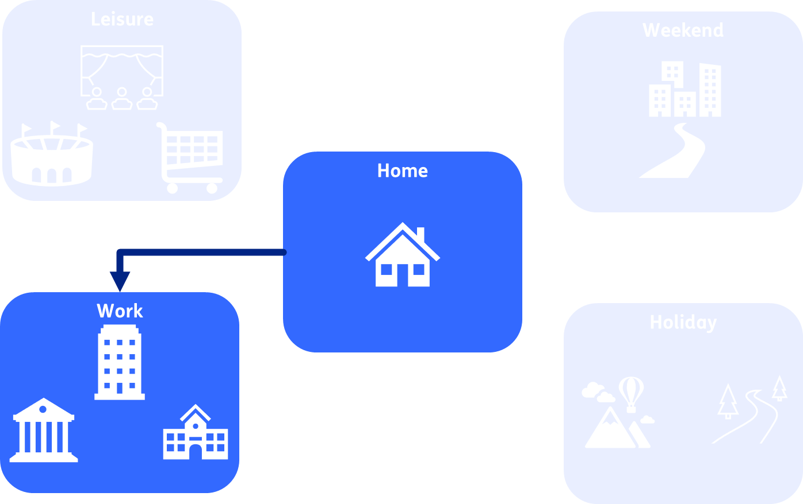
Theme name
Legs
Place text here

Slide 38
Place a title here
Theme name
Place text here

Slide 39
Place a title here
Theme name
Place text here
Work
Holiday
Home
Leisure

