Slide 1
Excel2map Overview of the configuration parameters

Slide 2
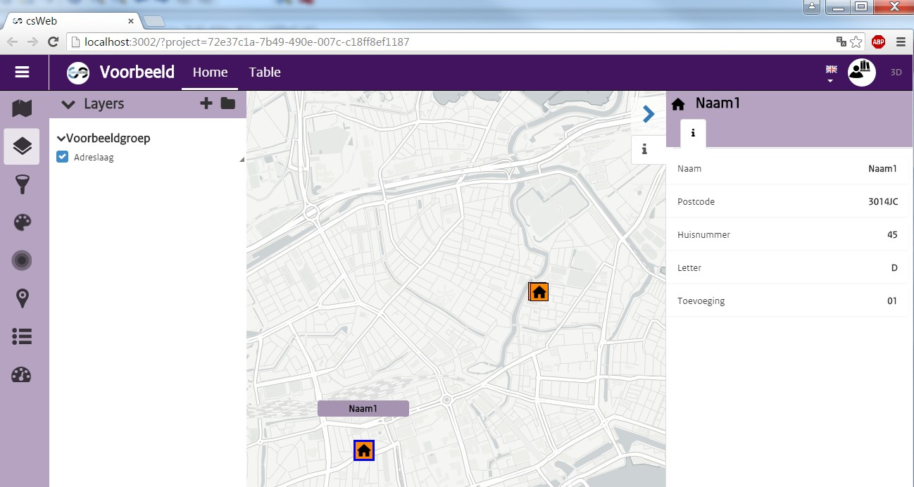
Terminology:
Feature: Point or region on the map, that has certain properties.
Property: Information element of a feature, can be a name, number, etc.
Layer: Collection of features.
Group: Collection of layers.
Project: Collection of groups and layers.

Slide 3
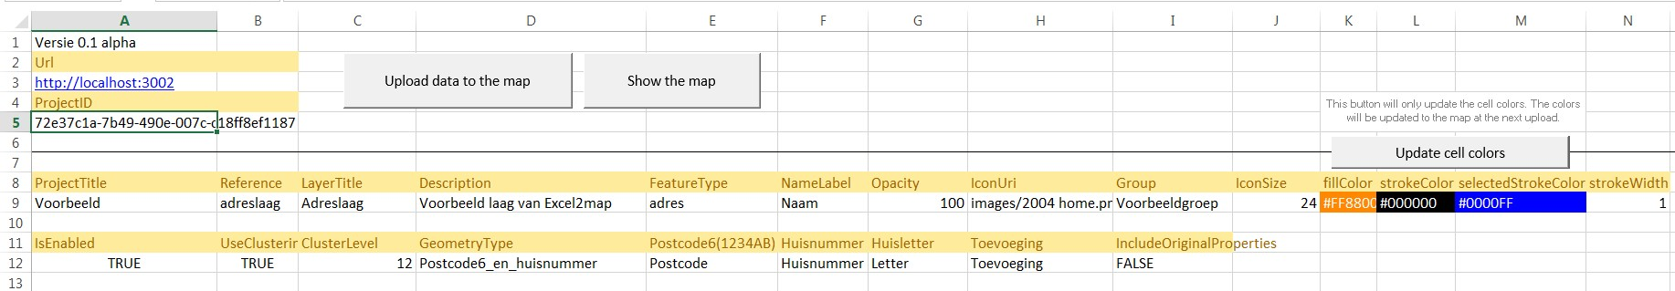
Url:
Shows the web address where csWeb is running. When you use the local server
(excel2map-v*.exe), this will be http://localhost:3002

Slide 4
ProjectID:
This is the unique id-code of your project. When there is no number in this cell, a new project will be automatically generated when you click “Upload data to the map”. When there ís an id in this cell, the project with that id-code will be updated when you click “Upload”.
If you have multiple excel files, you can add them all to one project by copying the project-id in every excel file.
When you click ‘Show the map’, the project-id will be used to open the webpage with that project-id.

Slide 5
ProjectTitle:
Title of the project

Slide 6
Reference:
This should be a unique name for your layer. It is not visible, but csWeb uses it to distinguish layers. So you can give two layers the same title (‘Adreslaag’), but their Reference should always be unique!
Only use letters or numbers for the reference, no spaces or special characters such as %&$# etc.

Slide 7
LayerTitle:
This is the title of your layer that will be shown in the layers list.

Slide 8

Description:
This is the description of your layer that will be shown when you hover your mouse cursor above the layertitle.

Slide 9
FeatureType:
This should be a unique name for the features in your layer. A feature is an item on the map, such as a house in this example, but it could also be a region (e.g. a province). The FeatureType is not visible, but csWeb uses it to distinguish features (such that it can add the correct icons and colors to each feature).
Only use letters or numbers for the reference, no spaces or special characters such as %&$# etc.

Slide 10
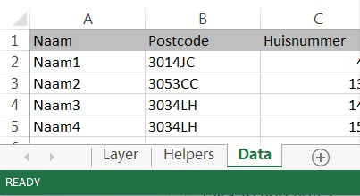
NameLabel:
This is the label of the feature that will be shown when you hover your mouse cursor above the feature. In this example the header ‘Naam’ is chosen, such that the label will be ‘Naam1’ for the first house, ‘Naam2’ for the second house, etc.

Slide 11
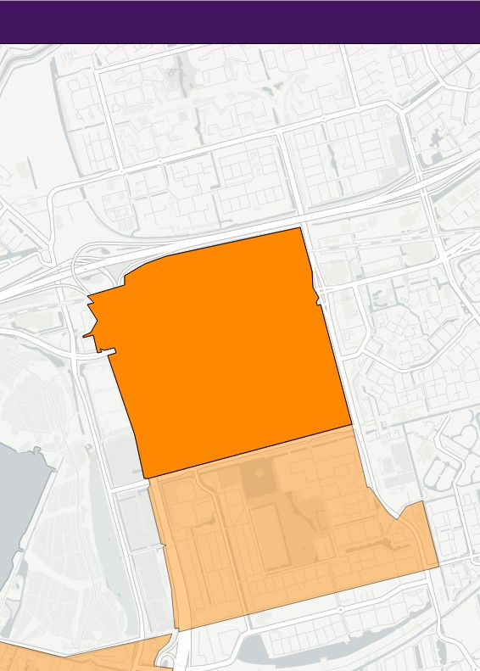
Opacity:
This defines the transparency of the icons or regions. 100 is completely opaque, 0 is completely transparant.
In the example image the two regions have the same color. The top region has an opacity of 100, the lower region has an opacity of 60.

Slide 12
IconUri:
This is the path to the icon that you want to use. You can select one from the list.
The icons are located in the folder ‘images’, which should be at the same location as your excel file.

Slide 13
Group:
This is the title of a group that your layer belongs to. If you have multiple excel files, you can add multiple layers to a group if you give them the same group title.
Only use letters, spaces or numbers for the group title, no special characters such as %&$# etc.

Slide 14
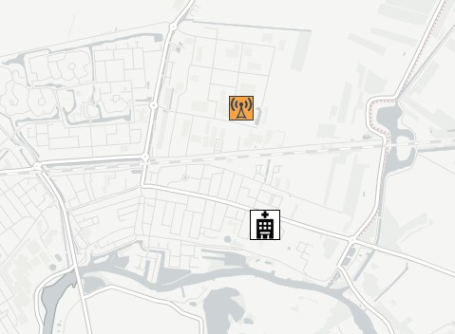
IconSize:
This is the size of your icons in pixels. In the example image the hospital is 30x30 pixels, whereas the celltower is 24x24pixels. Reasonable sizes range from 16-48 pixels.

Slide 15
Colors:
Defines the colors of icons or regions:
fillColor: the inside of the icon or region.
strokeColor: the color of the border of the icons or regions.
selectedStrokeColor: the color of the border of the selected feature (in this example, house Name1).
You can choose a color from a list. To view an example of the colors in Excel click ‘Update cell colors’. When you want to apply the colors to the map, use the ‘Upload data to map’ button.

Slide 16
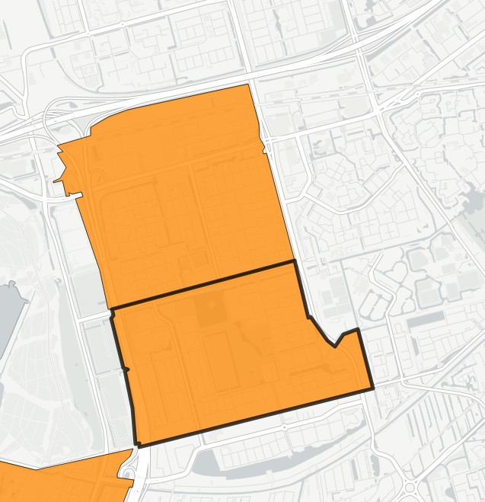
StrokeWidth:
Width of the stroke in pixels. Top region has 1 pixels border, bottom region 5 pixels.

Slide 17
IsEnabled:
Defines whether the map is enabled directly after uploading. When it is set to false, the layer will be shown in the layers list, but its features will not be visible on the map.

Slide 18
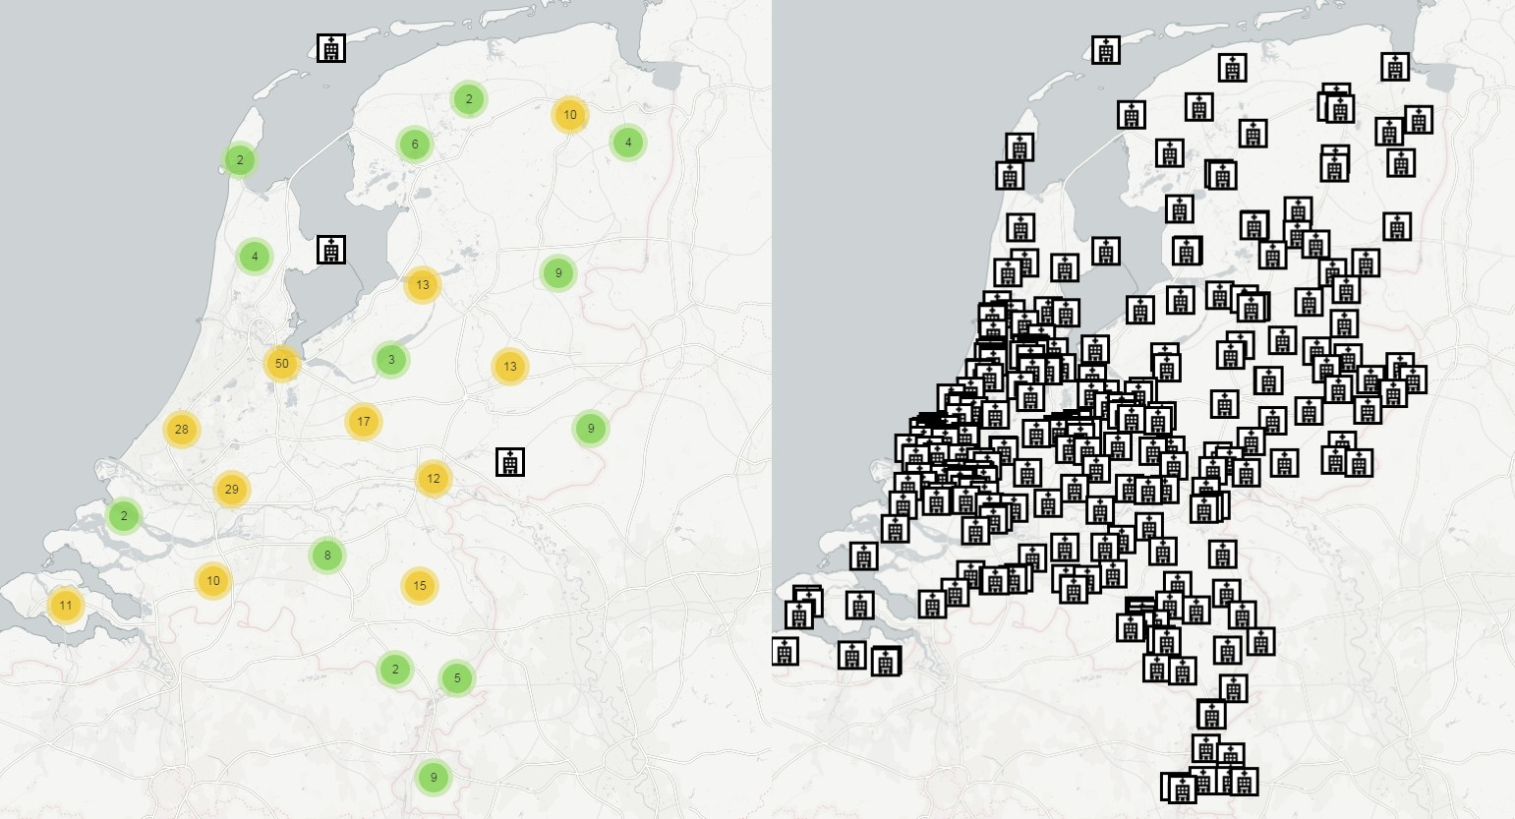
Clustering:
Defines whether features that are very close to each other should be clustered. Left clustering is turned on, right clustering is off.
(Note: clustering is performed automatically on points that are close to each other. No ‘meaningful’ clusters are created, e.g. one cluster per province. The number shows the amount of features inside a cluster.)

Slide 19
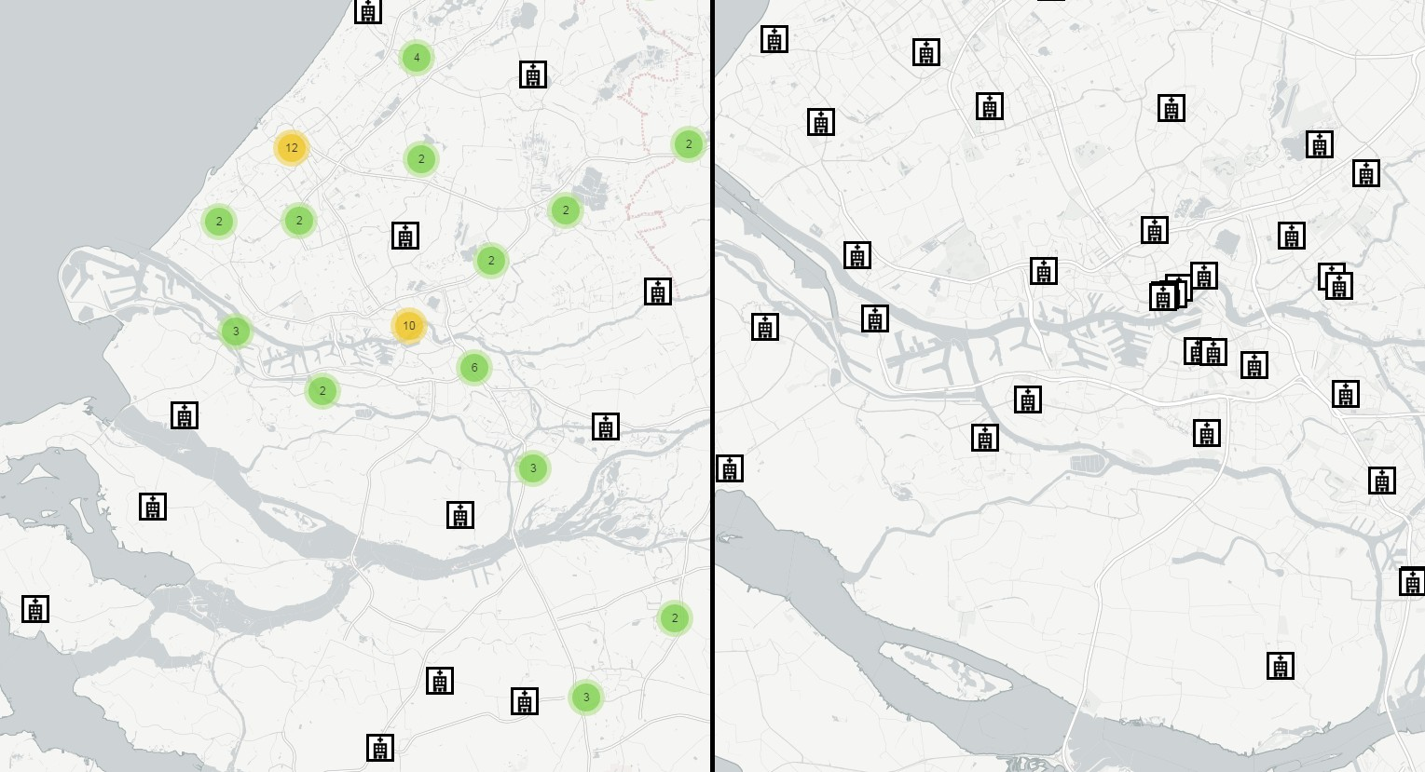
ClusterLevel:
Defines the zoomlevel where features should be clustered. The zoomlevel of the map ranges from 1-20, where 20 is zoomed in maximally, 1 is zoomed out to the complete world. If you set the clusterlevel to 1, features will only be clustered when you zoom out completely. When you set it to 20, features will even be clustered when you have completely zoomed in.
The example shows zoomlevel 12. When zoomed out to province level, features are clustered. When zoomed in to city level, the clusters are expanded.

Slide 20
GeometryType:
Defines the type of geometry of your data. In this case each row of the data is a location with a specific postal code and house number. Another option is to specify Rijksdriehoek (RD) coordinates, which is commonly used in Dutch governmental organisations. Furthermore, lat/lon coordinates can be used.
Next to point features, excel2map supports features that are regions, such as provinces, municipalities or P4-areas. For all options, scroll through the dropdown list.

Slide 21
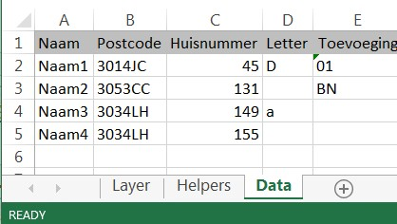
Parameters:
These 4 cells define the columns of your data that should be used to place each item on the map. The headers above these cells change when you select a different geometrytype. In this case a combination of postalcode, housenumber, letter and addition are used to find the locations in a BAG-database.
For some GeometryTypes only one parameter is needed. For example, if your data is based on provinces, you only need one parameter defining the province name/code, the other 3 parameters can remain empty in that case.

Slide 22
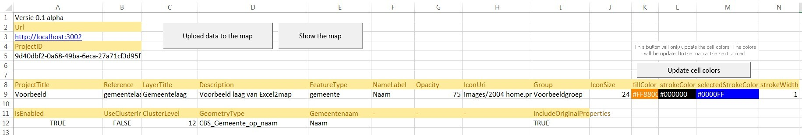
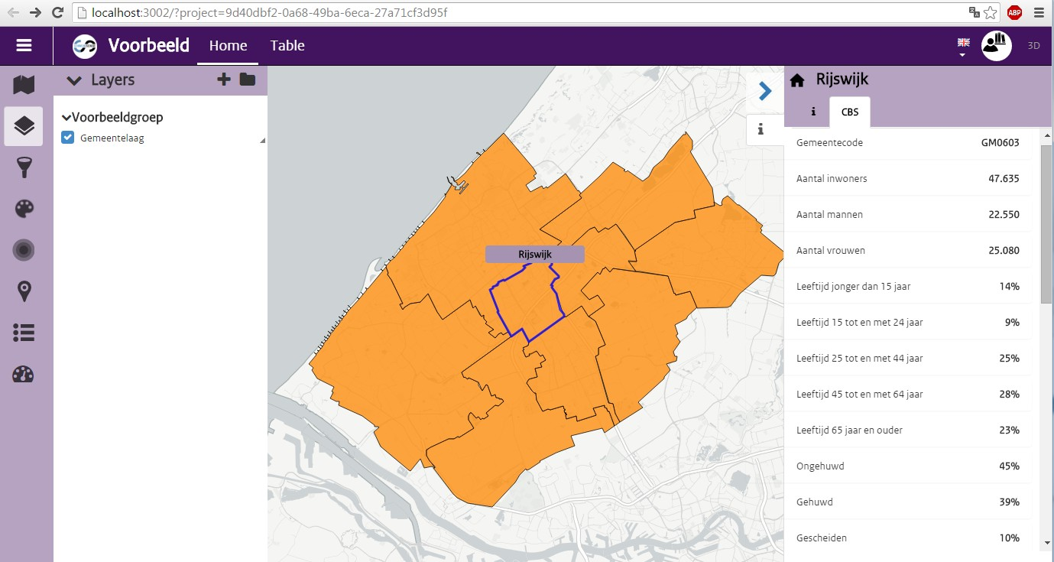
IncludeOriginalProperties:
When more information is available, it is added to each feature. In this example, census statistics (CBS) data is available for the regions.

Slide 23
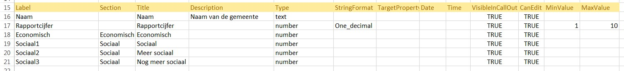
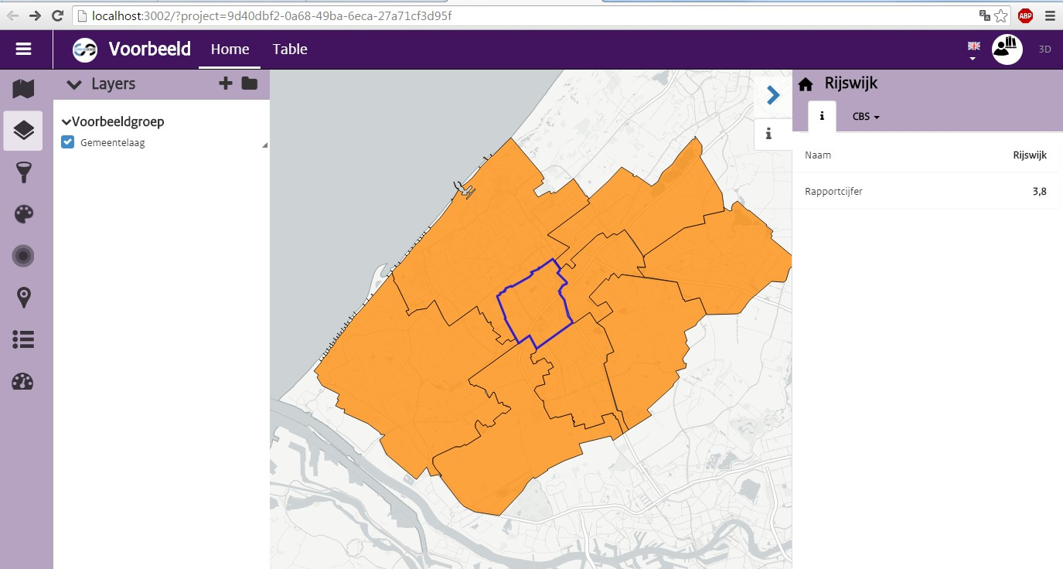
Label:
Unique name for the property. It is not directly visible, but it is used in csWeb to distinguish between different properties.

Slide 24
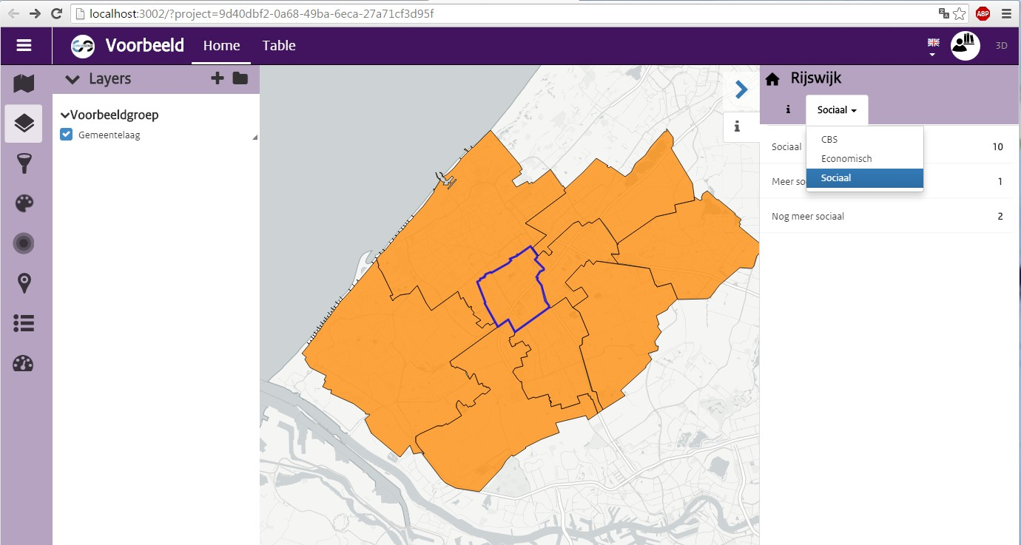
Section:
Can be used to group properties. In this example, there are 3 properties belonging to section ‘Sociaal’. By entering the same section name for all 3, they will be grouped together in the right panel in csWeb.
When the section column is empty, the property will be grouped in the default information (i)section.

Slide 25
Title:
Defines the title of each property. It does not need to be unique, and also does not need to be the same as the ‘label’.

Slide 26

Description:
Defines the description of each property. It is shown when you hover your mouse over the property.

Slide 27
Type:
Defines the type of data for each property. For example, for a column with street names, choose the ‘text’ property. When you have a column with grades, choose the ‘number’ type. Other options are ‘url’ for creating hyperlinks, and ‘date’ for dates.

Slide 28
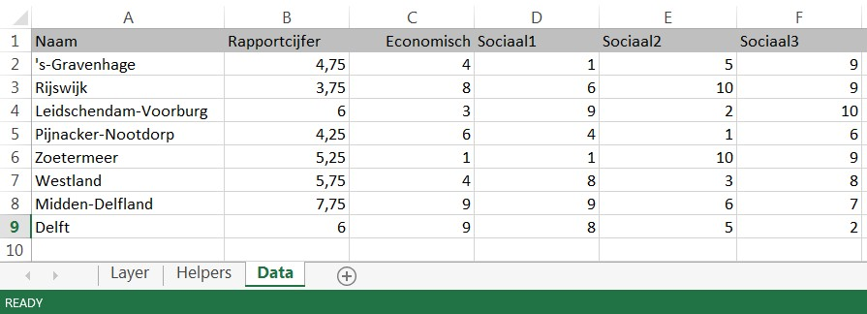
StringFormat:
Defines the formatting of a number. In the example, the number ‘3,75’ is rounded to one decimal, so ‘3.8’ is shown. Other options include adding a € euro sign or percentage %.
(Can only be used on numbers)

Slide 29
Not used yet:

Slide 30
VisibleInCallout:
Whether the property should be shown in the right panel. When for example ‘rapportcijfer’ is set to false, it will not be shown here anymore.

Slide 31
CanEdit:
Not used yet, can be set either to true or false, or empty.

Slide 32
Min/MaxValue:
Sets the minimum/maximum value of the property. For example, Dutch school grades range from 1 – 10.
When it is not filled in, csWeb automatically finds the minimum and maximum value from the data.

Slide 33
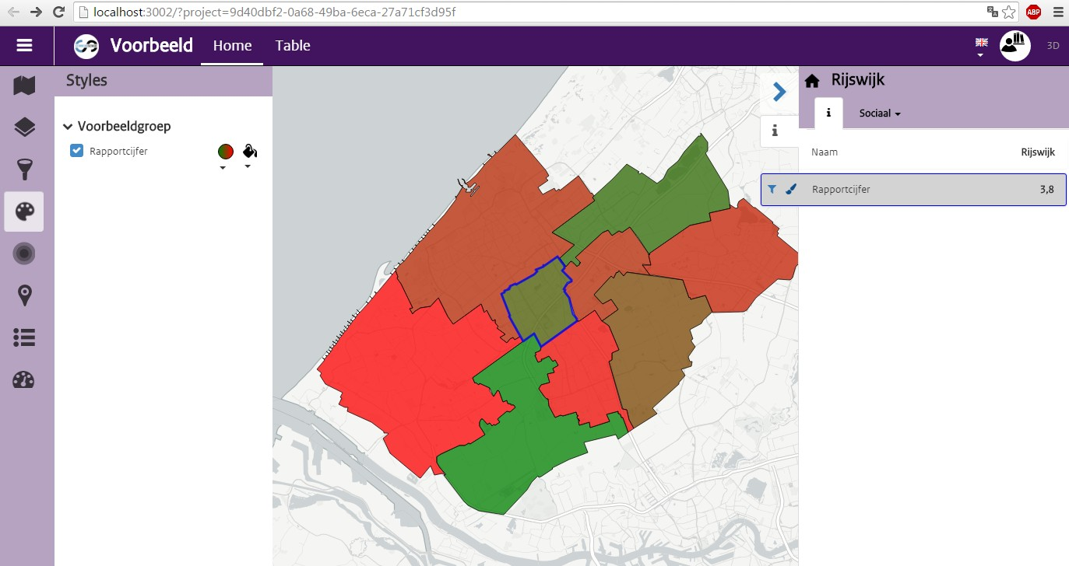
Tip: Styling:
Style the color of the regions/icons by clicking the paintbrush on a property. Each color is based on the value of the property for each region. In this case, low numbers get a green color, high numbers get a red color.
You can change color gradient here:

Slide 34
More information: https://github.com/TNOCS/csWeb/ https://github.com/TNOCS/csWeb/wiki/Excel2Map

