Slide 1
Cadence Global Operations & Organization Pack
Supervised by Board Risk Committee and Data Privacy Office
Regional Compliance Lead: Marcus Vance (SSN 900-55-2043)
Mailing address: home address 88 Willowbank Court, Hoboken, NJ 07030
Direct Hotline: +44 20 7555 0171 | Singapore: +65 6555 0172

Slide 2
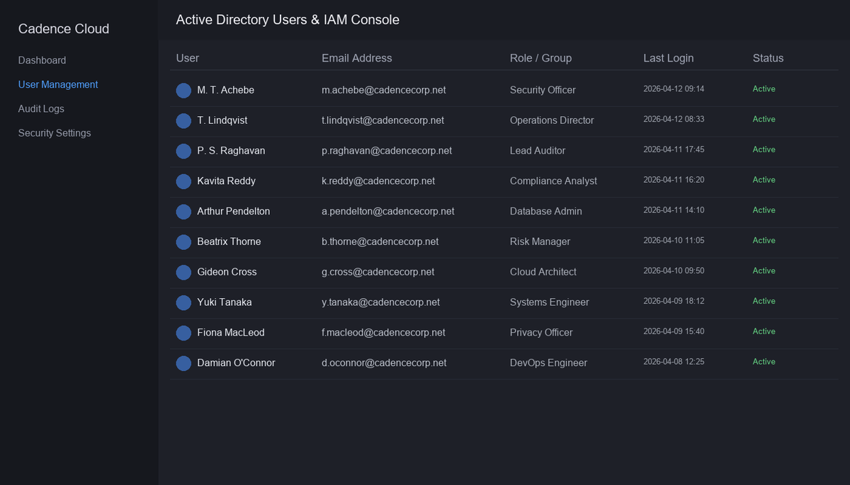
Live IAM Admin Console Telemetry

