Slide 2
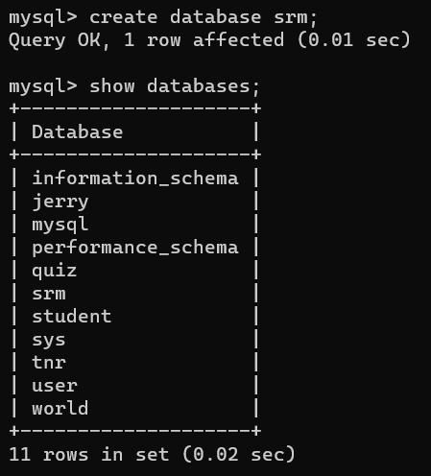
Create database

Slide 3
delete

Slide 4
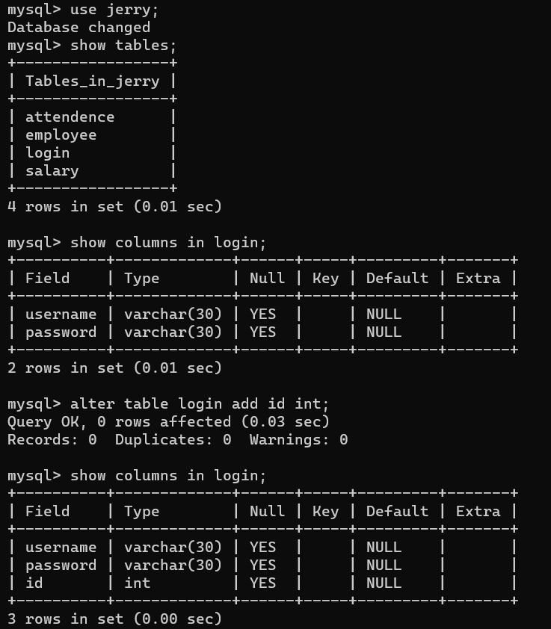
ALTER (inserting new column)

Slide 5
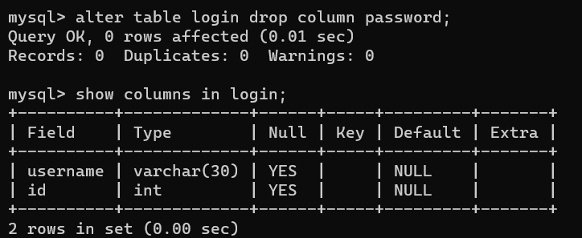
ALTER (DROP COLUMN IN TABLE)

Slide 6
Inserting record

Slide 7
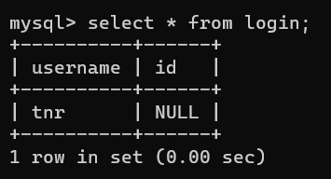
Select (allow duplicate values)

Slide 8
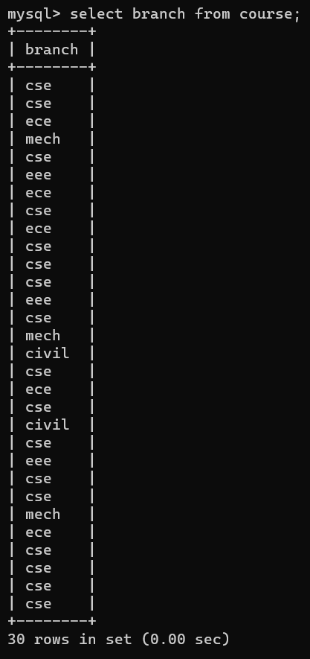
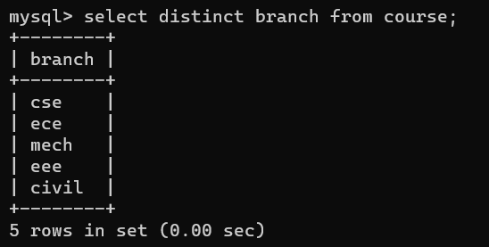
Select distinct

Slide 9
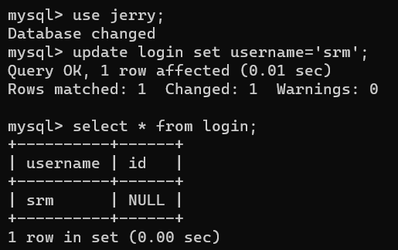
update

Slide 10
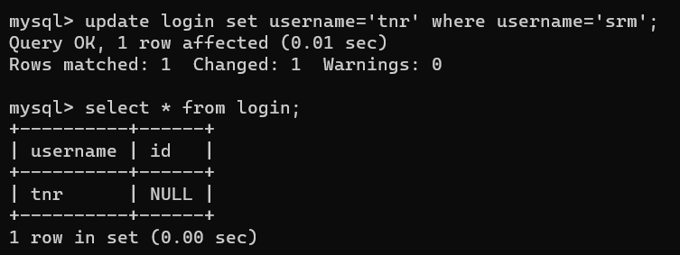
Update with condition

Slide 11
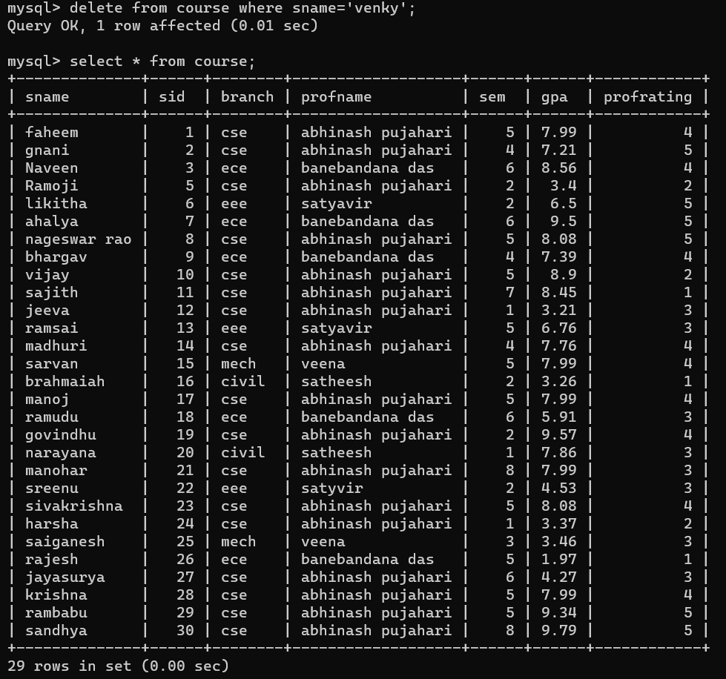
Delete query

Slide 12
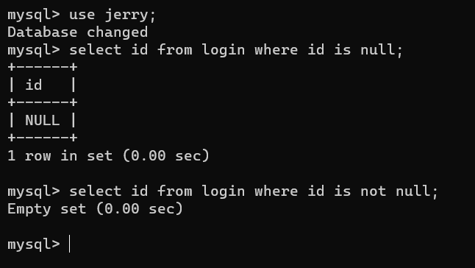
Is null and not null

Slide 13
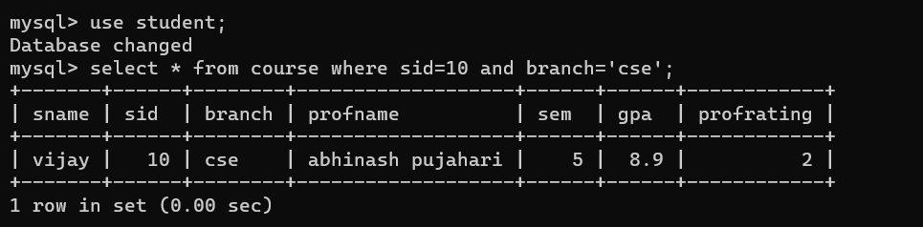
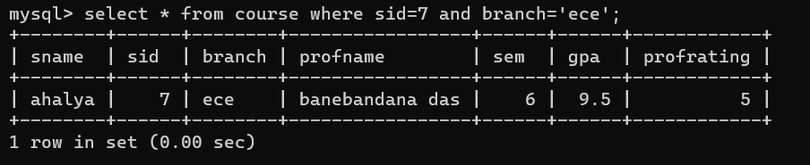
AND

Slide 14
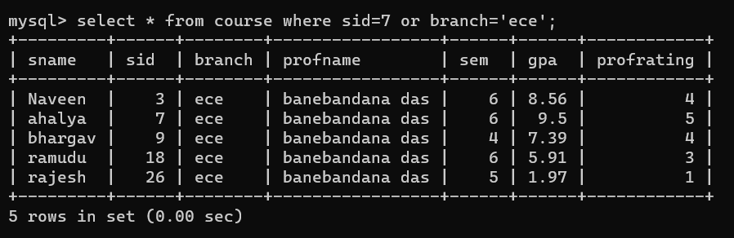
OR

Slide 15
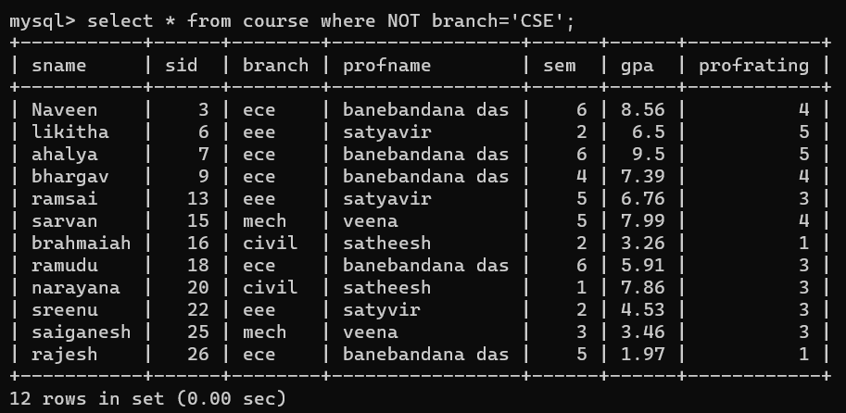
NOT

Slide 16
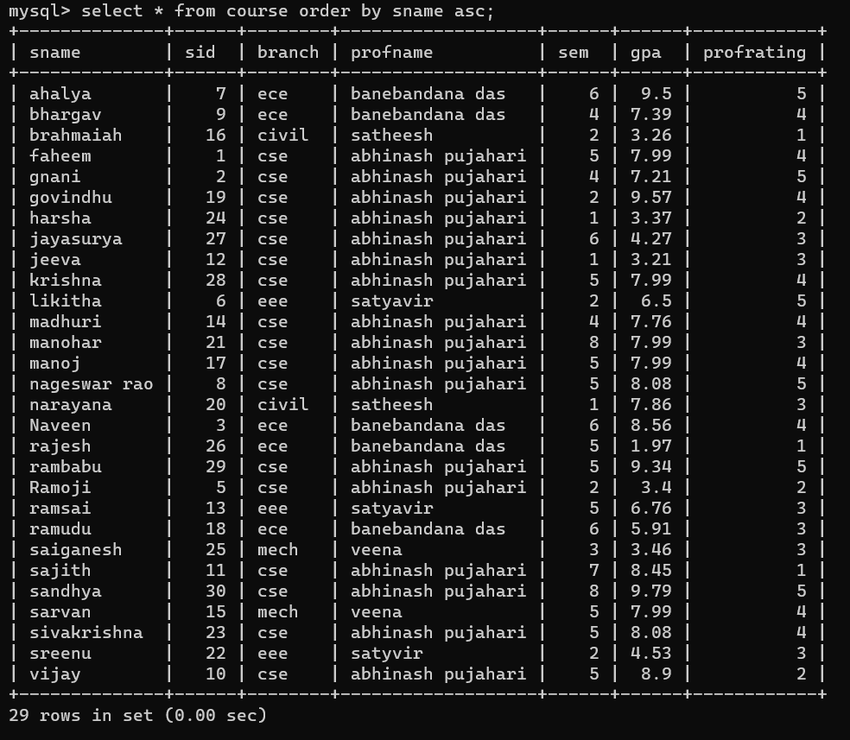
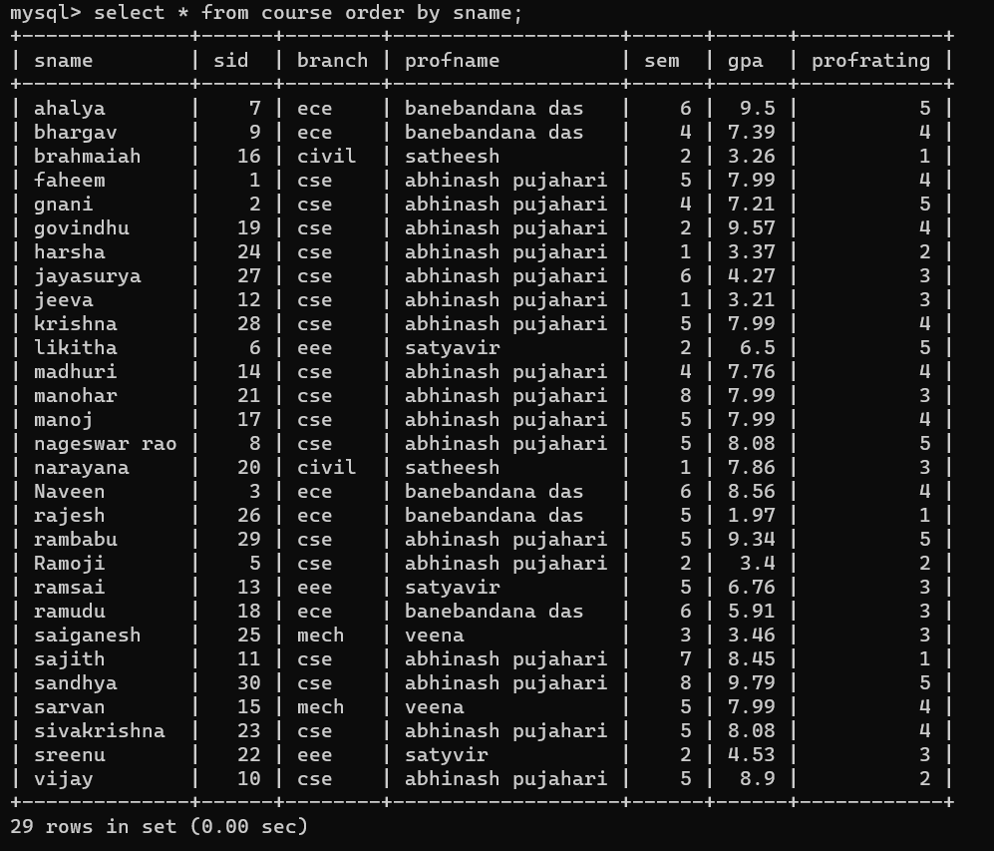
ORDER BY (ascending)

Slide 17
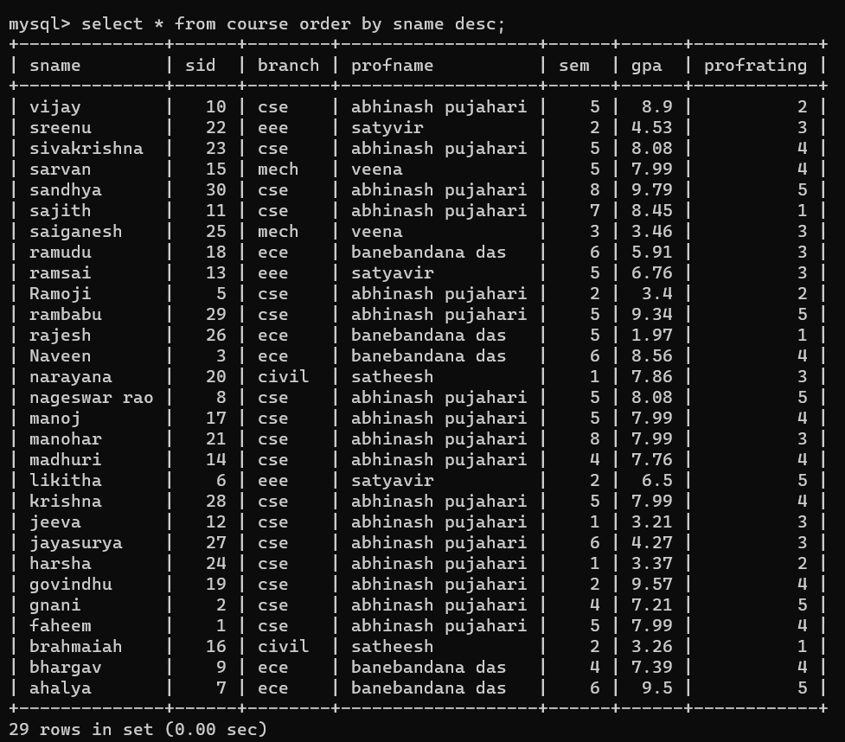
ORDER BY (descending)

Slide 18
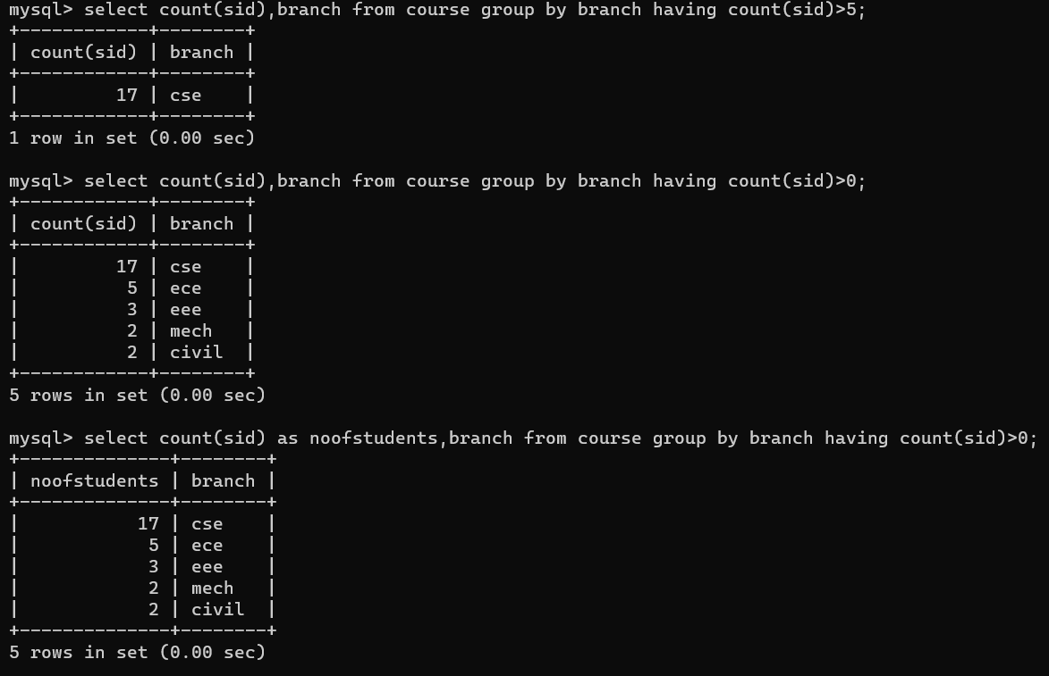
HAVING

Slide 19
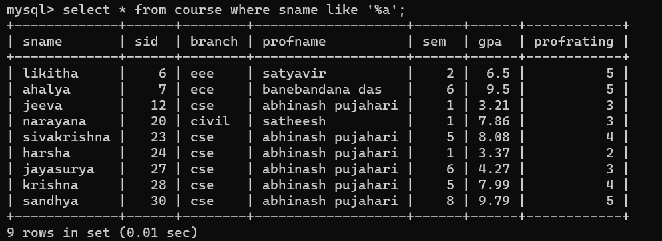
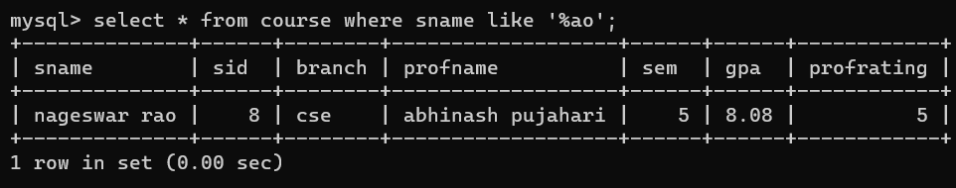
LIKE (%) – ending (used for patterns)

Slide 20
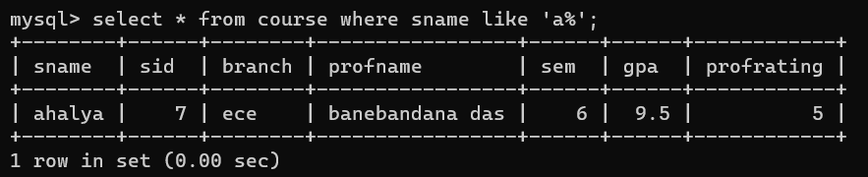
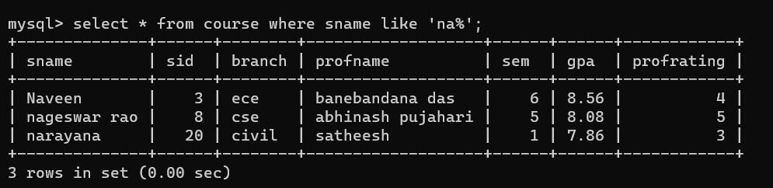
LIKE (%) - starting

Slide 21
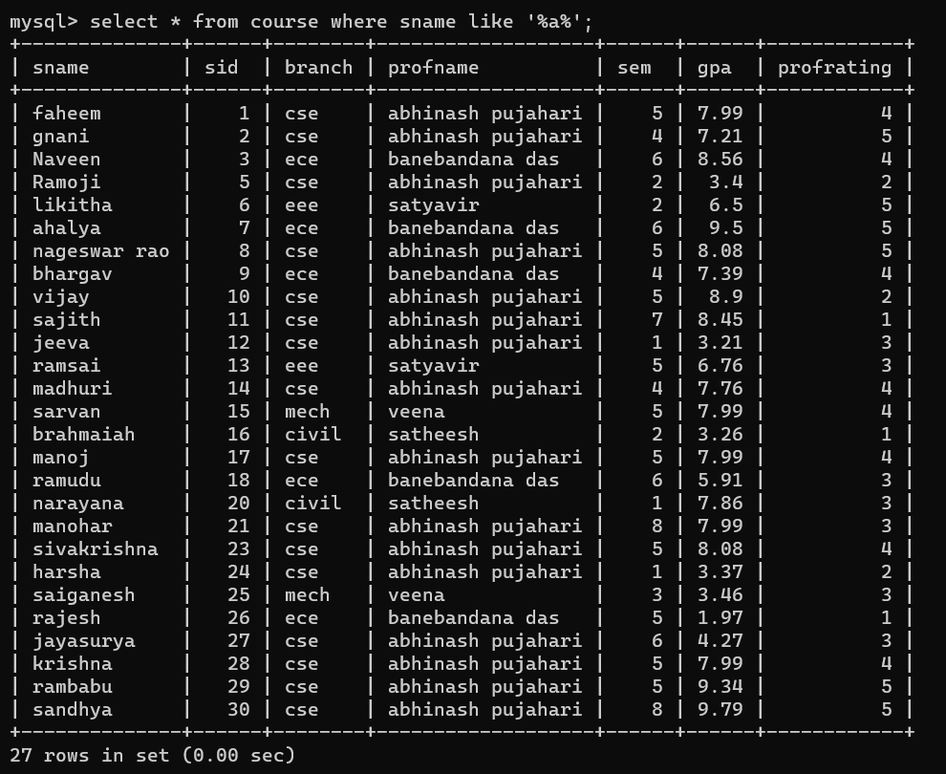
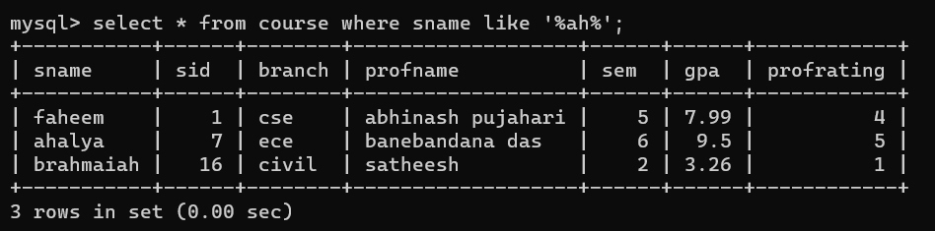
LIKE (%) - between

Slide 22
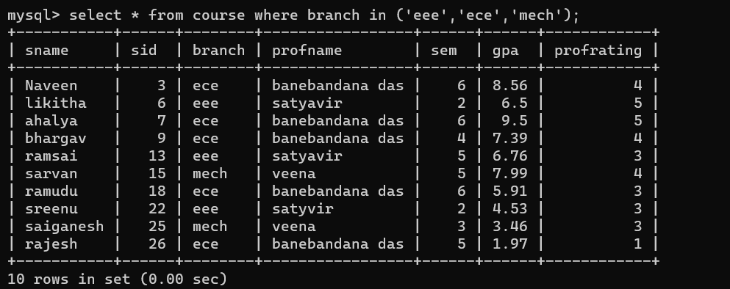
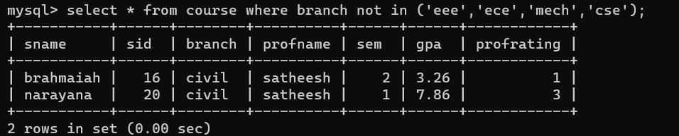
IN (multiple values)

Slide 23
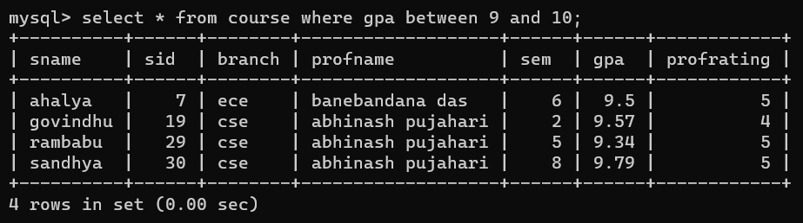
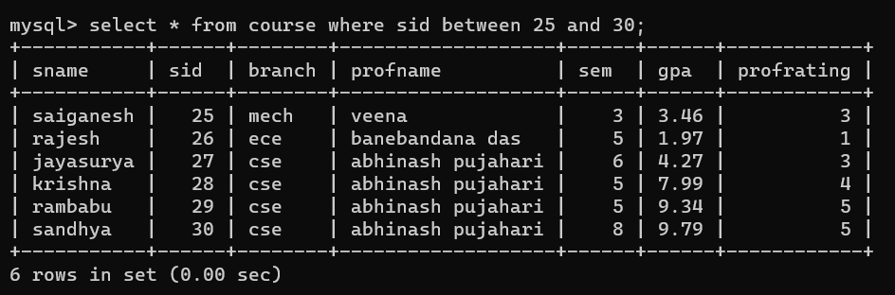
BETWEEN

Slide 24
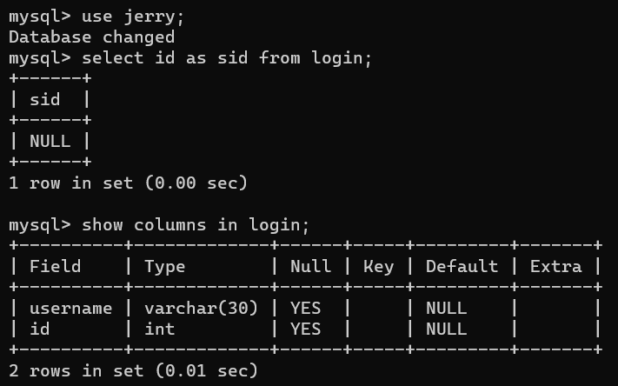
ALIAS (*,%,’’,””)

Slide 25
wildcard

Slide 26
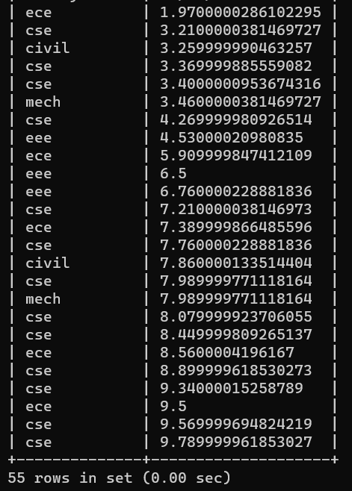
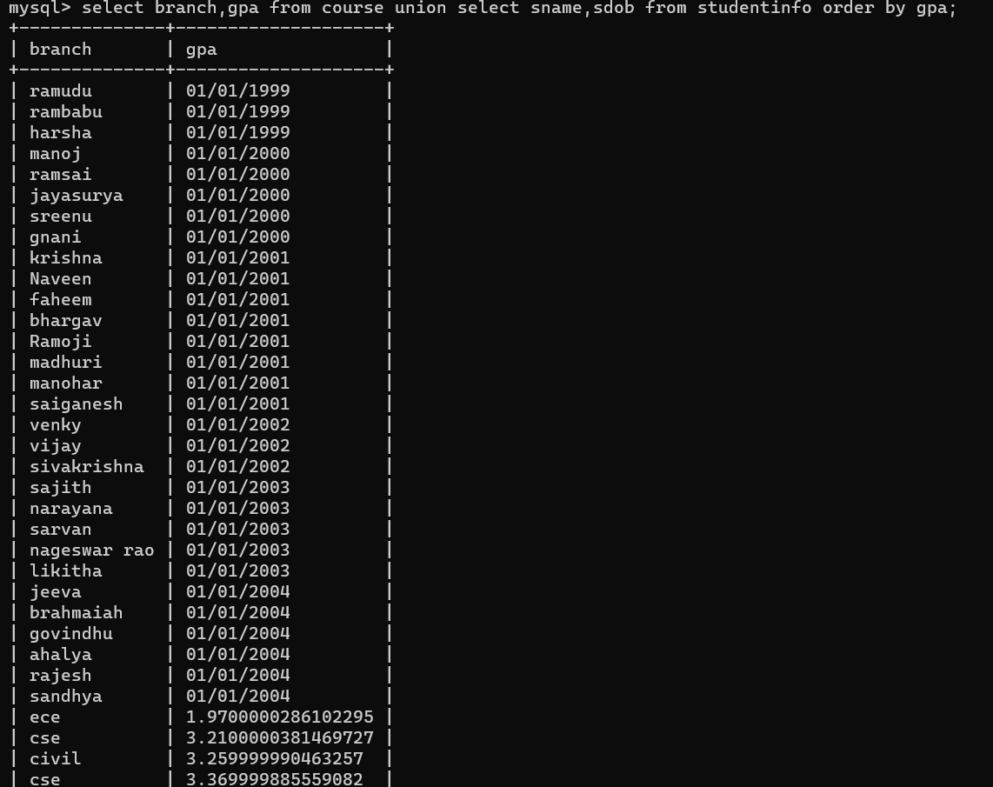


UNION

Slide 27
Union all

Slide 28
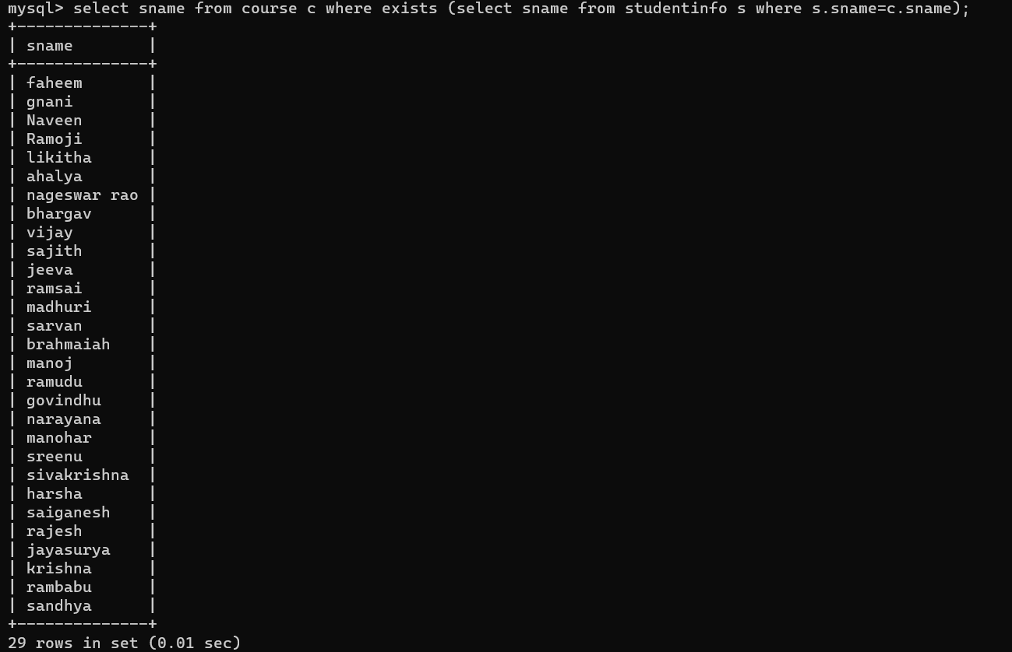
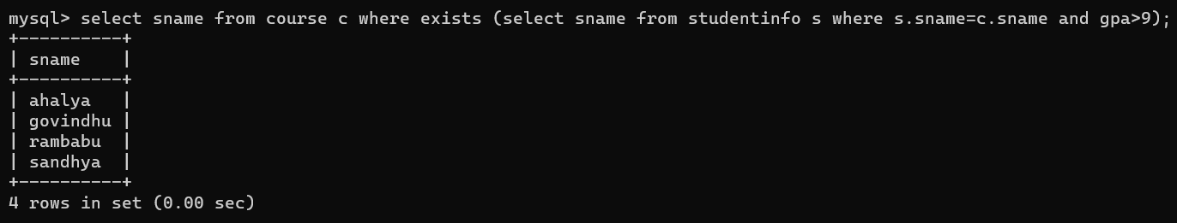
exists

Slide 29
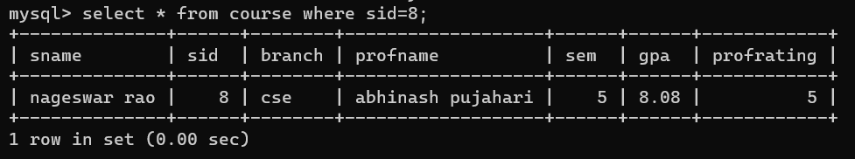
ANY

Slide 30
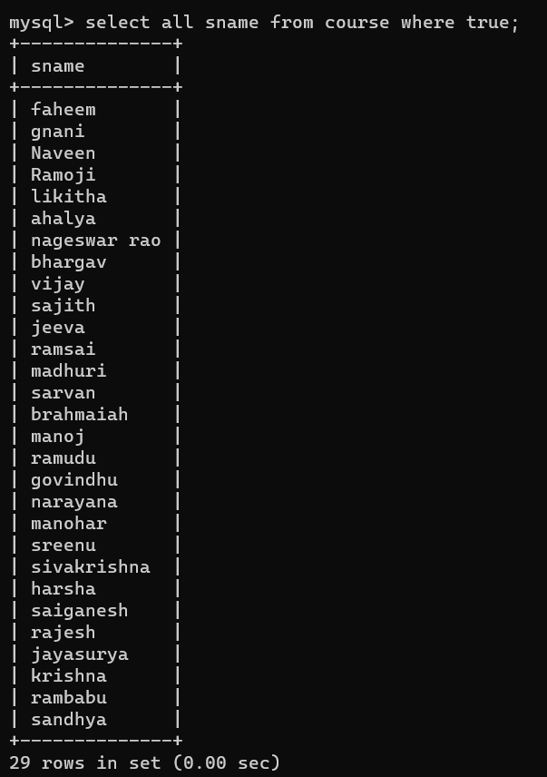
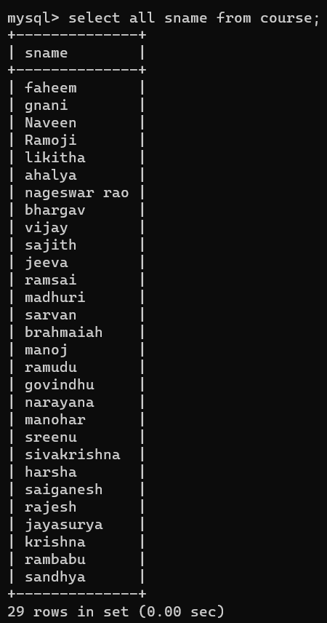
ALL

Slide 31
NUMERIC FUNCTIONS

Slide 32
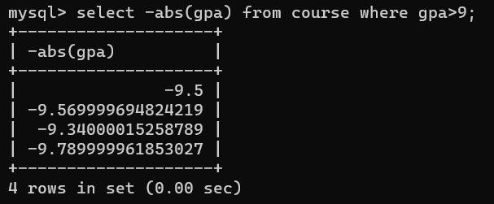
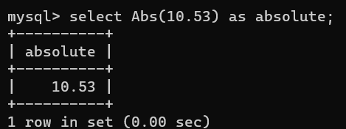
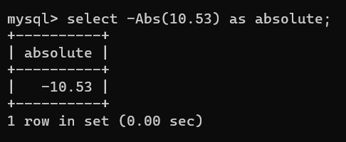
ABS

Slide 33
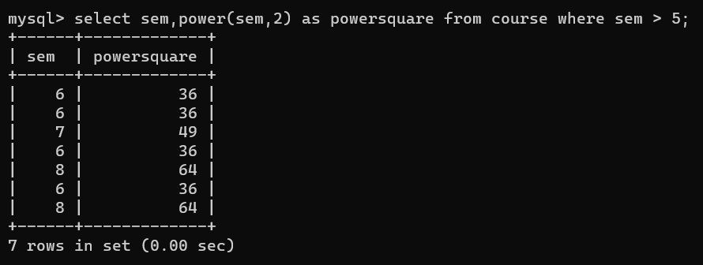
power

Slide 34
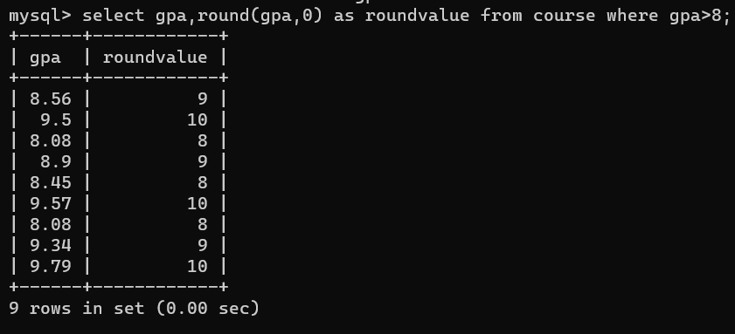
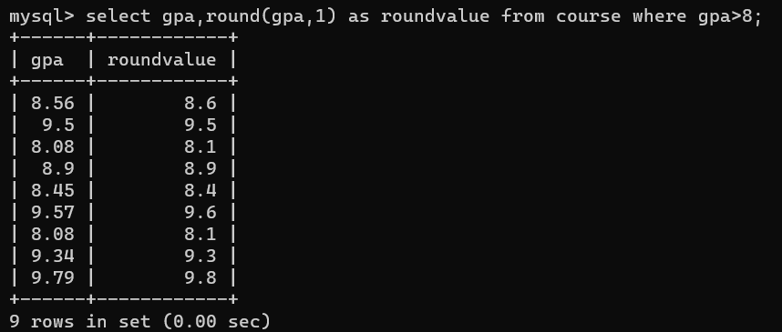
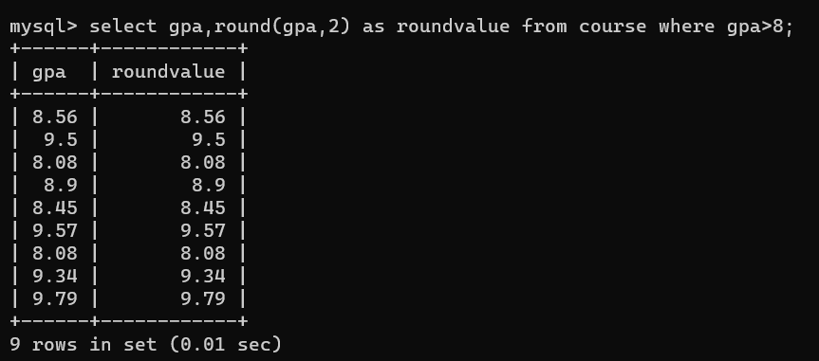
round

Slide 35
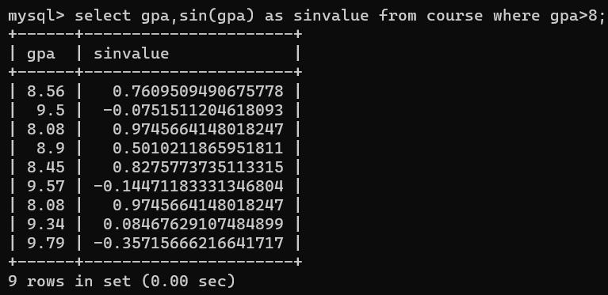
SIN

Slide 36
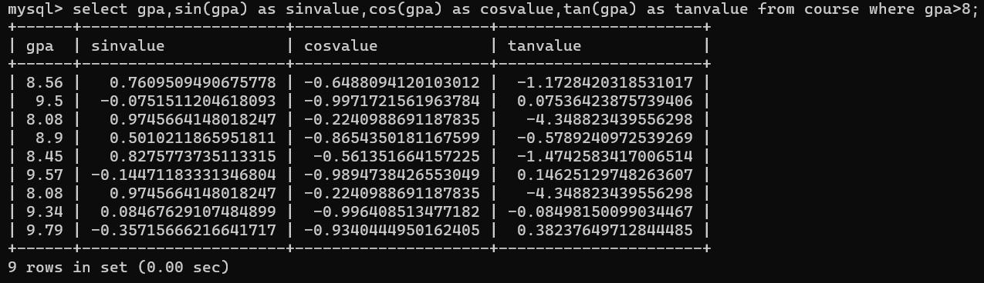
trignometry

Slide 37
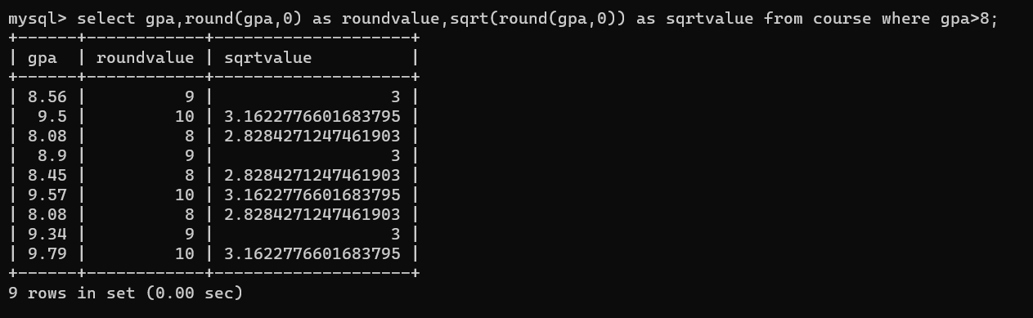
sqrt

Slide 38
square

Slide 39
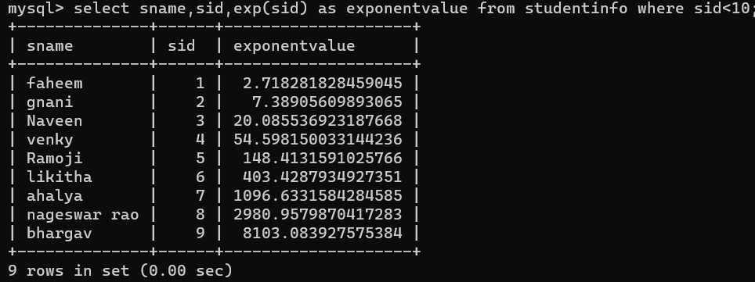
EXP

Slide 40
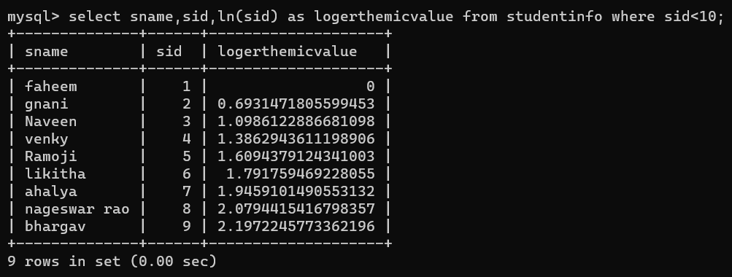
LN

Slide 41
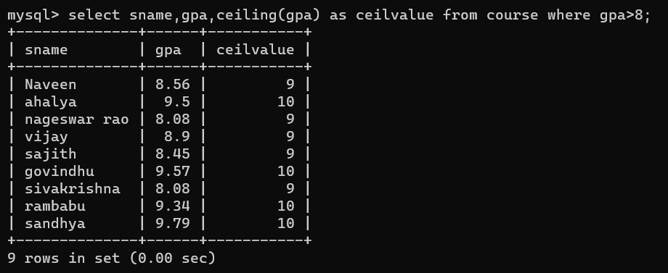
ceiling

Slide 42
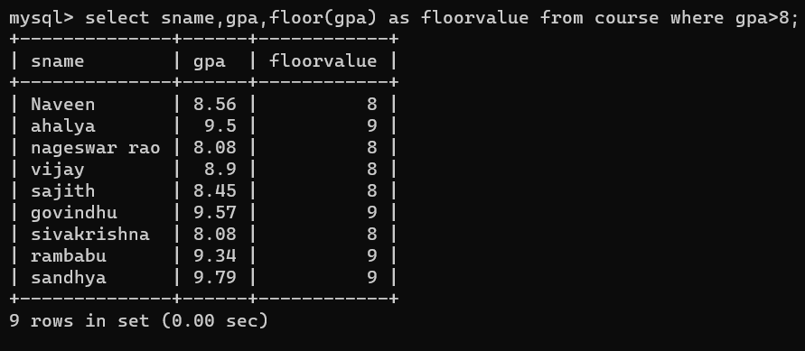
floor

Slide 43



sign

Slide 44
Aggregate functions

Slide 45


Min and max

Slide 46



Average count sum

Slide 47
String functions

Slide 48
INITCAP

Slide 49


Upper and lower

Slide 50


LTRIM RTRIM

Slide 51


REPLACE

Slide 52


SUBSTR length

Slide 53

SUBSTR + length

Slide 54

concat

Slide 55
Window function

Slide 56

ROW NUMBER

Slide 57

RANK

Slide 58


DENSE_RANK

Slide 59

LEAD

Slide 60
LAG

Slide 61


JOINS

Slide 62


Inner join

Slide 63

RIGHT GOIN

Slide 64

Dot operator The dot is used to specify a column in a particular table. This is especially useful in queries involving multiple tables where there may be column name conflicts.

Slide 65

DOT OPERATOR When a table or subquery is assigned an alias, the dot is used to refer to columns from that alias.

Slide 66


SUB QUERY

