Slide 1
COS 301 Omega Notifications team
Members:
U18140565 – J Janse van Rensburg
U17327408 – NS Maseko
U17043540 – JH Wolmarans
U15285830 –JH DU Preez

Slide 2
Emails : Implementation
1) Language used : JAVA
2) External libraries used: javax.mail org.jason
i) javax.mail: creation and sending of email
ii)org.json: Data structure used in onrder to capture the data and send it. Modulirising the service

Slide 3
Usage of email service
i) Explicit functions to call for the 3 different type of emails
ii) functions require certain paramaters such as the email address you wish to send the email too, the user name and a unique code for example

Slide 4
Email unit testing
We tested that the bodies of the emails are set as we would expect.
Tested the sending of emails.
Tested that emails are sent to correct email addresses.

Slide 5
Integration testing
We tested that calling the mail classes functions from a class not belonging to the project will heild in the disired outcome.
For this we created a test class and tried to initiate emails to be sent.

Slide 6
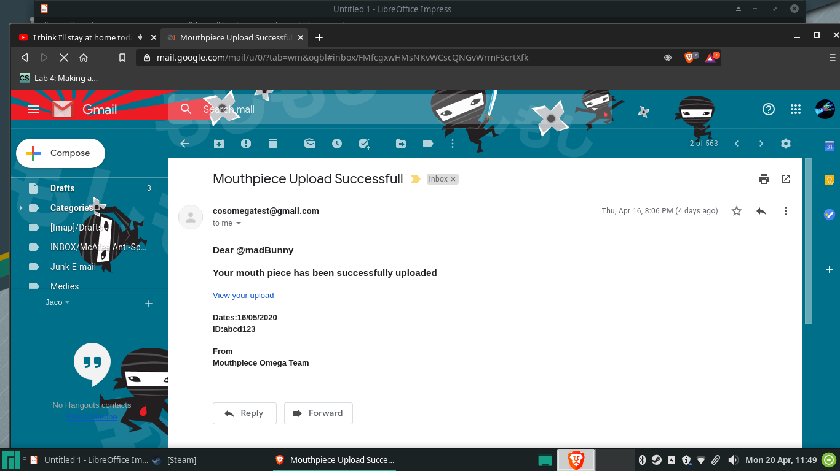
Examples of Emails sent

Slide 7
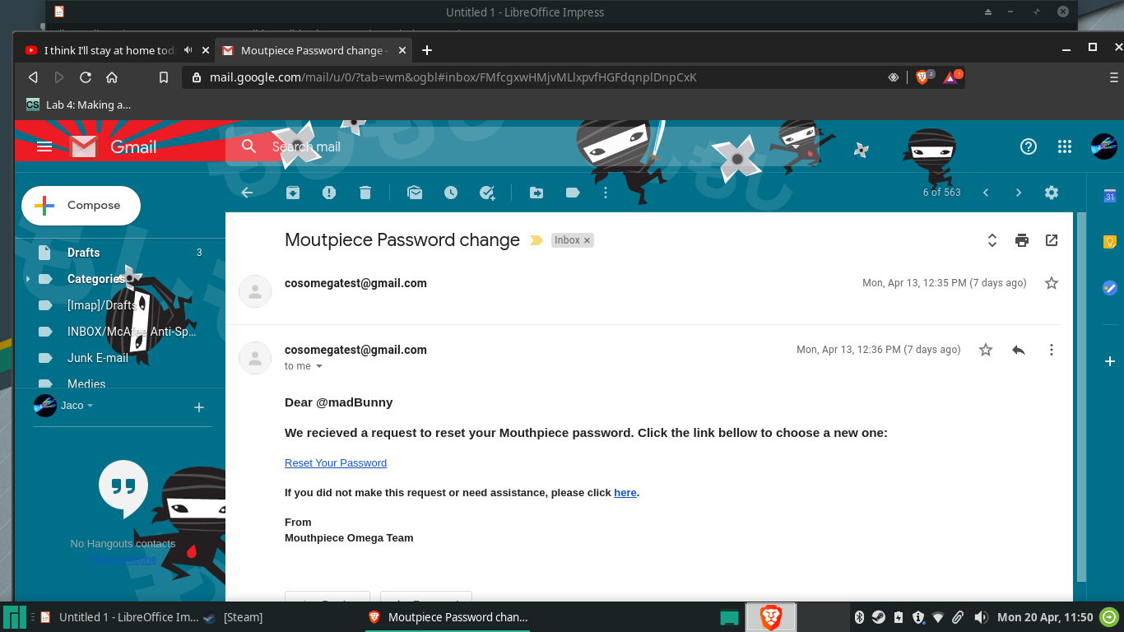
Example of emails sent

Slide 8
Email Integration
We developed the email classes so that an email will be sent as long as propper function call is made with the propper paramaters.
Read the Email docmentation files for a better understanding of the functions to call.
DifferentEmailFunctions.pdf file on github
In EmailApplication->Documentation

Slide 9
Local Notification
The integration team asked us to create a popup i.e Toast, that displays a “no internet connection” or “connected” message depending on your connectivivity.
Only shown when the application is lanched. This will act as an indication to let the user know what functions they’ll have access to depending on their connectivity.

Slide 10
Fire Base
Documentation of how we set up firebase and the notification class has been created and is available on github

Slide 11
API Rest Post Requests To Firebase

