Slide 1
DATA MINING ASSIGNMENT
DETECTING NBA
SALARY ANOMALIES
USING ISOLATION FOREST
Identifying Overpaid and Underpaid NBA Players
Nam Trung Tran – a1894661
Data Mining Application| Semester 1, 2026 | Isolation Forest · LOF · Python · Scikit-Learn
Notes:
Today I will be presenting my data mining application focused on detecting salary anomalies in the NBA using an unsupervised Isolation Forest approach. Let’s get started.

Slide 2
DECLARATION
Declaration of Originality
This is my own individual work.
GenAI was used to assist with code errors and analysis planning.
All methods, processes, and results are fully understood and can be explained independently.
Dataset sourced from Kaggle — full citation provided in the References slide.
"I understand everything presented in this talk and can explain it independently."
Notes:
Before I would want to declare that this project is my own individual work. And I also used GenAI to assist with code optimization and structuring my analysis pipeline.

Slide 3
INTRODUCTION
The Problem
NBA Salary Misallocation
$136M
$40–50M
$880K
NBA Hard Salary Cap
(2022–23 Season)
Annual Max Contract
(4–5 Years)
Ben Simmons — Cost Per
Game Played (2022–23)
"In 2023, Ben Simmons earned $37M for the Brooklyn Nets — playing 42 games at a role-player level. While players earning a fraction of that were contributing more wins."
Every dollar overspent on 1 player -> reduces budget for the rest of the roster.
Salary negotiations are driven by reputation, highlights, and agent leverage — not pure performance.
No systematic method to flag salary anomalies before signing.
Notes:
First, let’s look at the real problem. In the 2022–23 NBA season, Ben Simmons was paid 37 million dollars by the Brooklyn Nets while appearing in only 42 games. That equates to roughly 880,000 dollars per game played, with just a standard role-player performance.
This highlights an issue for front offices. NBA teams operate under a strict salary cap every year. Every dollar overspent on one player means less budget to build the rest of the team. And right now, player salaries are negotiated based on reputation, highlights, and agent leverage, not purely on performance data.
> A single bad max contract can literally cripple a franchise for half a decade.
> So the question is: can we build a data driven system that flags these salary anomalies? That's exactly what I’m gonna do in this project.

Slide 4
PROBLEM FRAMING
Mapping to a Data Mining Problem
✗ NOT These
✓ Outlier / Anomaly Detection
Classification
No pre-labelled 'overpaid' examples (ground truth unknown)
Regression
Predicts salary — we detect deviations, not predict values
Clustering (K-Means)
Requires knowing cluster count in advance
No class labels exist
No certified 'overpaid' set — supervised learning not applicable
Detects statistical deviations
Flags players anomalous vs the salary-performance pattern of the whole league
Why Isolation Forest:
Designed for tabular data
No normality assumption (salary is right-skewed)
Linear time complexity — scales to 400+ players
Outperforms distance-based methods (LOF) on global outliers
Notes:
we want to detect who deviates from the pattern of the league.
That is why outlier detection through unsupervised anomaly discovery is the right approach. I selected the **Isolation Forest** algorithm as it is effective for tabular data, makes zero assumptions about distributions, and it is computationally efficient.

Slide 5
DATA DESCRIPTION
Dataset Overview
Kaggle — NBA Player Salaries (2022–23 Season) by jamiewelsh2
467
323
12
$6.0M
Raw Player Records
After Filtering
(≥500 min)
Features Used
Median Salary
KEY FEATURES
PREPROCESSING STEPS
Salary · Points · Assists · Rebounds
WS (Win Shares) · PER (Player Efficiency Rating)
Engineered: salary_per_WS · pts_per_dollar · PER_salary_ratio
- Filtered players with < 500 minutes played
(insufficient sample size)
- Log-transformed salary (right-skewed distribution)
- Standardised all features with StandardScaler
Notes:
Log_salary, pts, ast, total rebounds, win shares, player efficiency rating (PER), usg% (what % of team plays a player involve, bpm box plus-minus, value over replacement player:total contribution, salaryperws, pts per dollar, per salary ratio.
Now Win Shares is a metric that estimates total wins a player contributes to their team by combining both offensive and defensive performance into 1 number. Conversely, PER—Player Efficiency Rating—is a per-minute measure of total productivity, normalized to a league baseline of 15. I also engineered some more features to formally assess this model.

Slide 6
METHOD
Method: Isolation Forest
Liu, Ting & Zhou (2008)
Core Idea: Anomalies are easier to isolate than normal points (require fewer random cuts).
1
2
3
4
Random Trees
Random Splits
Path Length
Anomaly Score
Build 200 isolation trees; each tree is trained on a random subset of data
Randomly pick a feature and a split value between min and max; partition data left/right
Count splits needed to isolate each point — short path = anomaly; long path = normal
Average path length across all trees; players below contamination threshold (10%) are flagged
Parameters: n_estimators = 200 · contamination = 0.10 · max_samples = auto (256) · random_state = 42
Notes:
Imagine you are in a room of 350 people, and you want to find the odd one out. A normal person blends in. You would need to ask many questions to single them out. But someone truly unusual? You identify them almost immediately.
Isolation Forest works the same by constructing an ensemble of random trees—I specified 200 trees. Each tree isolates data points by randomly picking a feature, randomly selecting a split value between the min and max, and partitioning the space.
The key metric is **path length**, how many splits it took to isolate this point. A short path means the point was isolated quickly, which means it is an anomaly. A long path means the point blends in with many others, which means it is normal.
By averaging path lengths across all 200 trees, we extract an anomaly score.
I configured the contamination parameter to 10 percent, expecting roughly 10 percent of the league salary to be anomalies.

Slide 7
PROCEDURE
Analysis Procedure
Step-by-step pipeline
1
Load & Inspect
2
Filter & Merge
Check shape, data types, missing values, and distributions
Remove players with < 500 minutes played; handle traded player duplicates
3
Feature Engineering
4
Transform & Scale
Create salary_per_WS, pts_per_dollar, and PER_salary_ratio
Log-transform salary (right-skewed); standardise all features with StandardScaler
5
Train Isolation Forest
6
Sensitivity Test
n_estimators=200, contamination=0.10, random_state=42; extract anomaly scores and labels
Repeat with contamination = 0.05, 0.15, 0.20 to validate robustness of results
7
LOF Comparison
8
Visualise Results
Train Local Outlier Factor (n_neighbors=20); compare flagged players with Isolation Forest
Scatter plots: Win Shares vs Salary, PER vs Salary; label top anomalies by name

Slide 8
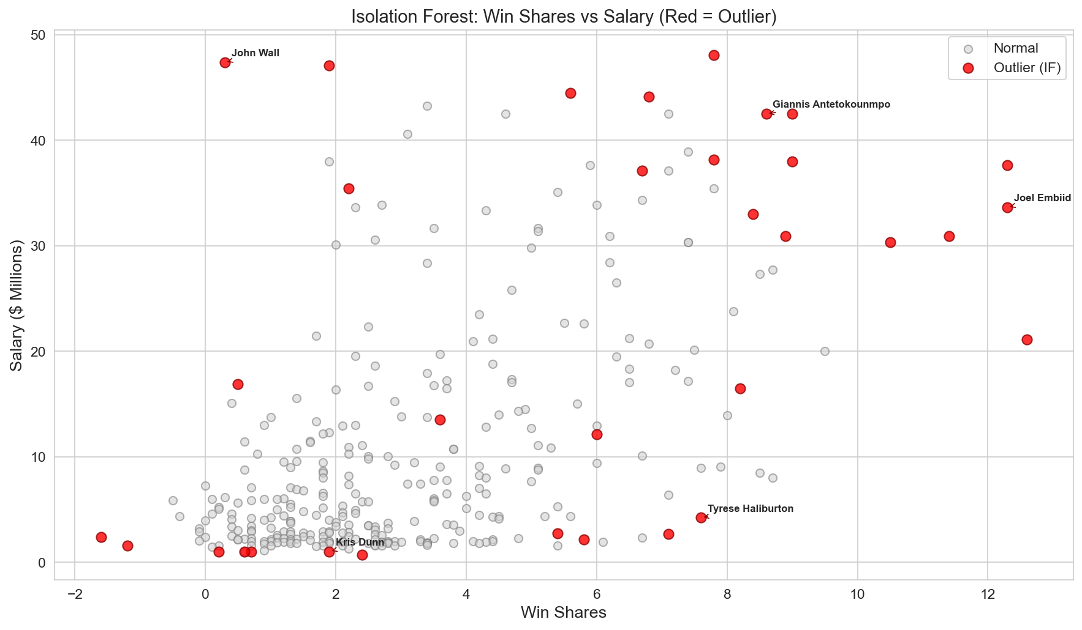
RESULTS
Results: Flagged Salary Anomalies
Isolation Forest — 323 players, contamination = 0.10
IF_ws_vs_salary 🔴 Red = Outlier
🔴 TOP OVERPAID
John Wall $47.3M — WS: 0.3
R. Westbrook $47.1M — WS: 1.9
Ben Simmons $35.4M — WS: 2.2
LeBron James $44.5M — WS: 5.6
🟢 TOP UNDERPAID
Desmond Bane $2.1M — WS: 5.8
Walker Kessler $2.7M — WS: 7.1
Tyrese Maxey $2.7M — WS: 5.4
Anthony Lamb $0.7M — WS: 2.4
Isolation Forest flagged 33 outliers (10.2% of filtered dataset) · LOF agreed on 19 of 33 cases
Notes:
Let’s look at the final results. The red points show 33 players flagged as outliers by the Isolation Forest.
The model immediately identified clear operational anomalies. Under the **Top Overpaid** category, John Wall emerges as an extreme outlier; with 47.3 million dollar salary while contributing 0.3 Win Shares—costing over 36 million dollars per win. Russell Westbrook followed a similar profile: 47 million dollars in salary against just 1.9 Win Shares.
On the other hand, our **Top Underpaid** category has Desmond Bane contributed 5.8 Win Shares on a meager 2.1 million dollar rookie contract, while Walker Kessler yielded an elite 7.1 Win Shares for just 2.7 million dollars.

Slide 9
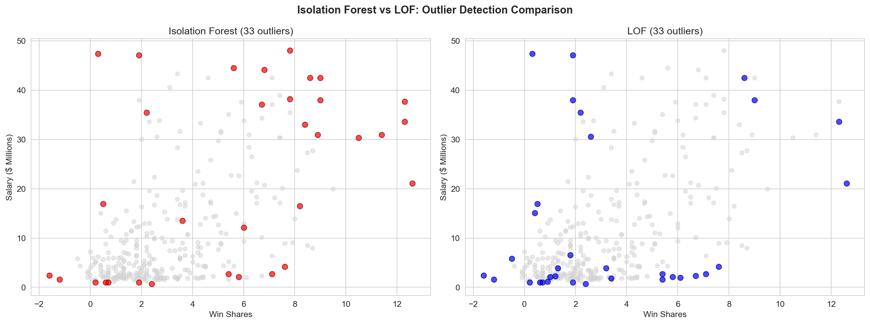
RESULTS
Supporting Visualisations
IF_vs_LOF_comparison.png
Isolation Forest vs LOF — Agreement Map
Notes:
As mentioned above, I also use Local Outlier Factor as a comparison model with regards to Isolation Forest.
**Local Outlier Factor (LOF)** calculates **local outliers** by evaluating local neighborhood densities against 20 nearest neighbors.
The 2 models only agreed on 19 players. 14 players were entirely unique to each method.
This divergence happens because **Isolation Forest** targets **global outliers**, regardless of local density. It asks: Which players are most different from everyone else?
And for LOF because these max-contract veterans all earn similar premium amounts and cluster tightly together at the top of the financial scale,
LOF views them as a dense, normal neighborhood of peers and misses them globally.
For this problem where salary extremes are global, Isolation Forest is the better architectural choice.

Slide 10
DISCUSSION
Discussion
Domain Knowledge Check — LeBron James (#5 Flagged Overpaid)
$44.5M salary, WS: 5.6 → $6.7M per win — flagged as overpaid by model
27 games missed (injury); then led Lakers from 2-10 to Western Conference Finals (same year he broke NBA scoring record).
Lesson: data-driven does not mean data-only — human judgment must complement algorithmic output
IF vs LOF Comparison
Limitations
Both agree on 19/33 flagged — strongest anomaly cases
IF-only (14): global outliers — extreme salaries far from median
LOF-only (14): local density anomalies IF missed
IF better suited here — NBA salary outliers are global, not local density effects
Single-season only — does not reflect multi-year contract context
Salary reflects future potential, not just current stats
WS is a counting stat — injury reduces accumulation even if per-game impact is elite
Intangibles (leadership, marketability) are invisible to the model
Notes:
Now let’s discuss with some domain knowledge.
Remember LeBron James? The algorithm flagged him as the 5th most overpaid player. But here is the full picture.
In that season, LeBron missed 27 regular season games due to injury.
Then in February 2023 of that season, he surpassed the legend: Kareem Abdul Jabbar to become the all time leading scorer in NBA history
and then continue to lead the Lakers all the way to the Western Conference Finals.
That is leadership and historic achievement that no statistics can capture.
This underscores a data mining lesson: data-driven does not mean data-only.**
And that we should combine both algorithmic output with human contextual judgement in solving problems.

Slide 11
CONCLUSION
Conclusion
.
Key Findings
Isolation Forest successfully identified 33 statistically anomalous salary cases (10.2% of filtered dataset).
Top flagged overpaid players (Wall, Westbrook, Simmons) align with publicly known cases — validating the approach.
Top underpaid players are mostly on rookie-scale contracts — a structural CBA limitation, not a market failure.
Combining IF and LOF produces more robust conclusions — consensus cases (19/33) are the strongest anomaly candidates.
Future Work
Incorporate multi-season data to capture career trajectory and contract context.
Add injury history as a feature to separate injury-driven anomalies from true overpayment.
Apply explanation to which features drive each player's anomaly score.
Stratify analysis by playing position as centre vs guard salary norms differ significantly.
Isolation Forest provides an objective, scalable framework for salary anomaly detection — a data-driven complement to subjective front-office valuation.
Notes:
In conclusion, Isolation Forest provides an objective framework for detecting anomalies in 10 percent of the dataset. Combined with Local Outlier Factor and domain knowledge, it is a powerful starting point for data driven roster analysis.
For future work, I am looking forward to incorporating multi-season data to capture career trajectories. We should also add injury history as an explicit feature to isolate injury-driven anomalies from true overpayment. Finally, stratifying the analysis by player position in basketball would be highly valuable, as salary norms differ significantly between centers and guards.

Slide 12
REFERENCES
References
DATASET
jamiewelsh2 (2023). NBA Player Salaries (2022–23 Season). Kaggle.
https://www.kaggle.com/datasets/jamiewelsh2/nba-player-salaries-2022-23-season
ALGORITHM
Liu, F.T., Ting, K.M., & Zhou, Z.H. (2008). Isolation Forest. 2008 Eighth IEEE
International Conference on Data Mining, pp. 413–422.
LIBRARY
Pedregosa, F., et al. (2011). Scikit-learn: Machine Learning in Python.
Journal of Machine Learning Research, 12, 2825–2830.
STATS
Basketball Reference (2023). 2022–23 NBA Player Stats.
https://www.basketball-reference.com

