Slide 1
Using SQL Queries to Insert, Update, Delete, and View Data
Chapter 3A
Wednesday 1/28/2015

Slide 2
Lesson 3A Objectives
You should know how to:
Run a script to create database tables automatically
Insert data into database tables
Create database transactions and commit data to the database
Create search conditions in SQL queries
Update and delete database records and truncate tables
Create and use sequences to generate surrogate key values automatically

Slide 3
Using Scripts to Create Database Tables
SQL Script
  Text file that contains one or more SQL statements
  Contains only SQL statements
  File extension must be .sql
Run a script
  At SQL prompt, type one of the following:
  start path\filemane
  @ path\filemane
  Example: start oralab00.sql
  Example: @ F:\MIS4200\script1.sql
Script1.sql
CREATE TABLE location
(loc_id NUMBER(5),
bldg_code NUMBER(3)
room VARCHAR2(20);
DESCRIBE location
ALTER TABLE location
ADD (capacity NUMBER(5);

Slide 4
Using the INSERT Command
Basic syntax for inserting data into every column:
    INSERT INTO tablename
    VALUES (column1_value, column2_value, … );
  Must list values in same order as in CREATE TABLE
  If a data value is unknown, must type NULL
  If character data, must use single quotation marks
  Value in quotations is case sensitive
Basic syntax for inserting into selected columns
    INSERT INTO tablename (columnname1, columnname2, …)
    VALUES (column1_value, column2_value, … );
Example
INSERT INTO student
VALUES (‘JO100’, ‘Jones’, ‘Tammy’, ‘R’, ‘1817 Eagleridge Circle’, ‘Tallahassee’, ‘FL’, ‘32811’, ‘7155559876’, ‘SR’, TO_DATE(‘07/14/1984’ ,‘MM/DD/YYYY’), ‘8891’, 1, TO_YMINTERVAL(‘3-2’));
Note: To specify 454 St. John’s Place, must type '454 St. John ''s Place'
Question: If you couldn’t remember the columns’ order for the table you want to insert data in, what command can you use in SQL Plus to verify?
Notes:
Question: If you couldn’t remember the columns’ order the table you want to insert data in, what command can you use in SQL Plus to verify?

Slide 5
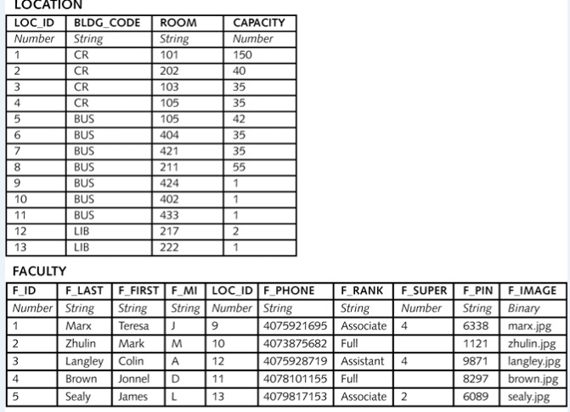
Using the INSERT Command (cont.)
Ensure all foreign keys that new row references have already been added to database.
Cannot insert a foreign key value unless the corresponding primary key is in the primary table.

Slide 6
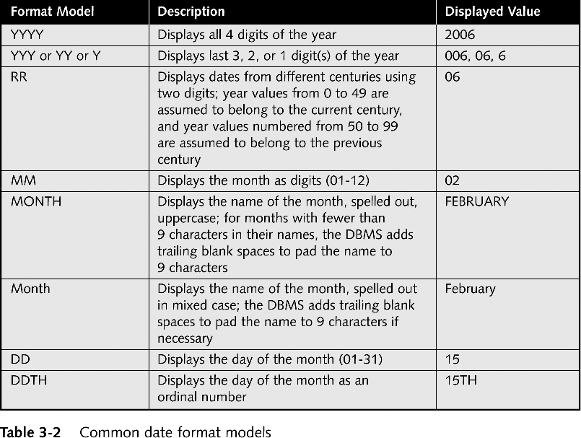
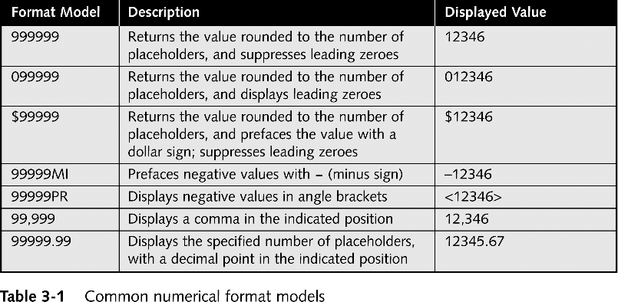
Format Models
With the $9999.99 mask, 1250.75 appears as $1250.75
Also called format mask
Used to specify different output format from default
For NUMBER data types, 9 represents digit
For DATE/TIMESTAMP data types
  Choose formats for year day, date, etc.
With the $9999.99 mask, how will appear 1500? 2340.1?

Slide 7
Inserting Date and Interval Values
Inserting values into DATE columns
  Use TO_DATE function to convert string to DATE
  Syntax:
  TO_DATE('date_string', 'date_format_model')
  Example:
    TO_DATE ('08/24/2010', 'MM/DD/YYYY’)
Inserting values into INTERVAL columns
  Syntax
    TO_YMINTERVAL('years-months')
    TO_DSINTERVAL('days HH:MI:SS.99')
Example
INSERT INTO student
VALUES (‘JO100’, ‘Jones’, ‘Tammy’, ‘R’, ‘1817 Eagleridge Circle’, ‘Tallahassee’, ‘FL’, ‘32811’, ‘7155559876’, ‘SR’, TO_DATE(‘07/14/1984’ ,‘MM/DD/YYYY’), ‘8891’, 1, TO_YMINTERVAL(‘3-2’));

Slide 8
Inserting LOB Column Locators
Oracle stores LOB data in separate (alternate) physical location from other types of data
LOB locator needs to be created to
  Hold information that identifies LOB data type, and
  Point to alternate memory location
Syntax for creating blob locator
  EMPTY_BLOB()
INSERT INTO faculty (f_id, f_last, f_first, f_image)
VALUES (2, ‘Zhulin’, ‘Mark’, EMPTY_BLOB());

Slide 9
Creating Transactions and Committing New Data
Transaction
  Represents logical unit of work (or action queries)
  All of action queries must succeed or no transaction can succeed
When a problem occurs and prevents some queries in a transaction to succeed, Oracle allows you rollback
Rollback
  Discard changes in transaction using ROLLBACK
Commit
  Save changes in transaction using COMMIT

Slide 10
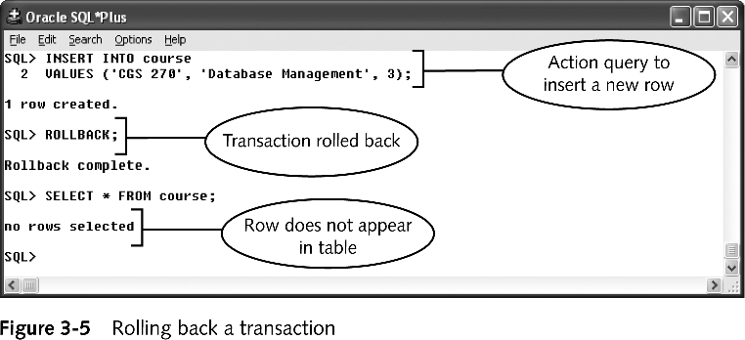
Creating Transactions & Committing Data (cont)
Purpose of transaction processing
  Enable users to see consistent view of database
  Preventing users from viewing or updating data that are part of a pending (uncommitted) transaction
New transaction begins when SQL*Plus started and command executed
Transaction ends when current transaction committed
ROLLBACK command restores database to point before last commit

Slide 11
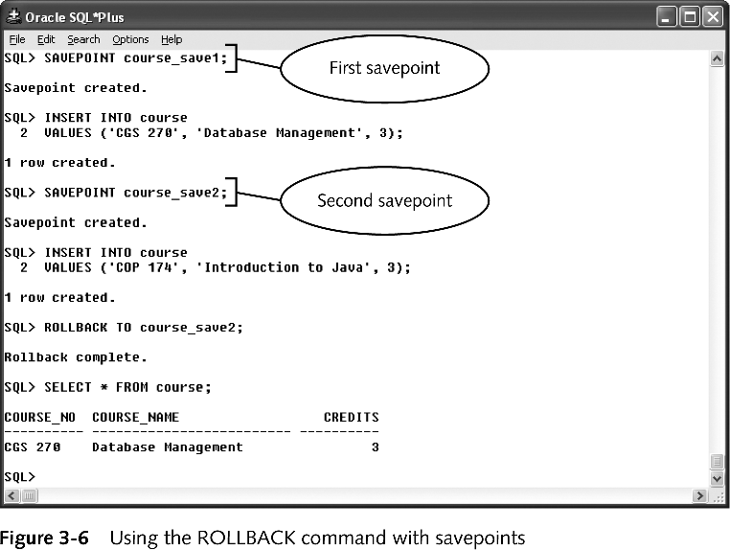
Rollback and Savepoints
Savepoints are used to rollback transactions to a certain point.

Slide 12
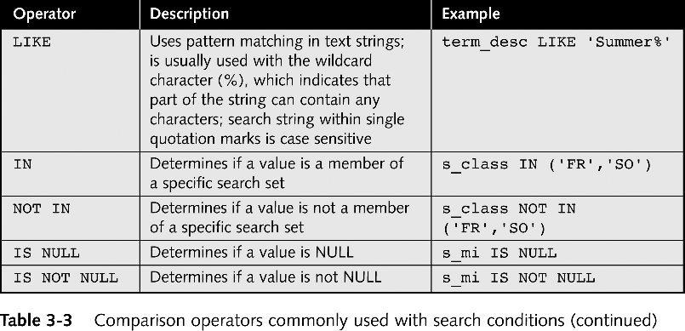
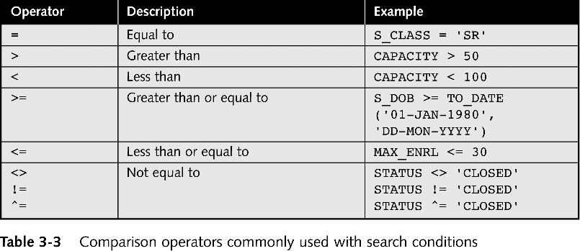
Creating Search Conditions in SQL Queries
Search condition
  Expression that seeks to match specific table rows
Syntax
  WHERE columnname comparison_operator search_expression
Example:
  DELETE FROM student WHERE s_id = ‘JO100’

Slide 13
Defining Search Expressions
NUMBER example: WHERE f_id = 1
Character data example: WHERE s_class = 'SR'
DATE example
  WHERE s_dob = TO_DATE('01/01/1980', ‘MM/DD/YYYY')
Creating Complex Search Conditions
Complex search condition combines multiple search conditions using logical operators
AND logical operator: True if both conditions true
OR logical operator: True if one condition true
NOT logical operator: Matches opposite of search condition
Example
WHERE bldg_code = ‘CR’ AND capacity > 50

Slide 14
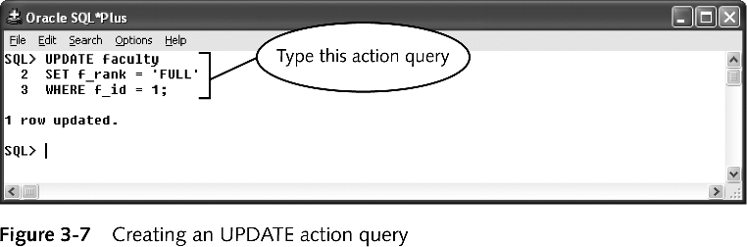
Updating Table Rows
UPDATE action query syntax
  UPDATE tablename
  SET column1 = new_value1, column2 = new_value2, …
  WHERE search condition;
Question: In a previous class session, we learned about the ALTER TABLE command. What is the difference between the ALTER TABLE and the UPDATE commands?

Slide 15
Deleting Table Rows
The DELETE action query removes specific rows
Syntax:
      DELETE FROM tablename
      WHERE search condition;
The TRUNCATE action query removes all rows
  TRUNCATE TABLE tablename;
Cannot truncate table with foreign key constraints
  Must disable constraints, first, using
    ALTER TABLE tablename
    DISABLE CONSTRAINT constraint_name;

Slide 16
Deleting Table Rows (continued)
Child row: a row containing a value as foreign key
  Cannot delete row if it has child row. In other words, you cannot delete a “parent” row …
    Unless you, first, delete row in which foreign key value exists
  Cannot delete LOCATION row for loc_id = 9 unless you delete FACULTY row for f_id = 1
FACULTY
F_ID | F_LAST | F_FIRST | F_MI | LOC_ID
1 | Marx | Teresa | I | 9
Child row
LOCATION
LOC_ID | BLDG_CODE | ROOM | CAPACITY
9 | BUS | 424 | 1
“Parent” row

Slide 17
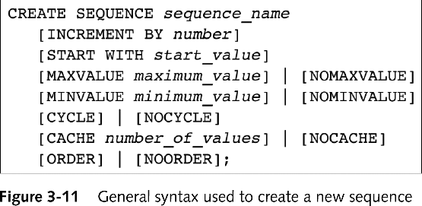
Creating New Sequences
A sequence is a series of number like 1, 2, 3, …
A sequence can be created as a database object
CREATE SEQUENCE is used to create a sequence
  CREATE SEQUENCE is a DDL command
  No need to issue COMMIT command because (it’s a DDL command)
Example:
    CREATE SEQUENCE loc_id_sequence
    START WITH 20;
CACHE stores 20 sequence numbers by default
CYCLE: when a minimum and a maximum are set, CYCLE allows the sequence to restart from minimum when the maximum is reached.

Slide 18
Viewing Sequence Information
The USER_SEQUENCES data dictionary view contains
  sequence_name
  sequence_minvalue
  sequence_maxvalue, etc.
Example (for viewing sequences’ info):
  SELECT sequence_name, sequence_minvalue
  FROM user_sequences;

Slide 19
Using Sequences
A pseudocolumn
  acts like column in database table
  is actually a command that returns specific value
CURRVAL
  sequence_name.CURRVAL returns most recent sequence value retrieved
NEXTVAL
  sequence_name.NEXTVAL returns next available sequence value
Example
INSERT INTO location
VALUES (loc__id_sequence.NEXTVAL, ‘CC, ‘105’, 150);

Slide 20
Using Sequences (continued)
DUAL
  Simple table in the SYSTEM user schema
  More efficient to retrieve pseudocolumns from DUAL
    SELECT sequence_name.NEXTVAL
    FROM DUAL;
DBMS uses user sessions
  To ensure that all sequence users receive unique sequence numbers

