Slide 1
Senior Software Engineering Project (Mobile Application Team)
Spring 2013
Team Members: Corey Young, Mason Reams, Thomas Heckwolf,
Team Lead: Erin Corona
Instructor: Dr. Adam Lewis

Slide 2

The Customers Problem:
Business Problem
Needs a way to display content to a mobile device.
Needs to be simple and easy to use.
Technical Problem
Needs to interact with the Winners and Upcoming Events from the Back Stage Groups System.

Slide 3


Challenges to the Team:
What Mobile Device to Use
Apple iOS
Android
Windows Phone Mobile
Display Similar Data as Digital Signage.

Slide 4


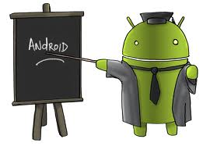

Challenges to the Team:
Learn New Technology
Android
MySQL
PHP
Eclipse
Work with Other Teams
Back Stage Group
Digital Signage Group

Slide 5



Challenges to the Team:
Google Drive
Temporary Documents
Team Sharing
Trac
User Stories
Subversion
Document Control
Released Software
Released Documents

Slide 6
Proposed Solution:
Android
Free
Open Source
Agile
Development Model
Subversion
Document Control
Released Software
Released Documents

Slide 7
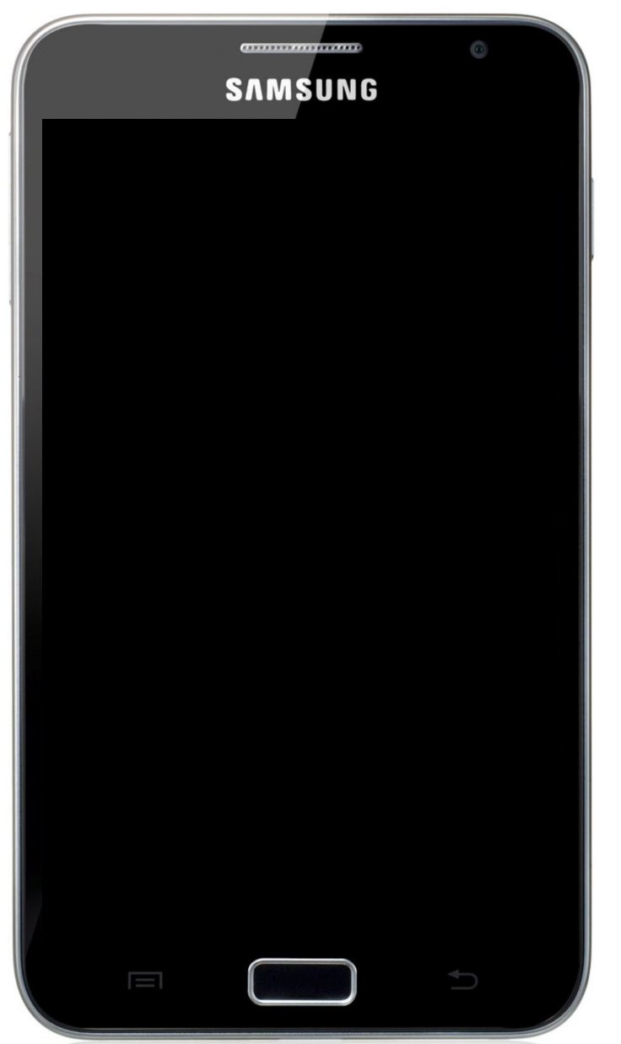
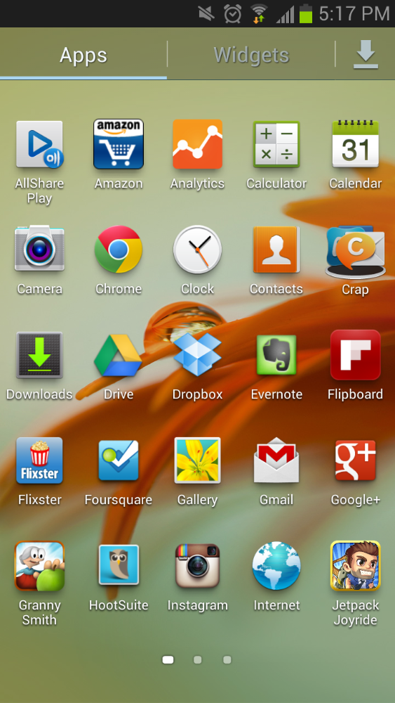

TVOTFC

Slide 8


9:10AM
Family,
Friends,
Fiddlers!
 | YOU'RE INVITED! To the 47th Annual Tennessee Valley Old Time Fiddlers Convention. Bring the family and enjoy a uniquely American experience whose roots are buried deep in the Appalachian mountains and beyond. It's a musical and cultural experience that will thrust you into a simpler time where families were bound by the music they created and the stories they told.

Slide 9
9:10AM
GENERAL INFORMATION
Considerations
Stage is outdoors - Bring lawn chairs
Contests will be held in Gym in event of rain. Limited Capacity - NO REFUNDS
Admission ticket will pay the entry fee for one category of competition.
Free Camping - No Hookups

Slide 10
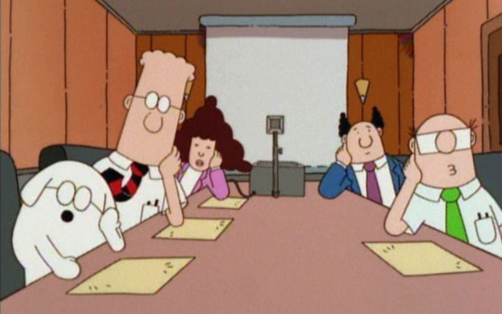
LIVE DEMO TIME!

Slide 11
Conclusions: What We Learned
How To Work As A Team
Have Meetings Often
Assign Task
Don’t Be afraid to ask for help.
Have meetings with Customer early.
Commit as a team to the amount of work.
Communicate between teams.
Commit into SVN Often.

Slide 12


Slide 13
Disclaimer:
Google , Google Logo , Android , and Android Logo are registered trademarks of Google Inc. © 2012 Google Inc. All rights reserved.
PHP Logo , Copyright © 2001-2013 The PHP Group.
Eclipse Logo , Copyright © 2013 The Eclipse Foundation. All Rights Reserved.
Trac Logo, Copyright © 2003-2012 Edgewall Software. All rights reserved.
Subversion Logo , Copyright © 2012 The Apache Software Foundation
MySQL Logo , © 2013, Oracle Corporation
Agile Image , © 2013, VersionOne, Inc. All Rights Reserved
Fiddlers Logo and Images , Copyright © 2013 Tennessee Valley Old Time Fiddlers Convention. All Rights Reserved.
Athens State University Logo , Copyright © 2012 Athens State University

