Slide 1


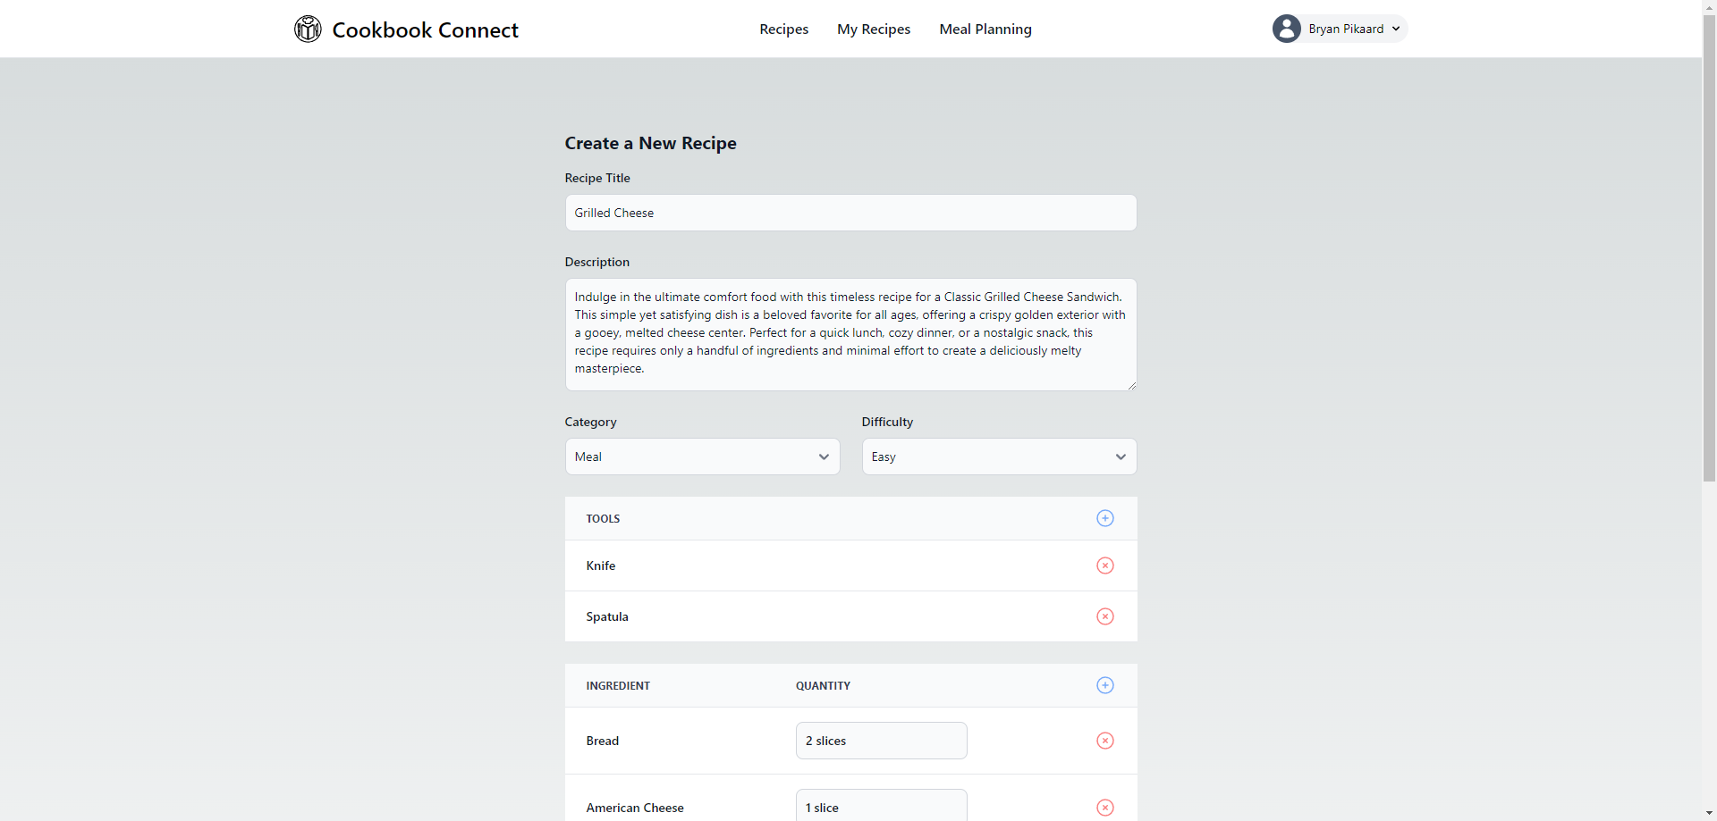
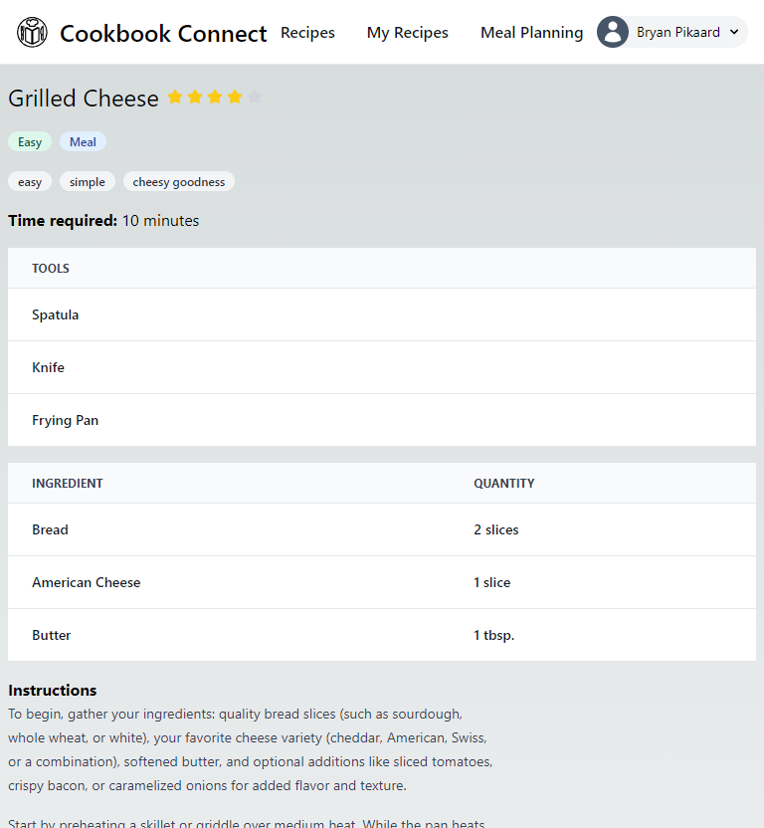
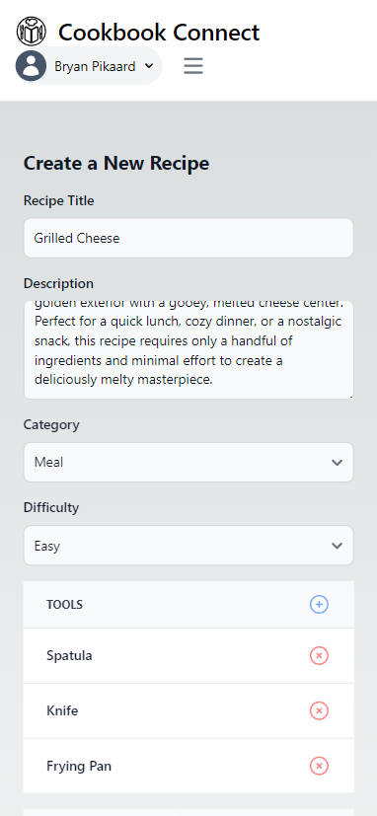
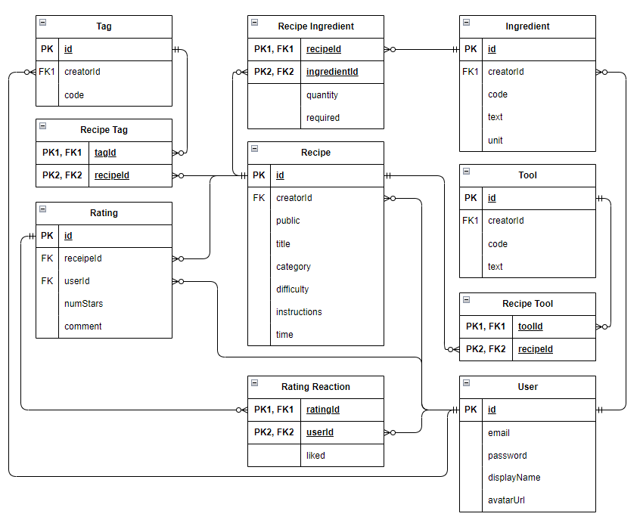

Cookbook Connect
Bryan Pikaard, Tyler Nelson, John Jones
Dept. Of Computer Science and Information Technology
Abstract
Design
Cookbook Connect represents a modern approach to recipe management and culinary exploration. This web-based application offers users a seamless experience for storing, organizing, and discovering handmade recipes. Through a user-friendly account creation and login process, individuals gain access to a robust set of tools to create and explore an unlimited number of recipes.
The platform revolutionizes meal preparation and grocery shopping, offering features for recipe management (Figure 1), personalized meal planning, and shopping list generation through a responsive website (Figure 2 & 3). Documenting the architecture serves to inform stakeholders, facilitate maintenance, and guide future enhancements, ensuring the project's long-term success.
The architecture of this project is closely aligned with its core objectives of scalability, maintainability, and enhancing user experience. It provides a strong and flexible foundation that supports the platform's current needs while allowing for easy adaptation and growth in the future.
Emphasizing modularity, scalability, and maintainability, the architecture supports independent feature development and easy scaling to meet growing user demand.
Future Work
Cookbook Connect is on a path of steady progress, marked by thoughtful refinements, significant achievements, and a clear vision for the future. As we address the remaining challenges and continue to build towards a fully-featured platform.
Despite the progress, challenges remain. The disparity between the completed design elements and their functional implementation presents a hurdle to the platform's overall readiness. This issue, while manageable, requires focused attention to ensure that the user interface's visual promise is matched by performance and reliability.
Figure 1: Desktop version of the create recipe page.
References
Node.js – nodejs.org
TypeScript – typescriptlang.org
Next.js – nextjs.org
Supabase – supabase.com
TypeORM – typeorm.io
React – react.dev
Tailwind – tailwindcss.com
Flowbite – flowbite.com
Vercel – vercel.com
Acknowledgements
We would like to thank Dr. Karen Meisch for her support of students in the College of Science, Technology, Engineering & Mathematics, and Dr. Leong Lee for his support of students in the Department of Computer Science and Information Technology.
Figure 2: iPad version of a public recipe.
Figure 3: Mobile version of the create recipe page.
Technology
The infrastructure of the project is built on a foundation that emphasizes automated deployment, robust data management, and scalability. Vercel plays a crucial role in this architecture by automating the deployment process directly from GitHub repositories. This automation not only streamlines the deployment workflow but also significantly enhances the scalability and maintainability of the platform. By monitoring for changes and automatically deploying updates, Vercel ensures that the application can scale seamlessly and remain up-to-date with minimal manual intervention.
Supabase complements this deployment strategy by offering a managed PostgreSQL database service to store the data required to make the website function (Figure 4). It stands out for its robustness, scalability, and ease of administration, making it an ideal choice for managing the application's data. With features like automated backups, security measures, and scalability options, Supabase takes away much of the complexity associated with database management, allowing the development team to focus on building features rather than worrying about database operations.
Ensuring the maintainability and integrity of database operations, TypeORM acts as the bridge between the NodeJS backend and the PostgreSQL database. By abstracting the complexity of database interactions, TypeORM allows developers to work with database entities using familiar JavaScript or TypeScript, significantly enhancing code readability and maintainability. Its support for active record and data mapper patterns provides the flexibility needed for complex application scenarios.
Scan to open our website!
Figure 4: Entity Relationship Diagram

