Slide 1
Cookbook Connect
Project Design
Bryan Pikaard, Tyler Nelson, John Jones

Slide 2
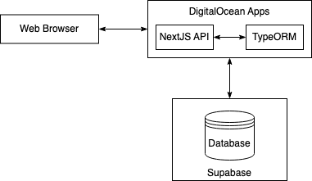
Block Diagram

Slide 3
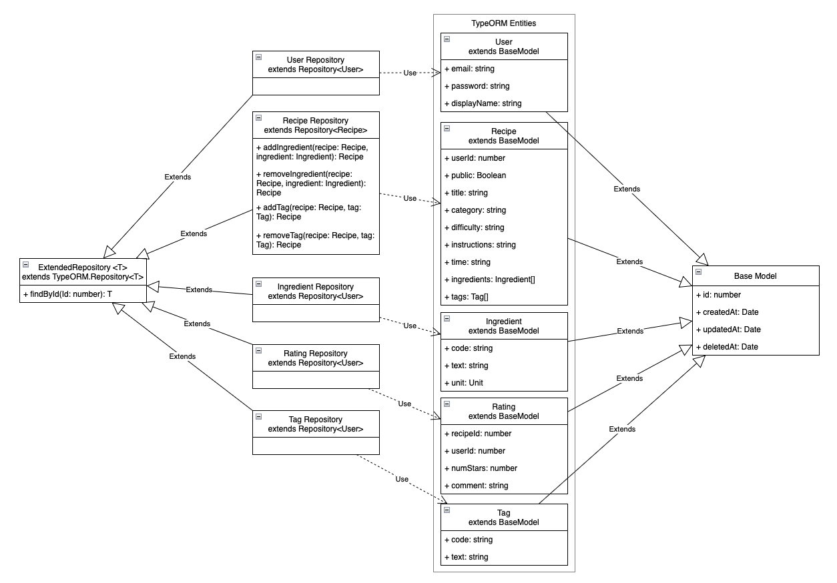
Component Diagram

Slide 4
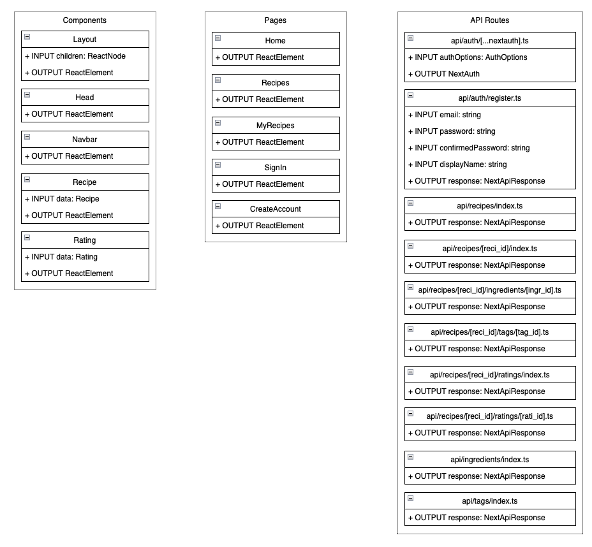
Component Diagram (continued)

Slide 5
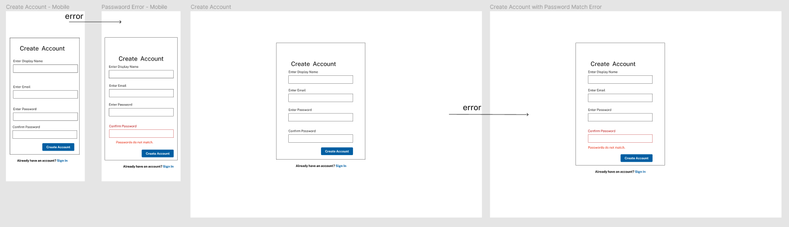
User Interface Storyboard

Slide 6
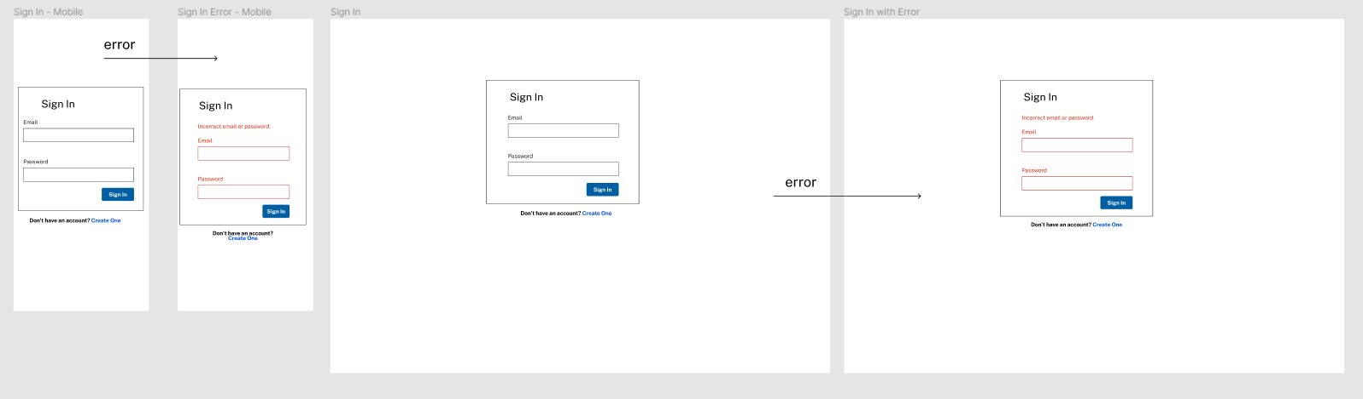
User Interface Storyboard (continued)

Slide 7
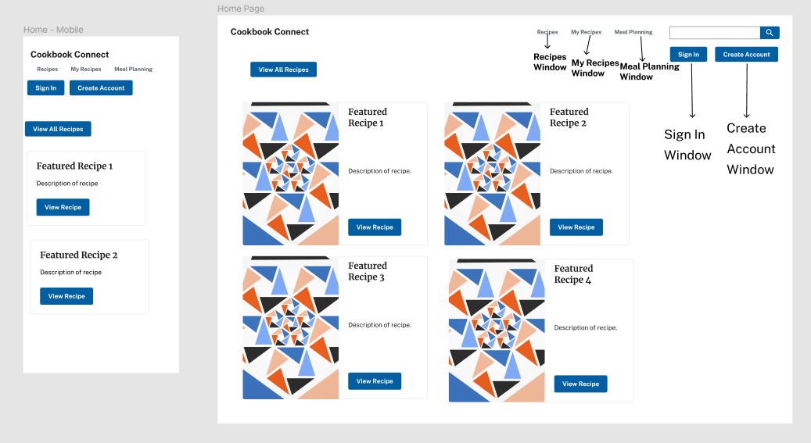
User Interface Storyboard (continued)

Slide 8
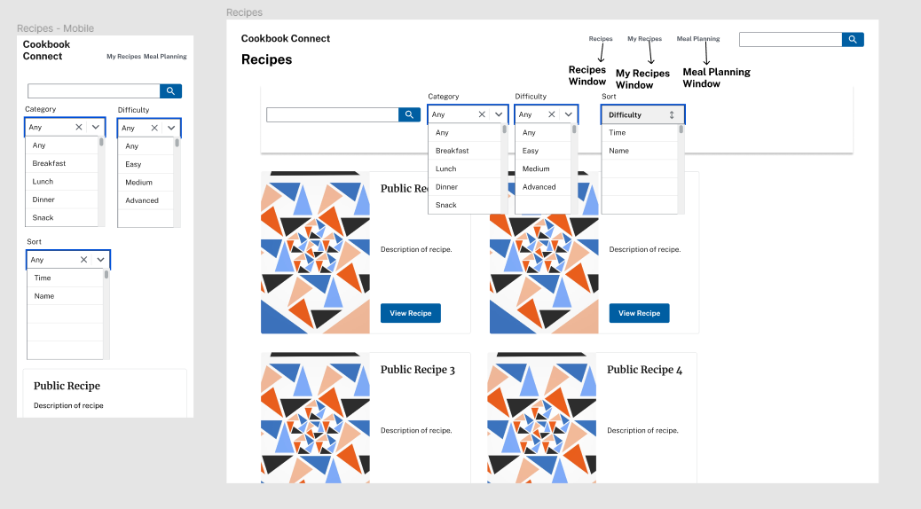
User Interface Storyboard (continued)

Slide 9
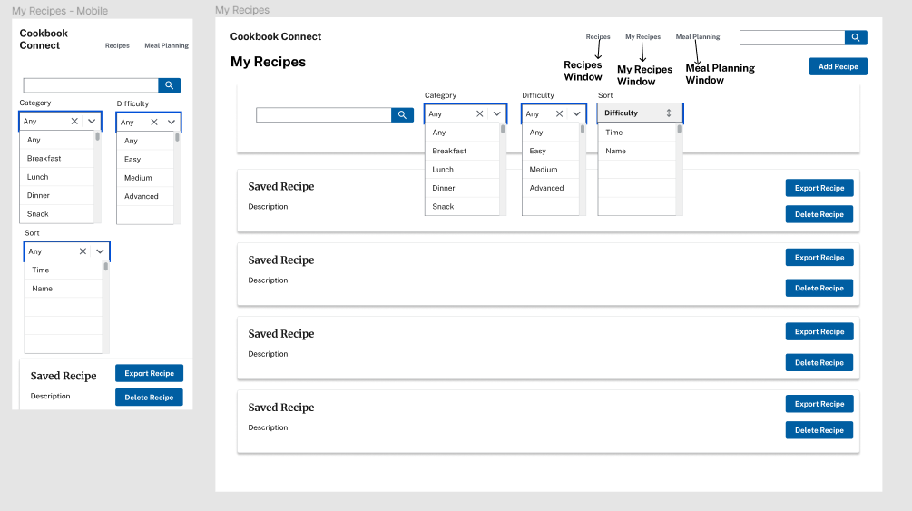
User Interface Storyboard (continued)

Slide 10
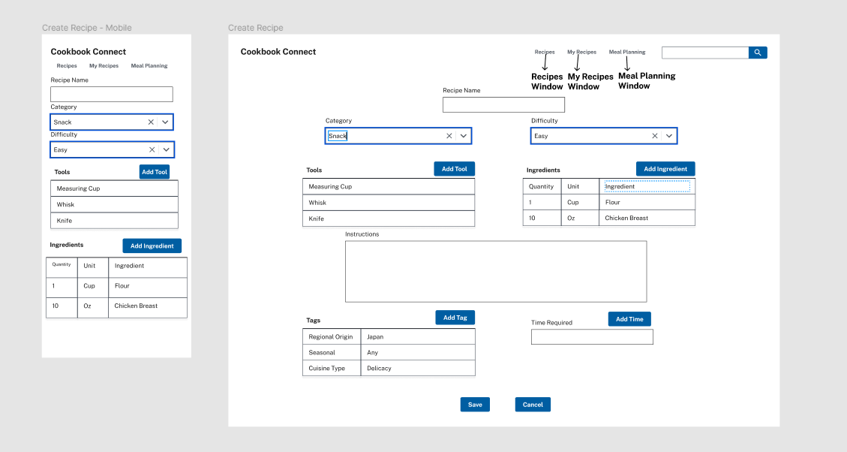
User Interface Storyboard (continued)

Slide 11
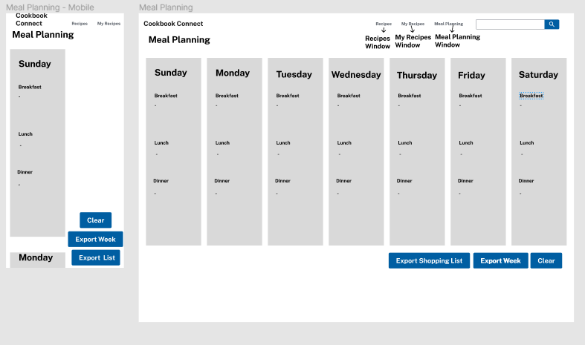
User Interface Storyboard (continued)

Slide 12
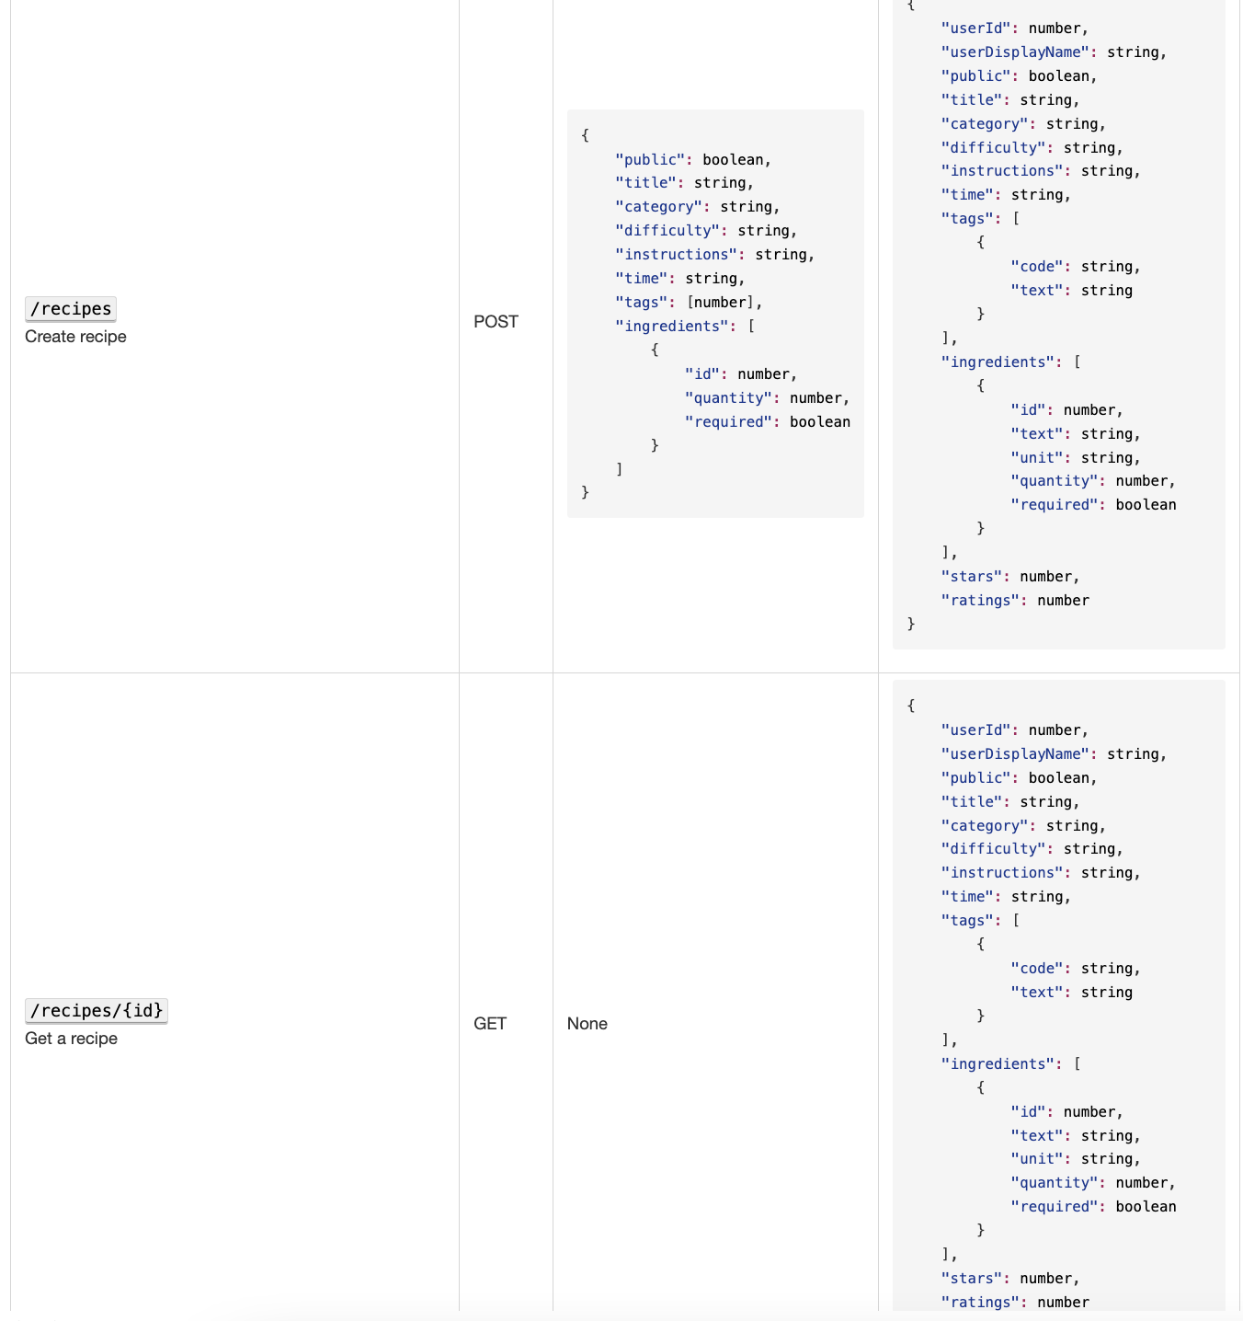
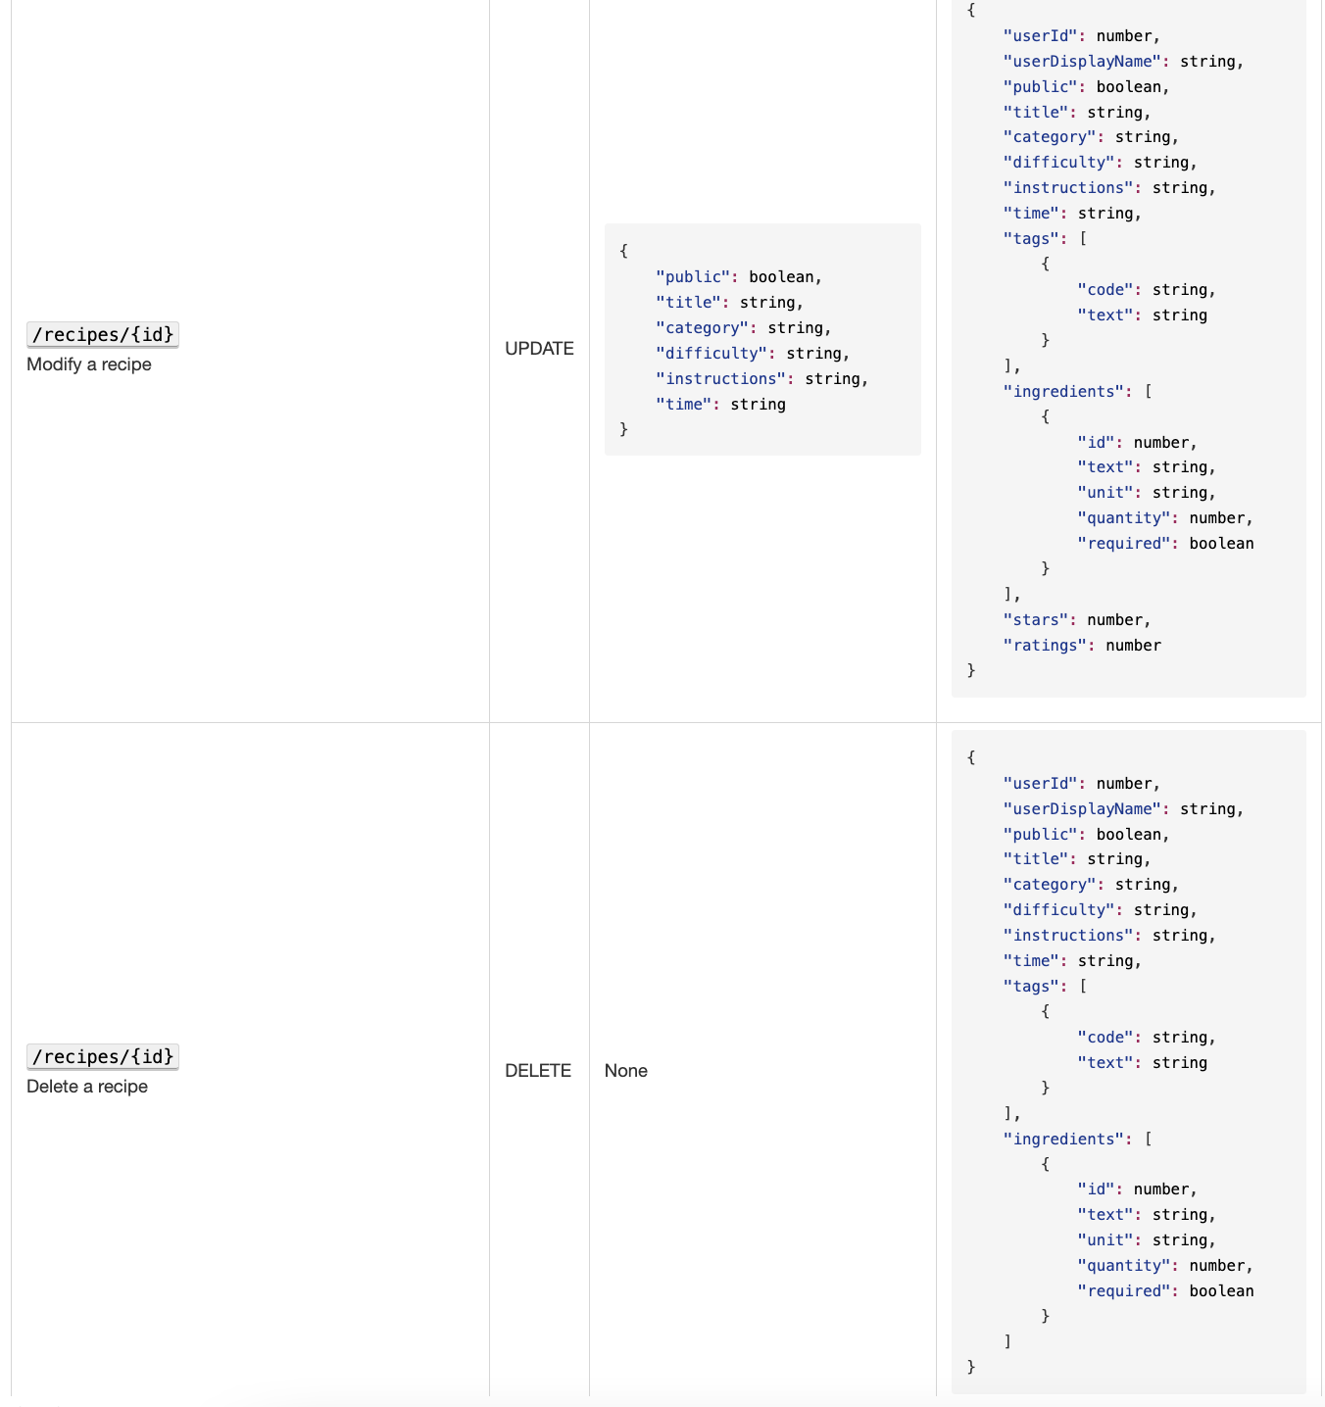
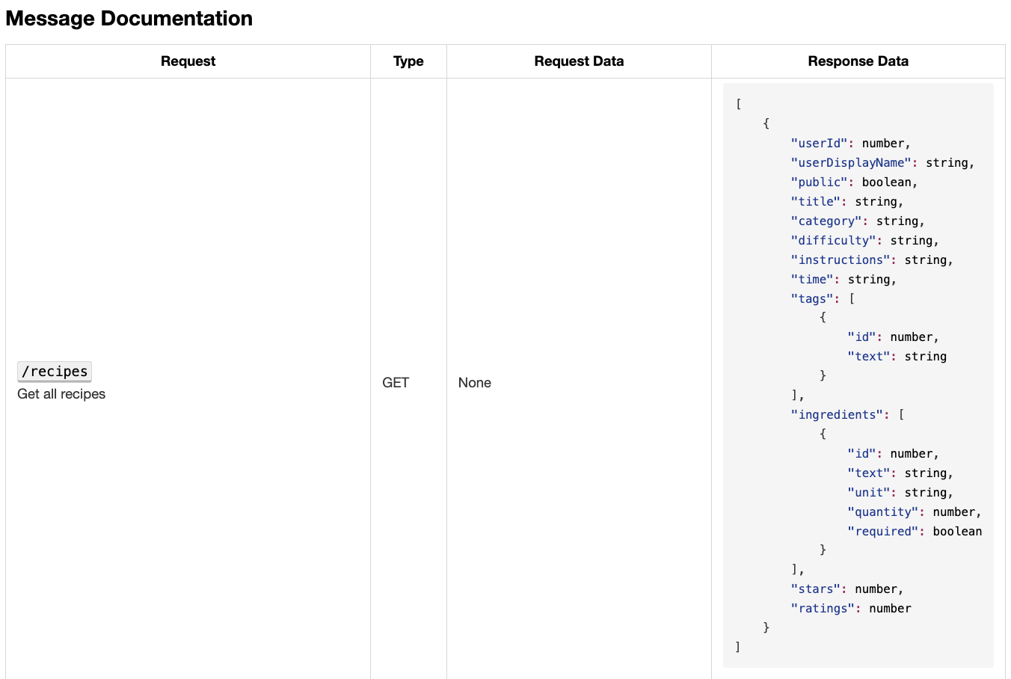
Message Documentation

Slide 13
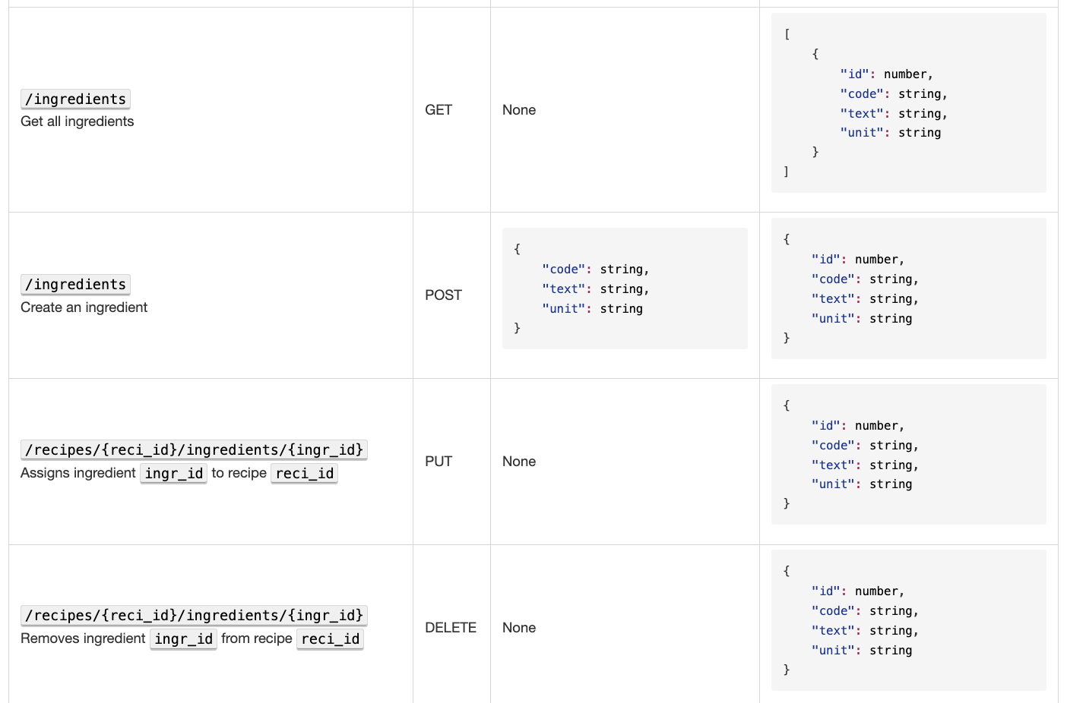
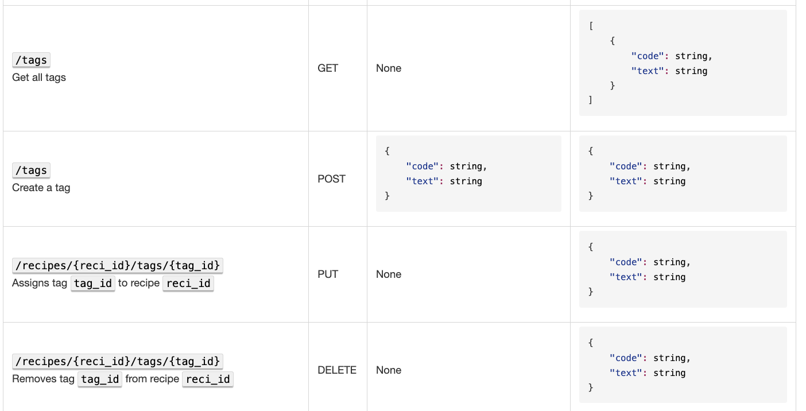
Message Documentation (continued)

Slide 14
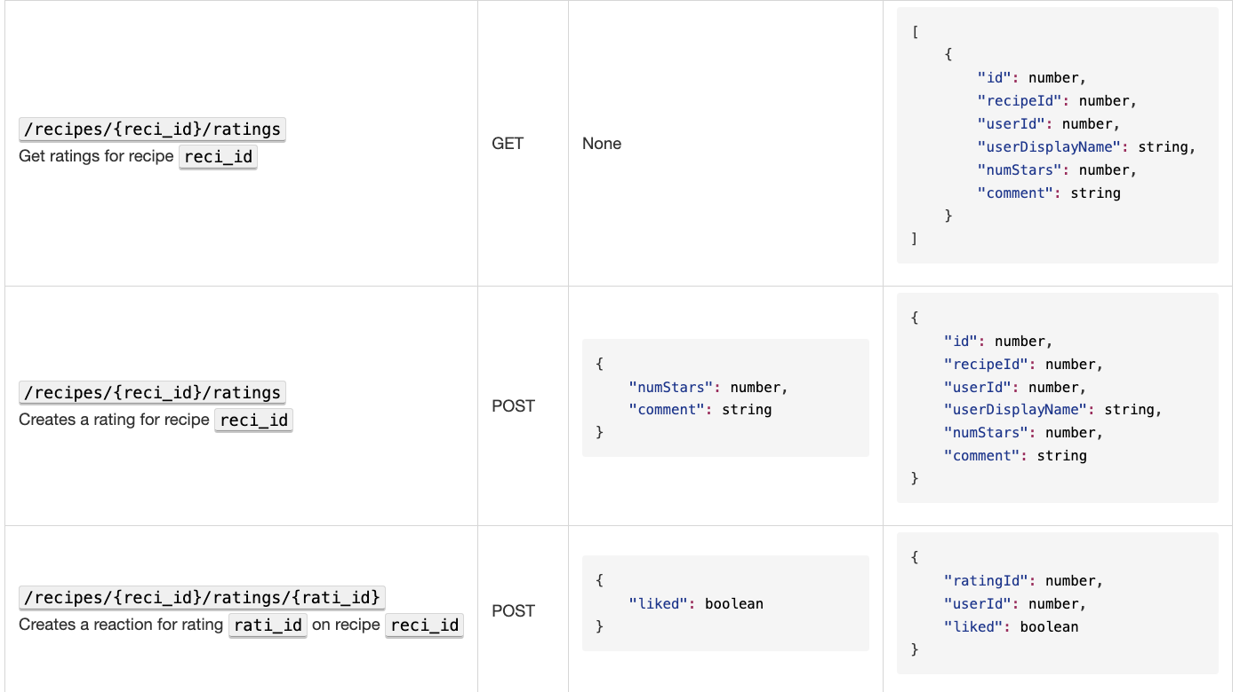
Message Documentation (continued)

Slide 15
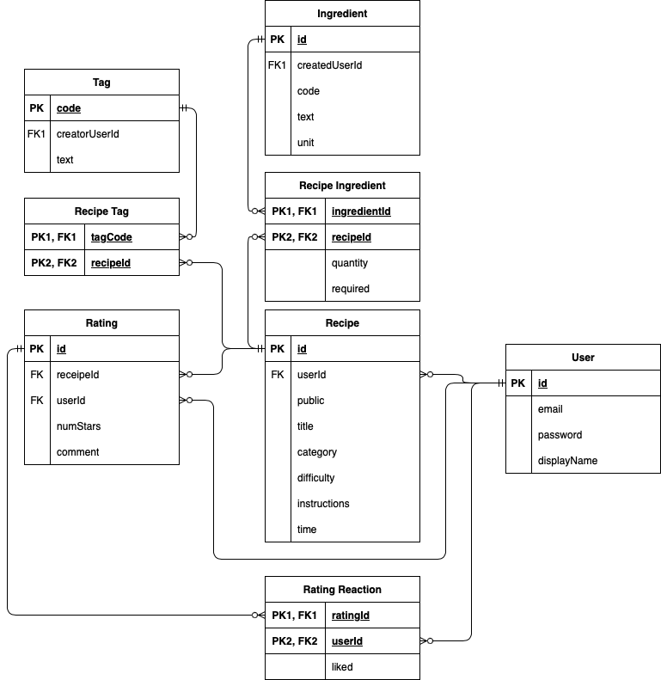
Storage Documentation

