Slide 1
Cookbook Connect Progress Update
Bryan Pikaard, Tyler Nelson, John Jones

Slide 2
Changes and Deviations

Slide 3
Component Diagram
Removal of Extended Repositories
Addition of:
RatingReaction
RecipeIngredient
Tool

Slide 4
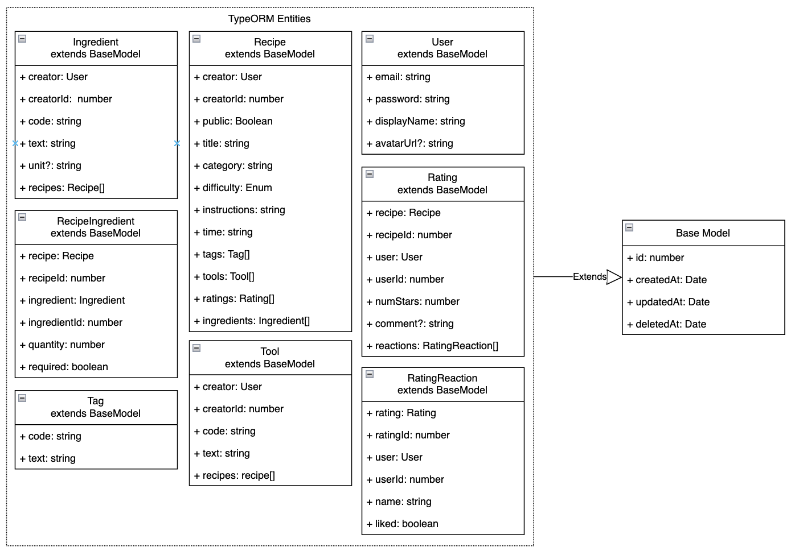

Slide 5
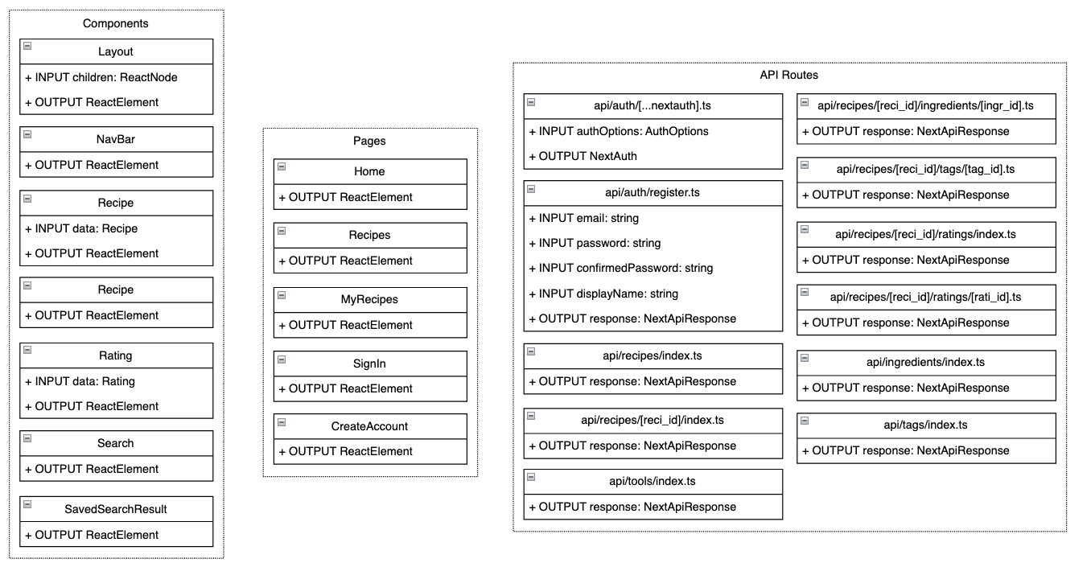

Slide 6
Entity Relationship Diagram
Minor modifications and additional fields
Addition of Tools

Slide 7
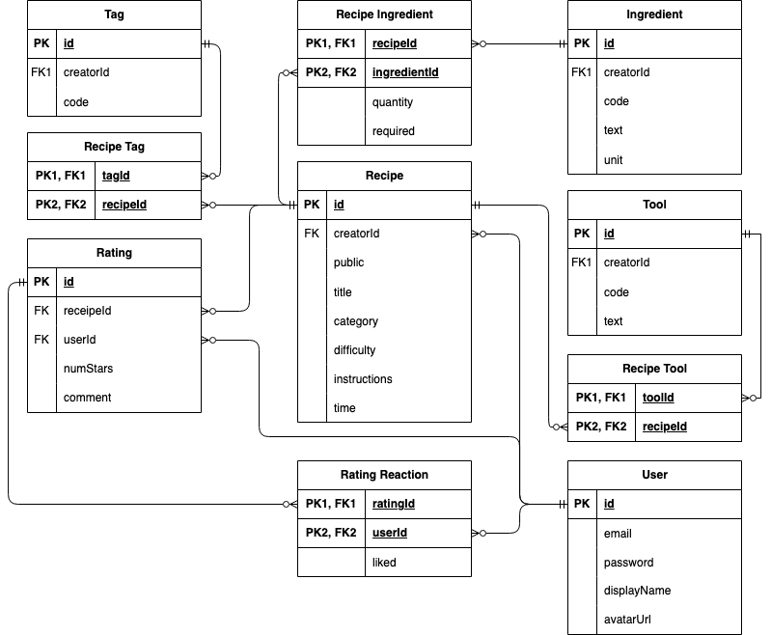

Slide 8
Completed Items

Slide 9
Frontend
Sign In
Create account
Create recipe
Search saved recipes

Slide 10
Backend / API
/api/[...nextauth].ts // Sign-in
GET /recipes
GET /recipes/[id]
PATCH /recipes/[id]
DELETE /recipes/[id]
GET /ingredients

Slide 11
Partially Completed Items

Slide 12
Frontend
Search public recipes

Slide 13
Backend / API
/api/[...nextauth].ts // Sign-up
POST /recipes
POST /ingredients
GET /tools
POST /tools

Slide 14
Items Pending Implementation

Slide 15
What Still Needs to be Implemented?
Meal Planning
Export to PDF

Slide 16
What Still Needs to be Implemented?
Pictures
Comments
Ratings

Slide 17
Backend / API
PUT /recipes/[reci_id]/ingredients/[ingr_id]
DELETE /recipes/[reci_id]/ingredients/[ingr_id]
PUT /recipes/[reci_id]/tools/[tool_id]
DELETE /recipes/[reci_id]/tools/[tool_id]
PUT /recipes/[reci_id]/tags/[tag_id]
DELETE /recipes/[reci_id]/tags/[tag_id]
GET /tags
POST /tags
GET /recipes/[reci_id]/ratings
POST /recipes/[reci_id]/ratings
GET /recipes/[reci_id]/ratings/[rati_id]/reactions
POST /recipes/[reci_id]/ratings/[rati_id]/reactions

Slide 18
Unresolved Issues

Slide 19
Next.js Host
DigitalOcean Apps - Monthly Plan
Vercel - Free

