Slide 1
Cookbook Connect
Report & Demo
Bryan Pikaard, Tyler Nelson, John Jones

Slide 2
Contents
Introduction
Technology
Design
Deploying the Application
Known Bugs

Slide 3
Introduction

Slide 4
Introduction
Users create and share recipes
Detailed recipe creation
Public recipe searching
Recipe ratings
Recipe exporting to PDF
Meal planning

Slide 5
Technology

Slide 6
Technology
Supabase
PostgreSQL
Vercel (Previously DigitalOcean Apps)
Node.js
TypeScript
Next.js
React
Tailwind CSS
Flowbite
Zod
NextAuth
Bcrypt
Axios
SWR
ESLint
date-fns
TipTap
DOMPurify

Slide 7
Design

Slide 8
Classes
Pages
Recipes
Recipe
UpdateRecipe
CreateRecipe
MealPlan
Settings
SignIn
SignUp
Components
Layout
NavBar
Loading
MealPlanColumn
MealPlanSlot
MealSchedulerModal
Rating
Recipe
RecipeSearch
AddIngredientModal
AddTagModal
AddToolModal

Slide 9
API Routes
/auth/[...nextauth].ts -> Sign In / Session Management
/auth/register -> Register
/auth/user -> Update User
/ingredients -> Get / Create Ingredients
/mealplan -> Get / Clear Meal Plan
/mealplan/[recipeId] -> Add Recipe to Meal Plan
/recipes -> Get / Create Recipes
/recipes/[id] -> Get / Update / Delete Recipe
/recipes/[id]/ratings -> Create Rating
/tags -> Get / Create Tags
/tools -> Get / Create Tools

Slide 10
Database Tables
Ingredient
MealPlanDay
RatingReaction
Rating
RecipeIngredient
Recipe
RecipeTool
RecipeTag
Tag
Tool
User

Slide 11
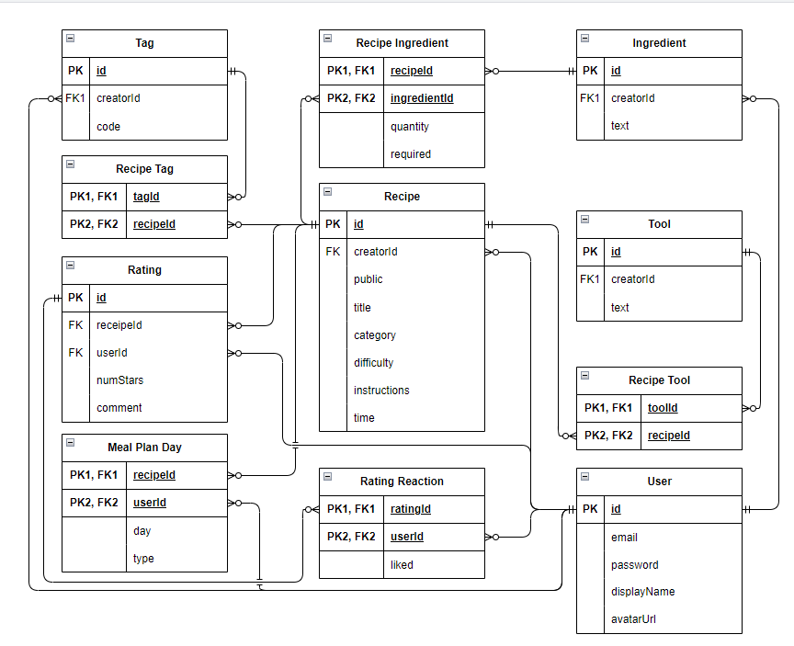
Entity Relationship Diagram

Slide 12
Deploying the Application

Slide 13
Vercel vs DigitalOcean Apps
DO Apps is $5/month
Vercel is free
Vercel is created by the creators of Next.js
Both are easy to use

Slide 14
How to Deploy with Vercel
Go to Vercel’s website (vercel.com)
Create an account or sign in
Sign in with GitHub
Add New -> Project
Import Git Repository
Add Environment Variables
Click Deploy
Profit!

Slide 15
Known Bugs

Slide 16
Known Bugs
Recipes page UI is a little wonky
Display name doesn’t update correctly
Exporting to PDF with dark mode

Slide 17
Demonstration

