Slide 1


How To Use Zeek Intelligence with SecurityOnion2
Taught by Mr. Mitchell Gibson

Slide 2
What is Zeek Intel?
Zeek intelligence is a way to configure alerts based off intelligence (indicators) against live network traffic.
With Zeek intel you can tailor these alerts to look for specific indicators happening on your network such as an md5 hash, known c2 URLs, TOR servers and more.
You can then have analysts monitor the Zeek Intel dashboard for potential alerts in Kibana
https://docs.zeek.org/en/master/frameworks/intel.html

Slide 3
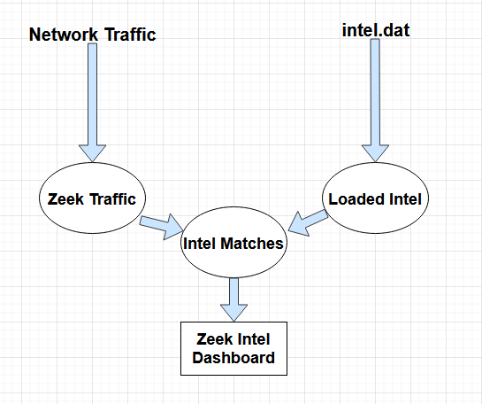
What is Zeek Intel?

Slide 4
Extracting Workable Intel CSV’s
The first step will be to obtain a .csv file of any indicators that you want to import into your SecurityOnion2 deployment
The main pieces of information you will need is the indicator itself, and the type of indicator. Everything else is superfluous
However, in the event that an alert does appear you will want to reference back the main IOC.csv file for any potential metadata when reporting the incident

Slide 5
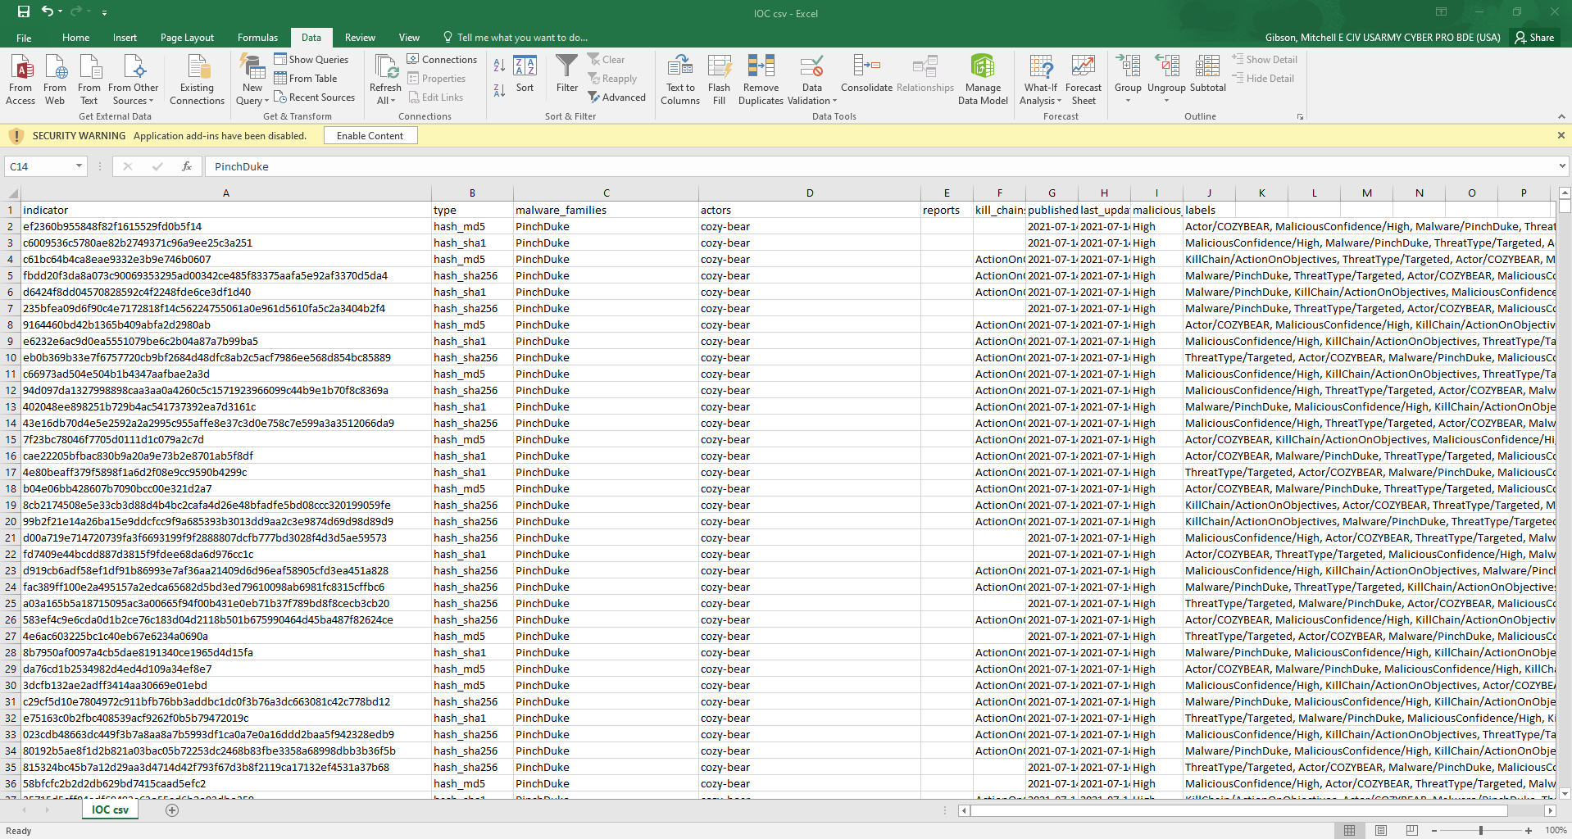

Slide 6
Extracting Workable Intel CSV’s
You will then need to curate the data to only list each indicator by their type
To do this you will first need to highlight column “B”, then navigate to the “Data” ribbon tab and click the filter button
This will allow you to filter for a specific type of indicator

Slide 7
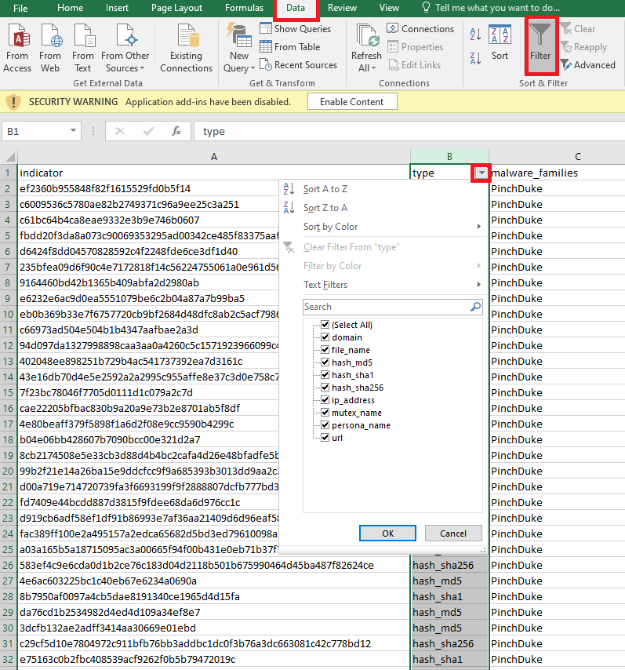

Slide 8
Extracting Workable Intel CSV’s
Next you will filter for each indicator type, copy all of the indicators and paste them into a new .csv and then save/export that as a .csv file comma separated
You will have to repeat these steps for each indicator type as seen on the next slide
You should have a folder on your host machine of all the different types of indicators inside their own .csv file
For URL indicator types, you will need to find and replace all instances of a prefix of “http://”, “https://”, “ftp://”, “file://” with blank spaces as prefixes don’t work with Intel::URL

Slide 9
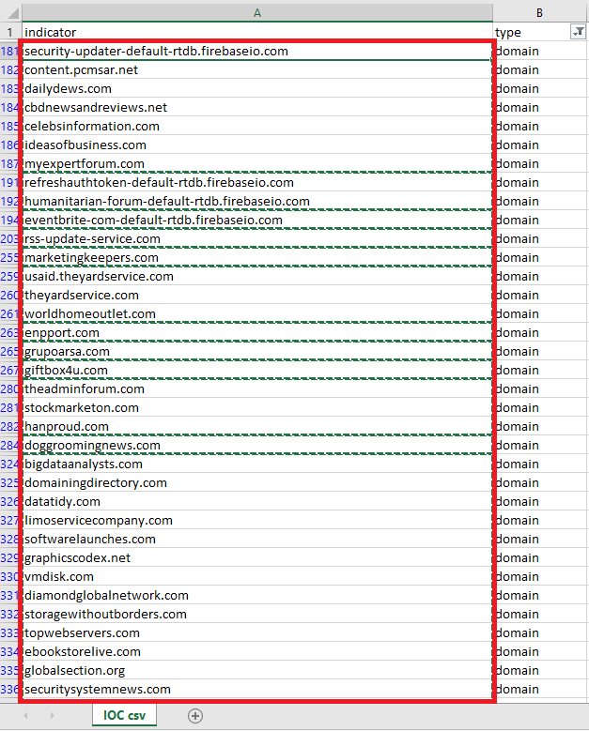
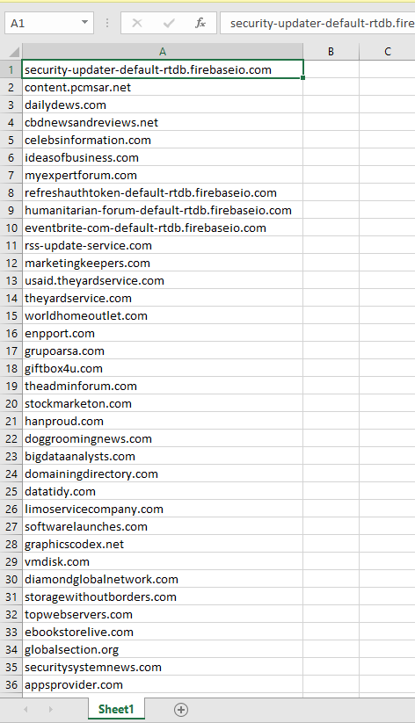

Slide 10
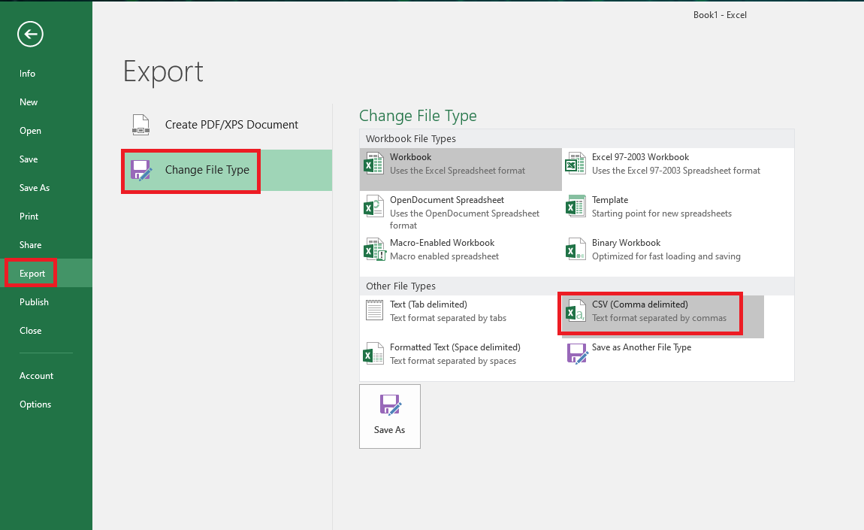

Slide 11
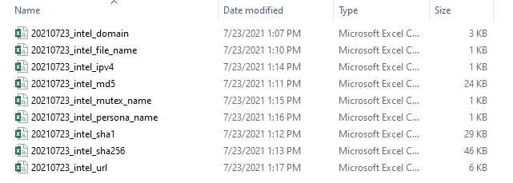

Slide 12
Pushing files to SecurityOnion2
Next you will push those documents as well as the zeek_import script into your SecurityOnion2 Manager
To do this, you will be utilizing SSH, which means that you will need to have console access to your manager.
Once you have console access to your manager, you will also need to have your host machine that you will be pushing the files from be in the same logical network as your manager in order to establish the connection.
Once these conditions have been met, you are ready to push files to your manager.

Slide 13
Pushing files to SecurityOnion2
On your manager type the following command to open up a hole in your SecurityOnion2 host-based firewall to enable the ssh connection.
sudo iptables -A INPUT -p tcp -s x.x.x.x -j ACCEPT
Where x.x.x.x is the IP address of your host machine where you will be pushing the files from.
2. Verify the change on your firewall.
sudo iptables -L | grep x.x.x.x
Where x.x.x.x is the IP address of your host machine where you will be pushing the files from. You’re looking to ensure you see a new created rule

Slide 14
Pushing files to SecurityOnion2

Slide 15
Pushing files to SecurityOnion2
Use a terminal emulator like putty (or command line) to transfer the files to the manager in the /home/xxxx directory. (There are numerous ways to accomplish this, here are just 2 examples)
Using a linux distro
sudo scp -r intel.folder yyyy@x.x.x.x:/home/yyyy
Where yyyy is the username of your SecOnion2 admin and x.x.x.x is the IP address of your SecOnion2 Manager.
Download and use a program like putty or WinSCP to transfer the files using a GUI.

Slide 16
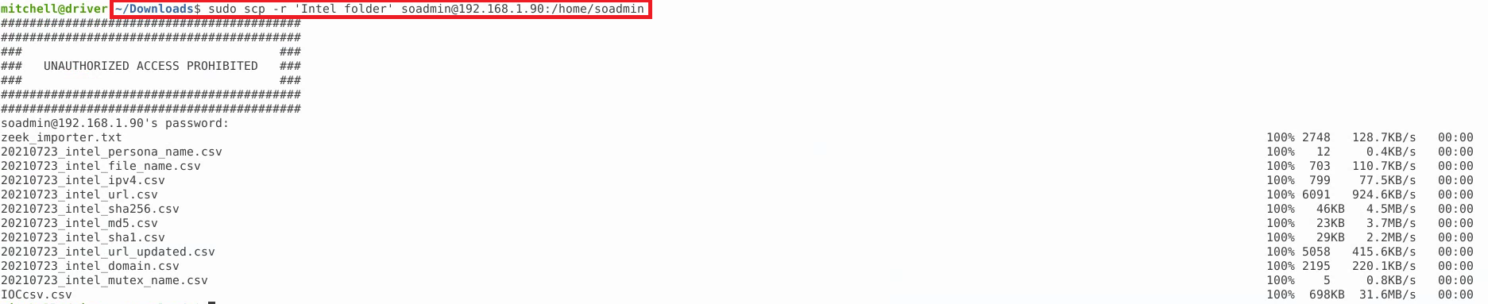
Pushing files to SecurityOnion2

Slide 17
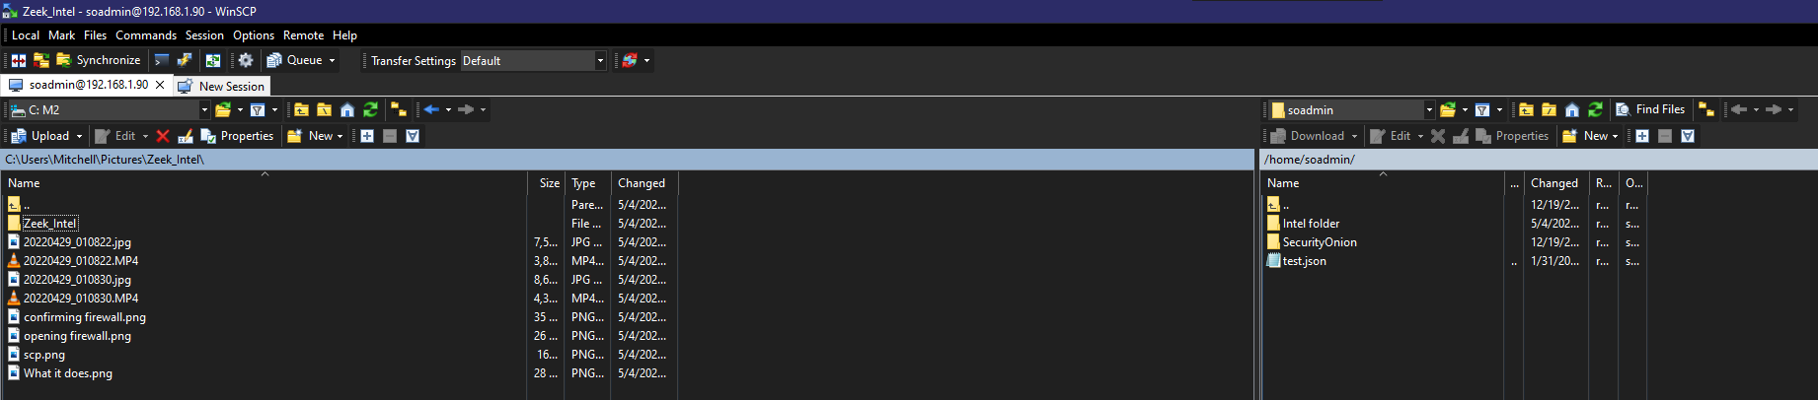
Pushing files to SecurityOnion2

Slide 18
Configuring Zeek Intel for SecurityOnion2
You will then start by renaming the script and giving it full permissions.
sudo mv zeek_importer.txt zeek_importer.py
sudo chmod 777 zeek_import.py
Next, you will be creating a temporary intel.dat file to later append your indicators to. This can be done using this command:
sudo cp /opt/so/saltstack/default/salt/zeek/policy/intel/* /opt/so/saltstack/local/salt/zeek/policy/intel/
**NOTE** Only do this if you haven’t previously configured intel.dat on this system.

Slide 19
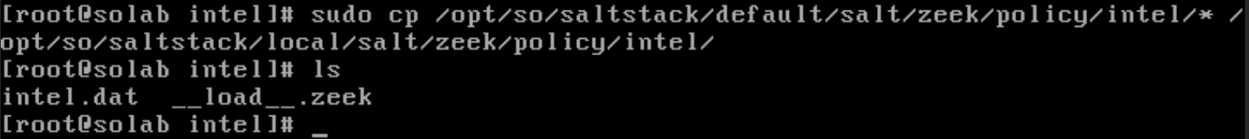
Configuring Zeek Intel for SecurityOnion2

Slide 20
Configuring Zeek Intel for SecurityOnion2
You will then start running the script against the .csv files by typing:
sudo python3 zeek_import.py
You will be prompted to answer the following questions:
indicator_type:
source:
description:
input_file:
output_file:
On the next slide we will go over the different types of inputs you should put for each selection

Slide 21
Configuring Zeek Intel for SecurityOnion2
indicator_type:
There are many different indicator types listed here: https://docs.zeek.org/en/master/scripts/base/frameworks/intel/main.zeek.html#type-Intel::Type
Select the appropriate type per intel file
example: FILE_HASH
source:
You should name this in accordance with the .csv you will be pulling from (ie. 20210723_intel_md5)
description:
You should put the indicator type here (ie. md5_hash, BadURL, BadIP)
input_file:
Where you are pulling the .csv file from (ie. /home/Desktop/20210723_intel_md5.csv)
output_file:
Where you want the .dat created file to be stored (ie. /opt/so/saltstack/local/salt/zeek/policy/intel/{indicator}.dat

Slide 22
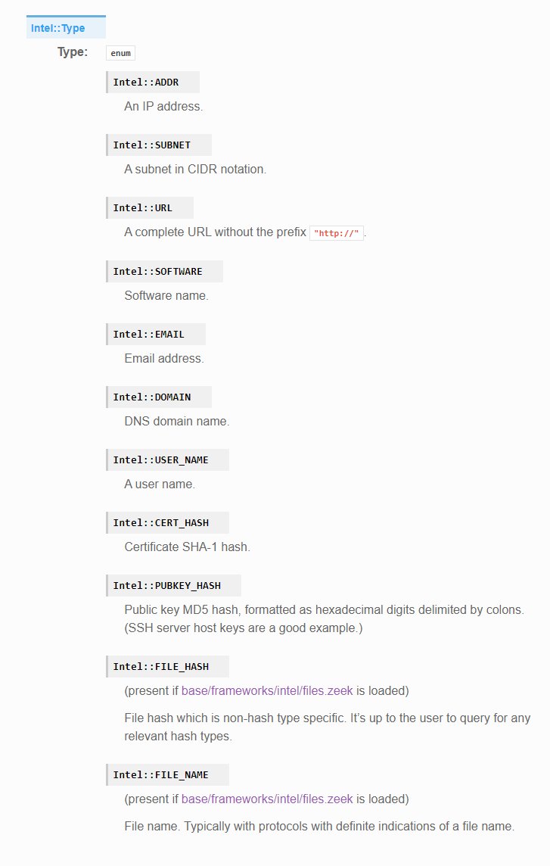

Slide 23
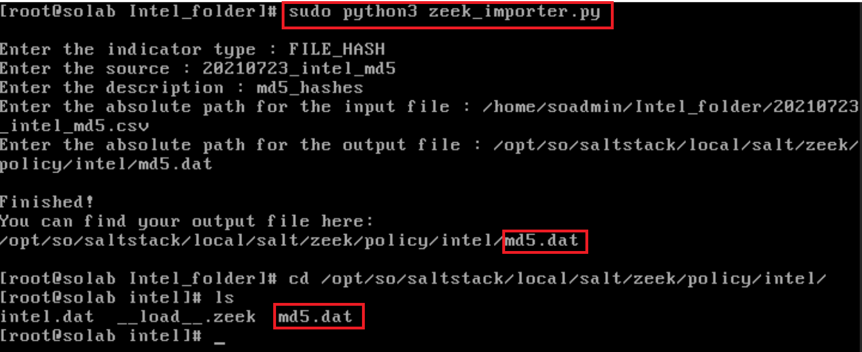

Slide 24
Configuring Zeek Intel for SecurityOnion2
Lastly all you will need to do is append all of your indicator files into the intel.dat file. You can do something like this manually for each indicator type you choose to use.
sudo cat md5.dat >> intel.dat
You will then want to check that your information has successfully been imported using the tail command on the intel.dat file.
sudo tail intel.dat

Slide 25
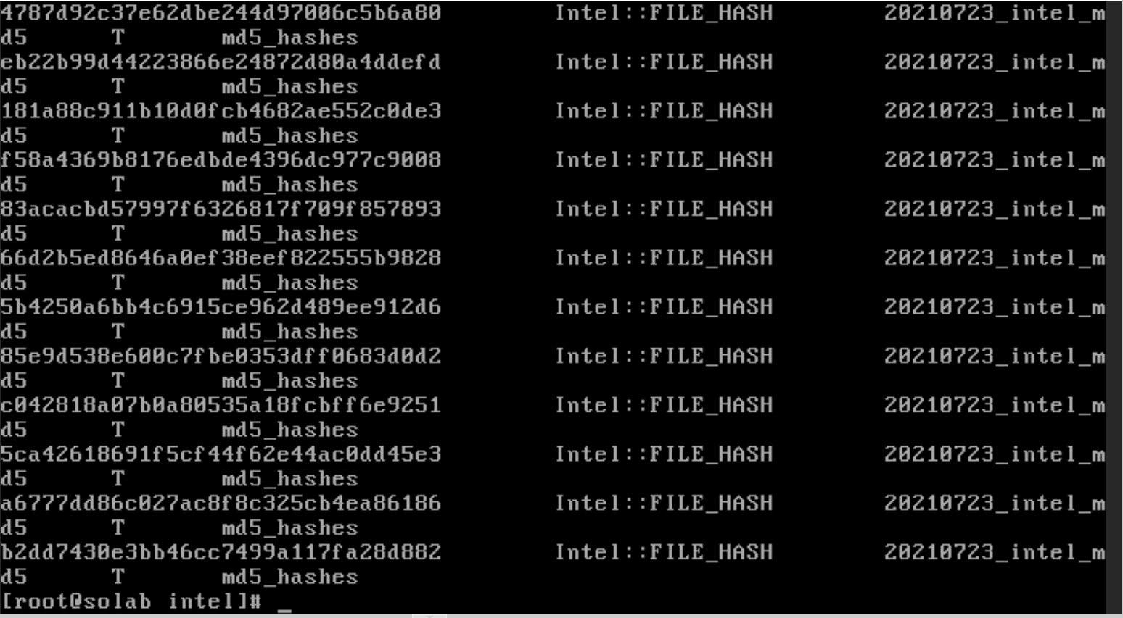

Slide 26
Configuring Zeek Intel for SecurityOnion2
From here all you will need to do is restart Zeek and Kibana using the following commands:
sudo so-zeek-restart
You should see your changes being applied!
sudo so-kibana-restart
To make sure they are working on your sensors you can use salt to apply the changes:
sudo salt “*” state.highstate

Slide 27
Configuring Zeek Intel for SecurityOnion2
To make sure that it’s working, first check to make sure that Zeek restarted successfully
sudo so-status
If you see any errors or don’t think anything is working make sure to check /nsm/zeek/logs/current/reporter.log
You should notice alerts being generated in /nsm/zeek/logs/current/intel.log and in the Intel dashboard in Kibana when intelligence matches are found

Slide 28
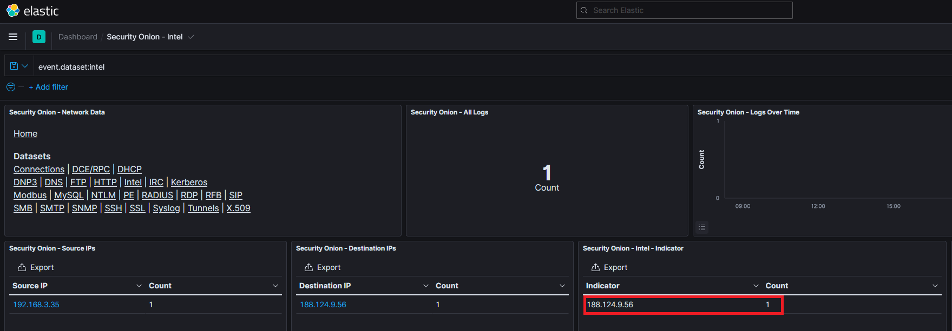

Slide 29
