Slide 1
UAV-Assisted Emergency Communication
(AERPAW Project)
Indoor–Outdoor Localization + Adaptive Relay Optimization
Generated slides with key plots and talking points

Slide 2
Project Overview
Goal: Restore emergency communications using UAV relays guided by indoor/outdoor localization.
• Use AERPAW testbed for UAV + SDR experimentation (SDR/USRP, GNU Radio).
• Localization: Outdoor (GPS), Indoor (RSSI fingerprinting / ToF / AoA).
• Adaptive UAV placement improves coverage, throughput, and reliability.

Slide 3
System Components
Ground users (indoor + outdoor) → Localization module → UAV relay (SDR) → Command center
Key components: USRP on UAV, RSSI collectors indoors, GPS outdoors, NS-3/GNU Radio for experiments.

Slide 4
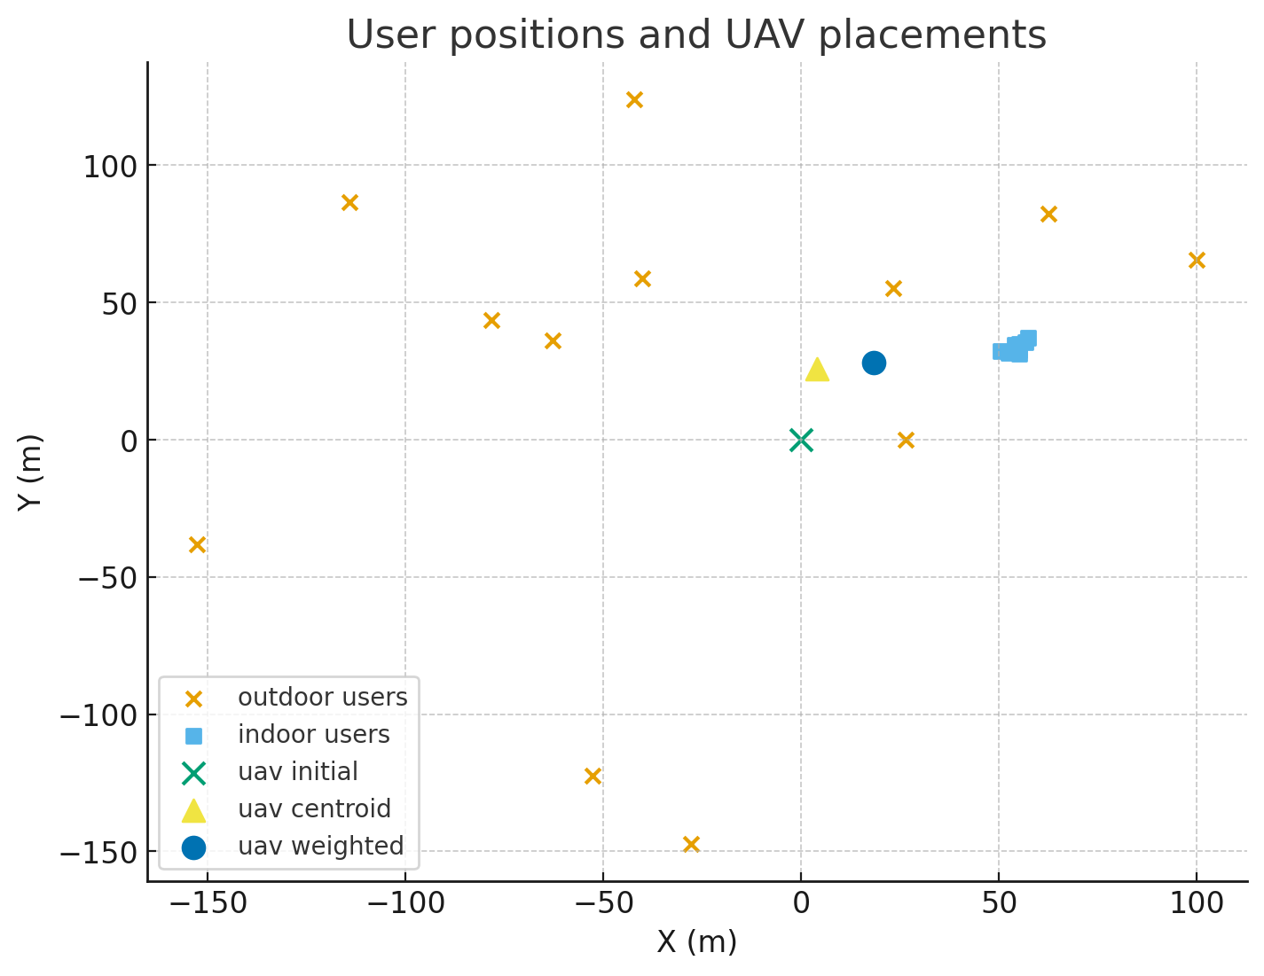
User Positions and UAV Placements
• Blue = outdoor users; square = indoor users (building offset).
• UAV initial at (0,0). Centroid and weighted centroid shown.
• Weighted centroid prioritizes indoor users (higher weight) to improve indoor coverage.

Slide 5
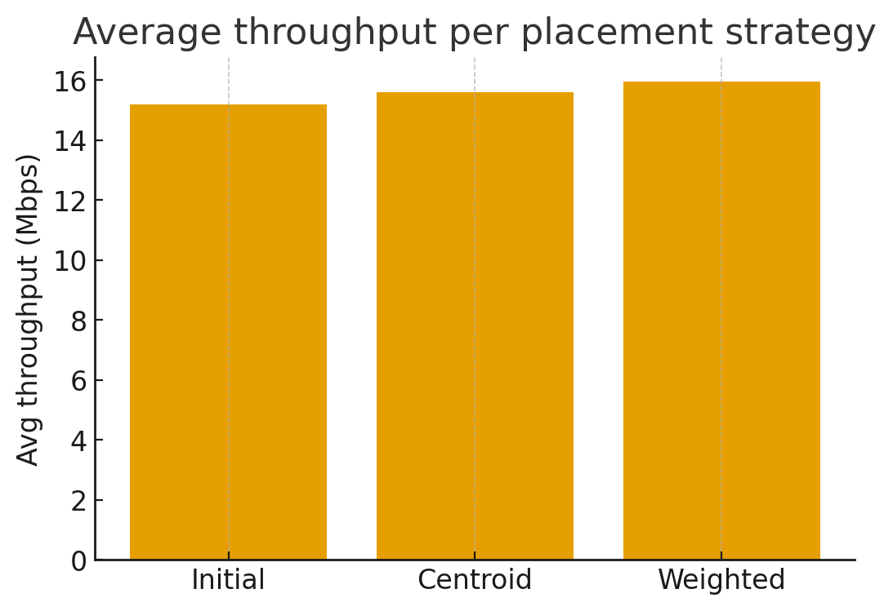
Throughput Comparison (Average)
• Centroid and weighted placements increase average throughput vs initial position.
• Weighted placement may slightly favor indoor users at small cost to some outdoor users.
• Use these results to justify adaptive UAV positioning in field tests.

Slide 6
Communication Experiments & Next Steps
Suggested experiments to run on AERPAW:
• GNU Radio OFDM link (BPSK/QPSK/16-QAM) between ground node ↔ UAV (USRP).
• Spectrum sensing algorithm for dynamic channel selection.
• Measure BER vs SNR and throughput vs UAV altitude/position.

Slide 7
Conclusions
• Localization-aware UAV relays can significantly improve emergency communications.
• Indoor localization is critical — weighted UAV placement helps serve indoor users.
• Next: port communication flowgraphs to USRPs and run on AERPAW; validate with real RSSI/GPS data.

