Slide 1

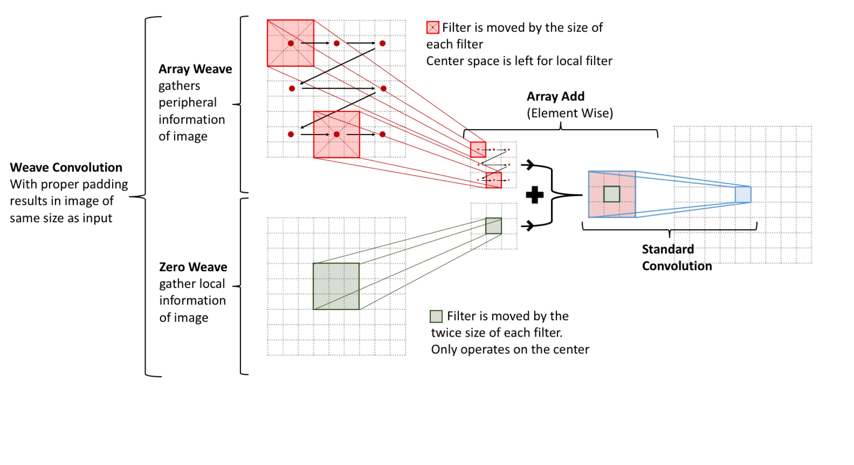
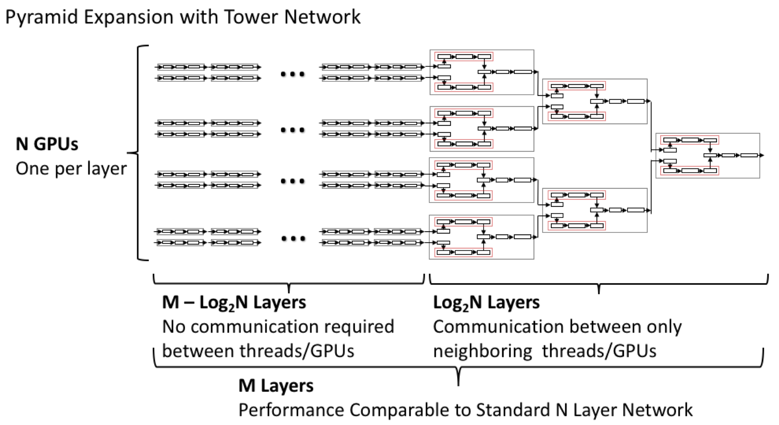
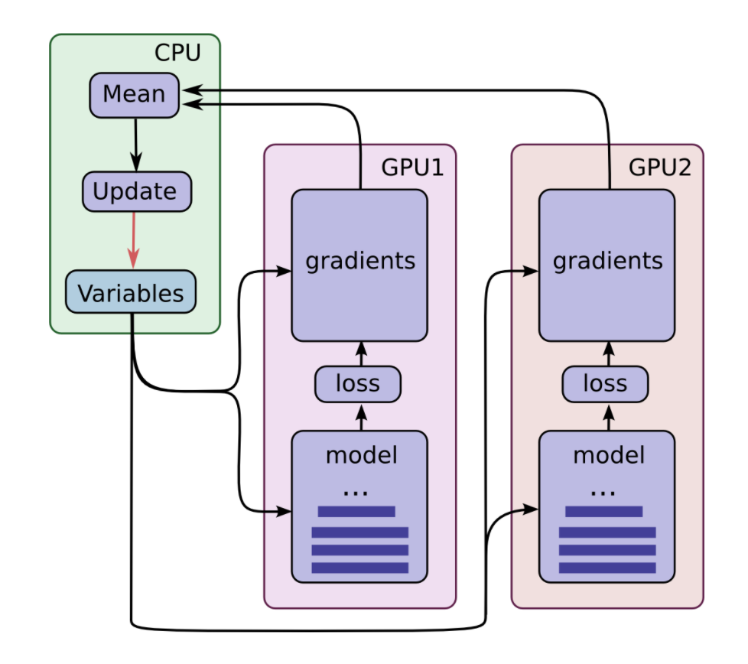
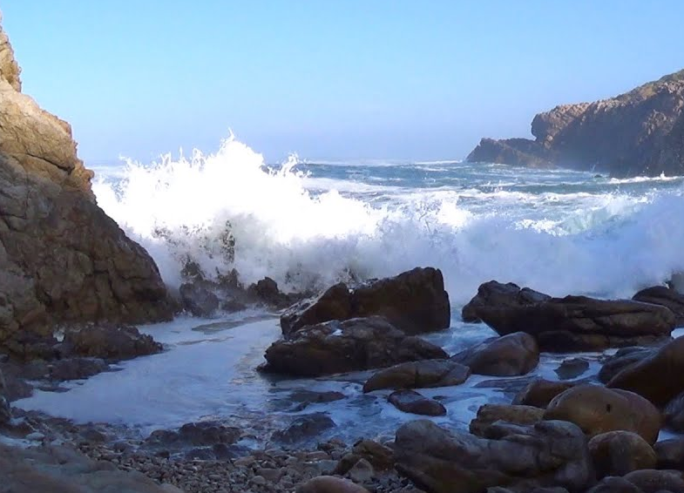

Parallelizing Image Convolution using Human Intuition and Peripheral Vision
Tim Nonet - Department of Computers Science (tan3@rice.edu)
Computer Science
Motivation
Implementation in Google’s TensorFlow
Theoretical Results
Convolution introduced by Kunihiko Fukushima¹ in 1980 revolutionized computer vision and machine learning
Convolution is a costly operation that is hard to parallelize when compared to its predecessor, matrix-vector multiplication
Current approaches to speed up convolution either require significant communication times or are disjointed and relatively inefficient
Unfortunately, due to time and budget constraints benchmark tests on CIFAR-10, CIFAR-100, and Image-Net datasets have not been preformed.
Tests will be completed by Fall 2019.
Theoretical Speed with efficient communication
$$≈\frac{MN}{M+{\left(N−1\right)log}_{2}{N}}, N<\log_{2}{M}$$
Where N is the number of GPUs and M is the number of layers
Promising results are expected because of the distributed communication. Each Array-Weave operator only needs to communicate with the two threads being combined. Conventional Parallel methods require communication overall threads.
Parallel models require communication after every epoch and inefficient due to average of learned parameters
Basic Pyramid Weave Unit (BPWU)
Zero-Padding
Convolution
Array-Weave
BPWU operates parallel convolution layers on the same image, one for peripheral filters and one for local filters.
Combines the results in a logical, continuous, and differentiable way and preforms convolution once again.
How can Humans learn so well?
(And how can we teach computers to be Human?)
Image
Array-Add
Zero-Padding
Convolution
Studies have shown that humans recognize objects by detecting the object’s features²
Human’s use peripheral vision to supply context to features
Convolution is essential feature detection where the features are learned by the computer
By implementing peripheral filters we can improve feature detection;
More context for each filter
Parallelize Convolution Operation
Decrease Parameters
Zero-Padding
Convolution
Zero-Weave
Disjoint Pyramid Weave Unit (DPWU)
Future Work
DPWU takes separate images as input for peripheral filters and local filters.
Can be run completely asynchronously until combination.
Zero-Padding
Convolution
Array-Weave
Image 1
Implementation of variable filters sizes. Struggling to generalize to (N by N filters) due to the nature of the weave convolution operator.
Implementation of variable ratio of number of peripheral filters vs local filters.
Improve support for multi GPU operations in TenserFlow.
Slide cover for peripheral vision
Image 2
Array-Add
Zero-Padding
Convolution
Zero-Padding
Convolution
Zero-Weave
Pyramid Arrangement (4 BPWU + 3 DPWU)
By combing BPWU and DPWU in a larger Pyramid Arrangement we quickly expand the number of convolutional layers being run in parallel.
Successively stacking DPWU results in an exponential growth of convolution operators in linear layers.
Gradient descent methods make sense of Local and Peripheral filters being learned on different images.
Acknowledgement/Sources:
I would like to thank Dr. Subramanian who has helped guide this project.
[1] K. Fukushima. Neocognitron: A self-organizing neural network model for a mechanism of pattern recognition unaffected by shift in position. Biological Cybernetics, 36(4): 93-202, 1980.
[2] DiCarlo JJ, Zoccolan D, Rust NC. How does the brain solve visual object recognition?. Neuron. 2012;73(3):415–434. doi:10.1016/j.neuron.2012.01.010
Sea Image: https://www.youtube.com/watch?v=3vmlIGCUY60
1
2
3
4
5
6
Notes:
Backgrounds on titles
Bold Key Words
Add line to What I did.

Slide 2
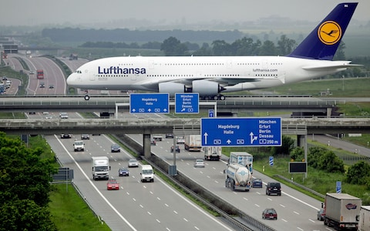

Basic Pyramid Weave Unit (BPWU)
Zero-Padding
Convolution
Array-Weave
Image
Array-Add
Zero-Padding
Convolution
Zero-Padding
Convolution
Array-Weave
Disjoint Pyramid Weave Unit (DPWU)
Zero-Padding
Convolution
Array-Weave
Image 1
Array-Add
Zero-Padding
Convolution
Image 2
Zero-Padding
Convolution
Array-Weave
Computer Science

Slide 3
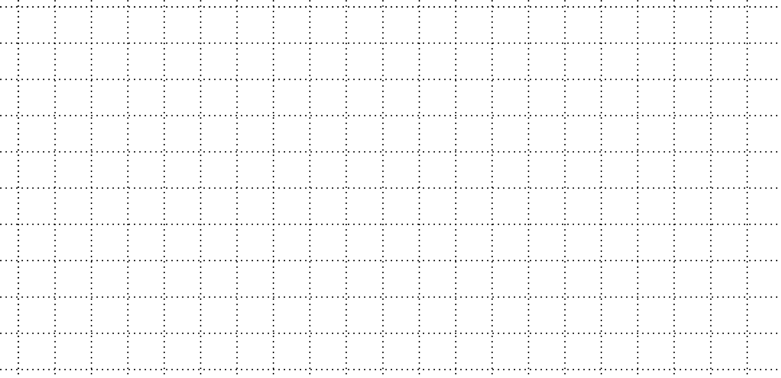
Filter is moved by the size of each filter
Center space is left for local filter
Array Weave
gathers peripheral information of image
Array Add
(Element Wise)
Standard Convolution
Zero Weave
gather local information of image
Filter is moved by the twice size of each filter.
Only operates on the center
Weave Convolution
With proper padding results in image of same size as input

Slide 4
Filter is moved by the size of each filter.
Center space is left for local filter.

