Slide 1
Decreasing Training Time of Deep Networks using N-GPUs
Tim Nonet
10/16/2018

Slide 2
Current Method Multi GPU Method (Tower Networks)
With N GPUS
Create N duplicate models each on one GPU
With batch size of M examples:
Train each model on ~M/N examples (mini batch)
Average gradients from N models
Update all N model variables with average gradients

Slide 3
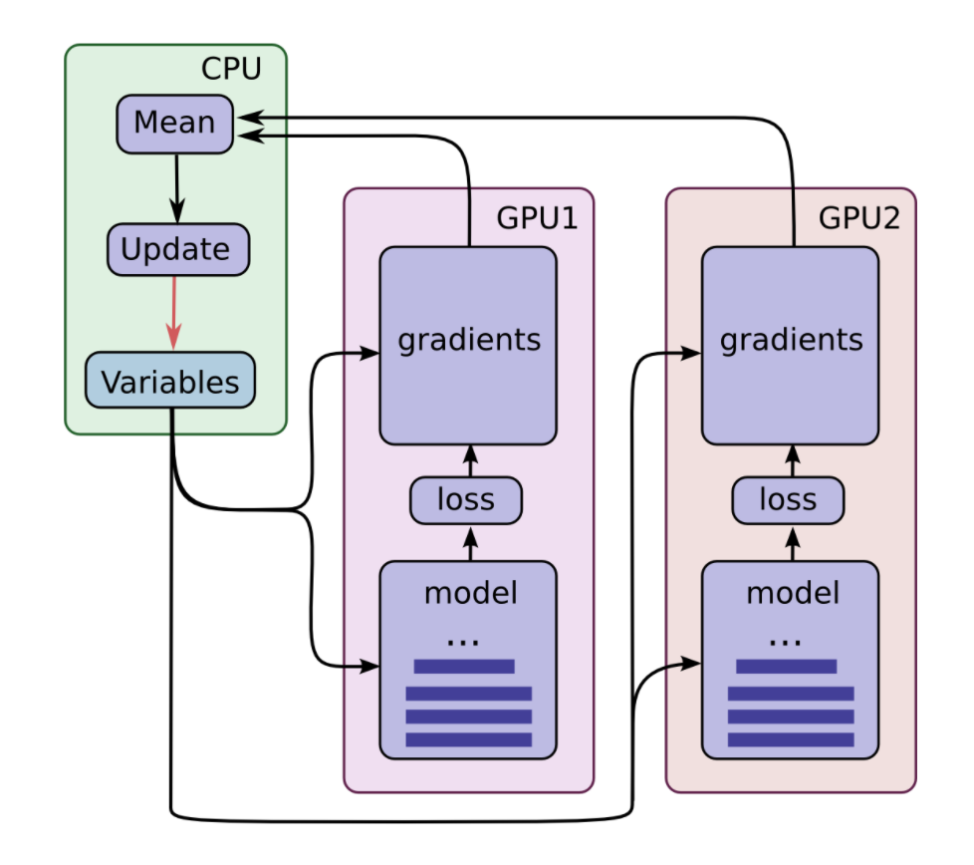
https://jhui.github.io/2017/03/07/TensorFlow-GPU/

Slide 4
Computational Performance (1/2)
With N GPUS can decrease training time by a factor of N.
One GPU – X time per epoch
Two GPUs ~ X/2 time per epoch
N GPUs ~ X/N time per epoch
In theory, regardless of number of GPUs used to train would result in the same gradients and parameters.

Slide 5
Computational Performance (2/2)
However, training time will approach the time one GPU takes to take the gradient of 1 example.
With deep networks this can still be significant.
Split batches over multi GPUs decreases total epoch training time by distributing tasks.
Does not change model computation time for single example

Slide 6
Weave Convolution
Decreasing model computation time by increasing number of GPUs used over a single model.
Model trained with N GPUs still computes in similar time as “normal” model if only 1 GPU is used.
Can be used at the same time as Tower Networks to decrease batch size.
Model Performance is similar to “normal” model

Slide 7
Weave Convolution Pyramid Networks
With N GPUs:
Split up convolution layers over N GPUs
Layer with F filters:
Create N parallel convolution layers with F/N filters
Combine N parallel convolution layers using Array Weave and Zero Weave (custom combining functions)

Slide 8
Basic Pyramid Weave Unit (BPWU)
Zero-Padding
2D-Convolution
Array-Weave
Image
Array-Add
Zero-Padding
2D-Convolution
Zero-Padding
2D-Convolution
Zero-Weave

Slide 9
Basic Pyramid Weave Unit (BPWU) Computational Sections
Zero-Padding
2D-Convolution
Array-Weave
Image
Array-Add
Zero-Padding
2D-Convolution
Zero-Padding
2D-Convolution
Zero-Weave
Red Sections can run in parallel (on separate GPUs)

Slide 10
Basic Pyramid Weave Unit (BPWU) In – Line Tasks
Zero-Padding
2D-Convolution
Array-Weave
Image
Array-Add
Zero-Padding
2D-Convolution
Zero-Padding
2D-Convolution
Zero-Weave
Can be run in parallel on separate GPUs
and then combined once finished

Slide 11
Stacked BPWU Model (9 Convolution Layers)
In-Line Tasks
1
2
3
4
5
6
Standard Convolution Unit Model (9 Convolution Layers)
Image
Zero-Padding
2D-Convolution
1
2
3
4
5
6
7
8
9

Slide 12
Run – Time Analysis
Stacked BPWU
Stacked Standard Convolution Layers
9 Convolution Layers in 6 in-line tasks
Requires two GPUS
33% speed up
9 Convolution Layers in 9 in-line tasks
Requires one GPU

Slide 13
But, we can do better...
Much better!

Slide 14
Disjoint Pyramid Weave Unit (DPWU)
Zero-Padding
2D-Convolution
Array-Weave
Image
Array-Add
Zero-Padding
2D-Convolution
Image
Zero-Padding
2D-Convolution
Zero-Weave

Slide 15
DPWU Computation Sections
Zero-Padding
2D-Convolution
Array-Weave
Image
Array-Add
Zero-Padding
2D-Convolution
Image
Zero-Padding
2D-Convolution
Zero-Weave
Red Sections can run in parallel (On separate GPUs)

Slide 16
Interpretation of Disjoint Nature of Input
If we interpret each input to the DPWU as the local and the peripheral features respectively we can rationalize the strange nature of performing different operations on different images.
Model can learn relationship, no need for human understanding of what a stacked net means

Slide 17
Pyramid Arrangement (2 BPWU + 1 DPWU) (9 Convolution Layers)
In-Line Tasks
1
2
3
4

Slide 18
Pyramid Arrangement (4 BPWU + 3 DPWU) (21 Convolution Layers)
In-Line Tasks
1
2
3
4
5
6

Slide 19
Run – Time Analysis
Pyramid Arrangement (BWPU + DWPU)
Stacked Standard Convolution Layers
X Convolution Layers in ~log(X) in-line tasks
Requires ~ log(X) GPUS
Possible X/log(X) % speed up
X Convolution Layers in X in-line tasks
Requires one GPU

Slide 20
Performance Analysis (Still working on this)
Preforms comparable to iso-parametric models that are stacked.
Limited in testing capability due only having 1 GPU.
Vastly outperforms iso-layer and iso-train_time models.
Certainly preforms better than ~log(.)/(.) that is required to make the stacked method computationally worth it.
Lacks vanishing gradients that deep networks often encounter.

Slide 21
Array Weave/Zero Weave Analysis
Array Weave and Zero Weave layers were built with intuition in mind, supplying more context without requiring (too many) more parameters.
However, the idea of combing multiple arrays into one can open a much more efficient network design.
More efficient combination methods most likely exist.

Slide 22
Pyramid Arrangement (7 DPWU) (For combing models)
…
N-1
N
N+1
N+2
N+3
N+4
N+5
N+6
In-Line Tasks

Slide 23
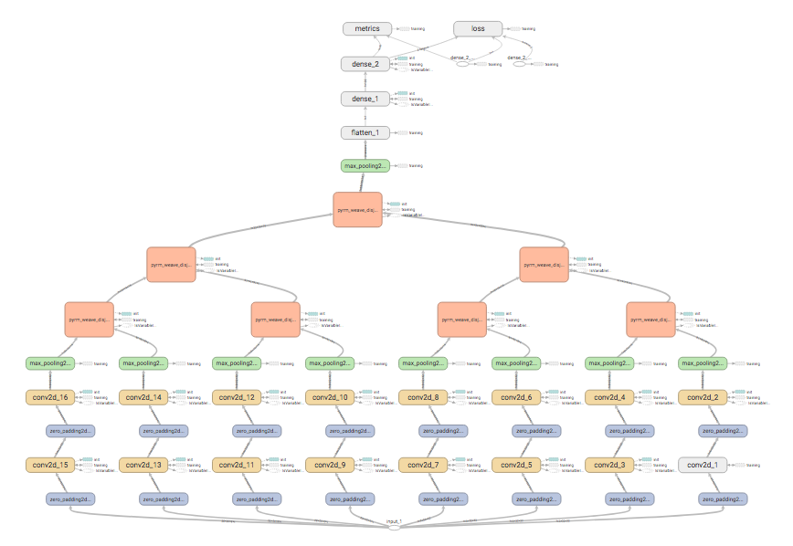

Slide 24
Test of Performance
Used AWS CPU clusters to train 12 different networks
60 Epoch Run
30 Epoch Run
Still Determining Proper Parameters on Array Weave

Slide 25
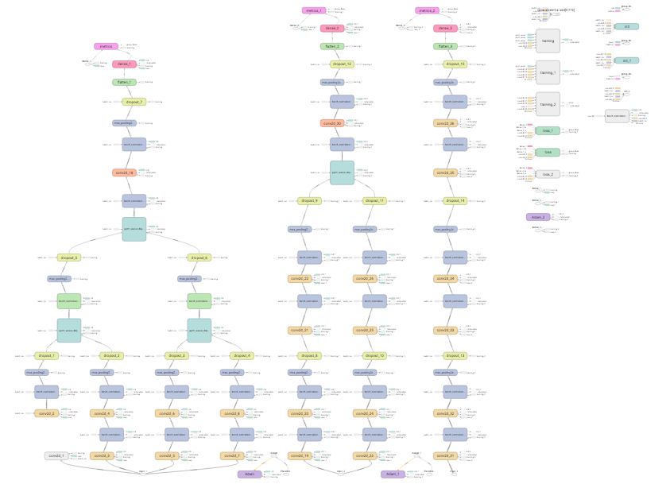

Slide 26
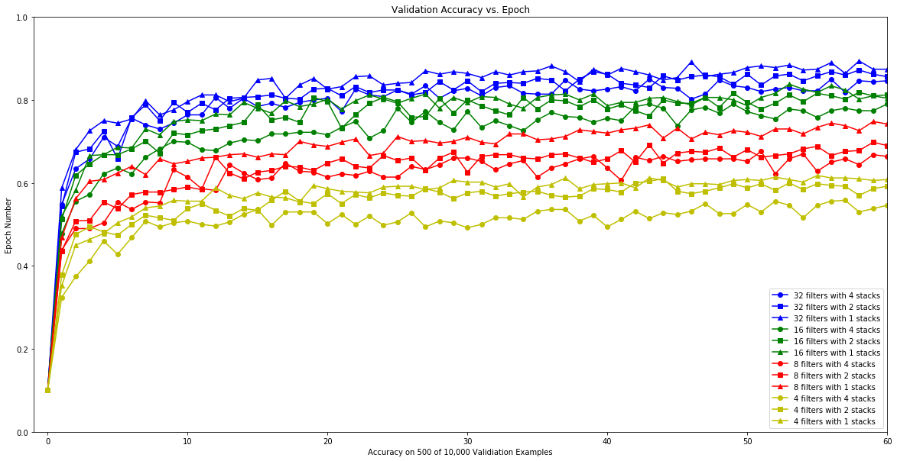

Slide 27
