Slide 1
Decreasing Training Time of Deep Networks using N-GPUs
Tim Nonet
10/16/2018

Slide 2
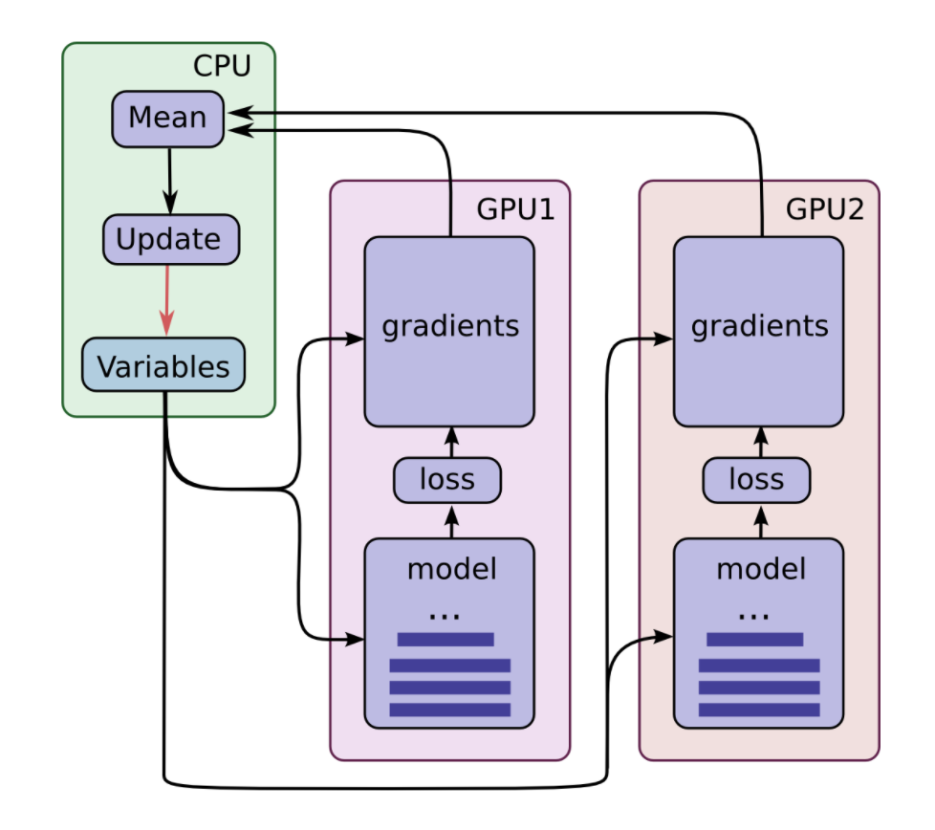
Current Method Multi GPU Method (Tower Networks)
With N GPUS
Create N duplicate models each on one GPU
With batch size of M examples:
Train each model on ~M/N examples (mini batch)
Average gradients from N models
Update all N model variables with average gradients
https://jhui.github.io/2017/03/07/TensorFlow-GPU/

Slide 3
Computational Performance (1/2)
With N GPUS can decrease training time by a factor of N.
One GPU – X time per epoch
Two GPUs – X/2 time per epoch
N GPUs – X/N time per epoch
In theory, regardless of number of GPUs used to train would result in the same gradients and parameters.

Slide 4
Computational Performance (2/2)
However, training time will approach the time one GPU takes to take the gradient of 1 example.
With deep networks this can still be significant.
Split batches over multi GPUs decreases total epoch training time by distributing tasks.
Does not change model computation time for single example.

Slide 5
Weave Convolution
Decreasing model computation time by increasing number of GPUs used over a single model.
Model trained with N GPUs still computes in similar time as “normal” model if only 1 GPU is used.
Can be used at the same time as Tower Networks to decrease batch size.
Model Performance is similar to “normal” model.

Slide 6
Weave Convolution Pyramid Networks
With N GPUs:
Split up convolution layers over N GPUs.
Layer with F filters:
Create N parallel convolution layers with F/N filters.
Combine N parallel convolution layers using Array Weave and Zero Weave (custom combining functions).
Simple element wise addition does not combine convolution filters well.

Slide 7
Basic Pyramid Weave Unit (BPWU)
Zero-Padding
2D-Convolution
Array-Weave
Image
Array-Add
Zero-Padding
2D-Convolution
Zero-Padding
2D-Convolution
Zero-Weave

Slide 8
Black Box Analysis of ArrayWeave and ZeroWeave
For efficient combination of two convolution Layers:
The processes must be an injective function (possibly bijective).
Otherwise there is wasted expressive range of the layers that will be combined.
Move relevant information of both filters close to each other
Can’t scatter information.
Computationally Efficient
ArrayWeave and ZeroWeave takes an image of size (Channels, Height, Width) and returns an array of (Channels, ~3*Height, ~3*Witdth)
Any non-zero element from ArrayWeave is zero in ZeroWeave and vise-versa. Injective!

Slide 9
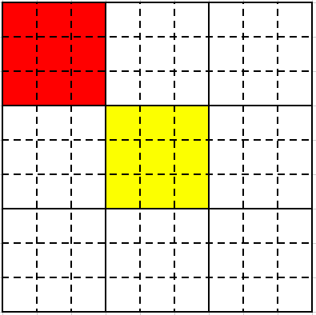
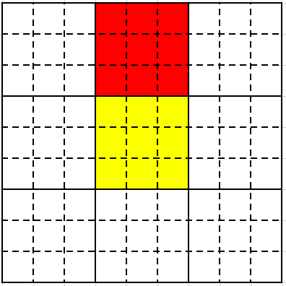
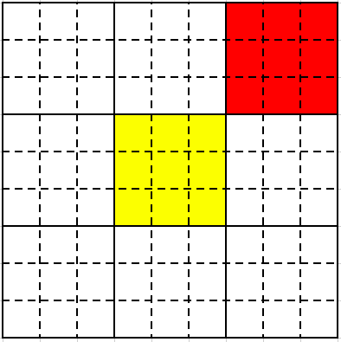
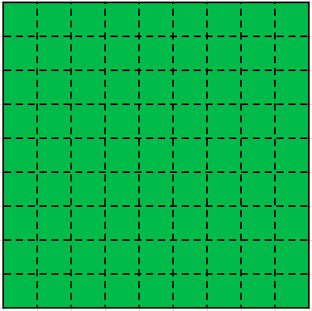
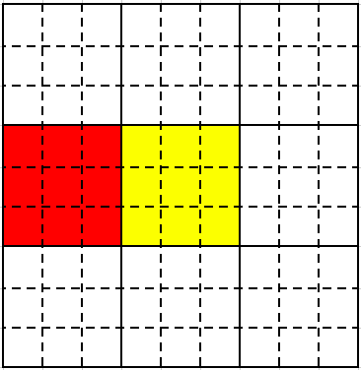
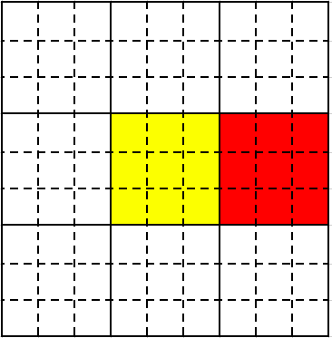
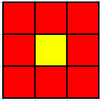
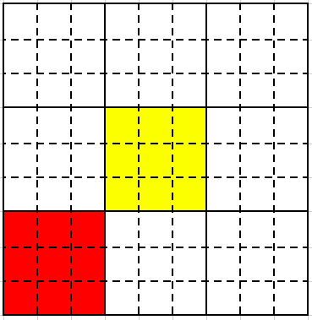
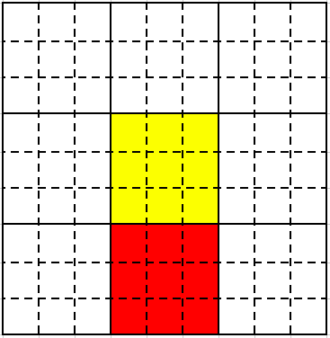
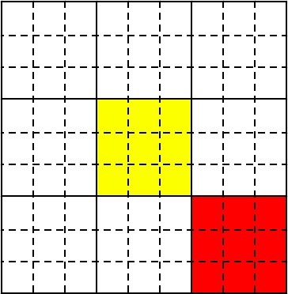
Black Box Analysis of ArrayWeave and ZeroWeave
ArrayWeave and ZeroWeave
Input Array
Output Array

Slide 10
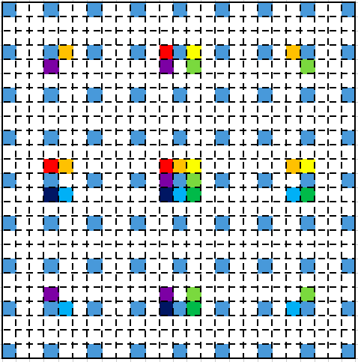
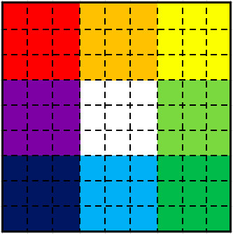
Black Box Analysis of ArrayWeave and ZeroWeave
Operation preformed for the center pixel
Peripheral filters are used in many locations
No easily implemented mapping using standard TensorFlow Layers

Slide 11
Basic Pyramid Weave Unit (BPWU) Computational Sections
Zero-Padding
2D-Convolution
Array-Weave
Image
Array-Add
Zero-Padding
2D-Convolution
Zero-Padding
2D-Convolution
Zero-Weave
Red Sections can run in parallel (on separate GPUs)

Slide 12
Basic Pyramid Weave Unit (BPWU) In – Line Tasks
Zero-Padding
2D-Convolution
Array-Weave
Image
Array-Add
Zero-Padding
2D-Convolution
Zero-Padding
2D-Convolution
Zero-Weave
Can be run in parallel on separate GPUs
and then combined once finished

Slide 13
Stacked BPWU Model (9 Convolution Layers)
In-Line Tasks
1
2
3
4
5
6
Standard Convolution Unit Model (9 Convolution Layers)
Image
Zero-Padding
2D-Convolution
1
2
3
4
5
6
7
8
9

Slide 14
Run – Time Analysis
Stacked BPWU
Stacked Standard Convolution Layers
9 Convolution Layers in 6 in-line tasks
Requires two GPUS
33% speed up
9 Convolution Layers in 9 in-line tasks
Requires one GPU

Slide 15
But, we can do better...
Much better!

Slide 16
Disjoint Pyramid Weave Unit (DPWU)
Zero-Padding
2D-Convolution
Array-Weave
Image
Array-Add
Zero-Padding
2D-Convolution
Image
Zero-Padding
2D-Convolution
Zero-Weave

Slide 17
DPWU Computation Sections
Zero-Padding
2D-Convolution
Array-Weave
Image
Array-Add
Zero-Padding
2D-Convolution
Image
Zero-Padding
2D-Convolution
Zero-Weave
Red Sections can run in parallel (On separate GPUs)

Slide 18
Interpretation of Disjoint Nature of Input
If we interpret each input to the DPWU as the local and the peripheral features respectively we can rationalize the strange nature of performing different operations on different images.
Model can learn relationship, no need for human understanding of what a stacked net means
In a general Neural Network sense we are creating neural network units out of convolution layers.
BiasArray
Convolution
ArrayWeave
ZeroWeave

Slide 19
Pyramid Arrangement (2 BPWU + 1 DPWU) (9 Convolution Layers)
In-Line Tasks
1
2
3
4

Slide 20
Pyramid Arrangement (4 BPWU + 3 DPWU) (21 Convolution Layers)
In-Line Tasks
1
2
3
4
5
6

Slide 21
Run – Time Analysis
Pyramid Arrangement (BWPU + DWPU)
Stacked Standard Convolution Layers
X Convolution Layers in ~log(X) in-line tasks
Requires ~ log(X) GPUS
Possible X/log(X) % speed up
X Convolution Layers in X in-line tasks
Requires one GPU

Slide 22
Performance Analysis (Still working on this)
Preforms comparable to iso-parametric models that are stacked.
Limited in testing capability due only having 1 GPU.
Vastly outperforms iso-layer and iso-train_time models.
Certainly preforms better than ~log(.)/(.) that is required to make the stacked method computationally worth it.
Lacks vanishing gradients that deep networks often encounter.

Slide 23
Array Weave/Zero Weave Analysis
Array Weave and Zero Weave layers were built with intuition in mind, supplying more context without requiring (too many) more parameters.
However, the idea of combing multiple arrays into one can open a much more efficient network design.
More efficient combination methods most likely exist.

Slide 24
Pyramid Arrangement (7 DPWU) (For combing models)
…
N-1
N
N+1
N+2
N+3
N+4
N+5
N+6
In-Line Tasks

Slide 25
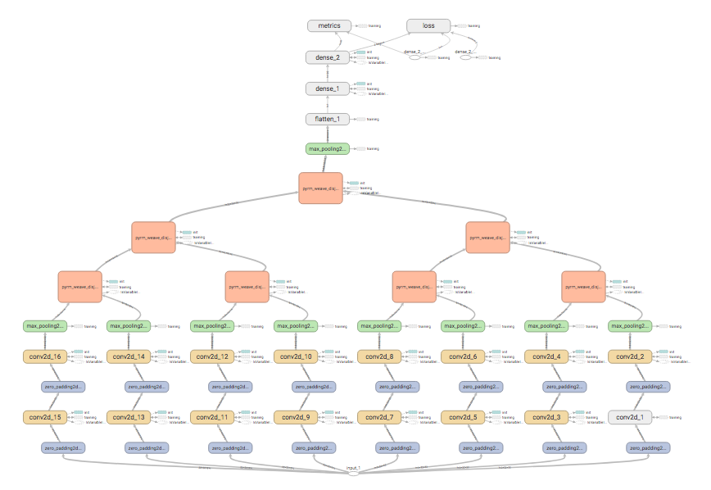

Slide 26
Test of Performance
Used AWS CPU clusters to train 12 different networks
60 Epoch Run
30 Epoch Run
Still determining proper parameters for Array Weave to increase accuracy.

Slide 27
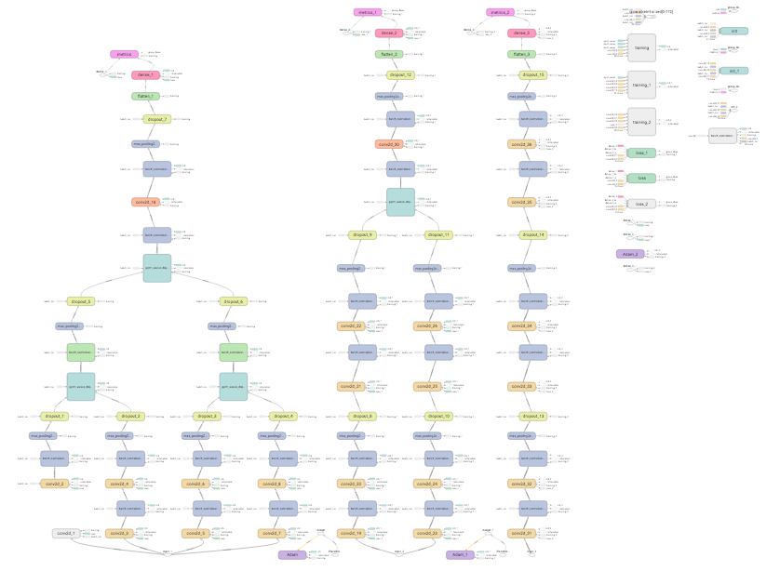

Slide 28
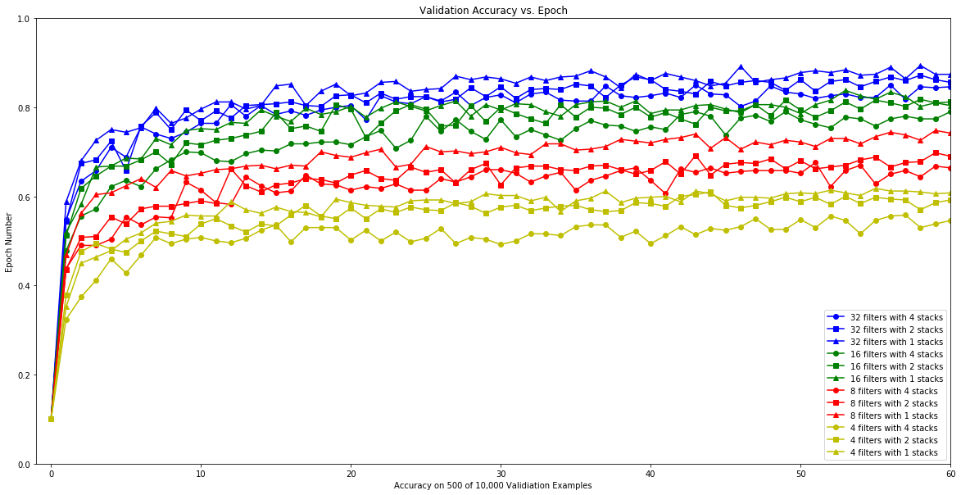

Slide 29
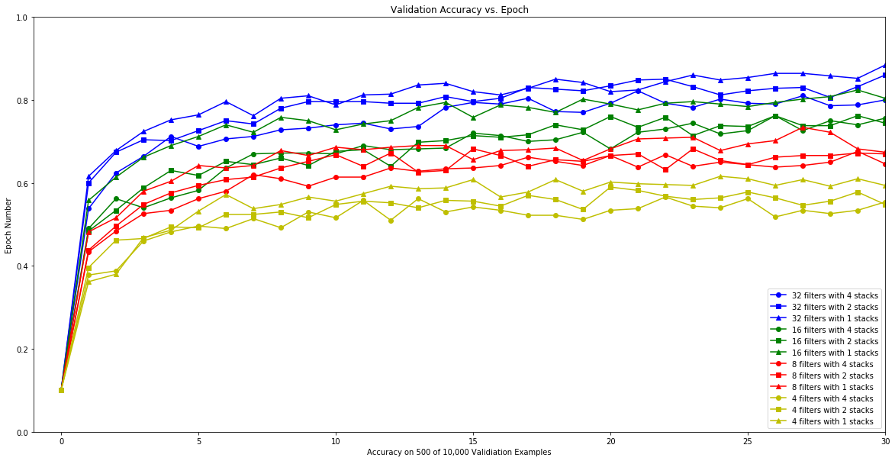

Slide 30
Model | Final Accuracy | Number of Parameters | Single CPU Time (s) | Speed Up With 4 GPUs (Theoretical)
32 Filters Single Stack | 0.8787 | 307946 | 647 | None
32 Filters 2 Stack Pyramid | 0.8574 | 313322 | 456.8 | 1.66x
32 Filters 4 Stack Pyramid | 0.8404 | 297834 | 437.81 | 2.33x

Slide 31
Future Plans
Issue with Weave Convolution
Often the most intensive layers exist deeper in the network when the pyramid network has collapsed to a single stack.
Two inputs create one output so a natural collapsing occurs.
Number of Parameters in each layer.
Deeper layers usually have more parameters and take longer to compute.
Effectiveness of multiple GPUS
Shallower layers are have less parameters but are more evenly distributed over GPUs

Slide 32
Future Plans
Exploring more of a grid pattern.
Prevents collapsing pattern
which reduces effectiveness
of multiple GPUs
Model Shape:
Decreasing Pyramid
Current
“Non-Decreasing” Pyramid
Better
“Increasing” Pyramid
Better

