Slide 1
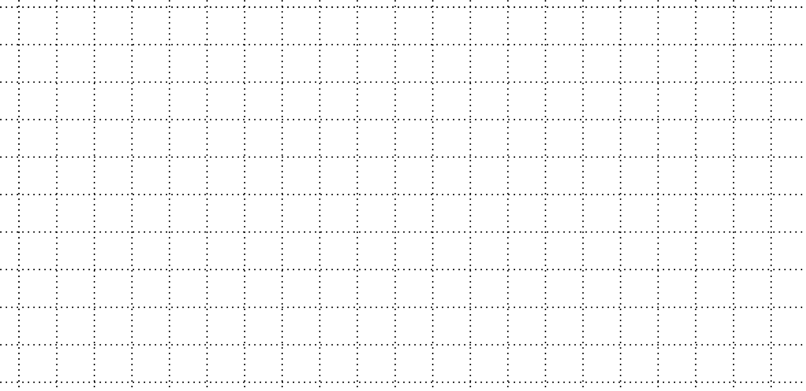
Filter is moved by the size of each filter
Center space is left for local filter
Array Weave
gathers peripheral information of image
Array Add
(Element Wise)
Weave Convolution
With proper padding results in image of same size as input
Standard Convolution
Zero Weave
gather local information of image
Filter is moved by the twice size of each filter.
Only operates on the center

Slide 2
Filter is moved by the size of each filter.
Center space is left for local filter.

