Slide 1
Decreasing Training Time of Deep Networks using N-GPUs
Tim Nonet
10/16/2018

Slide 2
Current Method Multi GPU Method (Tower Networks)
With N GPUS
Create N duplicate models each on one GPU
With batch size of M examples:
Train each model on ~M/N examples (mini batch)
Average gradients from N models
Update all N model variables with average gradients

Slide 3
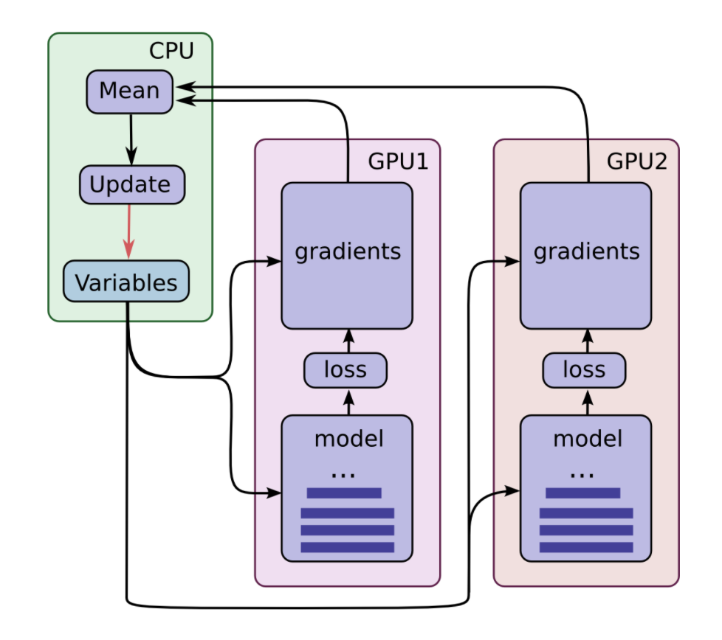
https://jhui.github.io/2017/03/07/TensorFlow-GPU/

Slide 4
Computational Performance (1/2)
With N GPUS can decrease training time by a factor of N.
One GPU – X time per epoch
Two GPUs ~ X/2 time per epoch
N GPUs ~ X/N time per epoch
In theory, regardless of number of GPUs used to train would result in the same gradients and parameters.

Slide 5
Computational Performance (2/2)
However, training time will approach the time one GPU takes to take the gradient of 1 example.
With deep networks this still is significant.
Split batches over multi GPUs decreases total epoch training time by distributing tasks.
Does not change model computation time for single example

Slide 6
Weave Convolution
Decreasing model computation time by log(N) number of GPUs.
Model trained with N GPUs still computes in similar time as “normal” model if only 1 GPU is used.
Can be used at the same time as Tower Networks to decrease batch size.
Model Performance is similar to “normal” model

Slide 7
Weave Convolution Pyramid Networks
With N GPUs:
Split up convolution layers over N GPUs
Layer with F filters:
Create N parallel convolution layers with F/N filters
Combine N parallel convolution layers using Array Weave and Zero Weave (custom combining functions)

Slide 8
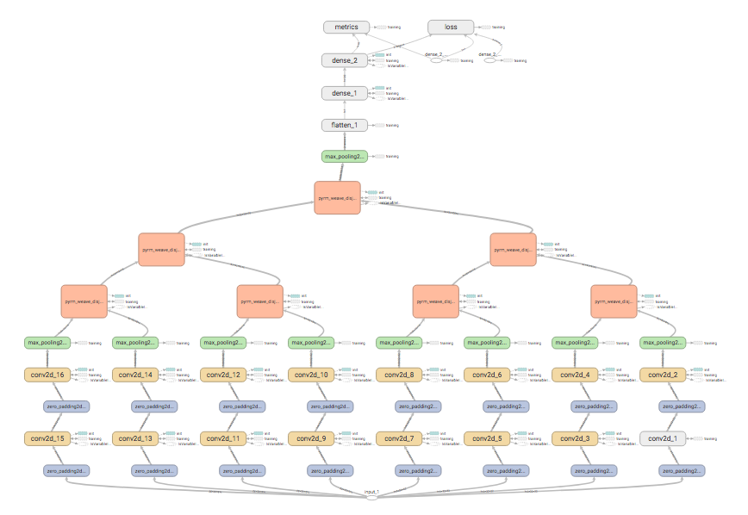

Slide 9
Computational Performance (1/2)

