Slide 1

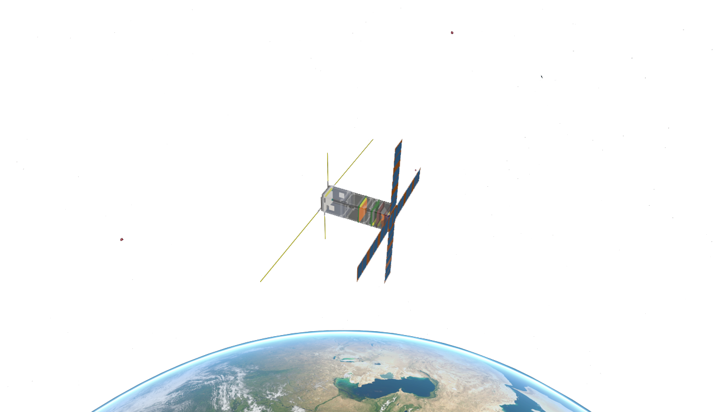


Collaborative Coding & Progress
An introduction to GitHub & Projects
Arnaud MULLER
20/10/2022

Slide 2

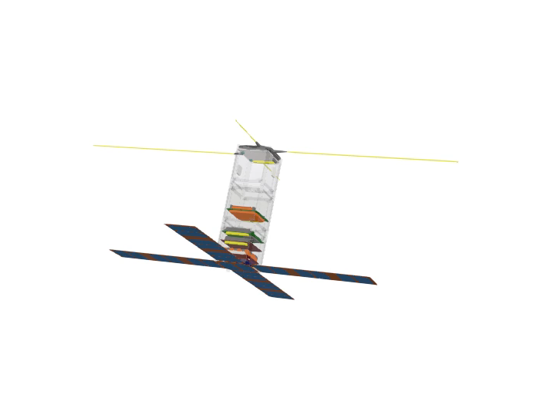
Table of Contents
TOLOSAT
General information
September recruitment
Calendar
CCS interviews
Managing the bizuths
Python Workflow
End of phase A2
Summer holiday news
Valispace
Planning
SSR meetings
Iteration Reviews
Work for the year to come
Phase A2 documentation
Phase B
05/2021
Mission Analysis in Python
1

Slide 3
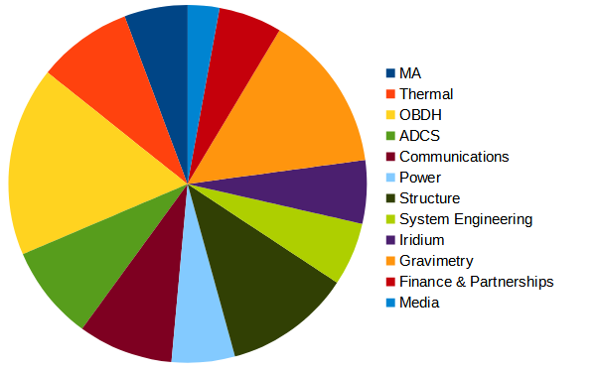
General information
TOLOSAT
Welcome back !
Thursday meetings will be face-to-face again
MA | 2
Thermal | 3
OBDH | 6
ADCS | 3
Comms. | 2
Power | 2
Structure | 2
Syst. Eng. | 2
Iridium | 2
Gravimetry | 5
F. & P. | 2
Media | 1
05/2021
Current team
Back-to-school meeting
2

Slide 4



State of the project
TOLOSAT
Phase A2 almost finished
Advice received from experts, the CSUT, companies,...
To be taken into account before going further
Phase B see later
Summer holiday
Meetings with Nicolas Verdier and Nicolas Nolhier
Presentation for deputies of the Assemblée Nationale
12th European Cubesat Symposium (in november)
New partnership with Valispace
Website
05/2021
Back-to-school meeting
3

Slide 5

Work for the year to come
TOLOSAT
Phase A2
Review your work
Make sure the experts’ advise have been taken into account
Finish your documentation
Back-to-school meeting
4

Slide 6
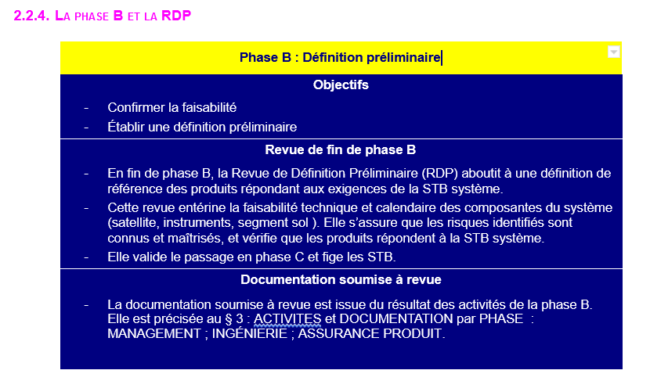
Work for the year to come
TOLOSAT
Phase B
RNC-CNES-HB-507 - Guide pédagogique pour le développement de projets nanosatellitesAG
Back-to-school meeting
5

Slide 7
Work for the year to come
TOLOSAT
Phase B
Confirm the feasibility
Give a preliminary definition of your technical solution(s)
Find, validate and anchor the technical specifications for your SS
How ?
Make and confirm models, simulations, computations,...
Apply what you read in papers during phase A
Find physical order of magnitudes and applicable requirements
...
Back-to-school meeting
6

Slide 8

September recruitment
TOLOSAT
MA | 2
Thermal | 3
OBDH | 6
ADCS | 3
Comms. | 2
Power | 2
Structure | 2
Syst. Eng. | 2
Iridium | 2
Gravimetry | 5
F. & P. | 2
Media | 1
Objective : to recruit 30-35 new members to rebuild a 65-70 people team
End of September - Beginning of October : Applications
For the CCS : short interviews
Early October :
Results
Current team
Back-to-school meeting
7

Slide 9
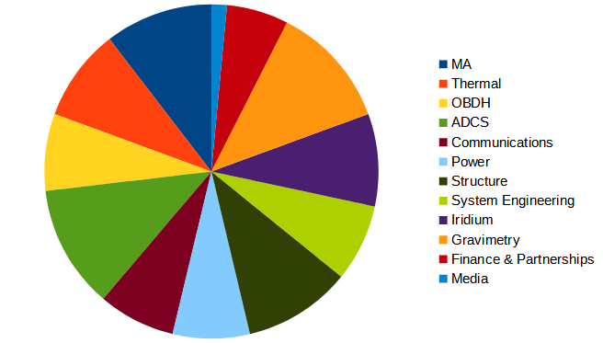
September recruitment
TOLOSAT
Objective
Current
05/2021
Back-to-school meeting
8

Slide 10

September recruitment
TOLOSAT
Welcoming the newcomers
Theoretical formation
Software(s) formation
Valispace formation
Asking them to read the phase A documentation
(and just the documentation in general)
Please have a finished phase A documentation before they arrive
Back-to-school meeting
9

Slide 11
Planning
TOLOSAT
SSR Meetings
Monthly ? Every 2 weeks ?
Iteration Reviews
2, 3 or 4 a year ?
Other meetings
When needed, 10-15min
Back-to-school meeting
10

Slide 12
Thank you !
16/09/2021

