Slide 1
1
1
1
1
1
1

Slide 2
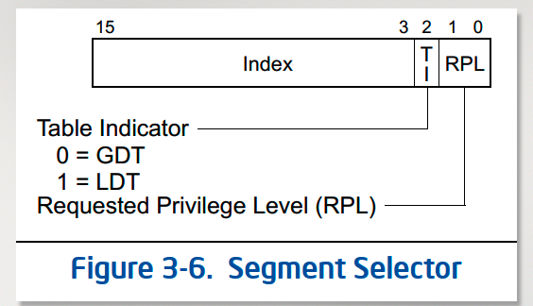
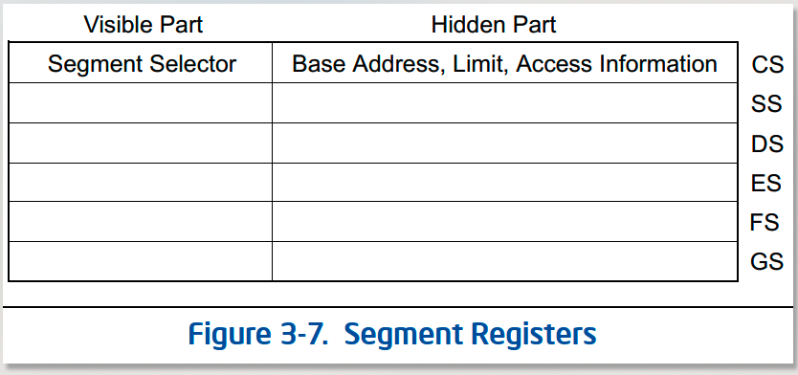
IDT ﻿gate descriptors
中断号
中断门/
陷阱门
DPL
segment selector
段选择子
Offset
+
255
中断
DPL_KERNEL
GD_KTEXT
__vectors[255]
__vectors
...
中断
DPL_KERNEL
GD_KTEXT
__vectors[...]
255
vector255
__alltraps
0x80
陷阱
系统调用=trap
DPL_USER
GD_KTEXT
__vectors[0x80]
...
vector...
...
中断
DPL_KERNEL
GD_KTEXT
__vectors[0]
0x80
vector128
1
中断
DPL_KERNEL
GD_KTEXT
__vectors[1]
...
vector...
0
中断
DPL_KERNEL
GD_KTEXT
__vectors[0]
1
vector1
0
vector0
ts
GDT ﻿gate descriptors
IDTR
索引(↑)
type(属性)
DPL
base
limit
base
limit
SS
5
SEG_TSS
STS_T32A
DPL_KERNEL1
&ts
sizeof(ts)
GDTR
4
SEG_UDATA
w
DPL_USER3
-
-
ESP
base
limit
3
SEG_UTEXT
x
DPL_USER3
-
-
图 2-6
2
SEG_KDATA
w
DPL_KERNEL1
-
-
1
SEG_KTEXT
x/r
DPL_KERNEL1
-
-
0
SEG_NULL
NULL
-
-
-

Slide 3
IDT ﻿gate descriptors
中断号
中断门/
陷阱门
DPL
segment selector
段选择子
Offset
255
中断
DPL_KERNEL
GD_KTEXT
__vectors[255]
...
中断
DPL_KERNEL
GD_KTEXT
__vectors[...]
0x80
陷阱
系统调用=trap
DPL_USER
GD_KTEXT
__vectors[0x80]
+
__vectors
...
中断
DPL_KERNEL
GD_KTEXT
__vectors[0]
255
vector255
1
中断
DPL_KERNEL
GD_KTEXT
__vectors[1]
...
vector...
0
中断
DPL_KERNEL
GD_KTEXT
__vectors[0]
0x80
vector128
...
vector...
1
vector1
IDTR
0
vector0
base
limit
GDT ﻿gate descriptors
ts，当前ts内核栈
索引(↑)
type(属性)
DPL
base
limit
__alltraps
5
SEG_TSS
STS_T32A
DPL_KERNEL1
&ts
sizeof(ts)
4
SEG_UDATA
w
DPL_USER3
-
-
ss
GDTR
3
SEG_UTEXT
x
DPL_USER3
-
-
esp
base
limit
2
SEG_KDATA
w
DPL_KERNEL1
-
-
...
1
SEG_KTEXT
x/r
DPL_KERNEL1
-
-
图 2-6
0
SEG_NULL
NULL
-
-
-
data seg

Slide 4
用户态
userlib/syscall.c
sys_xxx
syscall int 0x80,args...
IDT,GDT,TSS...
内核态
__alltraps
trap
trap_dispatch
T_PGFLT
T_SYSCALL
*syscalls
TIMER
1
sys_exit
trapframe
COM1
2
sys_fork
KBD
...
130
sys_dup
kern/syscall.c
trapframe
sys_xxx
经过系统调用，trapframe 可能被故意改变
进程
内存
文件
do_exit,do_kill,...
do_read...

Slide 5
context from被赋值
uint32_t ebp
uint32_t edi
uint32_t esi
uint32_t edx
uint32_t ecx
uint32_t ebx
eax->
uint32_t esp
uint32_t eip
&(next->context) //to
context to(被读取)
&(prev->context) //from
<- esp（pop 后）
uint32_t ebp
ret addr
<- esp（pop 前）
uint32_t edi
uint32_t esi
uint32_t edx
uint32_t ecx
uint32_t ebx
eax->
uint32_t esp
uint32_t eip

Slide 6
A user
A kernel
B kernel
B user
fokret
fokret
trap
int
处理中断
proc_run,switch_to
iret
iret
proc_run,switch_to
trap
int
schedule

Slide 7
mm_struct
mmap_list
pgdir
sm_priv
vma_struct
vm_start
vm_end
flags
vma_struct
vm_start
vm_end
flags
vma_struct
vm_start
vm_end
flags

