Slide 1


NORTH-CENTRAL NIGERIA SECURITY SUMMIT
COLLABORATIVE APPROACHES TO STRENGTHENING SECURITY IN NORTH-CENTRAL NIGERIA
Towards a People-Centred, Intelligence-Led and Sustainable Security Architecture
Air Vice Marshal Monday Riku Morgan (Rtd) | Former Chief of Defence Intelligence | 30-Minute Keynote
01

Slide 2

OPENING
One Ecosystem, Not Separate Problems
02
A mother in Benue sending her children to school,
wondering if they'll return safely.
A farmer in Plateau who fears the next sound may
be gunfire, not birdsong.
A traditional ruler in Niger State who sees armed men
enter the forest — but doesn't know whom to call.
A soldier redeployed again and again, without the
intelligence or mobility to prevent the next attack.
THE CENTRAL ARGUMENT
North-Central Nigeria cannot defeat insecurity through military operations alone. It requires a permanent partnership between the military, police, intelligence services, state and local governments, traditional institutions, communities, technology providers, and citizens.
02
AVM Monday Riku Morgan (Rtd) — North-Central Security Summit
2 / 28

Slide 3
SECTION 1
The North-Central Security Question
03
Benue • Kogi • Kwara • Nasarawa • Niger • Plateau • FCT
THE EVIDENCE
▸ The bridge between North and South Nigeria
▸ Major agricultural belts, forests, highways, energy infrastructure
▸ Beyond farmer-herder disputes: organised banditry, kidnapping, cattle rustling
▸ Communal militias, reprisal attacks, illegal arms proliferation
▸ Illegal mining, rural criminality, armed group proliferation
▸ We define this as: North-Central Agro-Pastoral Security & Territorial Conflict
ACLED recorded hundreds of security incidents and substantial fatalities in Benue, Plateau and Niger between Jan 2024 – Dec 2025. Niger and parts of Kwara face terrorist activity and cross-border movement of armed groups. The enemy does not respect state boundaries. Why should our response? Criminal conduct — not ethnicity — is the diagnosis.
03
AVM Monday Riku Morgan (Rtd) — North-Central Security Summit
3 / 28

Slide 4
SECTION 2
The Central Problem — We Are Too Reactive
04
Attack Occurs
People Killed
Police Alerted
Military Mobilised
Attackers Vanish
Community Searched
We Wait
This is a cycle of reaction without prevention.
FROM: “An attack has occurred. What do we do?”
TO: “What is the probability of an attack, and what can we do today to prevent it?”
04
AVM Monday Riku Morgan (Rtd) — North-Central Security Summit
4 / 28

Slide 5
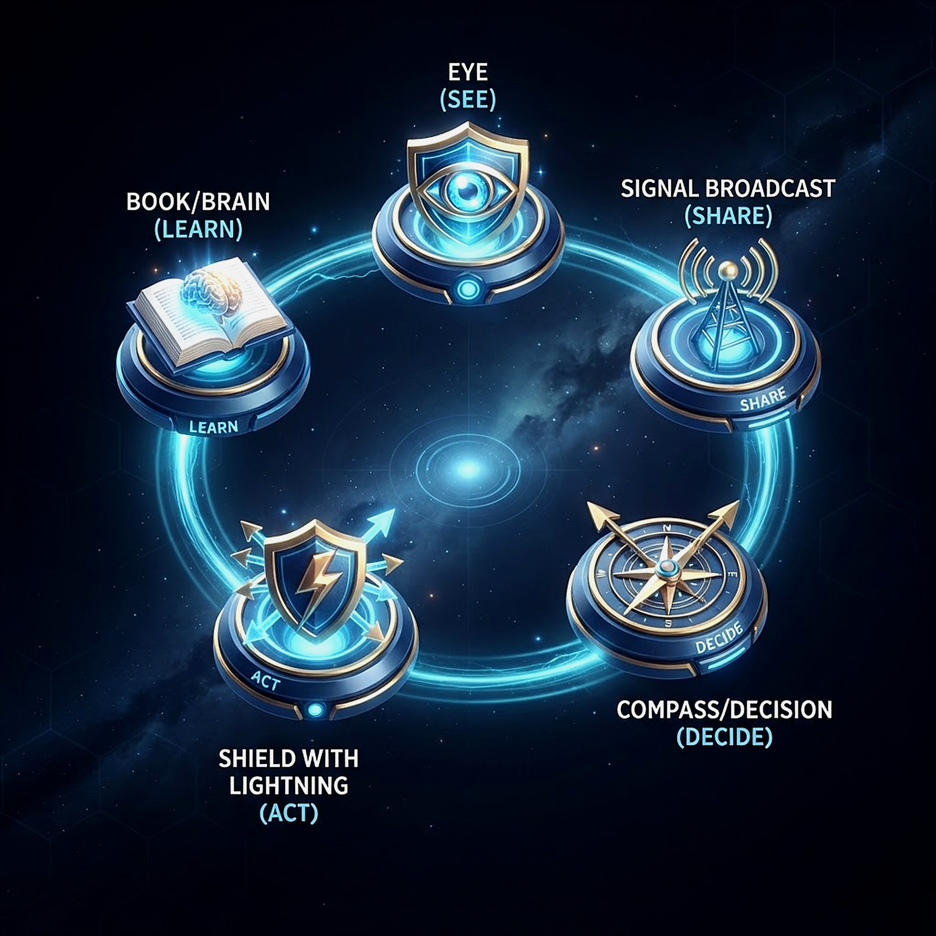
SECTION 3
Security as Collective Responsibility
05
No single agency can do everything. Together, they can know almost everything that matters.
SEE
Collect information
SHARE
Move it fast to those who need it
DECIDE
Establish responsibility & command
ACT
Respond proportionately & rapidly
LEARN
Analyse and prevent repetition
05
AVM Monday Riku Morgan (Rtd) — North-Central Security Summit
5 / 28

Slide 6
SECTION 4
One Security Picture, Multiple Capabilities
06
Armed Forces
Police Force
DSS
“The intelligence value is created when these pieces are fused into ONE threat picture.”
NSCDC
NDLEA / Customs
State Security Councils
Local Govt Structures
Traditional Institutions
Community & Civil Society
06
AVM Monday Riku Morgan (Rtd) — North-Central Security Summit
6 / 28

Slide 7
SECTION 5
Regional Security Intelligence & Fusion Centre
07
1
Where is the threat?
LIVING OPERATIONAL PICTURE
2
Who is responsible?
▸ Attack locations & kidnapping incidents
▸ Suspicious movements & criminal corridors
▸ Conflict flashpoints & abandoned settlements
▸ Vulnerable highways, forests, difficult terrain
▸ Illegal mining & arms trafficking routes
▸ Displacement concentrations
3
What is their capability?
4
What are they likely to do next?
5
What resource can respond fastest?
07
AVM Monday Riku Morgan (Rtd) — North-Central Security Summit
7 / 28

Slide 8
SECTION 6
From Intelligence Collection to Intelligence Action
08
“How long does it take for a credible warning from a village to become an operational decision?”
Community
Local Intel Node
Fusion Centre
Threat Assessment
Security Agency
Rapid Response
Confirmation + Follow-up
The community must receive feedback. If people repeatedly provide information and nothing happens, they stop reporting. If they see that lives are saved, trust grows.
08
AVM Monday Riku Morgan (Rtd) — North-Central Security Summit
8 / 28

Slide 9
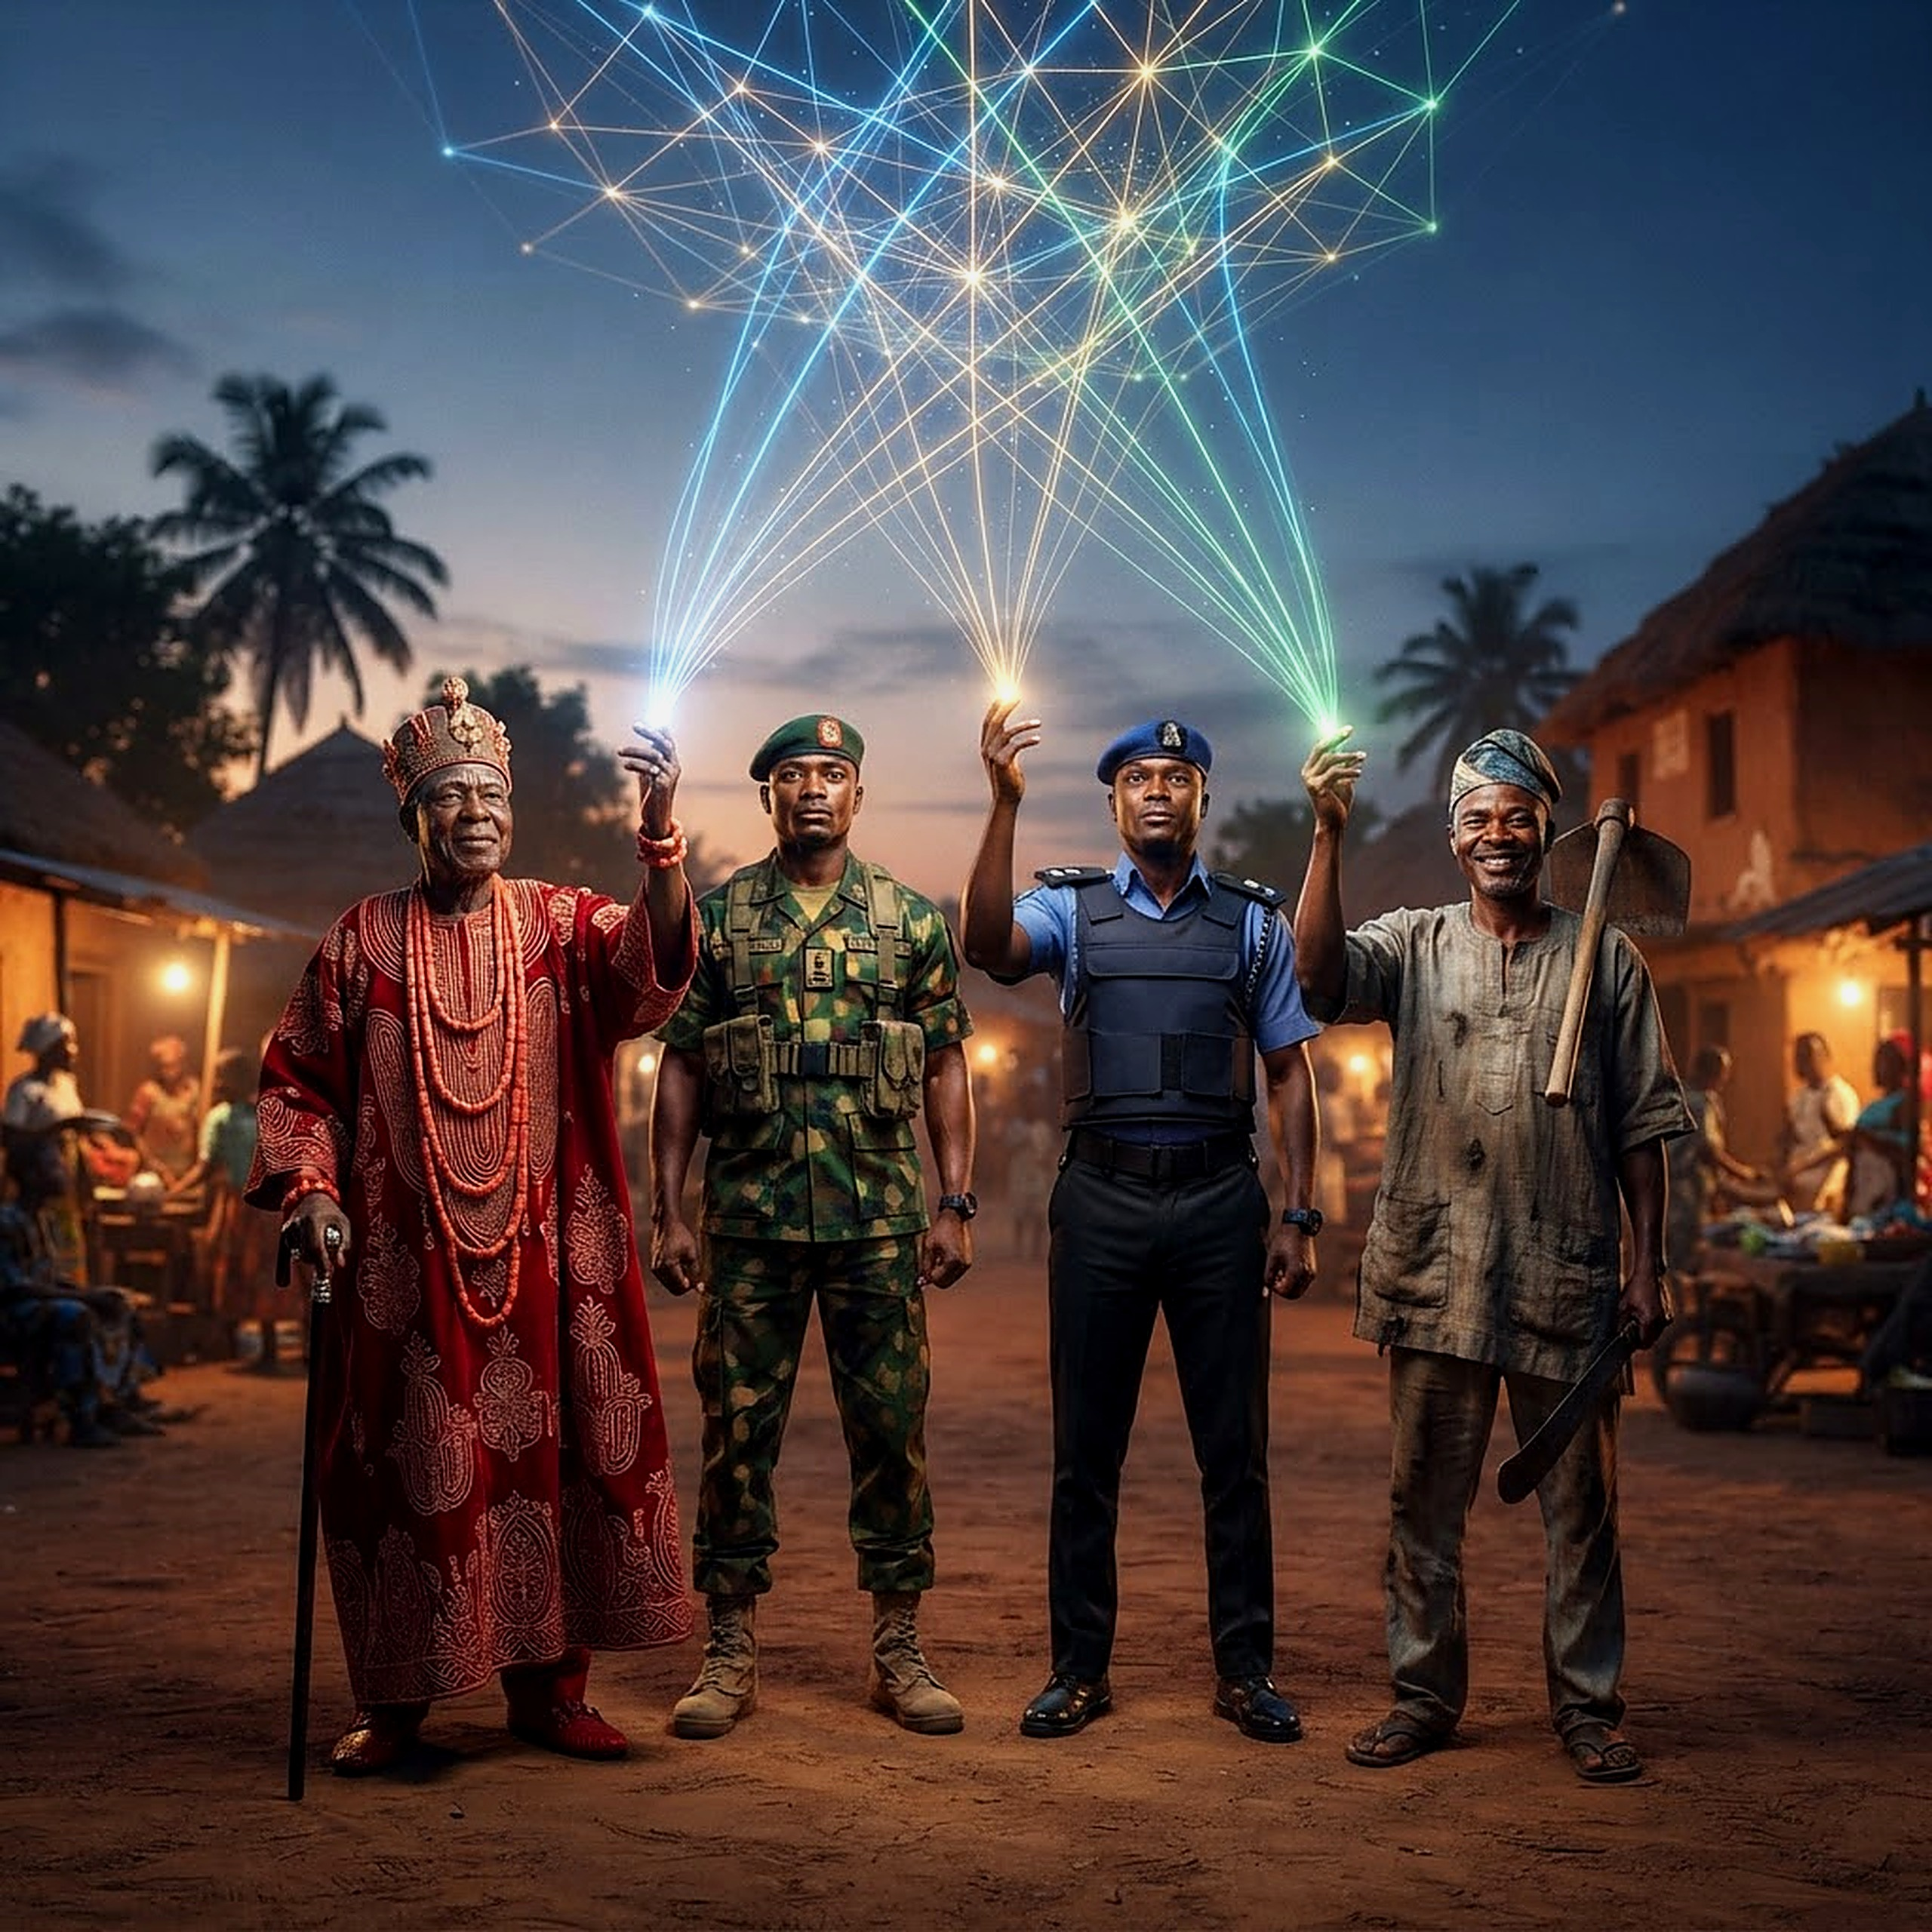
THE COMMUNITY MUST BECOME THE FIRST SENSOR
Farmers • Hunters • Teachers • Traditional Rulers • Transporters • Religious Leaders • Health Workers • Market Women
A structured Community Early Warning and Early Response Network — not a vigilante system, not a parallel intelligence service — a disciplined, legally governed community information network.
09
AVM Monday Riku Morgan (Rtd) — North-Central Security Summit
9 / 28

Slide 10
SECTION 8
Traditional Rulers in the Security Architecture
10
▸ Know who lives in — and enters — their domain
▸ Aware of families in conflict and land/resource disputes
▸ Often the first to see radicalisation among youth
▸ Know criminal routes and rising community tensions
▸ Currently consulted mostly AFTER violence occurs
THE STRUCTURED INTERFACE
Traditional Council
Police
DSS
Military Liaison
Local Government
Community Reps
10
AVM Monday Riku Morgan (Rtd) — North-Central Security Summit
10 / 28

Slide 11
SECTION 9
Security Corridors, Not Administrative Boundaries
11
A criminal group does not stop at a state border. Neither should our response.
Kwara – Niger – Kainji
Niger – Kaduna – FCT
Benue – Nasarawa
Benue – Taraba
Plateau – Bauchi
Kogi – Nasarawa – Benue
North-Central governors agreed in 2025 to pursue joint security operations. The next step: institutionalise it.
11
AVM Monday Riku Morgan (Rtd) — North-Central Security Summit
11 / 28

Slide 12
SECTION 10
Rapid Response — The 30 to 60 Minute Window
12
30–60
MINUTES CAN DETERMINE WHETHER AN INCIDENT BECOMES A FAILED ATTACK OR A MASS-CASUALTY EVENT
▸ Police rapid response units
▸ Military quick reaction forces
▸ Mobile security teams
▸ Medical evacuation capability
▸ Aviation support where appropriate
▸ Communications support
▸ Community liaison officers
▸ Pre-positioned, not reactive
12
AVM Monday Riku Morgan (Rtd) — North-Central Security Summit
12 / 28

Slide 13
SECTION 11
Technology Should Multiply Human Capability
13
Unmanned Aerial Surveillance
Satellite Imagery & Geospatial Intel
Secure Communications
Digital Incident Reporting
Vehicle & Movement Analytics
Lawful Telecoms Intelligence
Biometric & Identity Systems
GIS Crime Mapping
AI Pattern Analysis
“If a drone cannot transmit useful information to a commander who can act on it, it is merely an expensive flying camera.”
13
AVM Monday Riku Morgan (Rtd) — North-Central Security Summit
13 / 28

Slide 14
SECTION 12
The Forest Problem
14
▸ Provides concealment, mobility, temporary camps
▸ Access to water and routes between communities
▸ Sanctuary from conventional policing
FOREST SECURITY STRATEGY
Human Intelligence + Aerial Surveillance + Geospatial Mapping + Community Information + Controlled Access + Law Enforcement + Sustained Presence
Goal: deny armed groups sanctuary, mobility, supplies, communications, financing and freedom of movement — without treating every farmer or hunter as a suspect.
14
AVM Monday Riku Morgan (Rtd) — North-Central Security Summit
14 / 28

Slide 15
SECTION 13
Separate the Criminal from the Community
15
A Fulani pastoralist
→
is not a terrorist
A Tiv farmer
→
is not a militia
An Idoma youth
→
is not a criminal
A Muslim
→
is not a terrorist
A Christian
→
is not a militia member
A traditional hunter
→
is not automatically a vigilante
Identify perpetrators by behaviour and evidence — never by ethnicity, religion or community.
15
AVM Monday Riku Morgan (Rtd) — North-Central Security Summit
15 / 28

Slide 16
SECTION 14
Farmer-Herder Conflict as a Governance Issue
16
We cannot shoot our way out of every dispute. Some are criminal. Most are about:
Land
Water
Grazing Routes
Crop Destruction
Cattle Rustling
Migration
Boundary Disputes
Climate Pressure
Requires: functioning livestock management systems, negotiated grazing and stock routes, conflict-resolution mechanisms, land-use planning, livestock identification, compensation mechanisms, farmer-herder dialogue, and credible enforcement. Where governance fails, criminality fills the vacuum.
16
AVM Monday Riku Morgan (Rtd) — North-Central Security Summit
16 / 28

Slide 17
SECTION 15
Young People — The Most Important Long-Term Investment
17
“What does a 17-year-old boy in a forgotten rural community see as his future? If the answer is nothing, somebody else will offer him something.”
Vocational Training
Agriculture
Technology
Apprenticeships
Sports
Entrepreneurship
Education
Community Service
Targeted Deradicalisation
17
AVM Monday Riku Morgan (Rtd) — North-Central Security Summit
17 / 28

Slide 18
SECTIONS 16 – 17
Women as Security Partners & the Role of Local Government
18
WOMEN AS PARTNERS
LOCAL GOVERNMENT ROLE
▸ Know who has disappeared
▸ Notice changed behaviour in children
▸ Aware of unusual household visitors
▸ Track displaced-people movement
▸ Must be integrated operationally, not symbolically
▸ Security cannot be Abuja-centric
▸ LGA links: Chairman + Police + DSS
▸ + Military Liaison + Traditional Rulers
▸ + Health, Emergency & Community Reps
▸ Closer to community = faster warning & response
18
AVM Monday Riku Morgan (Rtd) — North-Central Security Summit
18 / 28

Slide 19
SECTION 18
State Police — An Opportunity That Requires Safeguards
19
The real question: how do we put competent officers close to the community while preventing political abuse?
Complement, not replace, the Nigeria Police Force
National minimum standards
Professional recruitment
Independent complaints mechanisms
Clear rules of engagement
Legislative & judicial oversight
19
AVM Monday Riku Morgan (Rtd) — North-Central Security Summit
19 / 28

Slide 20
SECTIONS 19 – 20
Predictable Funding & Personnel Welfare
20
SECURITY FUNDING
PERSONNEL WELFARE
Northern Nigerian Security Trust Fund inaugurated July 2026 — a foundation, not the finish line.
▸ Reliable communication & accommodation
▸ Medical care, food, transportation
▸ Equipment maintenance & rotation
▸ Psychological support
▸ “Morale is a combat capability.”
Must be: transparent + professionally managed + audited + measurable. “Every naira spent should answer: what security capability did this create?”
20
AVM Monday Riku Morgan (Rtd) — North-Central Security Summit
20 / 28

Slide 21
SECTION 25
The Three-Layer Security Model
21
LAYER 3 — FEDERAL
Airpower • Special Operations • Heavy Mobility • Strategic Surveillance
LAYER 2 — STATE
Police • DSS • NSCDC • Analysis & Coordination
LAYER 1 — COMMUNITY
Traditional Rulers • Citizens • Local Govt • Early Warning
21
The three layers must operate as ONE system.
AVM Monday Riku Morgan (Rtd) — North-Central Security Summit
21 / 28

Slide 22
SECTION 27
A 24-Hour Security Cycle
22
00:00 – 06:00
Intelligence Monitoring
06:00 – 12:00
Community Reporting & Operational Assessment
12:00 – 18:00
Patrol, Surveillance & Preventive Deployment
18:00 – 00:00
Night Security Posture & Rapid-Response Readiness
Security never sleeps simply because government offices have closed.
22
AVM Monday Riku Morgan (Rtd) — North-Central Security Summit
22 / 28

Slide 23
SECTION 28
What Should Happen in the Next 90 Days
23
1. Create a North-Central Security Coordination Secretariat
2. Establish a regional intelligence-fusion mechanism
3. Map all major criminal and terrorist corridors
4. Identify the 100 most vulnerable communities
5. Create community early-warning networks
6. Establish rapid-response protocols
7. Link governors' security councils digitally
8. Common training for military, police & liaisons
9. Transparent regional security funding mechanism
10. Publish measurable security indicators quarterly
23
AVM Monday Riku Morgan (Rtd) — North-Central Security Summit
23 / 28

Slide 24
SECTION 31
The North-Central Security Compact — Seven Commitments
24
1
One Threat Picture
We share intelligence
2
One Early-Warning System
We listen to communities
3
One Rapid-Response Philosophy
We respond before massacres
4
One Professional Standard
Discipline, law, dignity
5
One Regional Approach
No exploiting state boundaries
6
One Development Agenda
Secure & rebuild together
7
One Measure of Success
Safety & dignity of the citizen
24
AVM Monday Riku Morgan (Rtd) — North-Central Security Summit
24 / 28

Slide 25
SECTION 29
What Success Should Look Like in Three Years
25
▸ Kidnapping has fallen substantially
▸ Attacks on rural communities are declining
▸ Major highways are secure
▸ Farmers can return to their farms
▸ Displaced families are returning home
▸ Criminal sanctuaries are progressively denied
▸ Intelligence moves faster, response times shorter
▸ Communities trust security agencies
▸ Security personnel are better supported
▸ Networks dismantled via arrests & prosecution
25
AVM Monday Riku Morgan (Rtd) — North-Central Security Summit
25 / 28

Slide 26
SECTION 30
The Biggest Change We Need Is Mental
26
Not simply: More troops
But: Better intelligence
Not simply: More weapons
But: Better coordination
Not simply: More operations
But: Better prevention
Not simply: More money
But: Better accountability
Not simply: More security personnel
But: More trust between forces and people
26
AVM Monday Riku Morgan (Rtd) — North-Central Security Summit
26 / 28

Slide 27

“He simply wants to arrive alive.”
That is the standard by which we must judge ourselves — and it is not beyond the capacity of Nigeria.
THANK YOU — Air Vice Marshal Monday Riku Morgan (Rtd)
27

Slide 28
REFERENCES
Sources & Citations (Harvard Style)
28
Amnesty International (2024) Nigeria: scores killed in coordinated Plateau State attacks. London: Amnesty International.
Reuters (2026) Nigeria charges nine men with terrorism over Yelwata massacre. London: Reuters.
BBC (2025) Yelwata massacre: what we know about the Benue State killings. London: BBC News.
NPR (2025) Pope Leo prays for victims of Nigeria massacre at Sunday Angelus. Washington DC: National Public Radio.
Vatican News (2025) Pope's Angelus address on violence in Nigeria. Vatican City: Vatican News.
International Organization for Migration (2025) Displacement Tracking Matrix: North-Central and North-West Nigeria. Geneva: IOM.
The Kukah Centre (2025) Conflict trends and community resilience in Nigeria's Middle Belt. Abuja: The Kukah Centre for Faith, Leadership and Public Policy.
United Nations Peacebuilding Support Office (2025) Nigeria peacebuilding fund report. New York: UN Peacebuilding.
Channels Television (2024) Mangu attacks: death toll rises in renewed Plateau violence. Lagos: Channels Television.
Premium Times (2025) Benue killings: a data investigation, 2023–2025. Abuja: Premium Times.
National Assembly of Nigeria (2026) Constitution of the Federal Republic of Nigeria (Alteration) (State Police) Bill, 2026. Abuja: National Assembly.
Kaduna State Government and Katsina State Government (2025) Early Warning and Early Response System: outcomes report. Kaduna/Katsina: State Governments.
28
AVM Monday Riku Morgan (Rtd) — North-Central Security Summit
28 / 28

