Slide 1
ZEROPAY ATTACK VALIDATION LAB
Granular Operating Walkthrough — How We Independently Prove
6 Attack Vectors Cannot Cause Fund Loss
Prepared for: Tom Ugbodaga, Shareholder & CEO — BETONIQ WEST LTD
ZeroPay How It Works Series — Volume 2

Slide 2
OVERVIEW
What This Lab Actually Is
Not a facility we build — an engagement with an existing accredited hardware-security testing firm (Riscure/Brightsight/NCC Group-tier), who run 6 physical attack simulations directly against our terminal and Solar Mesh Hub prototype.
Output: a signed, independently certified report — the evidence artifact that proves “uncapped, double-spend-proof, fully offline” to Kwati, CBN, and investors.
THIS TURNS “WE CLAIM IT'S SECURE” INTO “AN ACCREDITED THIRD PARTY VERIFIED IT”
ZeroPay How It Works — Vol. 2 | Attack Validation Lab | CONFIDENTIAL

Slide 3
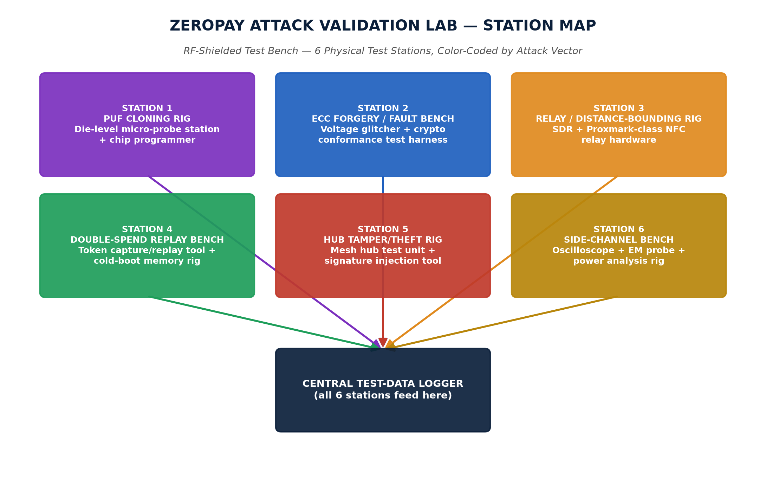
PHYSICAL LAYOUT
The 6 Test Stations — Color-Coded by Attack Vector
ZeroPay How It Works — Vol. 2 | Attack Validation Lab | CONFIDENTIAL

Slide 4
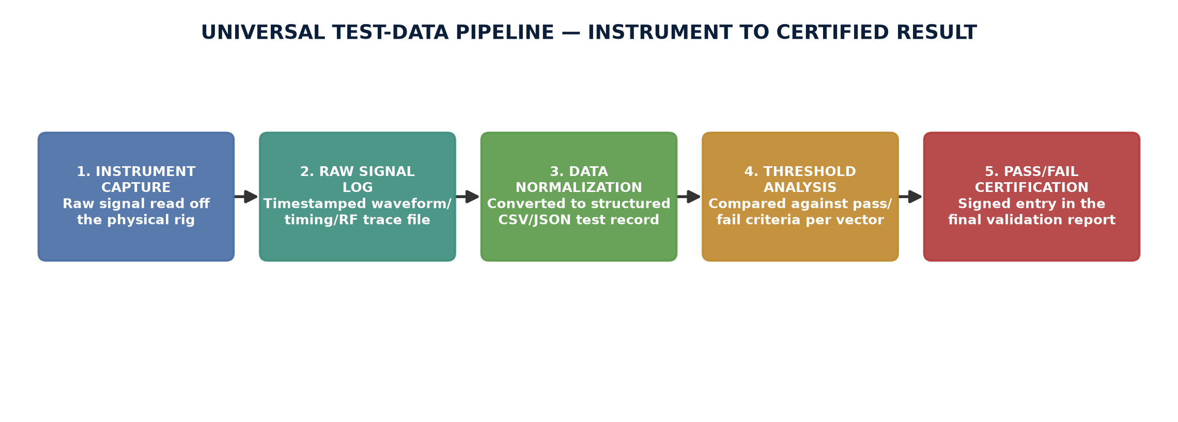
METHODOLOGY
The Universal Data Pipeline
Every station feeds this same 5-stage pipeline before a result counts as final.
ZeroPay How It Works — Vol. 2 | Attack Validation Lab | CONFIDENTIAL

Slide 5
TEST 1 OF 6
PUF CLONING ATTEMPT
STEPS
1. Decap an identical chip, expose the die under microscope
2. Attempt to physically probe/read the PUF challenge-response
3. Program a clone chip with anything extracted
4. Run clone against our terminal's handshake — ~2,000 attempts
INSTRUMENTS USED Die-level micro-probe station, decapsulation rig, logic analyzer, chip programmer
PASS THRESHOLD 0 successful clone authentications out of 2,000 attempts
ZeroPay How It Works — Vol. 2 | Attack Validation Lab | CONFIDENTIAL

Slide 6
TEST 2 OF 6
ECC P-256 FORGERY & FAULT INJECTION
STEPS
1. Attempt signature forgery without the private key vs. NIST vectors
2. Trigger precisely-timed voltage glitches during signing (DFA)
3. Vary glitch timing in microsecond steps — ~5,000 attempts
4. Analyze any output signature for key-bit leakage
INSTRUMENTS USED Programmable voltage glitcher, oscilloscope, crypto conformance harness
PASS THRESHOLD 0 forgeries; no glitch ever leaks partial key material
ZeroPay How It Works — Vol. 2 | Attack Validation Lab | CONFIDENTIAL

Slide 7
TEST 3 OF 6
RELAY ATTACK / DISTANCE-BOUNDING
STEPS
1. Two SDR/Proxmark-class proxies relay the NFC handshake
2. Test over WiFi, 4G, and satellite-latency emulation
3. 1,500 relay attempts + genuine local-tap control set
4. Log round-trip time for every single attempt
INSTRUMENTS USED SDR relay hardware (x2), network latency emulator, timing logger
PASS THRESHOLD 100% rejection above 5ms added latency; 0% false rejection
ZeroPay How It Works — Vol. 2 | Attack Validation Lab | CONFIDENTIAL

Slide 8
TEST 4 OF 6
DOUBLE-SPEND / TOKEN REPLAY
STEPS
1. Capture a genuine signed token via protocol sniffer
2. Replay it, attempt power-cut counter rollback, cold-boot read
3. ~1,000 trials per sub-test with randomized timing
4. Verify decrement-before-transmit sequencing via power trace
INSTRUMENTS USED Protocol sniffer, power-cut rig, cold-boot extraction tool, oscilloscope
PASS THRESHOLD 100% rejection of every replay/rollback attempt, zero exceptions
ZeroPay How It Works — Vol. 2 | Attack Validation Lab | CONFIDENTIAL

Slide 9
TEST 5 OF 6
SOLAR MESH HUB TAMPERING / THEFT
STEPS
1. Simulate physical hub theft — extract battery, radio, token queue
2. Attempt to inject/alter/replay tokens in the relay stream
3. Confirm hub never held a terminal signing key
4. Send all attempts to a mock settlement backend for verification
INSTRUMENTS USED Physical hub unit, signal injection tool, mock settlement backend
PASS THRESHOLD 0 forged or altered tokens accepted by settlement
ZeroPay How It Works — Vol. 2 | Attack Validation Lab | CONFIDENTIAL

Slide 10
TEST 6 OF 6
SIDE-CHANNEL / PHYSICAL KEY EXTRACTION
STEPS
1. Monitor power draw and EM emissions during signing/PUF ops
2. Capture ~10,000 operation traces
3. Run differential power/EM correlation analysis
4. Flag any statistically significant key-bit correlation
INSTRUMENTS USED Oscilloscope, EM near-field probe, side-channel analysis software
PASS THRESHOLD 0 recoverable key bits across all 10,000 traces
ZeroPay How It Works — Vol. 2 | Attack Validation Lab | CONFIDENTIAL

Slide 11
SUMMARY
All 6 Tests At a Glance
1
PUF Cloning
0/2,000 clones succeed
2
ECC Forgery / Fault Injection
0/5,000 forgeries; no key leak
3
Relay / Distance-Bounding
100% rejected above 5ms latency
4
Double-Spend / Replay
100% rejected, 1,000 trials
5
Hub Tampering / Theft
0 forged tokens accepted
6
Side-Channel Extraction
0 key bits recovered, 10,000 traces
ZeroPay How It Works — Vol. 2 | Attack Validation Lab | CONFIDENTIAL

Slide 12
PEOPLE
Who Actually Runs This Lab
TESTING FIRM'S TEAM (covered by the $28,000 engagement fee)
Lab Test Lead / Principal Security Engineer — owns methodology, signs the report
Hardware/RF Test Engineer — Tests 3 & 6
Embedded Security Test Engineer — Test 1 + fault-injection half of Test 2
Cryptography Analyst — forgery half of Test 2
Firmware/Protocol Test Engineer — Tests 4 & 5
QA/Data Analyst & Report Writer — owns the data pipeline, compiles final report
OUR SIDE (BETONIQ WEST LTD)
Agent 1 — Protocol & Security Architect: technical liaison, hands over prototype, owns remediation work
Tom Ugbodaga — Shareholder & CEO: final sign-off authority before any production rollout
ZeroPay How It Works — Vol. 2 | Attack Validation Lab | CONFIDENTIAL

Slide 13
BUDGET
Exact Cost — Already Inside the $1M Kwati Ask
This is the existing Independent Security Validation line item, not a new cost.
Independent third-party security testing partner (runs all 6 tests)
$28,000
Staged field validation exercise, one pilot site per zone
$9,000
Remediation engineering buffer (pre Tranche 2/3 release)
$12,000
TOTAL — INDEPENDENT SECURITY VALIDATION
$49,000
ZeroPay How It Works — Vol. 2 | Attack Validation Lab | CONFIDENTIAL

Slide 14
This report is what converts “we claim it's double-spend-proof”
into “an accredited third party independently verified it.”
The exact artifact Kwati, CBN, and serious investors expect before real capital moves past Tranche 1.
BETONIQ WEST LTD — Confidential

