Slide 1
Headache: the question flow
A first draft for any reviewing clinician to correct
This is a proposal, not clinical guidance. Every question, every red flag and every outcome here is yours to change, delete or reorder.
The aim: help a person with a headache decide how fast to seek care. It never names a cause or a diagnosis.
Please mark anything unsafe, missing, badly worded, or wrongly ranked. Disagreement is the most useful feedback.
Tom Ugbodaga, Managing Director, BETONIQ WEST LTD
MSc Computer Systems Security, University of Gloucestershire (England, 2011) | linkedin.com/in/tom-deggs-ugbodaga-2306692bb

Slide 2
How the flow works
2 / 8
Short yes/no questions, red flags first, one of three outcomes
1. Red-flag questions come first. One "yes" stops the flow and gives the urgent outcome at once.
2. If all red flags are "no", it asks a few context questions (age group, pregnancy, how long).
3. It then gives one of three outcomes, always with warning signs to watch for.
4. Every screen carries: "This is a screening aid, not a diagnosis. If you are worried, seek care."
5. Built for SMS or USSD too: each question is a single short message answered 1 for yes, 2 for no.
EMERGENCY
Go to the nearest emergency unit now
Your call:
Are three outcomes enough, or do you want a fourth, such as "see a clinician this week"?
Should timings (now, 24 hours) be different?
CLINIC TODAY
See a clinician within 24 hours
SELF-CARE
Home care with clear warning signs
TriageAI headache flow | DRAFT for clinician correction | Not medical advice | BETONIQ WEST LTD

Slide 3
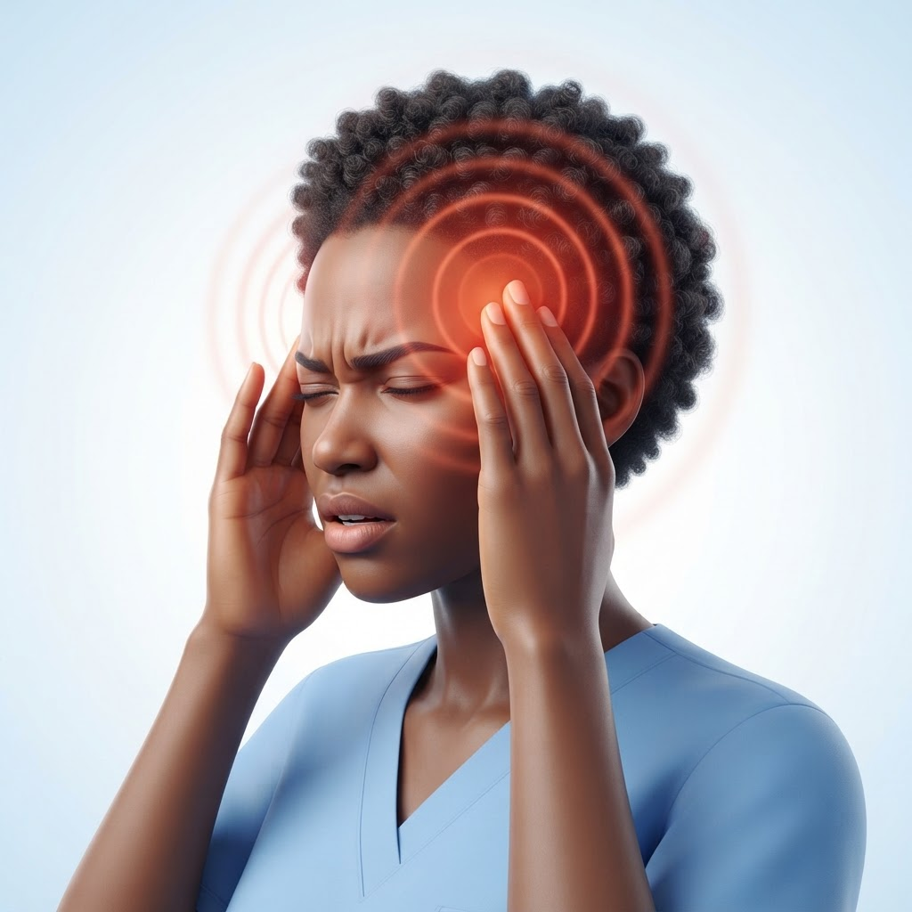
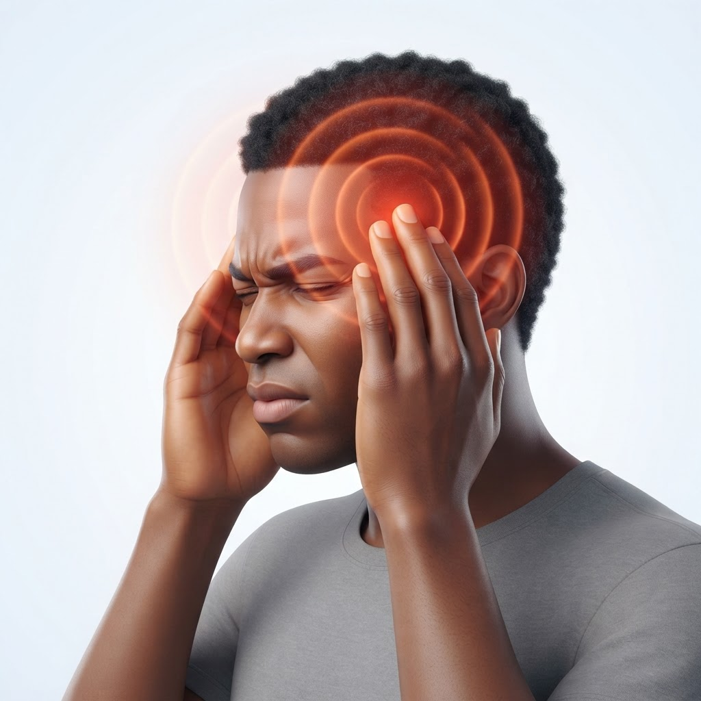
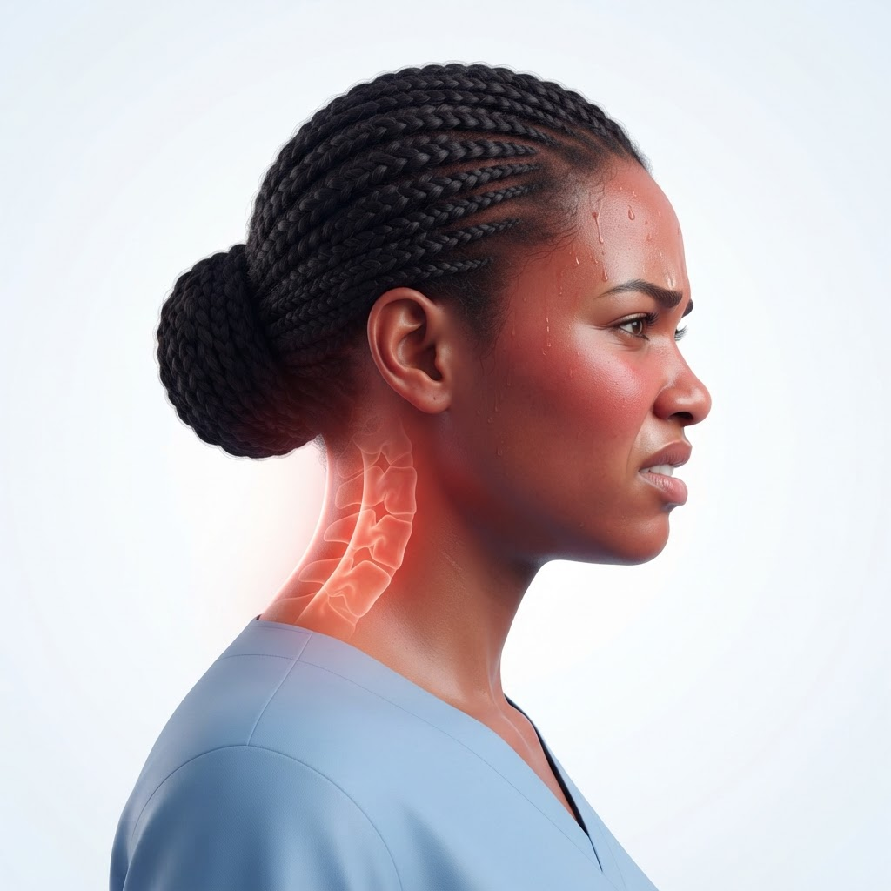
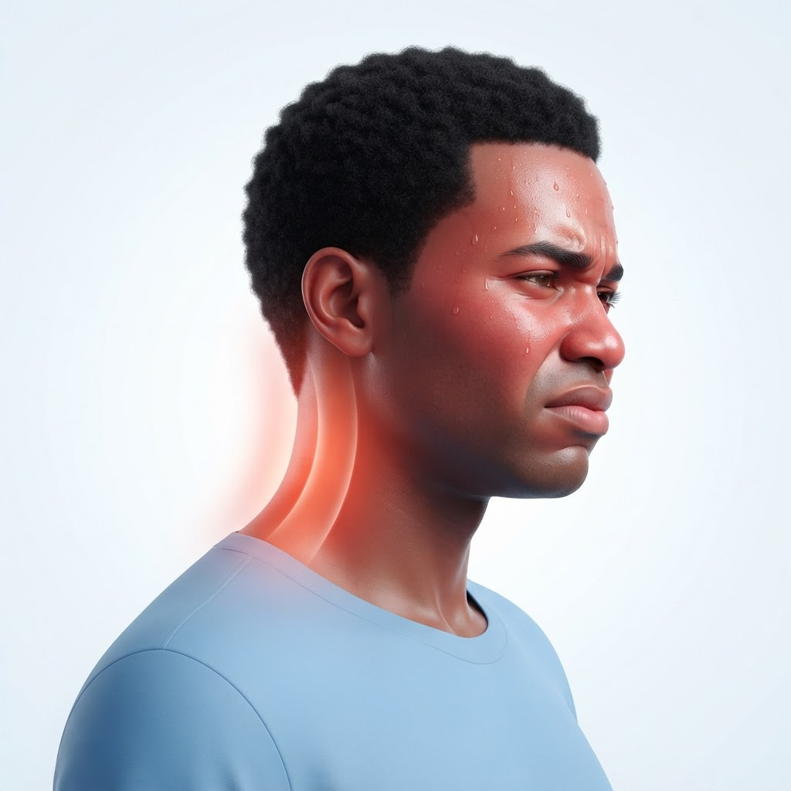
What the symptoms can look like
3 / 8
Illustrations to help a reviewer picture each warning sign. Not diagnostic images.
Severe headache: hands to the temples, pain behind the eyes, throbbing.
Stiff neck with fever: neck held rigid, flushed face, discomfort bending forward.
Your call: do these show the right picture of each symptom? Which expression or posture is missing or misleading for the people we are trying to reach?
TriageAI headache flow | DRAFT for clinician correction | Not medical advice | BETONIQ WEST LTD

Slide 4
Step 1: red-flag questions
4 / 8
Any "yes" leads straight to EMERGENCY. Please check this list hard.
1. Did it come on suddenly and reach full pain within a minute (like a thunderclap)?
2. Is it the worst headache you have ever had?
3. Do you have a stiff neck, or a fever with the headache?
4. Any weakness, numbness, face drooping, trouble speaking or confusion?
5. Any new loss of vision, double vision, or a seizure?
6. Did it follow a head injury or a fall?
7. Have you fainted, or are you very drowsy and hard to wake?
8. Are you pregnant (or just given birth) with a severe headache, swelling or visual changes?
Questions for you
Is anything on this list wrong or missing?
Should "known HIV or on chemotherapy" or "age over 50 with a new headache" be red flags?
Is the pregnancy question worded safely?
Are 8 red flags too many for an SMS flow?
TriageAI headache flow | DRAFT for clinician correction | Not medical advice | BETONIQ WEST LTD

Slide 5

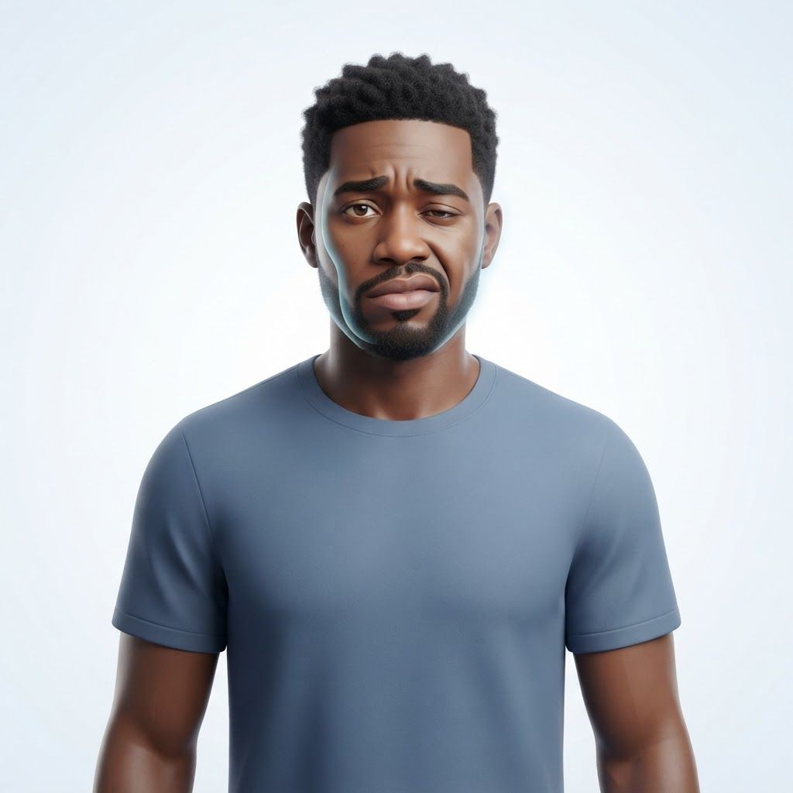


Emergency signs shown visually
5 / 8
A "yes" to any of these sends the person straight to EMERGENCY
Face drooping, one arm weak, confusion: possible stroke signs.
Chest tightness, a squeezing band across the chest: seek urgent care.
Your call: should chest tightness appear in a headache flow at all, or only as a separate flow? Are the stroke signs shown clear enough for a non-medical person?
TriageAI headache flow | DRAFT for clinician correction | Not medical advice | BETONIQ WEST LTD

Slide 6
Step 2: if every red flag is "no"
6 / 8
A few context questions decide between CLINIC TODAY and SELF-CARE
A. How long have you had this headache?
Under 24 hours | 1 to 3 days | more than 3 days
B. Is it getting worse day by day, or waking you from sleep?
C. Do you have vomiting that will not stop, or cannot keep fluids down?
D. Are you over 50 with a headache that is new for you?
E. Do you have a long-term illness or a weak immune system?
F. Is the pain stopping you doing normal daily things?
CLINIC TODAY if any of:
B yes | C yes | D yes | E yes | A is more than 3 days | F yes with fever
SELF-CARE if:
none of the above apply
Your call: are these thresholds sensible, and is anything missing for children?
TriageAI headache flow | DRAFT for clinician correction | Not medical advice | BETONIQ WEST LTD

Slide 7
Step 3: what the person sees
7 / 8
Wording is as important as logic. Please rewrite it freely.
EMERGENCY
"Your answers suggest you should get urgent medical care now. Go to the nearest emergency unit or call emergency services. Do not wait. Do not drive yourself if you feel unwell."
CLINIC TODAY
"Please see a doctor or nurse within 24 hours. If you get a stiff neck, confusion, weakness, vision change or a sudden severe worsening, go to emergency care at once."
SELF-CARE
"This does not look like an emergency. Rest, drink fluids and take your usual pain relief as directed on the pack. See a clinician if it lasts more than 3 days or gets worse, or if any warning sign appears."
Your call: should the SELF-CARE text mention any specific medicine, or never? We lean towards never, so the app does not advise on drugs.
TriageAI headache flow | DRAFT for clinician correction | Not medical advice | BETONIQ WEST LTD

Slide 8
What we are asking, and what we will not do
8 / 8
Your corrections shape the next version
Please tell us:
1. Which red flag or question is unsafe, missing or wrongly worded?
2. Are the three outcomes and their timings right?
3. Which patients should the app refuse to triage at all, such as young children?
4. The single most important change to make first.
What we will not do
Name or suggest a diagnosis.
Advise on medicines or doses.
Publish anything until you have reviewed it.
Use your name publicly without your written agreement.
Reply by voice note, message or a marked-up copy. A few honest lines is plenty. Thank you.
TriageAI headache flow | DRAFT for clinician correction | Not medical advice | BETONIQ WEST LTD

