Slide 1

COLLABORATIVE APPROACHES TO
STRENGTHENING SECURITY
IN NORTH CENTRAL NIGERIA
The Three-Tier Devolution Framework — Regional, Local Government, and Community
BETONIQ WEST LTD — Strategic Briefing Series | Prepared August 22, 2026

Slide 2
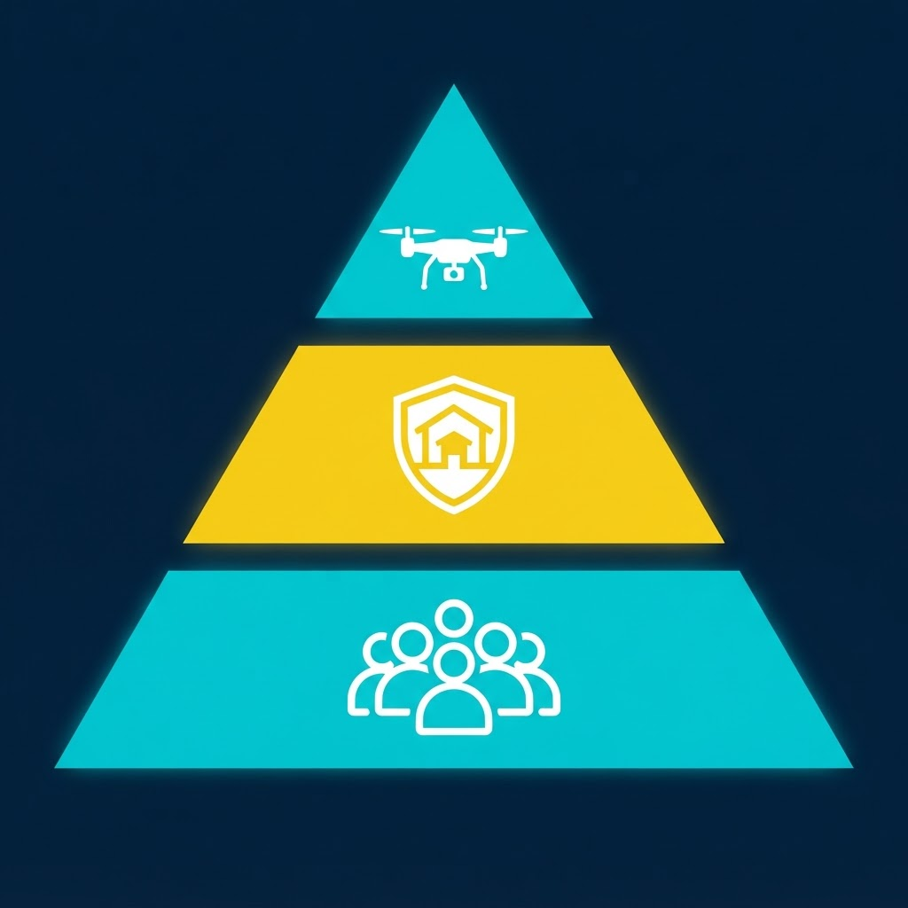
Address Roadmap
› Why centralized security has reached its structural limit
› The empirical record — Niger, FCT/Kogi/Nasarawa, Benue, Plateau
› The Three-Tier Devolution Framework, explained
› Technology that makes devolution affordable
› Safeguards — accountability built in, not bolted on
› The 12-month implementation roadmap
COLLABORATIVE SECURITY — THREE-TIER DEVOLUTION FRAMEWORK
2/30

Slide 3

Opening Remarks
› A policy memorandum, not another response plan
› Grounded in the empirical record from 2025–2026
› Three operational tiers: Regional, Local Government, Community
COLLABORATIVE SECURITY — THREE-TIER DEVOLUTION FRAMEWORK
3/30

Slide 4
Executive Summary
› North Central: Nigeria's agricultural engine and socioeconomic bridge
› Centralized federal control has proven structurally inadequate
› Devolves tactical control, intelligence, and surveillance across 3 tiers
› Built on the 2026 National Assembly decentralized-policing bills
COLLABORATIVE SECURITY — THREE-TIER DEVOLUTION FRAMEWORK
4/30

Slide 5

The Context of Insecurity
› Threats shifted: land disputes → monetized, trans-border criminal networks
› Not a lack of military intent — a deep implementation gap
› Bureaucratic chains of command delay engagement of local threats
COLLABORATIVE SECURITY — THREE-TIER DEVOLUTION FRAMEWORK
5/30

Slide 6
The Implementation Gap
› Vast rural/forested terrain becomes ungoverned space
› Criminal groups exploit the absence of immediate state authority
› Target: agricultural clusters and educational institutions
COLLABORATIVE SECURITY — THREE-TIER DEVOLUTION FRAMEWORK
6/30

Slide 7

Case Study: Niger State School Abduction
› Early 2025: mass abduction, hundreds of students marched into forest
› DSS + Army rescue succeeded — but weeks of delay, not minutes
› This is exactly the delay Tier Two is engineered to eliminate
COLLABORATIVE SECURITY — THREE-TIER DEVOLUTION FRAMEWORK
7/30

Slide 8
Case Study: The FCT–Kogi–Nasarawa Corridor
› 2021–2025: staggering escalation in kidnapping events
› Syndicates exploit state-border seams to evade pursuit
› The exact seam a Regional Security Coalition eliminates
COLLABORATIVE SECURITY — THREE-TIER DEVOLUTION FRAMEWORK
8/30

Slide 9
Case Study: Benue and Plateau Communal Violence
› Late 2025–early 2026: recurrent communal violence
› Without local early-warning, military response stays reactive
› A common signature: lag between first tension and capable response
COLLABORATIVE SECURITY — THREE-TIER DEVOLUTION FRAMEWORK
9/30

Slide 10

The Structural Failure of Centralized Architecture
› Governing 200M+ people from one command in Abuja is unsustainable
› Governors are 'chief security officers' with no command authority
› Political accountability without tactical control = paralysis
COLLABORATIVE SECURITY — THREE-TIER DEVOLUTION FRAMEWORK
10/30

Slide 11
Five Structural Pathologies
› 1. Fragmented inter-agency coordination
› 2. Deficit in localized intelligence integration
› 3. Critical equipment shortages in rural stations
› 4. Weak prosecutorial efficacy for arrested bandits
› 5. Siloed institutional culture among federal agencies
COLLABORATIVE SECURITY — THREE-TIER DEVOLUTION FRAMEWORK
11/30

Slide 12
Conceptualizing Devolution
› Policing as collaborative civic responsibility, not federal monopoly
› Routine Activity Theory: crime needs an absent 'capable guardian'
› Devolution places that guardian directly within the community
COLLABORATIVE SECURITY — THREE-TIER DEVOLUTION FRAMEWORK
12/30

Slide 13
The Three-Tier Framework
REGIONAL
Legislative harmony, data fusion, trans-border rapid response
LOCAL GOVERNMENT
Funding, multi-agency deployment, infrastructure security
COMMUNITY
Human intelligence, grassroots mediation, neighbourhood watch
COLLABORATIVE SECURITY — THREE-TIER DEVOLUTION FRAMEWORK
13/30

Slide 14

Tier One: The Regional Security Coalition
› NCDC's ₦140 billion 2026 budget powers a Joint Security Command
› Bypasses state-border limits — no jurisdiction-hopping for criminals
› 6 states + FCT, one unified regional command
COLLABORATIVE SECURITY — THREE-TIER DEVOLUTION FRAMEWORK
14/30

Slide 15
Regional Data Fusion Centre & HALE Drones
› Real-time satellite imagery, geospatial mapping, cellular metadata
› High-altitude, long-endurance drones over Niger, Kaduna, FCT forests
› Continuous thermal coverage, coordinates relayed direct to strike teams
COLLABORATIVE SECURITY — THREE-TIER DEVOLUTION FRAMEWORK
15/30

Slide 16
Tier Two: Local Government Area Command Hubs
› 121 LGAs, each with a Local Security Advisory Council
› Chaired by the elected Council Chairman
› Police, NSCDC, Army, and local intel — one coordinating table
COLLABORATIVE SECURITY — THREE-TIER DEVOLUTION FRAMEWORK
16/30

Slide 17

Biometric Profiling & the 15-Minute Standard
› Registers residents, pastoralists, transport operators
› Eliminates anonymity insurgent networks rely on
› Alert → armed enforcement within a max 15-minute window
COLLABORATIVE SECURITY — THREE-TIER DEVOLUTION FRAMEWORK
17/30

Slide 18

Tier Three: Grassroots Community-Led Intelligence
› Security as active civic duty, not a distant state function
› Legally integrates watch groups, hunters, and the VGN
› Operates under strict formal oversight
COLLABORATIVE SECURITY — THREE-TIER DEVOLUTION FRAMEWORK
18/30

Slide 19
M-PIDS: Every Citizen an Intelligence Node
› Standard smartphones, offline-capable apps
› Geotagged evidence sent instantly to the LGA Command Hub
› From passive bystander to protected intelligence node
COLLABORATIVE SECURITY — THREE-TIER DEVOLUTION FRAMEWORK
19/30

Slide 20

Integrating Traditional & Religious Leadership
› Emirs and chiefs hold unmatched local legitimacy and intelligence
› Mandatory town hall security dialogues, on a fixed schedule
› Mediates farmer-herder friction before it becomes violence
COLLABORATIVE SECURITY — THREE-TIER DEVOLUTION FRAMEWORK
20/30

Slide 21

Low-Cost Smart Surveillance Tools
› Regional tier funds drones; local tiers use COTS equipment
› Minimal maintenance, basic training required
› Affordability is designed in, not an afterthought
COLLABORATIVE SECURITY — THREE-TIER DEVOLUTION FRAMEWORK
21/30

Slide 22
LoRa, Acoustic Sensors & Predictive AI
› Solar mesh cameras at rural transit choke points
› LoRa devices — no cellular network required
› Acoustic gunshot detection feeds predictive AI at LGA hubs
COLLABORATIVE SECURITY — THREE-TIER DEVOLUTION FRAMEWORK
22/30

Slide 23
Safeguards & the Risk of Abuse
› Political weaponization and extrajudicial excess are real risks
› No formation operates without registration + DSS vetting
› Continuous human-rights training, mandatory not optional
COLLABORATIVE SECURITY — THREE-TIER DEVOLUTION FRAMEWORK
23/30

Slide 24
The Independent Civilian Oversight Board
› Human rights attorneys, civil society, retired judges
› Power to investigate, audit spending, recommend prosecution
› Public safety only counts if constitutional rights hold
COLLABORATIVE SECURITY — THREE-TIER DEVOLUTION FRAMEWORK
24/30

Slide 25

Implementation: Phase One — Legal Alignment
› Months 1–3
› Pass uniform sub-national legislation across all states
› Built on the 2026 state-policing amendment bills
COLLABORATIVE SECURITY — THREE-TIER DEVOLUTION FRAMEWORK
25/30

Slide 26
Implementation: Phases Two & Three
› Phase 2 (Months 4–8): fund LGA hubs, deploy biometric + M-PIDS grids
› Phase 3 (Months 9–12): full integration + inter-agency field simulations
COLLABORATIVE SECURITY — THREE-TIER DEVOLUTION FRAMEWORK
26/30

Slide 27
Conclusion: Structural Evolution
› Centralized operations alone cannot resolve this crisis
› Devolve control across all three tiers — together, not in isolation
COLLABORATIVE SECURITY — THREE-TIER DEVOLUTION FRAMEWORK
27/30

Slide 28
Closing: A Call to Action
› This restores governance legitimacy, not just security
› The technology exists today; the constitutional path is already open
COLLABORATIVE SECURITY — THREE-TIER DEVOLUTION FRAMEWORK
28/30

Slide 29
Final Words
› The tiers are defined. The tools exist. The bill is before the House.
› What remains is the will to implement it — starting now.
COLLABORATIVE SECURITY — THREE-TIER DEVOLUTION FRAMEWORK
29/30

Slide 30

References
Akinfe, A. (2026) 'The Nigeria Geo-Political Zone Bill 2026', Restructuring Policy Review, 14(2), pp. 45-62.
ACLED (2026) Asymmetrical Violence and Fragmented Criminal Networks in Central Nigeria: 2023-2026. Abuja: ACLED Africa Bureau.
Egwemi, V. and Odo, L.U. (2003) 'Local Government Administration and Rural Security Challenges', J. Econ. Admin. Studies, 1(1), pp. 12-25.
Fapohunda, A. (2024) New Governance Model for Nigeria Act 2024. Lagos: Afenifere Policy Secretariat.
National Assembly of Nigeria (2026) Joint Committee Report on State and Decentralized Police Forces (HB.1422/SB.893). Abuja: NASS Press.
NCDC (2026) Strategic Action Plan and Capital Budget Allocation FY2026. Abuja: NCDC Federal Secretariat.
Nwachukwu, B.U. and Ellah, C.C. (2024) 'Local Government and Security Challenges in Nigeria', IJEDSS, 1(1), pp. 15-32.
Olayiwola, L. (2026) 'Deconstructing Nigeria's Asymmetrical Security Challenge', The Cable Policy Series, 21 Aug.
Oteri, J. (2026) 'Decentralized Security Architecture', Keynote, Feast of Barracuda, NAS, Zuma Deck, Abuja, 20 June.
Routine Activity Theory Review (2026) 'Community-Based Approaches to Tackling Insecurity', J. Crime Justice Studies, 8(3), pp. 114-129.
COLLABORATIVE SECURITY — THREE-TIER DEVOLUTION FRAMEWORK
30/30

