Slide 1


NORTH-CENTRAL NIGERIA SECURITY SUMMIT
COLLABORATIVE APPROACHES TO STRENGTHENING SECURITY IN NORTH-CENTRAL NIGERIA
Towards a People-Centred, Intelligence-Led and Sustainable Security Architecture
Air Vice Marshal Monday Riku Morgan (Rtd) | Former Chief of Defence Intelligence | 30-Minute Keynote
01

Slide 2

SECTION 1
The North-Central Paradox
02
Benue • Kogi • Kwara • Nasarawa • Niger • Plateau • FCT
THE QUESTION
▸ Bridge between North and South — the heartland of Nigeria’s territorial cohesion
▸ Home to vital agricultural lands, forests, water resources and mineral deposits
▸ Yet increasingly an arena of insecurity, displacement and communal tension
▸ Kidnapping, banditry, and violent competition over land and resources
▸ A region that should be a bastion of unity and food security
▸ The paradox: resource-rich, strategically vital — yet chronically insecure
Not simply: who is responsible for the insecurity? The deeper question: why, despite the Armed Forces, Police, intelligence agencies, civil defence, state institutions and traditional structures, does insecurity keep reproducing itself? This paper submits: the challenge is not the absence of institutions. It is the fragmentation of the response.
02
AVM Monday Riku Morgan (Rtd) — North-Central Security Summit
2 / 26

Slide 3
OPENING — THE SCALE OF THE CRISIS
The Human Cost, In Numbers
03
SIX FIGURES THAT DEFINE THE PROBLEM
ACCOUNTABILITY
▸ 140+ killed — Plateau State, December 2023.
▸ 1,043 killed in Benue State, May 2023 – 2025.
▸ 160 killed in a single night — Yelwata.
9 individuals have been charged with terrorism over the Yelwata killings. The numbers behind them are why this keynote exists.
03
AVM Monday Riku Morgan (Rtd) — North-Central Security Summit
3 / 26

Slide 4
SECTION 2
The Critical Question — Fragmentation, Not Absence
04
Farmer Sees
Ruler Sees
Vigilante Sees
Ranger Sees
Police Sees
Intel Officer Sees
No Fusion
A threat is seen — but seen by everyone, owned by no one.
THE PROBLEM: “Information that does not reach a common system remains merely information.”
THE STAKES: “Information that does not produce action cannot protect lives.”
04
AVM Monday Riku Morgan (Rtd) — North-Central Security Summit
4 / 26

Slide 5
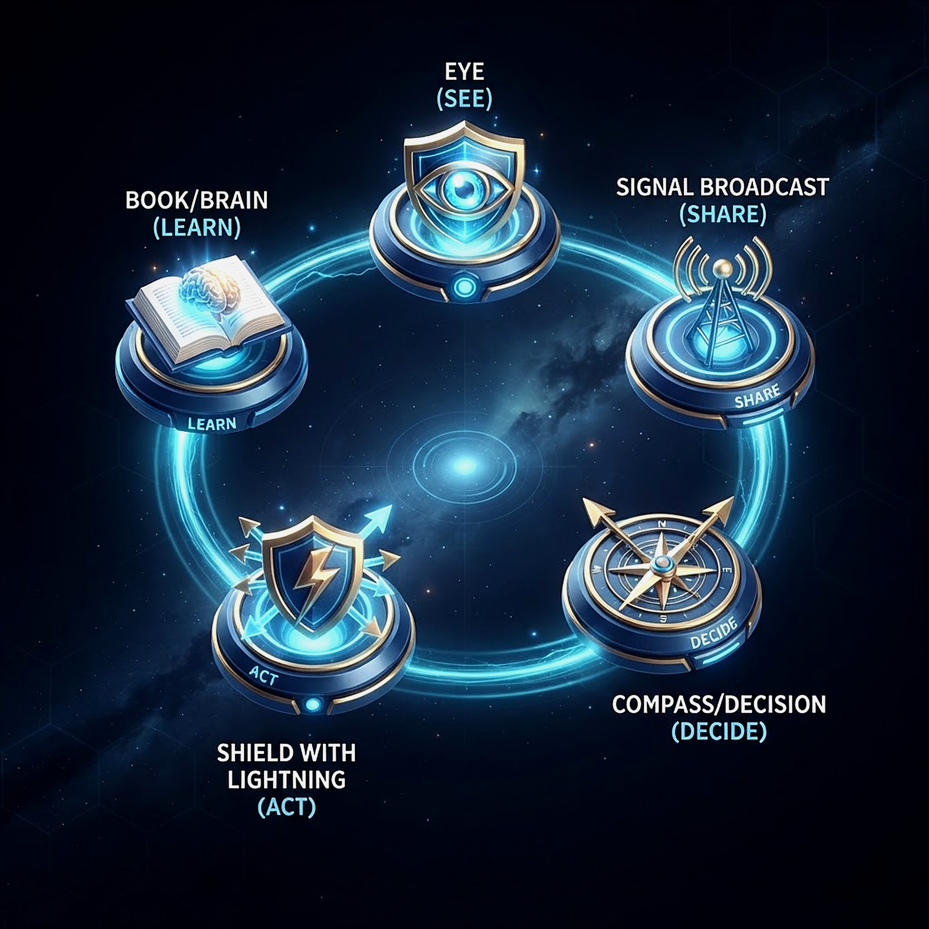
SECTION 3
Collaboration as the Centrepiece
05
Not occasional meetings between agencies — one common security framework, understood at every level of government.
SHARED
Intelligence is shared
INTEGRATED
Capabilities are integrated
COMPLEMENTARY
Responsibilities are complementary
ENGAGED
Communities are engaged
EXPLOITED
Technology is exploited
05
AVM Monday Riku Morgan (Rtd) — North-Central Security Summit
5 / 26

Slide 6
SECTION 4
Four Shifts the North-Central Must Make
06
Agency-Centric → System-Centric
Reaction → Prevention
Isolated Intel → Fusion
Govt-Only → Partnership
NDLEA / Customs
State Security Councils
Local Govt Structures
Traditional Institutions
Community & Civil Society
06
AVM Monday Riku Morgan (Rtd) — North-Central Security Summit
6 / 26

Slide 7
SECTION 5
Lessons From Israel and Britain
07
1
Israel: intelligence, military, emergency structures and communities fused into one resilient system
TOWARD A NIGERIAN MODEL
2
Britain: institutions retain distinct roles, coordinated within one national framework
▸ Intelligence fusion (Israel)
▸ Institutional coordination (Britain)
▸ State & local government participation
▸ Traditional institutions & community early-warning
▸ Modern technology
▸ The reservoir of retired military, intelligence & police professionals
3
Nigeria cannot simply copy either model
4
We must build a Nigerian model — our own hybrid
5
Combining intelligence fusion, inter-agency coordination, and community early warning
07
AVM Monday Riku Morgan (Rtd) — North-Central Security Summit
7 / 26

Slide 8
SECTION SIX
The Central Question — Two Models to Learn From
08
ISRAEL • BRITAIN • NIGERIA
WHY THESE TWO
▸ Not whether Nigeria has enough security agencies — we do.
▸ The real question: are agencies, governments, communities and citizens connected enough to act as one system?
▸ Two nations offer proven, opposite-but-complementary answers: Israel and Britain.
Israel: deep integration under sustained threat. Britain: coordination without destroying institutions. Together they map the Nigerian hybrid.
08
AVM Monday Riku Morgan (Rtd) — North-Central Security Summit
8 / 26

Slide 9
SECTION SEVEN
Two Proven Models, One Nigerian Hybrid
09
UNITED KINGDOM — COORDINATION, NOT REPLACEMENT
ISRAEL — INTEGRATION AS DOCTRINE
▸ CONTEST: Prevent, Pursue, Protect, Prepare — four pillars, one strategy ▸ 43 police forces cooperate nationally — capability surges, local ties stay intact ▸ CTOC turns shared intelligence into action faster ▸ Principle: centralise intelligence & standards; decentralise implementation
▸ NSC fuses intel, political, military & government info into one national assessment ▸ Home Front Command links military capability directly to local authorities ▸ Chain: intelligence → decision → command → local authority → community → response ▸ The citizen is not a victim waiting for government — the citizen IS the architecture
09
AVM Monday Riku Morgan (Rtd) — North-Central Security Summit
9 / 26

Slide 10
SECTION EIGHT
The Israeli Model — The Citizen as Sensor
10
HOME FRONT COMMAND
THE PRINCIPLE
▸ The Home Front Command keeps a continuous relationship with local authorities.
▸ Exercises, emergency plans, and a direct link between military capability and civilian structures.
▸ The citizen is not a victim waiting for government — the citizen is part of the security architecture.
▸ Our communities already know who is entering the forest, who is moving cattle, who is unfamiliar — often before headquarters does.
Intelligence to decision to command to local authority to community to response — a continuous loop, not a one-way order.
10
AVM Monday Riku Morgan (Rtd) — North-Central Security Summit
10 / 26

Slide 11
SECTION NINE
Five Lessons Israel Offers North-Central Nigeria
11
WHAT WE BORROW — AND WHAT WE DON’T
THE CAVEAT
▸ Permanent intelligence fusion.
▸ Strong regional operational coordination.
▸ Military–police–intelligence integration.
▸ Prepared local authorities.
▸ Community participation and resilience.
We do not copy Israel’s highly militarised environment wholesale — Nigeria is a larger, more diverse federation with different realities.
11
AVM Monday Riku Morgan (Rtd) — North-Central Security Summit
11 / 26

Slide 12
SECTION TEN
The UK Model — CONTEST and Coordinated Policing
12
FOUR PILLARS, ONE STRATEGY
THE CTOC
▸ CONTEST: Prevent, Pursue, Protect, Prepare — linking government, intelligence, police, military, emergency services, local authorities and communities.
▸ Forty-three police forces across England and Wales, plus Scotland and Northern Ireland, cooperate through one national counter-terrorism structure.
▸ Capability surges to wherever the threat is greatest, without dismantling local forces.
The Counter Terrorism Operations Centre converts intelligence into action faster by putting agencies and policing in the same room.
12
AVM Monday Riku Morgan (Rtd) — North-Central Security Summit
12 / 26

Slide 13
SECTION ELEVEN
The UK Model — The Lesson for Nigeria
13
ONSA / NCTC
THE PRINCIPLE
▸ Nigeria’s NCTC already runs an all-source intelligence function under ONSA.
▸ Whole-of-Government, Whole-of-Society is already our stated doctrine.
▸ The gap is not institutions. It is integration between them.
Centralise intelligence. Decentralise delivery. Let every agency keep its identity while operating toward one national objective.
13
AVM Monday Riku Morgan (Rtd) — North-Central Security Summit
13 / 26

Slide 14
SECTION TWELVE
Israel vs UK — Neither Model Alone Is Right for Us
14
Dimension | Israeli Model | UK Model
Intelligence | Highly integrated | Highly coordinated
Military role | Very prominent | More specialised
Local authorities | Strong emergency role | Strong prevention role
Community | Active security participant | Prevention & resilience partner
Command | Strong operational integration | Networked coordination
Technology | Very intensive | Very intensive
National strategy | Strong central direction | Strong central framework
Best lesson for Nigeria | Integration & rapid response | Coordination & institutional balance
14
AVM Monday Riku Morgan (Rtd) — North-Central Security Summit
14 / 26

Slide 15
SECTION THIRTEEN
The Hybrid Model — The NCISRM
15
THE NORTH-CENTRAL INTEGRATED SECURITY & RESILIENCE MODEL
ONE SENTENCE
▸ Israeli intelligence integration.
▸ Israeli local resilience.
▸ British institutional coordination.
▸ Nigerian community intelligence.
Neither model copied wholesale — a deliberate Nigerian hybrid, built for our federation, our geography and our communities.
15
AVM Monday Riku Morgan (Rtd) — North-Central Security Summit
15 / 26

Slide 16
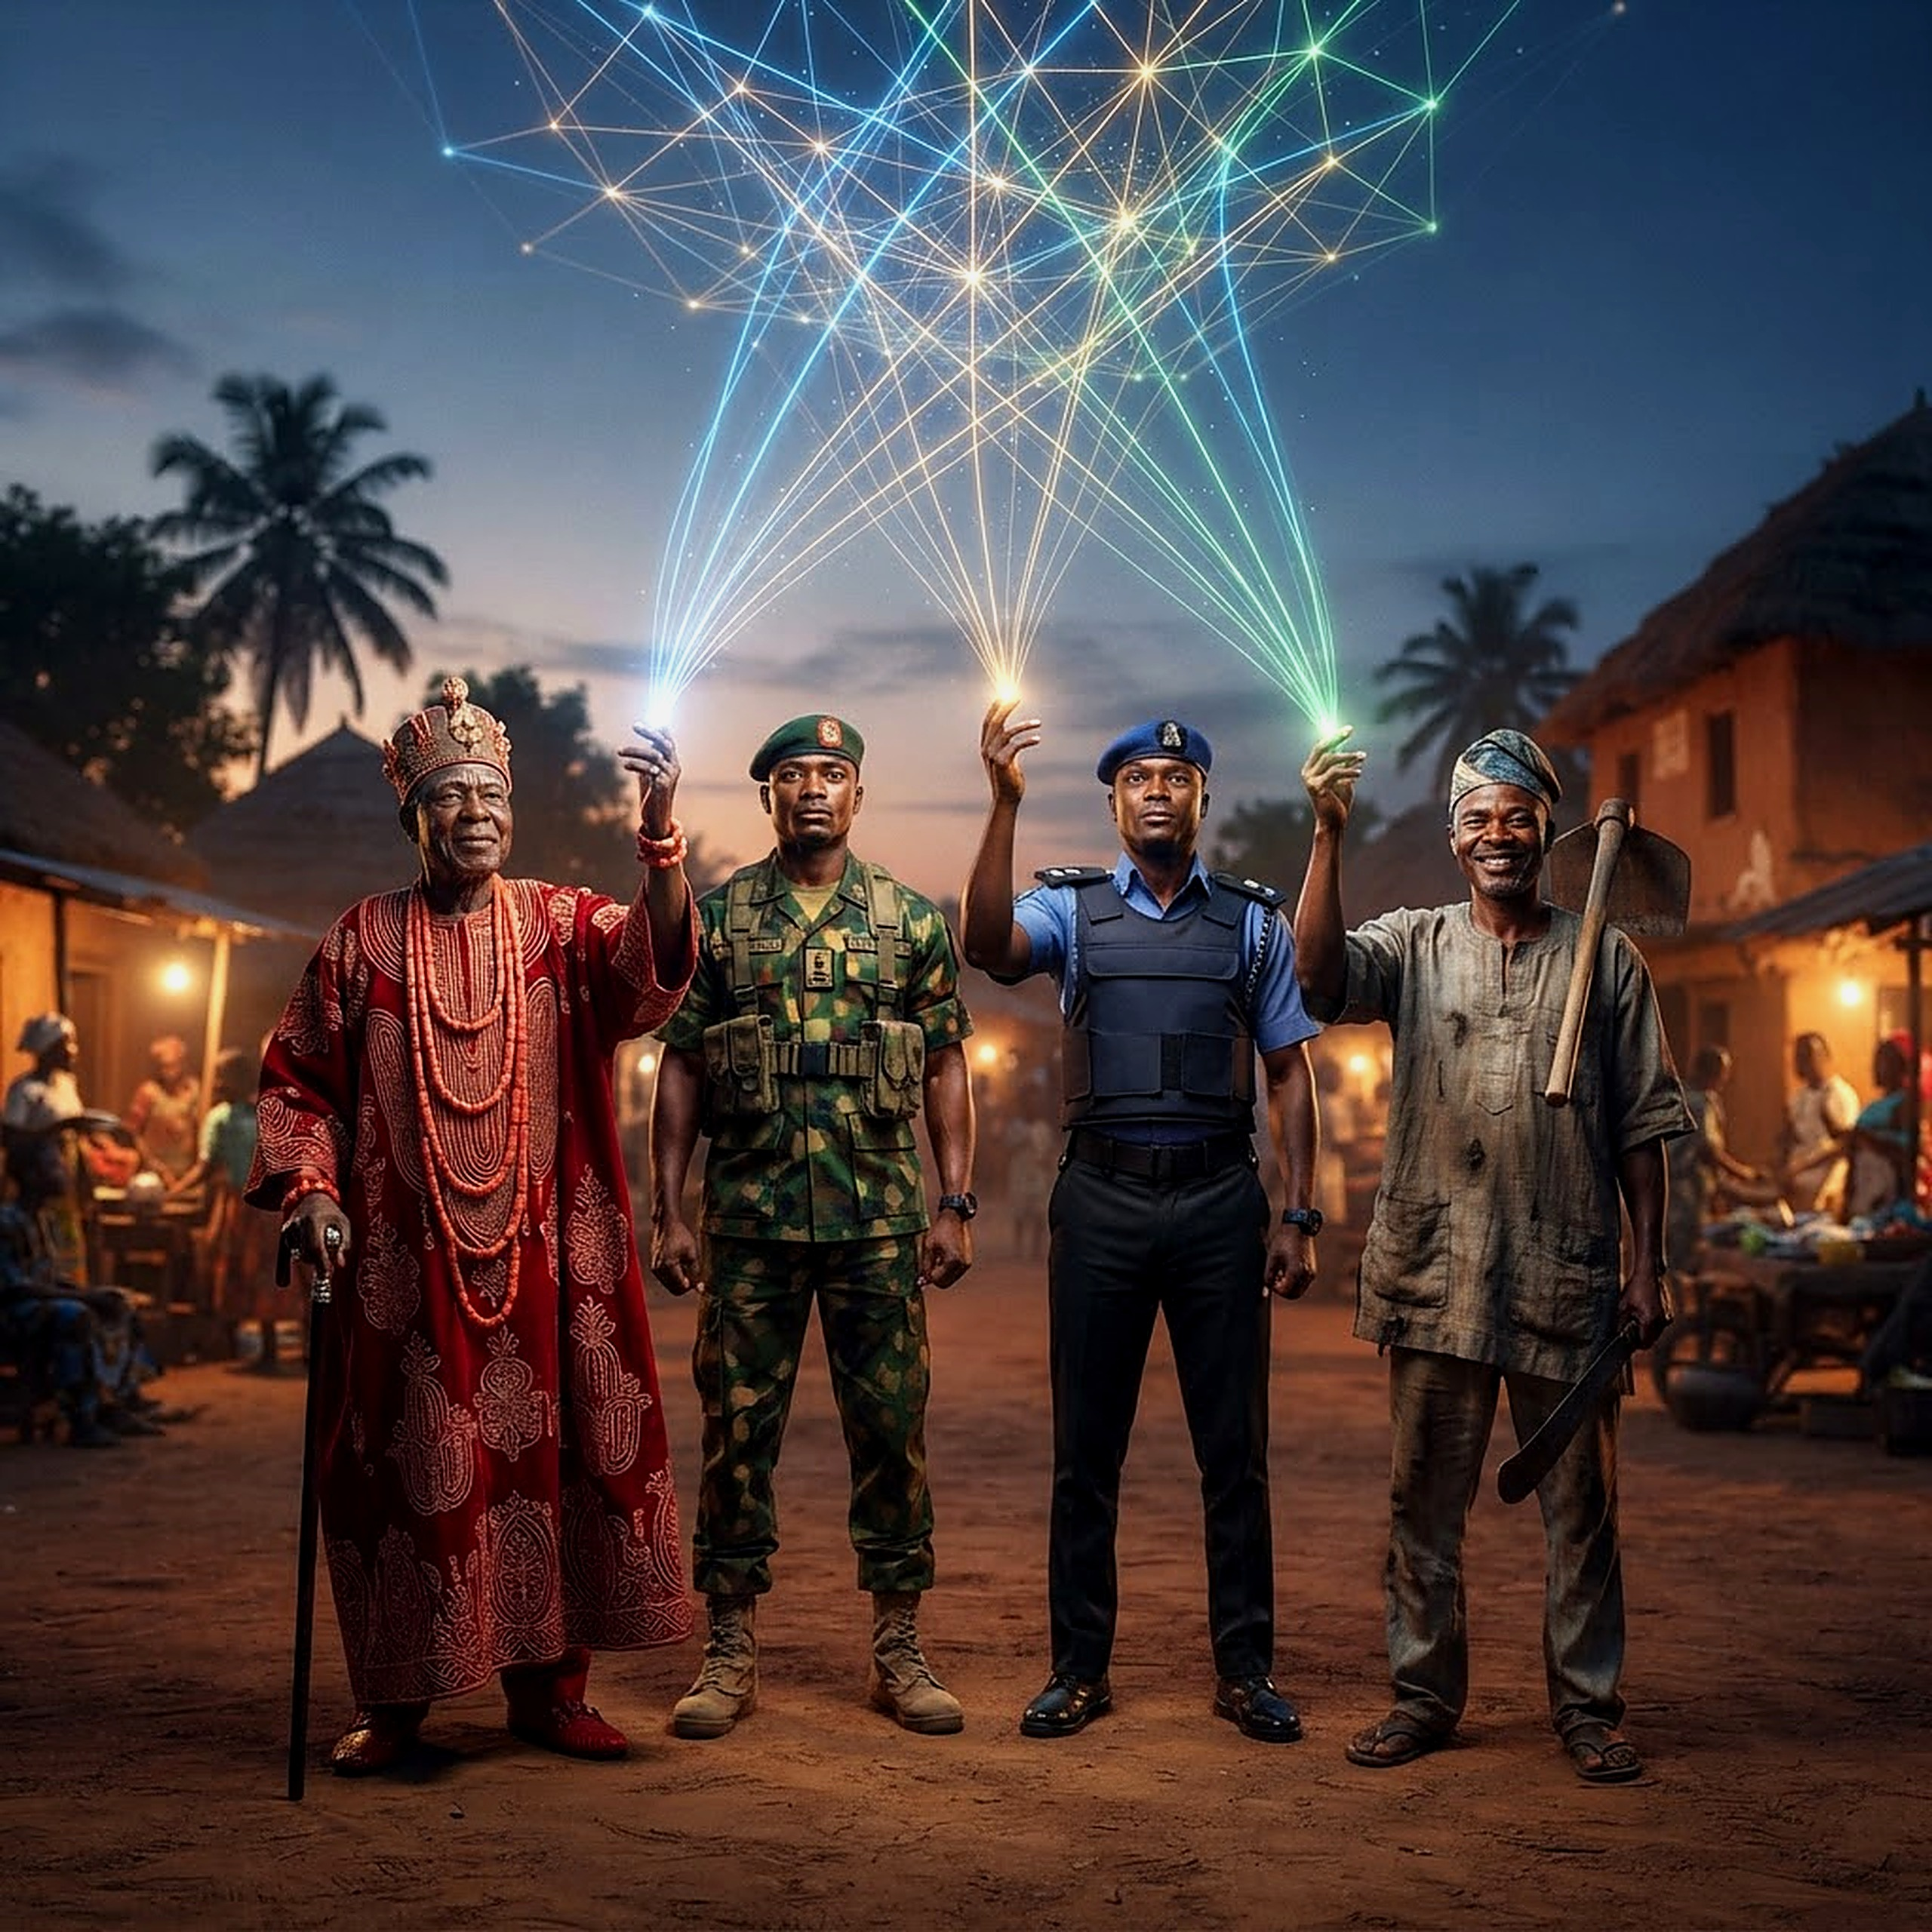
The NCISRM — Five Levels, One System
Level 1: Regional Fusion Centre • Level 2: State Coordination Centres • Level 3: Local Security Network • Level 4: Forest & Rural Layer • Level 5: The Citizen
Five levels, one threat picture — from the regional fusion centre down to the citizen, who must become a sensor in the network, not simply a casualty statistic.
16
AVM Monday Riku Morgan (Rtd) — North-Central Security Summit
16 / 26

Slide 17
SECTION FIFTEEN
NCISRM Level Three — The Local Security Network
17
ONE STRUCTURE PER HIGH-RISK LGA
THE GOAL
▸ Security agencies + traditional institutions + local government + community leaders.
▸ Farmers + pastoralists + credible civil society + trained community observers.
▸ One integrated structure per high-risk LGA — structured early warning, lawful information sharing.
▸ This is not vigilante justice.
Turn scattered local knowledge into one lawful, structured channel that reaches the state coordination centre in minutes, not weeks.
17
AVM Monday Riku Morgan (Rtd) — North-Central Security Summit
17 / 26

Slide 18
SECTION SIXTEEN
NCISRM Level Four — The Forest and Rural Security Layer
18
DENY SANCTUARY, NOT THE FARMER
THE PRINCIPLE
▸ Forests and rural spaces cannot remain intelligence black holes.
▸ Rangers become the eyes and ears of the state — trained, equipped, connected.
▸ Specialised units retain the high-risk operations; rangers are not asked to fight wars.
Deny sanctuary, mobility, supplies, communications, financing and movement to armed groups — without criminalising the honest farmer or herder.
18
AVM Monday Riku Morgan (Rtd) — North-Central Security Summit
18 / 26

Slide 19
THE CENTRAL PROBLEM, RESTATED
We Are Too Reactive
19
THE CYCLE THAT REPEATS
THE ENORMITY OF THE PROBLEM
▸ An attack occurs. People are killed.
▸ Police are alerted. The military is mobilised.
▸ The attackers vanish. The community is searched.
No amount of additional manpower fixes a cycle that is structurally reactive. This is the scale we must design our way out of — not police our way out of.
19
AVM Monday Riku Morgan (Rtd) — North-Central Security Summit
19 / 26

Slide 20
SECTION SEVENTEEN
NCISRM Level Five — The Citizen
20
THE CITIZEN AS SENSOR
THE STANDARD
▸ Who do I call?
▸ What do I report?
▸ How do I report it?
▸ What happens after I report it?
The citizen must become a sensor in the security network — not simply a casualty statistic.
20
AVM Monday Riku Morgan (Rtd) — North-Central Security Summit
20 / 26

Slide 21
SECTION EIGHTEEN
The Role of Veterans — The North-Central Advantage
21
▸ A large pool of experienced retired military, intelligence & police professionals
▸ Contributes intelligence analysis and strategic planning
▸ Delivers training, mentoring and simulation exercises
▸ Strengthens early-warning systems and lessons-learned review
▸ Never replaces serving personnel — strengthens the system instead
REGIONAL SECURITY ADVISORY & TRAINING RESERVE
Veteran Reserve
Intel Analysis
Strategic Planning
Training & Mentoring
Early Warning
Lessons Learned
21
AVM Monday Riku Morgan (Rtd) — North-Central Security Summit
21 / 26

Slide 22
SECTION NINETEEN
From Reaction to Prevention — The Fifth P
22
Attack, deploy, fight, withdraw, wait — that is reactive. Information, analysis, early warning, prevention, response, recovery — that is collaborative.
PREVENT
PURSUE
PROTECT
PREPARE
PARTNER
COLLABORATIVE SECURITY
The Nigerian answer: Israeli integration + Israeli local resilience + British coordination + Nigerian community intelligence — the NCISRM.
22
AVM Monday Riku Morgan (Rtd) — North-Central Security Summit
22 / 26

Slide 23
SECTION TWENTY
Conclusion — Three Lessons, One System
23
NO INTELLIGENCE ISOLATED. NO COMMUNITY DISCONNECTED.
THE SYNTHESIS
▸ Israel: no intelligence should remain isolated, and no community should remain disconnected from the security system.
▸ Britain: different agencies can retain their identities while operating toward one national objective.
▸ Nigeria: our solution must be built around our geography, our communities, our constitutional structure and our own realities.
Three lessons. One system. A model that is unmistakably Nigerian.
23
AVM Monday Riku Morgan (Rtd) — North-Central Security Summit
23 / 26

Slide 24
SECTION TWENTY-ONE
Conclusion — The Nigerian Commitments
24
UNMISTAKABLY NIGERIAN
NINE COMMITMENTS
▸ Centralised intelligence. Integrated command. Decentralised community engagement.
▸ Technology-enabled surveillance. Prepared local authorities. Veteran expertise.
▸ Early warning. Rapid response. Continuous learning.
These nine commitments are the measurable core of the NCISRM — what North-Central Nigeria will actually build, together.
24
AVM Monday Riku Morgan (Rtd) — North-Central Security Summit
24 / 26

Slide 25

“He simply wants to arrive alive.”
Not a soldier in every village — a system where intelligence reaches the right commander, the commander reaches the right capability, and the capability reaches the threatened community before the attack occurs.
Finally, I recommend the establishment of a North-Central Security Endowment Fund, jointly financed by the Federal Government and the North-Central Governors, with transparent governance and sustainable funding to meet the significant financial requirements of implementing this new security architecture.
Thank you.
25
THANK YOU — Air Vice Marshal Monday Riku Morgan (Rtd)

Slide 26
REFERENCES
Sources
26
Israel National Security Council (2023) National Security Concept and the Role of the Situation Room. Jerusalem: Prime Minister’s Office.
Israel Home Front Command (2022) Civilian Preparedness and Local Authority Coordination Doctrine. Ramla: Israel Defense Forces.
Byman, D. (2011) A High Price: The Triumphs and Failures of Israeli Counterterrorism. Oxford: Oxford University Press.
International Crisis Group (2024) Rethinking Nigeria’s Approach to Farmer-Herder and Communal Conflict. Brussels: ICG.
HM Government (2023) CONTEST: The United Kingdom’s Strategy for Countering Terrorism. London: Home Office.
National Police Chiefs’ Council (2022) Counter Terrorism Policing: National Structures and the CTOC. London: NPCC.
Office of the National Security Adviser, Nigeria (2024) National Counter Terrorism Centre: Whole-of-Government Framework. Abuja: ONSA.
ACLED (2025) Nigeria: North-Central Conflict Trends, Benue, Plateau and Niger States. Madison, WI: ACLED.
26
AVM Monday Riku Morgan (Rtd) — North-Central Security Summit
26 / 26

