Slide 1
01 / 23
NORTH-CENTRAL SECURITY SUMMIT · 20-YEAR DEVELOPMENT PLAN · 2026
SECURITY AS THE FOUNDATION OF 20-YEAR DEVELOPMENT
Presented by AVM Monday Riku Morgan (Rtd)
"Give communities the resources, institutions and partnerships to secure peace — and peace will give development the space to flourish."
SAY: Open with the full 2-minute introduction — LG financial autonomy is the hinge that changes the whole security equation.

Slide 2
02 / 23
DOCUMENTED EVIDENCE · TABLE 1
Chronology of Kidnapping & Banditry
Period | Location | Incident | Killed | Abducted
May 2026 | Plateau State | Coordinated attacks, multiple communities | 62 | —
June 2026 | Plateau State | Continued attacks, multiple LGAs | 43 | —
1-11 Jul 2026 | Plateau State | Early-July escalation | 16 | —
22 Aug 2026 | Niger (Borgu) | Mosque raid, Kpenya/Dekara | 30 confirmed | 60-80 confirmed; 600 UNVERIFIED
Aug 2026 (ongoing) | Niger → Benin Rep. | Mass displacement post-raid | — | ~2,000 fled
Jul25-Jun26 | National | Full 12-month total | 1,142 | 7,825
NOTE: "Unverified" figures (e.g. 600 claim) are video-sourced, not police-confirmed — distinguish confirmed vs unverified at the podium.
SAY: A 12-month, nationally-documented pattern — North-Central sits at the centre of it.

Slide 3
03 / 23
DOCUMENTED EVIDENCE · TABLE 2
The Economy of Kidnapping
Metric | Figure | Note
Total ransom paid (12 months) | ₦7.78 billion | SBM Intelligence (2026)
Total victims (12 months) | 7,825 | SBM Intelligence (2026)
Average ransom per victim | ≈ ₦994,500 | Calculated: ₦7.78bn ÷ 7,825
USD equivalent of total ransom | ≈ US$5.2 million | ≈₦1,500/US$1; matches Reuters (2026c)
Year-on-year growth | 66% | SBM Intelligence (2026)
NOTE: Average-per-victim and USD figures are calculated national averages, not confirmed per-case amounts.
SAY: Every naira paid is seed capital for the next attack — a self-funding business model.

Slide 4
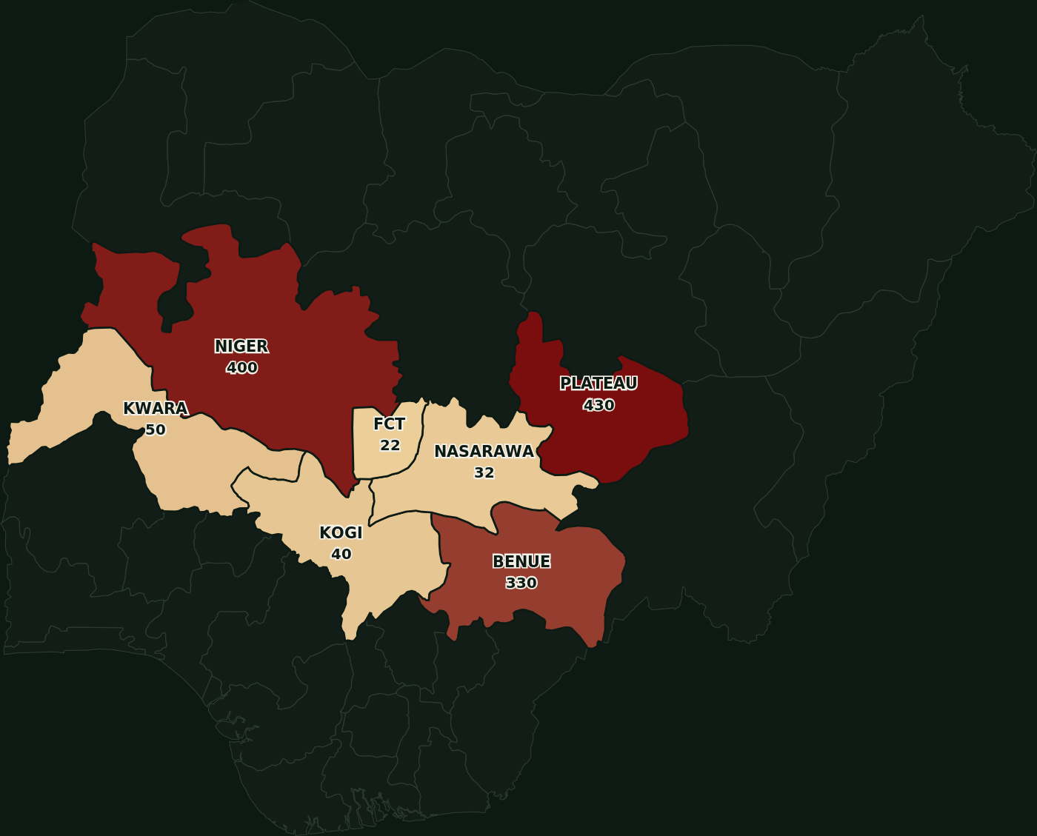
GRAPHICAL REPRESENTATION · TABLE 1
Severity Map: Kidnapping & Banditry by State
NOTE: Gradient = pale gold (lower) to deep red (higher), scaled to each state's share of the 1,304 recorded regional incidents. Non-NC states muted for context.
SAY: Plateau and Niger carry the deepest red — that's where this crisis is heaviest right now.

Slide 5
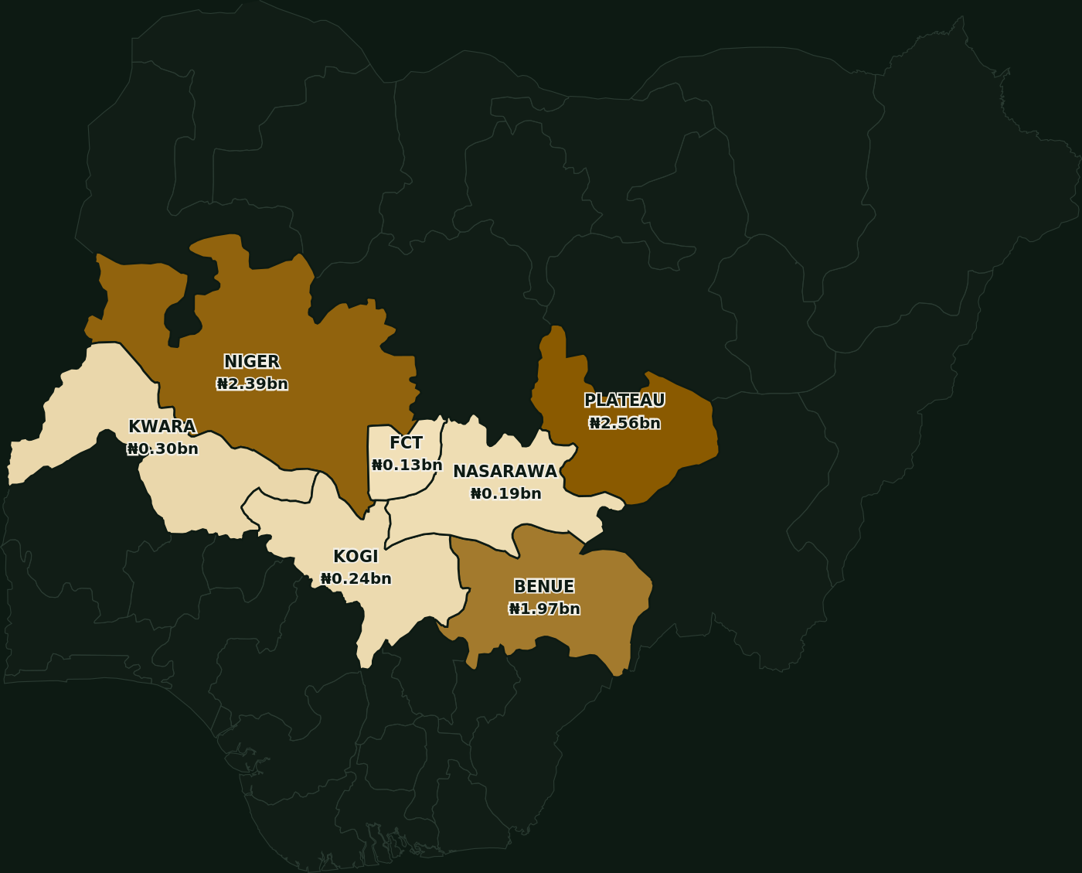
GRAPHICAL REPRESENTATION · TABLE 2
Economic Exposure Map: The Ransom Economy by State
NOTE: Modeled estimate: national ransom total (N7.78bn) is not broken down per state in source data. Figures are calculated proportionally to each state's incident share - illustrative, not independently reported.
SAY: Same pattern, different lens — where the violence is worst, the ransom economy is deepest too.

Slide 6
06 / 23
REGIONAL CONTEXT
The North-Central Security Question
Benue, Kogi, Kwara, Nasarawa, Niger, Plateau, and the FCT form the bridge between north and south — our agricultural belts, forests, highways, energy infrastructure. Increasingly, they contain terrorism, banditry, kidnapping, farmer-herder conflict and rural criminality.
SAY: The enemy does not respect state boundaries. Why should our response?

Slide 7
07 / 23
PLATEAU STATE · CONFIRMED, NAMED INCIDENTS
121 Killed in 10 Weeks
Period | Killed
May 2026 | 62
June 2026 | 43
1-11 July 2026 | 16
SAY: 121 people. One state. Ten weeks. This is happening right now.

Slide 8
08 / 23
NIGER STATE · BORGU, KPENYA/DEKARA · AUG 2026
A Single Operation, Hundreds of Lives
Metric | Figure
Confirmed Killed | 30
Abducted (Confirmed) | 60-80
Unverified (Video) | 600
Fled to Benin Republic | ~2,000
SAY: One raid emptied entire villages — some fled the country to survive.

Slide 9
09 / 23
FULL REGIONAL TOTALS · 7 NORTH-CENTRAL UNITS
Every State Carries a Share
State | Total
Plateau | 430
Niger | 400
Benue | 330
Kwara | 50
Kogi | 40
Nasarawa | 32
FCT | 22
SAY: No state in this region is untouched — this is a regional emergency.

Slide 10
10 / 23
UNDERSTANDING THE THREAT
The Ransom Economy Self-Funds
1. Abduct → 2. Hold → 3. Collect (₦7.78bn/12mo) → 4. Reinvest (weapons, transport, recruits) → 5. Repeat, stronger
SAY: Every naira paid in ransom funds the next attack. It's a business model.

Slide 11
11 / 23
THIS IS A DEVELOPMENT EMERGENCY
Not merely a law-and-order problem. Lost harvests. Interrupted schooling. A generation growing up distrustful of the state.
SAY: Say it plainly: we are losing a generation, not just a security statistic.

Slide 12
12 / 23
NEW SECURITY ARCHITECTURE · PART 1
One Threat Picture
Discipline | Action
SEE | Collect information
SHARE | Move it fast to who needs it
DECIDE | Clear command & responsibility
ACT | Respond fast & proportionately
LEARN | Prevent repetition
SAY: No single agency can do everything — together, fused, our agencies can know almost everything that matters.

Slide 13
13 / 23
NEW SECURITY ARCHITECTURE · PART 2
Regional Security Intelligence & Fusion Centre
Answers five questions continuously: where is the threat, who is responsible, what is their capability, what will they do next, what resource responds fastest.
Precedents: UK JTAC · US NCTC · India's MAC (post-2008 Mumbai)
SAY: Fragmented agencies, however capable, lose to threats that move faster than their information.

Slide 14
14 / 23
NEW SECURITY ARCHITECTURE · PART 3
Community Early Warning & Early Response Network
Farmers, hunters, teachers, traditional rulers, transporters, market women see things no satellite or patrol ever will. A disciplined, legally-governed network — not a vigilante system.
Precedents: Kenya's Nyumba Kumi · Philippines' Barangay Peacekeeping
SAY: Formal, well-governed community structures outperform informal vigilantism on accuracy and accountability.

Slide 15
15 / 23
NEW SECURITY ARCHITECTURE · PART 4
Traditional Rulers in the Security Architecture
Traditional Council → Police/DSS → Military Liaison → Local Govt → Community Reps
SAY: Today rulers are consulted mostly after violence — a standing table, not an emergency meeting.

Slide 16
16 / 23
NEW SECURITY ARCHITECTURE · PART 5
Security Corridors, Not Administrative Boundaries
Kwara-Niger-Kainji · Niger-Kaduna-FCT · Benue-Nasarawa · Benue-Taraba · Plateau-Bauchi · Kogi-Nasarawa-Benue — the actual routes threats move today.
SAY: Governors agreed on joint corridor operations in 2025. The next step is institutionalisation.

Slide 17
17 / 23
NEW SECURITY ARCHITECTURE · PART 6
Rapid Response: The 30-60 Minute Window
Police rapid response units, military QRF, mobile teams, medical evacuation, aviation support, community liaison — all pre-positioned, not reactive.
SAY: Israel's civil defence doctrine proves what a well-rehearsed short window achieves.

Slide 18
18 / 23
THE SOLUTION · BOTTOM-UP SECURITY ARCHITECTURE
Financially Autonomous Local Governments
Federal → State → Accountable LG → Community → Security
SAY: Push power and money down to the LG — that's where the threat actually lives.

Slide 19
19 / 23
THE FORMULA
Financial Autonomy + Accountability + Local Intelligence + Responsive Governance + Professional Coordination
= Stronger Grassroots Security
SAY: Autonomy without audits just decentralises corruption — say this caveat out loud.

Slide 20
20 / 23
EVALUATION ROADMAP
5-Year Metrics & Evaluation Roadmap
Phase | Years | Key Evaluation Targets
I - Foundation | 1-5 | Fusion Centre in all 7 states/FCT; kidnapping down 30%; Early-Warning Network in 50% of high-risk LGAs; response <90 min
II - Consolidation | 6-10 | Kidnapping down 60%; 100% LGAs fused; all 6 corridors institutionalised; return >70%; audit compliance >90%
III - Maturity | 11-15 | Kidnapping down 85%; response <45 min region-wide; rising prosecutions; trust index >75%; farms fully reactivated
IV - Sustained Peace | 16-20 | Kidnapping industry <5% of baseline; region exports best practice; full corridor integration; self-sustaining LG financing
SAY: A twenty-year plan without five-year checkpoints is just a hope.

Slide 21
21 / 23
THE NORTH-CENTRAL SECURITY COMPACT
Seven Commitments
1. One Threat Picture — we share intelligence
2. One Early-Warning System — we listen to communities
3. One Rapid-Response Philosophy — before massacres, not after
4. One Professional Standard — discipline, law, dignity
5. One Regional Approach — no state-border cover
6. One Development Agenda — secure and rebuild together
7. One Measure of Success — the safety and dignity of the citizen
SAY: Ask the summit to adopt all seven, together, as one compact.

Slide 22
22 / 23
CLOSING
"If every local government across the North-Central states is empowered, accountable and connected — we begin to build a regional security shield."
He simply wants to arrive alive. That is the standard by which we must judge ourselves. And it is not beyond the capacity of Nigeria.
AVM MONDAY RIKU MORGAN (RTD) · NORTH-CENTRAL SECURITY SUMMIT · 2026

Slide 23
23 / 23
HARVARD-STYLE REFERENCES
References
ACLED (2026) Nigeria conflict and fatality data, North-Central zone, March-September 2026. acleddata.com
Berom Youth Moulders Association (2026) Incident data on Plateau attacks, May-July 2026, via HumAngle Media (2026).
Daily Trust (2026) 30 killed in attacks on four Niger mosques. dailytrust.com
Government of India, MHA (2026) Multi-Agency Centre (MAC), est. post-2008 Mumbai attacks.
Government of Israel, Home Front Command (2026) Civil defence rapid-response doctrine. idf.il
Government of Kenya, National Police Service (2026) Nyumba Kumi Community Policing Initiative.
Government of the Philippines, DILG (2026) Barangay Peacekeeping Action Teams (BPAT).
Government of the UK, MI5 (2026) Joint Terrorism Analysis Centre (JTAC). mi5.gov.uk
HumAngle Media (2026) Nigeria Conflict Tracker, March-June 2026. humanglemedia.com
HumAngle Media (2026) Residents recall a weekend of bloodshed across Benue and Plateau. humanglemedia.com
IOM (2026) Displacement Tracking Matrix (DTM), Nigeria, Round 18. Geneva: IOM.
National Counterterrorism Center (2026) About NCTC. dni.gov/nctc
North-Central Nigeria Governors' Forum (2025) Joint Security Operations Agreement.
Premium Times (2026) Nine family members, baby killed in Plateau attack. premiumtimesng.com
Reuters (2026a) Gunmen abduct over 60 worshippers, Nigeria mosque, police say. 22 Aug.
Reuters (2026b) Video appears to show 600 people abducted, residents say. 24 Aug.
Reuters (2026c) Nigerian gunmen raise over $5 million in mass kidnappings, study finds. 26 Aug.
Revo Culture (2026) Regional synthesis of Niger State Borgu attacks. revoculture.org
SBM Intelligence (2026) The Economics of Nigeria's Kidnap Industry (2026 Edition). Lagos.
Vanguard (2026) 7,825 abducted, 1,142 killed in one year - SBM. vanguardngr.com
FULL HARVARD-STYLE REFERENCE LIST ALSO IN TALKING POINTS DOCUMENT

