Slide 1



Blockchain
Team Member:
Tommy Jiang 20004769
Allen Liang 20016750

Slide 2
Agenda
What is
Blockchain
Blockchain advantage
Summary
1
2
3
4
5
International Trade weakness
Demo

Slide 3
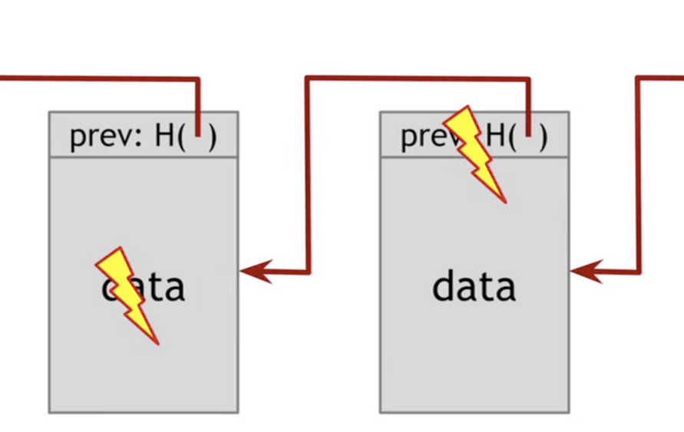

1
What is Blockchain
A new type of distributed shared ledger
Blocks are linked using cryptography.
Each block contains a cryptographic hash of the previous block
Index Timestamp Hash of previous block …... …...
Content or Transations or …...
Index Timestamp Hash of previous block …... …...
Content or Transations or …...
SHA256
SHA256

Slide 4
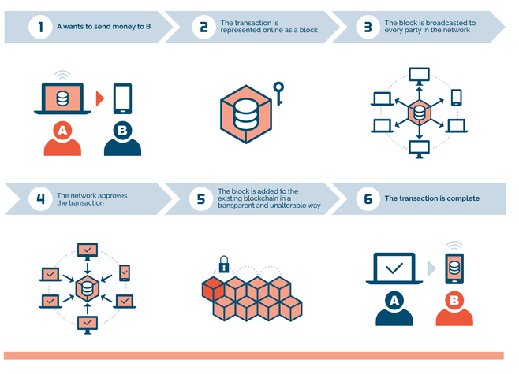
1
What is Blockchain

Slide 5
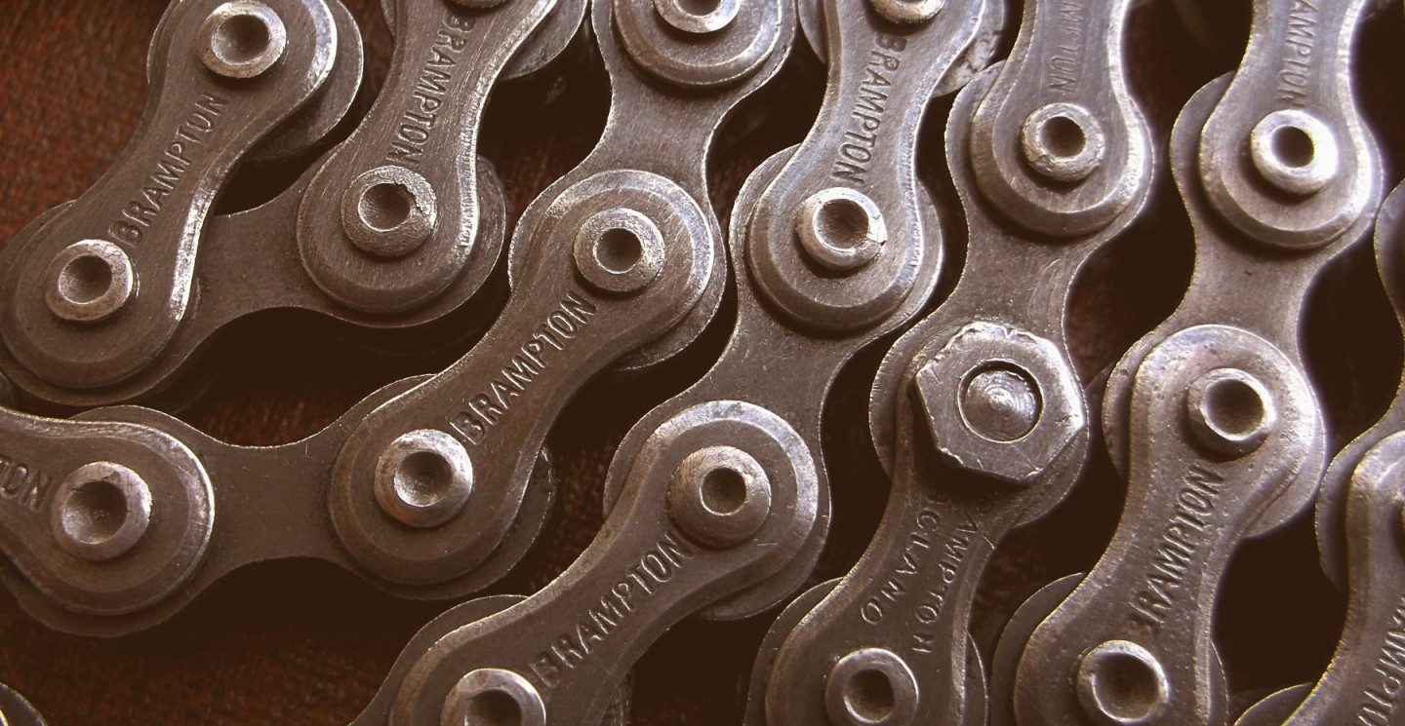
1
Blockchain Features
Decentralized
Information Immutability
Traceability of records
Security encryption

Slide 6
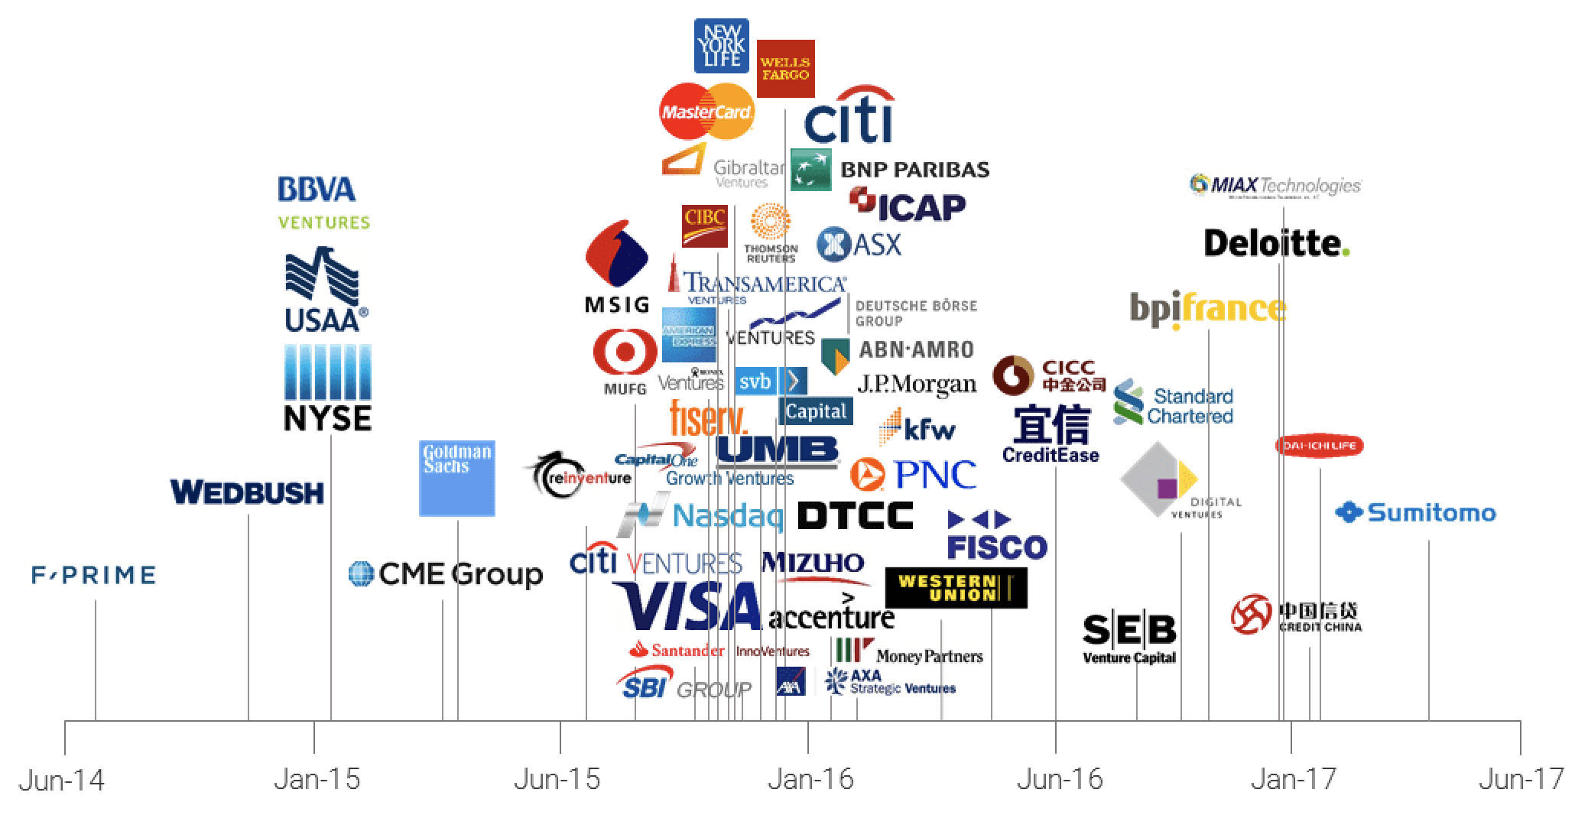

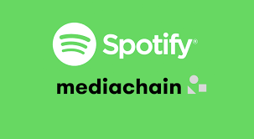
1
Blockchain Implementation
Cryptocurrency :Bitcoin
Mediachain: Spotify

Slide 7
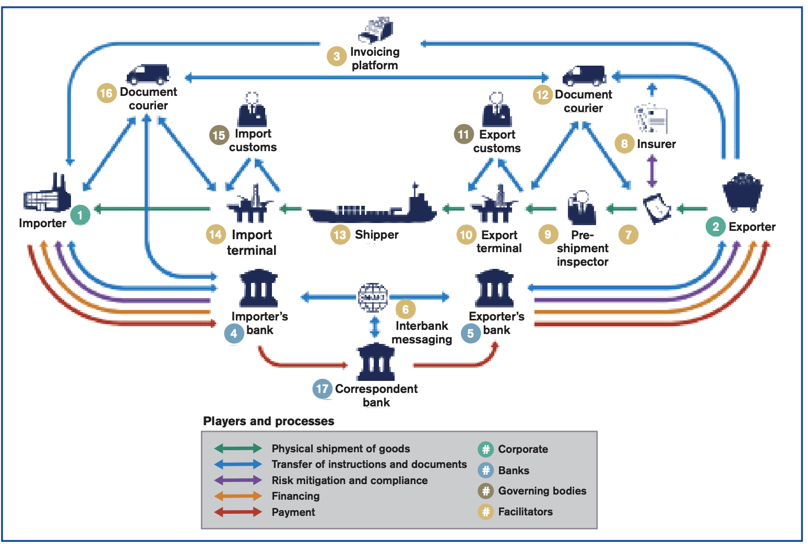
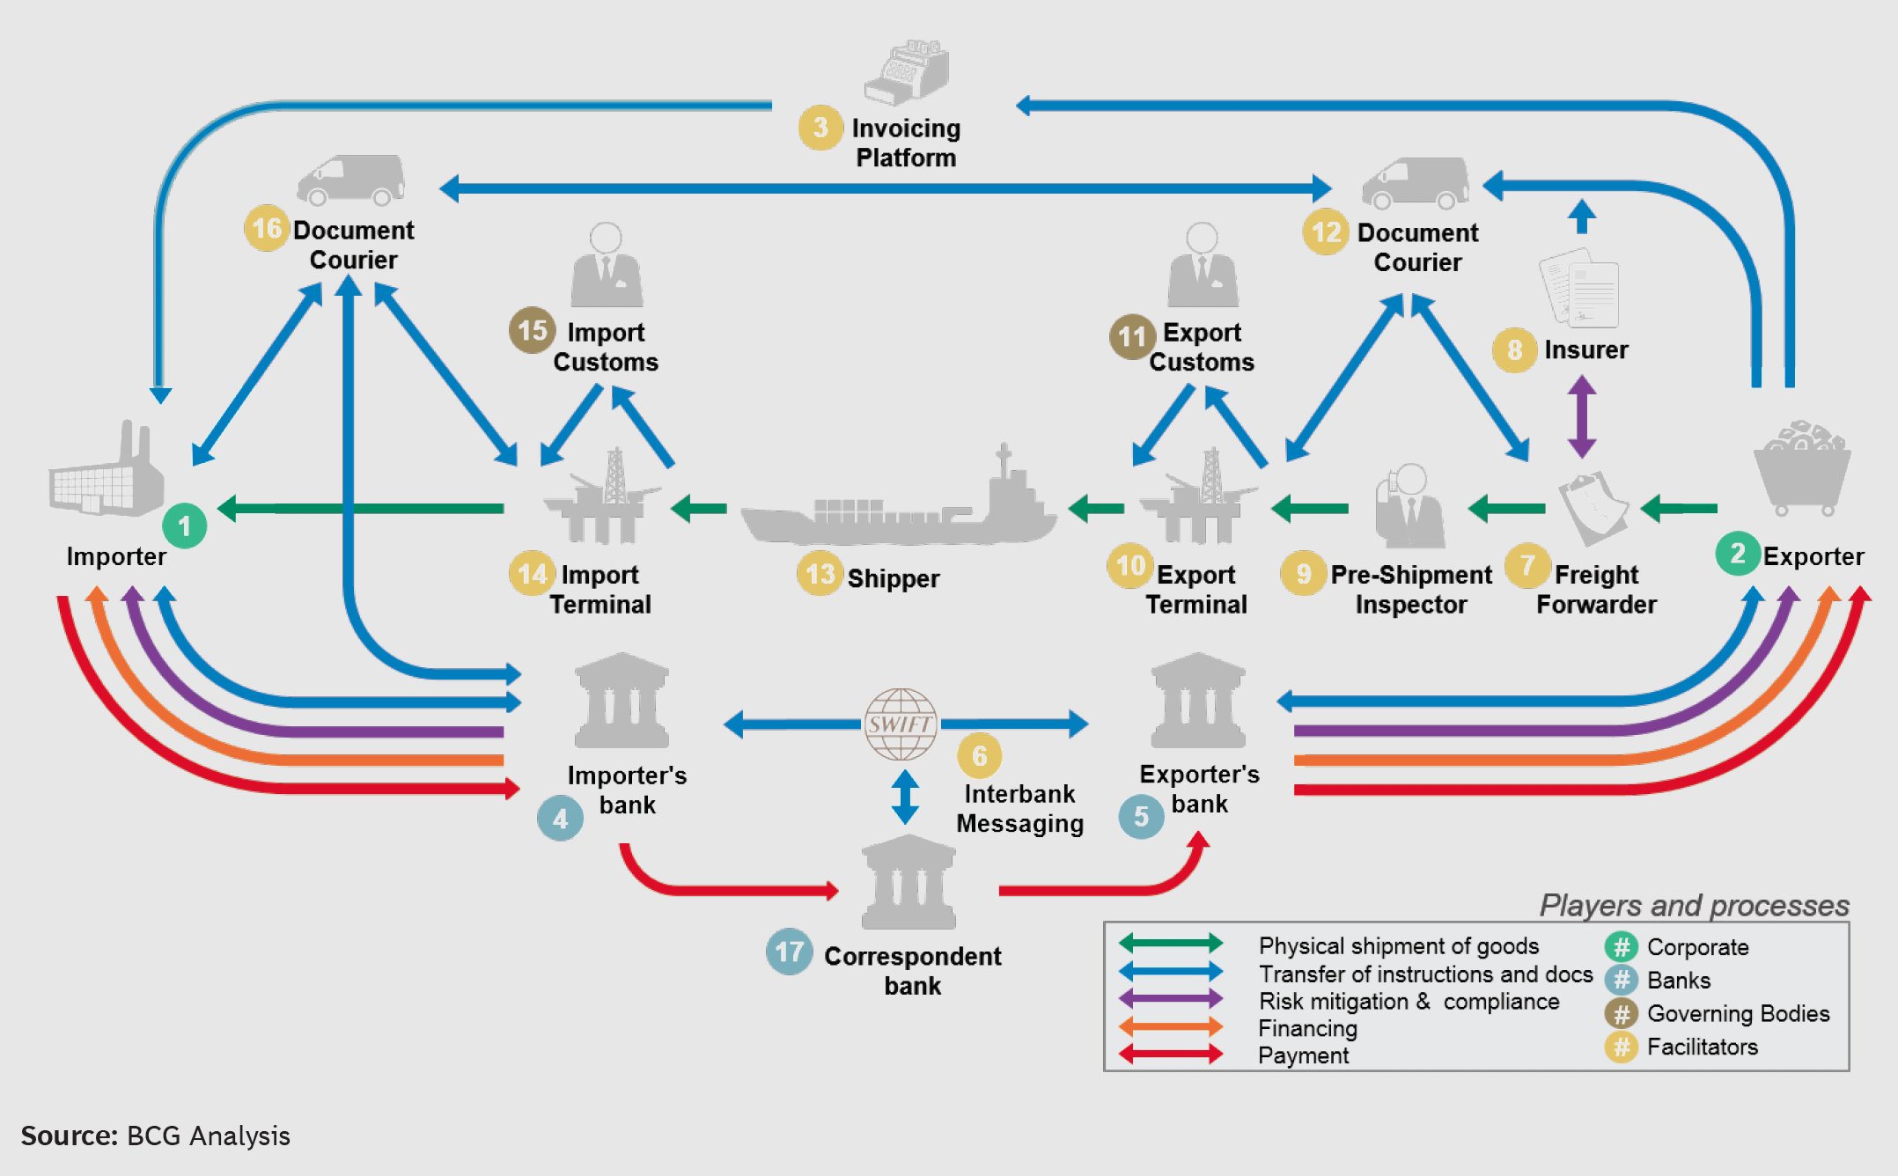
2
International Trade Processes

Slide 8
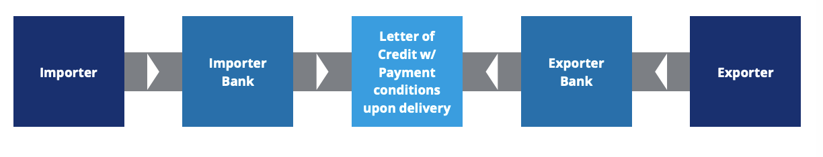
2
International Trade Pain points
Data silo
Inefficient process collaboration & long settlement cycle
Lack of trust
Bottleneck of centralized platform

Slide 9
3
Blockchain advantage
Pain points
Values of BlockChain
Lake of trust
Trust Emhancement
Data Silo
Data Connectivity
Inefficient collaboration
Optimized process collaboration
Bottleneck of Centralized Platform
Weakly centralized network

Slide 10
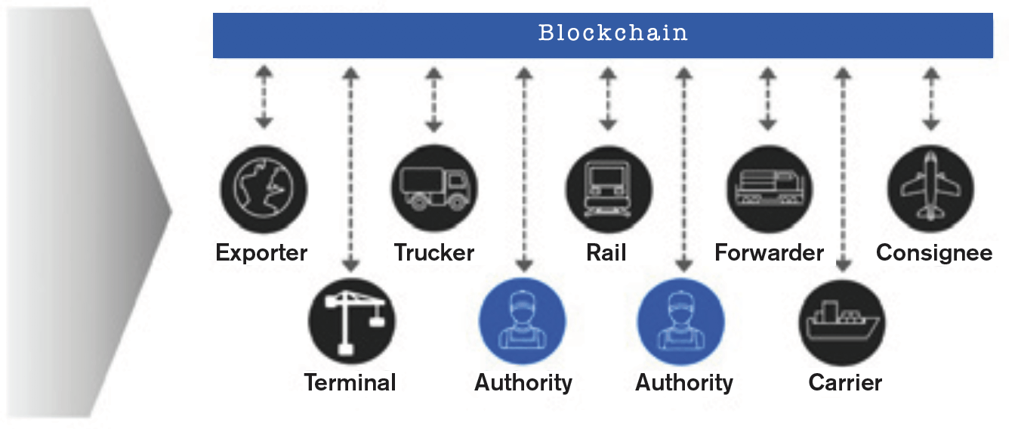
3
Blockchain advantage

Slide 11
3
Summary
Wide range of applications
Decentralization concept
Proof of work - brute force computing

Slide 12

4
Demo
A simple demo of blockchain network
Multiple nodes in the network
New block depends of proof of work
Mining on request

Slide 13
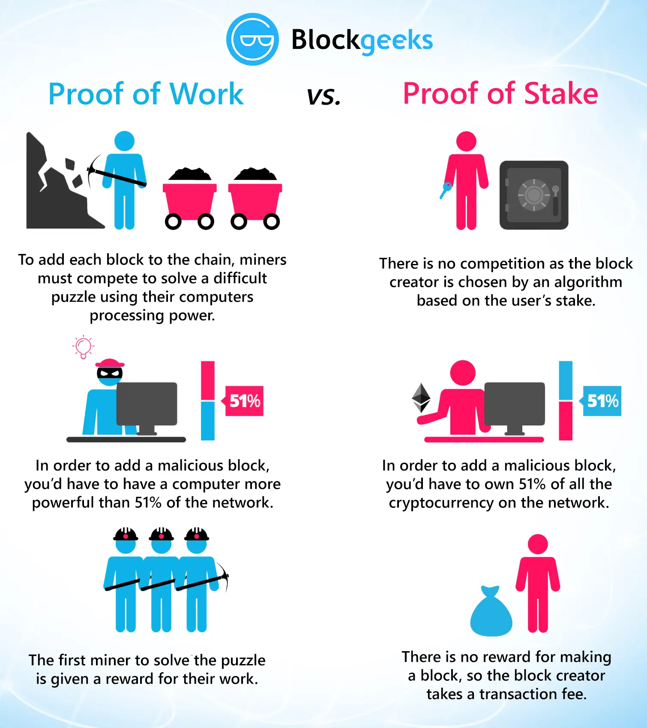
4
Proof of Work or Stake
Which one is better?

Slide 14
5
Reference
http://jmcauley.ucsd.edu/data/amazon/
https://en.wikipedia.org/wiki/Recommender_system
http://surpriselib.com/
https://sifter.org/~simon/journal/20061211.html
https://surprise.readthedocs.io/en/stable/matrix_factorization.html#surprise.prediction_algorithms.matrix_factorization.SVD
https://research.ijcaonline.org/volume87/number14/pxc3894033.pdf
http://papers.nips.cc/paper/1861-algorithms-for-non-negative-matrix-factorization.pdf
https://surprise.readthedocs.io/en/stable/similarities.html
https://spring.io/
https://github.com/macrozheng/mall
https://en.wikipedia.org/wiki/CAP_theorem

Slide 15
Questions?

Slide 16
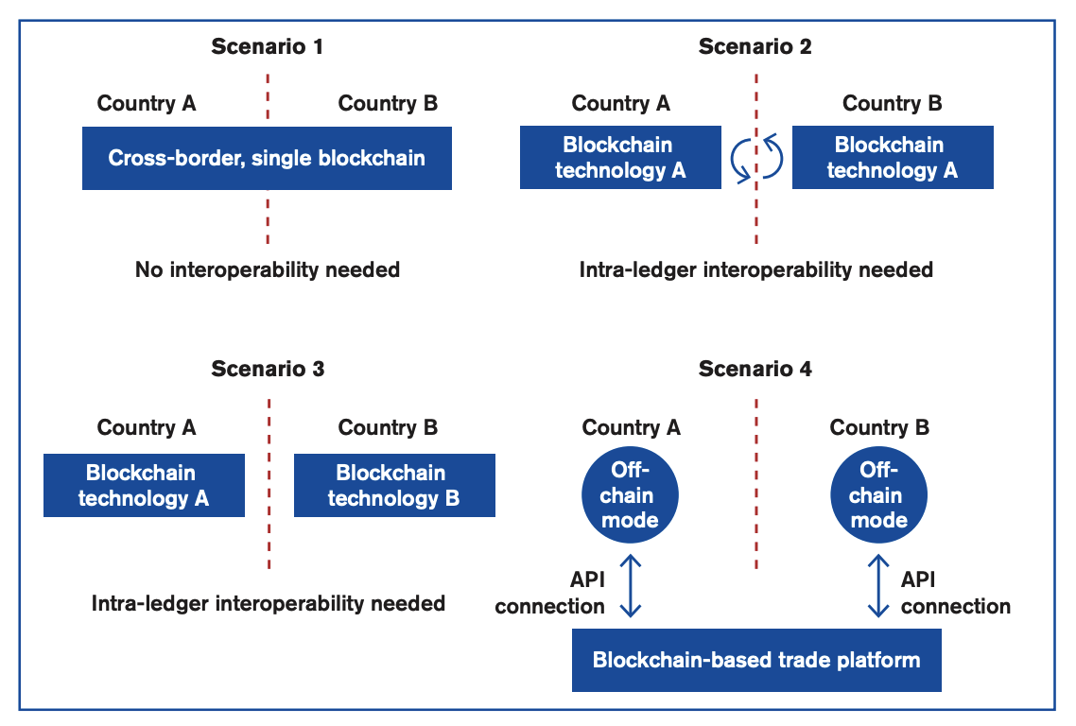
3
Blockchain advantage

Slide 17
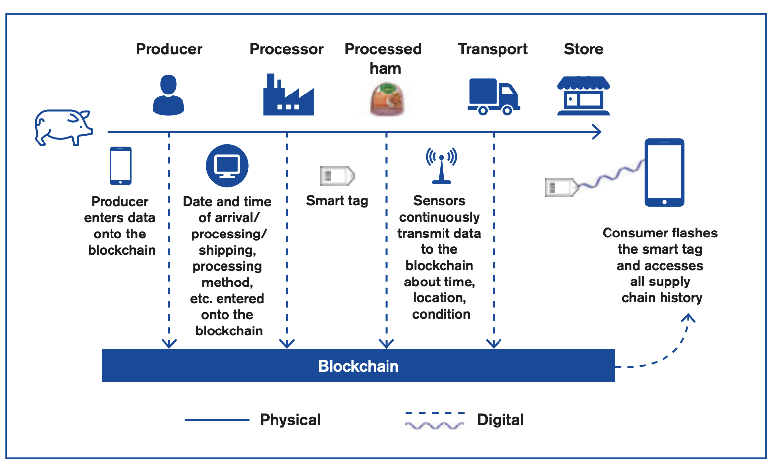
4
Prospect

Slide 18
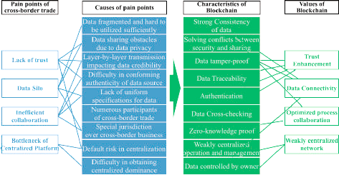
3
Blockchain advantage

Slide 19
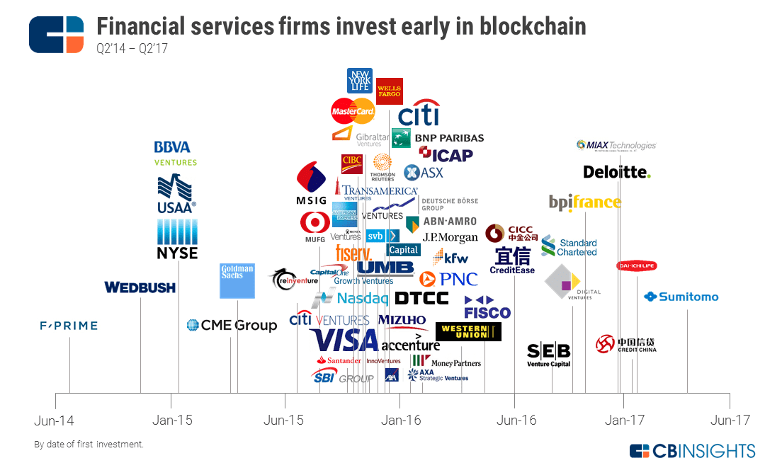
1
Blockchain Background
A new type of distributed shared ledger and database
Decentralized ，information Immutability ， traceability of records，Openness- Transparency
Cryptocurrency – Bitcoin，
Mediachain-Spotify

