Slide 1

AI player in Flappy Bird
Jihui Wu (Joe 19034794)

Slide 2
Flappy bird
Outline
Reinforcement Learning
Q-learning

Slide 3
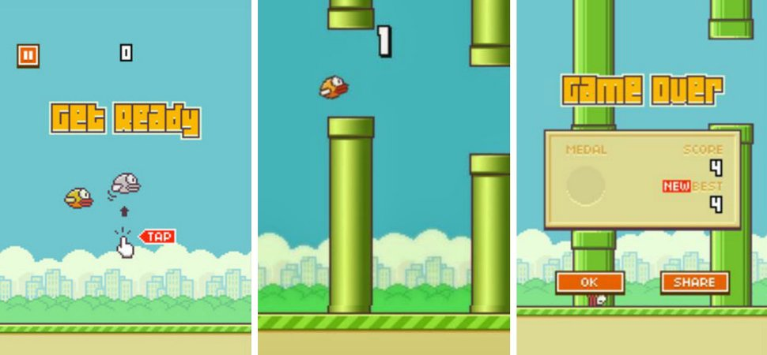
Flappy Bird
WPS演示助您快速创建极具感染力的演示文稿，打造令人震撼的影院效果。WPS演示助您快速创建极具感染力的演示文稿，打造令人震撼的影院效果。WPS演示助您快速创建极具感染力的演示文稿，打造令人震撼的影院效果。WPS演示助您快速创建极具感染力的演示文稿，打造令人震撼的影院效果。WPS演示助您快速创建极具感染力的演示文稿，打造令人震撼的影院效果。

Slide 4

Analysis
Rules in this game
Actions
Simple rules
⸮⸮⸮
Insanely difficult
click
do nothing
Results (rewards)
crashing
surviving (next frame)

Slide 5
Analysis - Human player
How a human player improve the score?
Practice
Why it works?
learning process of our brain
muscle memory
conditioned reflex
less reaction time

Slide 6
How we can use an AI player to improve the score?
- Reinforcement learning
......

Slide 7
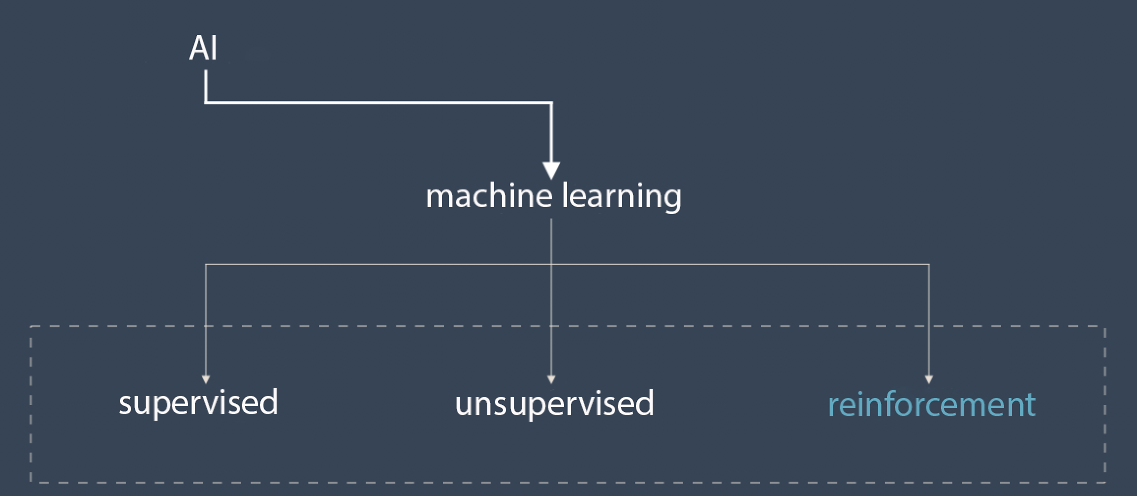
machine learning
Classification of machine learning

Slide 8

Reinforcement learning
*.What makes it different ?
Reinforcement learning
1. RL is about learning what to do
2. how to map situation to actions
3. to maximize the rewards
We do not need to feed it with data.
instead, it explores to get data

Slide 9
Reinforcement learning
The biological motivation for RL is a simple trial and error.
Positive reinforcement – given to an agent for a good response
Negative reinforcement (punishment) – for a poor response

Slide 10
Reinforcement learning
It’s related to early mathematical psychology models of conditioning, or behaviour learning in animals
The animal will have memory that taking which action will receive high rewards in different situation.
So, What should we do in reinforcement learning???
We train an agent to take different actions in diferent kinds of states , and then record rewards.
map state and action to rewards

Slide 11
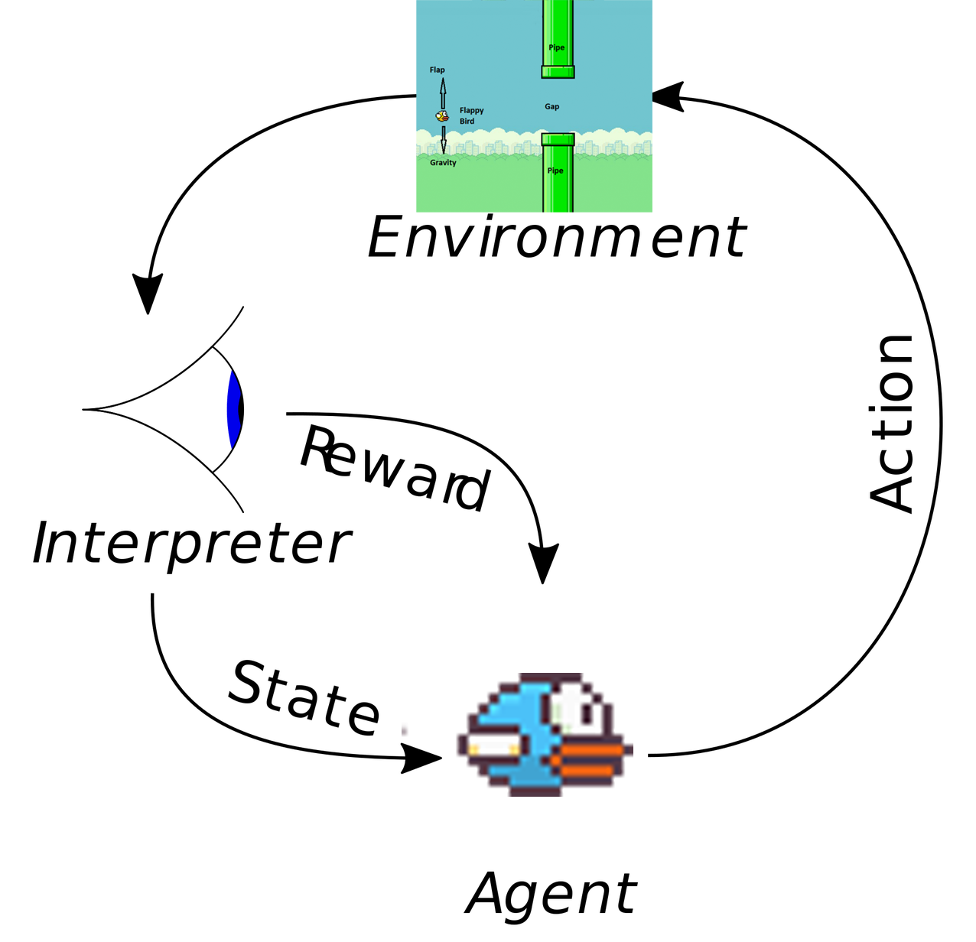
Reinforcement learning
RL model(S-A-R)
S– set of states
A– set of actions
R(s,a)– the reward for taking action a in state s
a₀
a1
a2
s₀
s₁
s2
s3
r₀
r1
r2

Slide 12
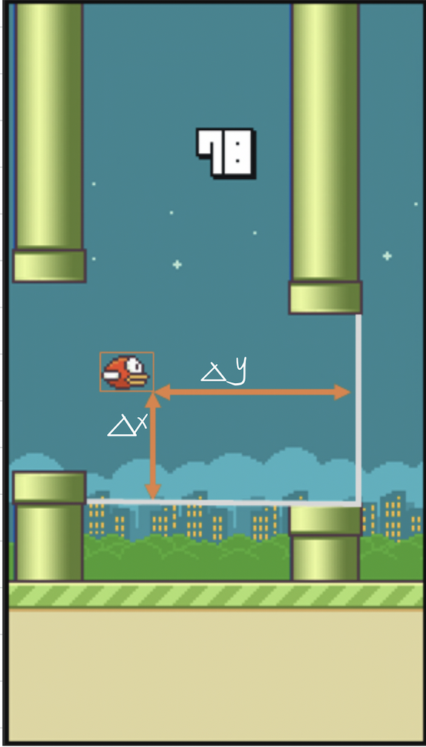
Reinforcement learning - State
State → (Δx, Δy)
Δx: Vertical distance from lower pipe
Δy: Horizontal distance from next pair of pipes

Slide 13
Reinforcement learning
Action
Click
Do nothing
State
(Δx,Δy)
NextState
(Δx',Δy')
.....
Reward
Die
Survive
Record & learn to form a successful policy

Slide 14
Q - Learning (Watkins, 1989)
start
start
start
start
Q-Learning
one variant of RL
most popular
For the
current state (s),
Select an action (a)
Q-value???
Receive Reward / Punishment (r)
Q-value: expecation/prediction of the reward based on experience
No
For state (s), and action (a) pair,
Update the Q-value,
given the reward (r)
Yes
Transition to new state (s)

Slide 15
Q - Learning update
Q-Learning update function (Bellman equation)
(action-utility function)
Q(s,a) - Q value for state s, taking action a
α: learning rate
γ: discont factor
maxQ: the maximum Q value for the nextstate
r: reward for entering the nextState

Slide 16
Q - Learning update
α - Learning rate
Q[S,A] ← (1-α)*Q[S,A] + α*(R(S,a) + γ* max Q[S',a])
The learning rate para(α) defines how important new learned information is to the agent.
↓ ： learning can be slow
↑ ：(1-α)*Q[S,A] ->0
previously learned information can be lost;
can result to instability in the learning process

Slide 17
Q - Learning update
γ - Discount factor
Q[S,A] ← (1-α)*Q[S,A] + α*(R(S,a) + γ* max Q[S',a])
Q[S,A] ← (1-α)*Q[S,A] + α*(R(S,a) + γ* max Q[S',a])
The discount factor (γ) defines whether new information is more important than the previously learned information. Range [0, 1]
If immediate rewards are more important than long-term rewards, set discount factor = 0
If future (delayed) rewards are more important, set discount factor close to 1.

Slide 18
Q - Learning update
Criteria for updating Q-table
State | Score
die | -100
survive | +1/frame
State(m*n) | Click(jump) | Do nothing(stay)
(Δx1,Δy1) | 1 | 20
(Δx1,Δy2) | 20 | -100
... | ... | ...
(Δxm,Δyn-1) | -1000 | 2
(Δxm,Δyn) | 50 | -100

Slide 19
Update Q value
Pseudocode
Initialize Q table as {} or [m*n][2];
Repeat(Until Q is sufficiently good):
Initialize position S, start a game:
while (S != died)：
use strategy π，receive action a=π(S)
adopt action a，receive new position S' and reward R(S,a)
Q[S,A] ← Q[S,A] + α*(R(S,a) + γ* max Q[S',a]- Q[S,A]) //update Q
S ← S' //update S

Slide 20
Code for updating Q
function reward(Q, S, S_, A, R) {
if (S && S_ && A in [0, 1] && S in Q && S_ in Q)
Q[S][A] = (1 - qlAlpha) * Q[S][A] + qlAlpha * (R + qlGamma * max(Q[S_]));
return Q;
}

Slide 21
In this case, we set α=0.6, because we values information from new learning, and set γ=0.8, because in this case, the punishment is often delayed. (1) The bird is in state (30,50) ; (2) According to the action selection policy π, it choose to explore ‘click’ (0 is the initial Q-value)
(3) Get the reward from the environment 10; (4) The agent will enter into the next state(30,55): Qmax(30,55) = 50; (4) According to the Q function, do the calculation Q[S,A] ← Q[S,A] + α*(R(S,a) + γ* max Q[S',a]- Q[S,A]) Q((30,50),’jump’)← 0+0.6(10+ 0.8*50-0)= 30 (5)update the Q((30,50),’jump’) value to be 30 in the Q table.
Update Q value
An example
State(Δx,Δy) | Click(jump) | Do nothing(stay)
(30,50) | 0 -> 30 | 20
... | ... | ...
(30,55) | 50 | -100
... | ... | ...

Slide 22
Policy for action selection (1)
Greedy
always select the action with the highest Q value
directely base on Q-value
advantages: seems to have the highest expectation
disadvantages: Localized optimal
State(m*n) | Click(jump) | Do nothing(stay)
(Δx-1,Δy-1) | 1 | 20
(Δx-1,Δy-2) | 20 | -100
... | ... | ...
(Δx-m,Δ-n-1) | -1000 | 2
(Δx-m,Δ-n) | 50 | -100

Slide 23
Code for Greedy Policy
function updateQL(gameState){
...
if (actionPolicy== GREEDY) {
//0 for stay, 1 for jump
A_ = Q[S_][0] >= Q[S_][1] ? 0 : 1;
}
}

Slide 24
Policy for action selection (2)
ε-Greedy (Probabilistic greedy)
explore the env and experiment all possible actions
probabilistically choose action
indirectly based on Q-value
Q-value ↑ => possibility ↑
State(m*n) | Click(jump) | Do nothing(stay)
(Δx-1,Δy-1) | 1 | 20
(Δx-1,Δy-2) | 20 | -100
... | ... | ...
(Δx-m,Δ-n-1) | -1000 | 2
(Δx-m,Δ-n) | 50 | -100

Slide 25
Code for Greedy Policy
function updateQL(gameState){
...
if (actionPolicy== EPSILON_GREEDY) {
if (Math.random() < qlEpsilon) { // explore
A_ = Math.random() < qlExploreJumpRate ? 1 : 0;
} else if (S_ in Q) { // exploit
A_ = Q[S_][0] >= Q[S_][1] ? 0 : 1;
}
}
}

Slide 26
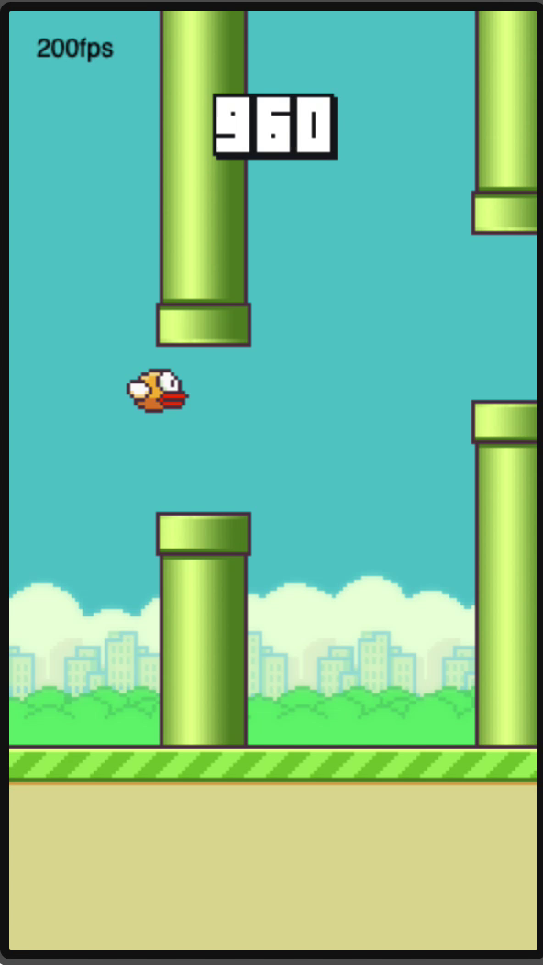
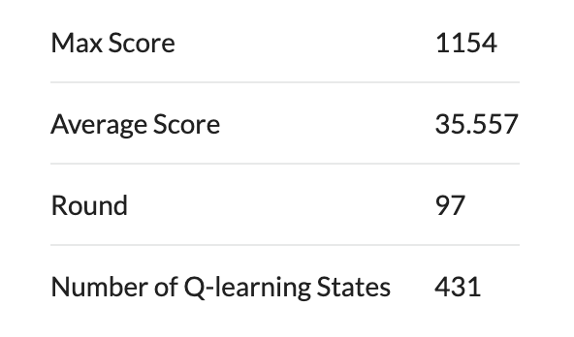
Performance
Params
Game size: 512*288px
maxΔ: 320* (172+48) px;
α (learning rate): 0.6 (values new information)
γ (discount factor): 0.8 (delayed reward)

Slide 27
Thanks

