Slide 1

Having Solution or Not
(You already learned in high school)
Notes:
Q: 能否在此舉一個具體的例子! For solution or not
Q: can we have an example for linear combination

Slide 2
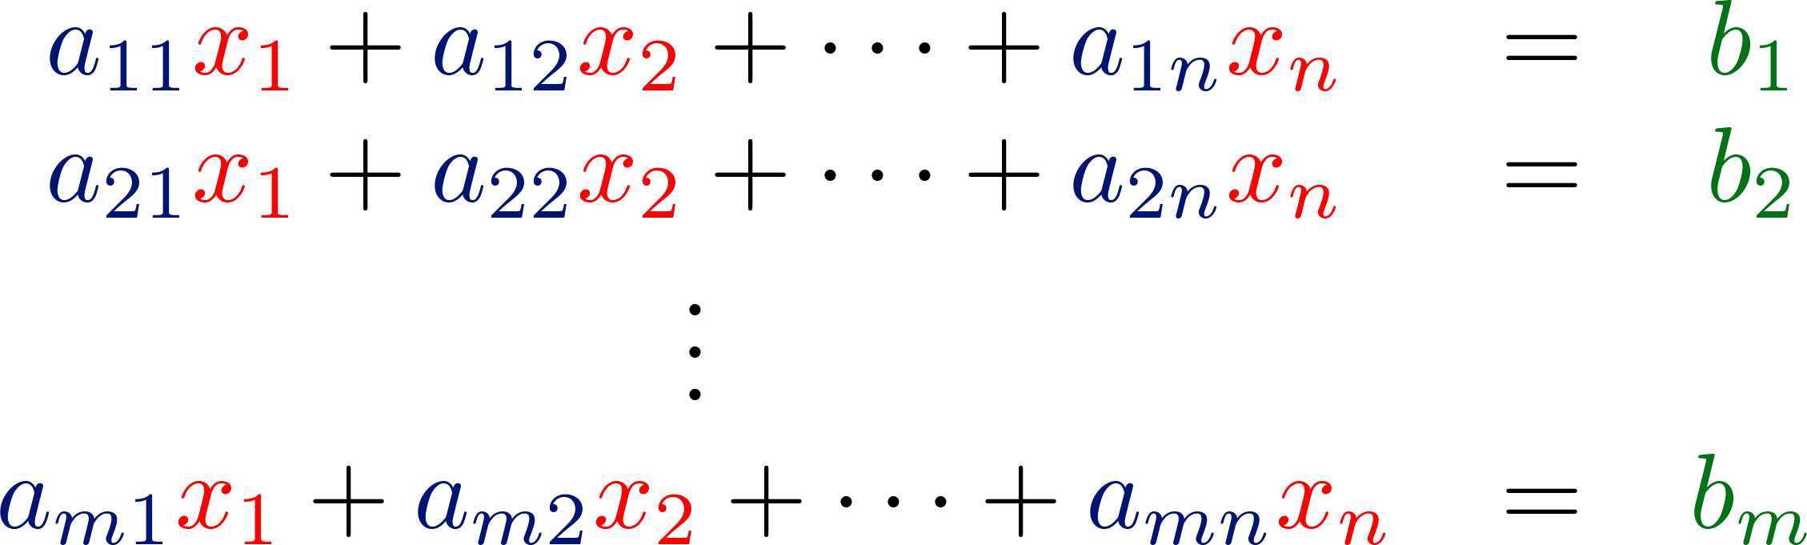

Review
Linear
System
x
b
System of Linear Equations
Matrix-vector product:
Given A and b, let’s find x

Slide 3
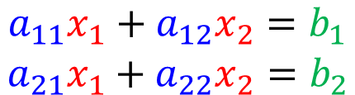
In High School ……
More Variables?
Considering any system of linear equations with 2 variables and 2 equations
$$\begin{matrix}a_{11}x_{1}+a_{12}x_{2}=b_{1} \\ a_{21}x_{1}+a_{22}x_{2}=b_{2}\end{matrix}$$
…… line 1
…… line 2
1ine 1
line 1
=line 2
1ine 1
1ine 2
1ine 2
unique solution
no solution
infinite solutions
consistent
inconsistent
consistent

Slide 4




















Only Unique and Infinite?
為什麼不能只有兩個解？
A
一旦找到兩個解，
就可以找到無窮多解
$$x?$$
$$b$$
A
A
$$u$$
$$b$$
$$v$$
$$b$$
$$0.3u$$
A
$$0.3b$$
$$0.7v$$
A
$$0.7b$$
$$0.4u$$
$$0.4b$$
$$0.6v$$
$$0.6b$$
3rd solution
$$0.3u+0.7v$$
A
$$0.3b+0.7b$$
$$=b$$
4th solution
$$0.4u+0.6v$$
$$0.4b+0.6b$$
$$=b$$

Slide 5
Having Solution or Not
(Linear Algebra version)
Notes:
Q: 能否在此舉一個具體的例子! For solution or not
Q: can we have an example for linear combination
True or False
If the columns of A are linear independent, then Ax=b has unique solution.
If the columns of A are linear independent, then Ax=b has at most one solution.
If the columns of A are linear dependent, then Ax=b has infinite solution.
If the columns of A are linear independent, then Ax=0 (homogeneous equation) has unique solution.
If the columns of A are linear dependent, then Ax=0 (homogeneous equation) has infinite solution.

Slide 6

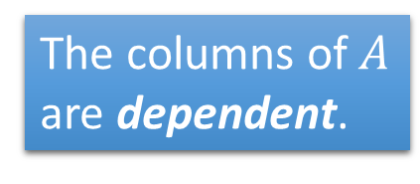



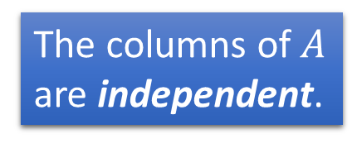

Summary
$$A:m×n$$
$$x∈R^{n}$$
$$b∈R^{m}$$
Is $b$ a linear combination of columns of $A$?
Is $b$ in the span of the columns of $A$?
NO
YES
No solution
The columns of $A$ are independent.
The columns of $A$ are dependent.
Rank A = n
Rank A < n
Nullity A = 0
Nullity A > 0
Unique solution
Infinite solution
Notes:
Check existence first
One or infinite soluiton

Slide 7








Summary
The columns of $A$ are independent.
$$A:m×n$$
Rank A = n
$$x∈R^{n}$$
$$b∈R^{m}$$
Nullity A = 0
NO
YES
Is $b$ a linear combination of columns of $A$?
Is $b$ a linear combination of columns of $A$?
Is $b$ in the span of the columns of $A$?
Is $b$ in the span of the columns of $A$?
NO
YES
NO
YES
No solution
Infinite
solution
No solution
Unique solution

