Slide 1

Linear Combination

Slide 2
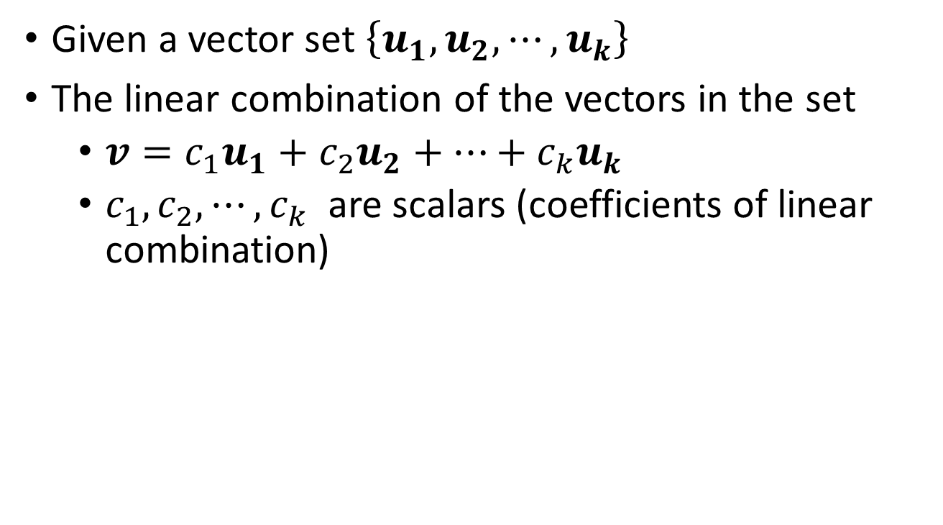
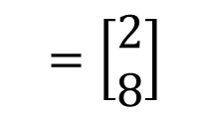
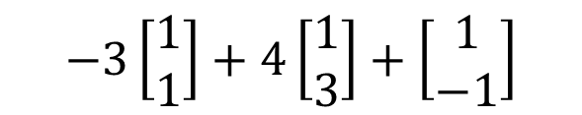
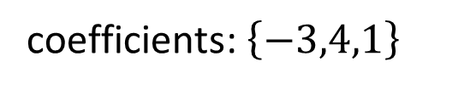
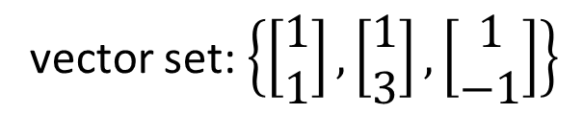
Linear Combination
Given a vector set $\left\{u_{1},u_{2},⋯,u_{k}\right\}$
The linear combination of the vectors in the set
$v=c_{1}u_{1}+c_{2}u_{2}+⋯+c_{k}u_{k}$
$c_{1},c_{2},⋯,c_{k}$ are scalars (coefficients of linear combination)
vector set: $\left\{\left[\begin{matrix}1 \\ 1\end{matrix}\right],\left[\begin{matrix}1 \\ 3\end{matrix}\right],\left[\begin{matrix}1 \\ −1\end{matrix}\right]\right\}$
$$−3\left[\begin{matrix}1 \\ 1\end{matrix}\right]+4\left[\begin{matrix}1 \\ 3\end{matrix}\right]+\left[\begin{matrix}1 \\ −1\end{matrix}\right]$$
coefficients: $\left\{−3,4,1\right\}$
$$=\left[\begin{matrix}2 \\ 8\end{matrix}\right]$$
其實就是 weighted sum 啦 ☺
Notes:
[2 8]

Slide 3
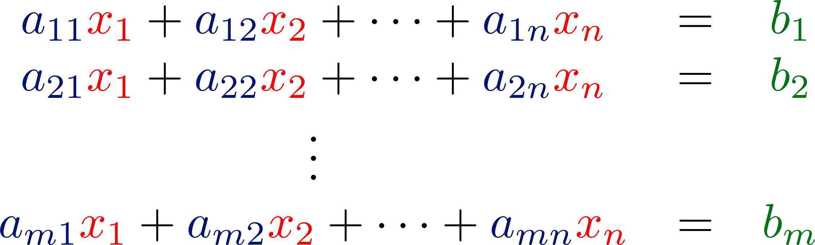



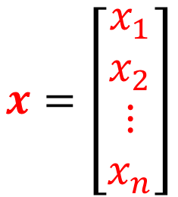



Column Aspect
$$a_{1}$$
$$a_{2}$$
$$a_{n}$$
$$A=\left[\begin{matrix}\begin{matrix}a_{1} & a_{2}\end{matrix} & ⋯ & a_{n}\end{matrix}\right]$$
$$x=\left[\begin{matrix}\begin{matrix}x_{1} \\ x_{2}\end{matrix} \\ ⋮ \\ x_{n}\end{matrix}\right]$$
Vector set
coefficients
Linear Combination
$$=x_{1}a_{1}+x_{2}a_{2}+⋯+x_{n}a_{n}$$
Notes:
[2 8]

Slide 4


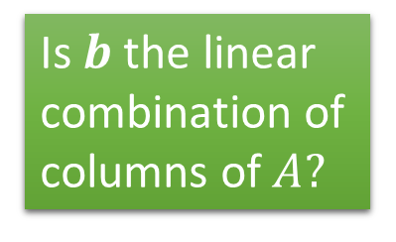
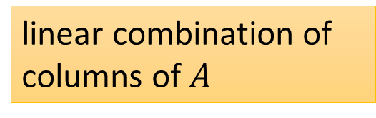

System of Linear Equations v.s. Linear Combination
Non empty solution set?
Has solution or not?
(A system of linear equations)
Consistent?
The Same question
Column Aspect
$$=b$$
Is $b$ the linear combination of columns of $A?$
$$=x_{1}a_{1}+x_{2}a_{2}+⋯+x_{n}a_{n}$$
linear combination of columns of $A$
Notes:
The coefficient is the solution

Slide 5
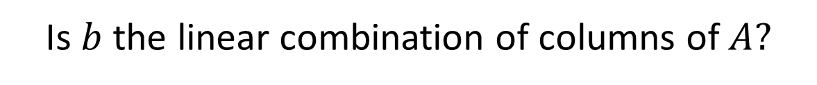

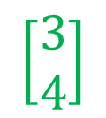


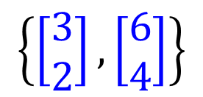


Example 1
$$3x_{1}+6x_{2}=3$$
$$2x_{1}+4x_{2}=4$$
$$A=\left[\begin{matrix}3 & 6 \\ 2 & 4\end{matrix}\right]$$
$$x=\left[\begin{matrix}x_{1} \\ x_{2}\end{matrix}\right]$$
$$b=\left[\begin{matrix}3 \\ 4\end{matrix}\right]$$
Has solution or not?
Is $b$ the linear combination of columns of $A?$
$$\left[\begin{matrix}3 \\ 4\end{matrix}\right]$$
$$\left\{\left[\begin{matrix}3 \\ 2\end{matrix}\right],\left[\begin{matrix}6 \\ 4\end{matrix}\right]\right\}$$
Notes:
高中、大學分隔線

Slide 6






Example 1
$$3x_{1}+6x_{2}=3$$
$$2x_{1}+4x_{2}=4$$
Has solution or not?
Vector set: $\left\{\left[\begin{matrix}3 \\ 2\end{matrix}\right],\left[\begin{matrix}6 \\ 4\end{matrix}\right]\right\}$
Is $\left[\begin{matrix}3 \\ 4\end{matrix}\right]$ a linear combination of $\left\{\left[\begin{matrix}3 \\ 2\end{matrix}\right],\left[\begin{matrix}6 \\ 4\end{matrix}\right]\right\}$?
NO
$$\left[\begin{matrix}3 \\ 4\end{matrix}\right]$$
The linear combination is always on the dotted line.
$$\left[\begin{matrix}6 \\ 4\end{matrix}\right]$$
$$\left[\begin{matrix}3 \\ 2\end{matrix}\right]$$

Slide 7
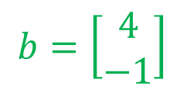
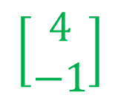


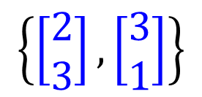

Example 2
$$2x_{1}+3x_{2}=4$$
$$3x_{1}+1x_{2}=−1$$
$$A=\left[\begin{matrix}2 & 3 \\ 3 & 1\end{matrix}\right]$$
$$x=\left[\begin{matrix}x_{1} \\ x_{2}\end{matrix}\right]$$
$$b=\left[\begin{matrix}4 \\ −1\end{matrix}\right]$$
Has solution or not?
Is $b$ the linear combination of columns of $A?$
$$\left[\begin{matrix}4 \\ −1\end{matrix}\right]$$
$$\left\{\left[\begin{matrix}2 \\ 3\end{matrix}\right],\left[\begin{matrix}3 \\ 1\end{matrix}\right]\right\}$$
Notes:
高中、大學分隔線

Slide 8


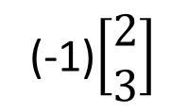
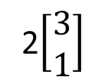
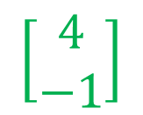
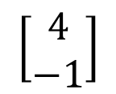
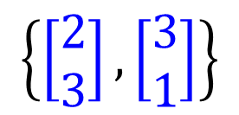


Example 2
$$2x_{1}+3x_{2}=4$$
$$3x_{1}+1x_{2}=−1$$
Has solution or not?
$$\left\{\left[\begin{matrix}2 \\ 3\end{matrix}\right],\left[\begin{matrix}3 \\ 1\end{matrix}\right]\right\}$$
$$\left[\begin{matrix}2 \\ 3\end{matrix}\right]$$
$$\left[\begin{matrix}4 \\ −1\end{matrix}\right]$$
2$\left[\begin{matrix}3 \\ 1\end{matrix}\right]$
$$\left[\begin{matrix}3 \\ 1\end{matrix}\right]$$
$$\left[\begin{matrix}4 \\ −1\end{matrix}\right]$$
(-1)$\left[\begin{matrix}2 \\ 3\end{matrix}\right]$
Notes:
Unique solution
在第二項限如何、在第三項限如何

Slide 9
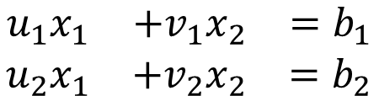


Example 2
If u and v are any nonparallel vectors in R², then every vector in R² is a linear combination of u and v
Nonparallel: u and v are nonzero vectors, and u ≠ cv.
If u, v and w are any nonparallel vectors in R³, then every vector in R³ is a linear combination of u, v and w?
$$\begin{matrix}u_{1}x_{1} & +v_{1}x_{2} & =b_{1} \\ u_{2}x_{1} & +v_{2}x_{2} & =b_{2}\end{matrix}$$
$$u$$
$$v$$
u and v are not parallel
?
Has solution
NO
Notes:
It is easy to understand for e1 and e2
Unique coefficient
Obviously, every vector in R^{n} may be uniquely linearly combined by these standard vectors.
劍圍???

Slide 10
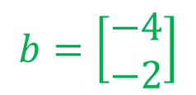
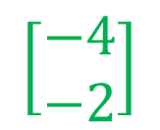


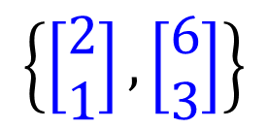

Example 3
$$2x_{1}+6x_{2}=−4$$
$$1x_{1}+3x_{2}=−2$$
$$A=\left[\begin{matrix}2 & 6 \\ 1 & 3\end{matrix}\right]$$
$$x=\left[\begin{matrix}x_{1} \\ x_{2}\end{matrix}\right]$$
$$b=\left[\begin{matrix}−4 \\ −2\end{matrix}\right]$$
Has solution or not?
Is $b$ the linear combination of columns of $A?$
$$\left[\begin{matrix}−4 \\ −2\end{matrix}\right]$$
$$\left\{\left[\begin{matrix}2 \\ 1\end{matrix}\right],\left[\begin{matrix}6 \\ 3\end{matrix}\right]\right\}$$
Notes:
高中、大學分隔線

Slide 11
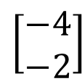





Example 3
$$2x_{1}+6x_{2}=−4$$
$$1x_{1}+3x_{2}=−2$$
Has solution or not?
Vector set: $\left\{\left[\begin{matrix}2 \\ 1\end{matrix}\right],\left[\begin{matrix}6 \\ 3\end{matrix}\right]\right\}$
Is $\left[\begin{matrix}−4 \\ −2\end{matrix}\right]$ a linear combination of $\left\{\left[\begin{matrix}2 \\ 1\end{matrix}\right],\left[\begin{matrix}6 \\ 3\end{matrix}\right]\right\}$?
Yes
$$\left[\begin{matrix}6 \\ 3\end{matrix}\right]$$
$$\left[\begin{matrix}2 \\ 1\end{matrix}\right]$$
$$\left[\begin{matrix}−4 \\ −2\end{matrix}\right]$$
u and v are not parallel
Has solution
Notes:
Infinite many solutions

Slide 12







Summary
$$A:m×n$$
$$x∈R^{n}$$
$$b∈R^{m}$$
Is $b$ a linear combination of columns of $A$?
Is $b$ in the span of the columns of $A$?
NO
YES
No solution
The columns of $A$ are independent.
The columns of $A$ are dependent.
Rank A = n
Rank A < n
Nullity A = 0
Nullity A > 0
Unique solution
Infinite solution
Notes:
Check existence first
One or infinite soluiton

