Slide 1
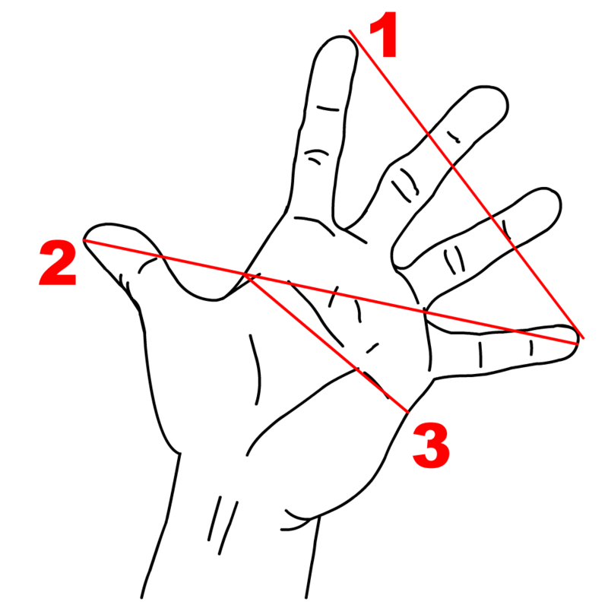

Span
Hand
Span
Palm
Span

Slide 2
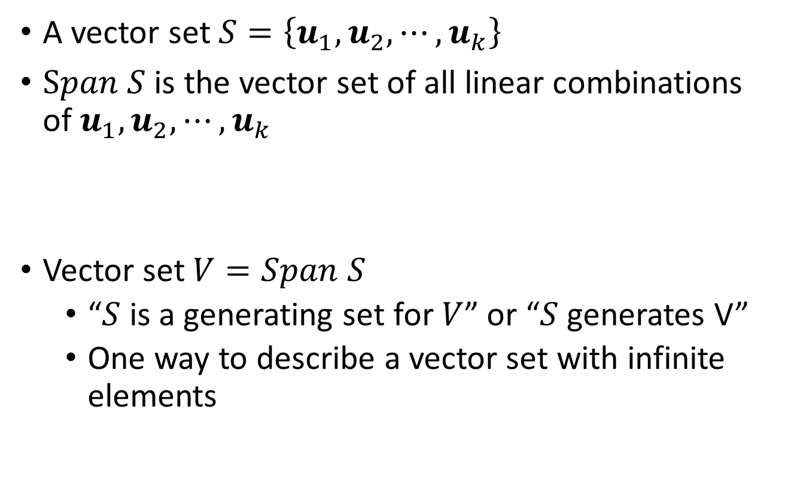
Span
A vector set $S=\left\{u_{1},u_{2},⋯,u_{k}\right\}$
$Span S$ is the vector set of all linear combinations of $u_{1},u_{2},⋯,u_{k}$
Vector set $V=Span S$
“$S$ is a generating set for $V$” or “$S$ generates V”
One way to describe a vector set with infinite elements
$$Span S=\left\{{c_{1}u}_{1}+{c_{2}u}_{2}+⋯+{c_{k}u}_{k}| for all c_{1},c_{2},⋯,c_{k}\right\}$$

Slide 3
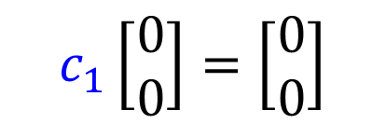
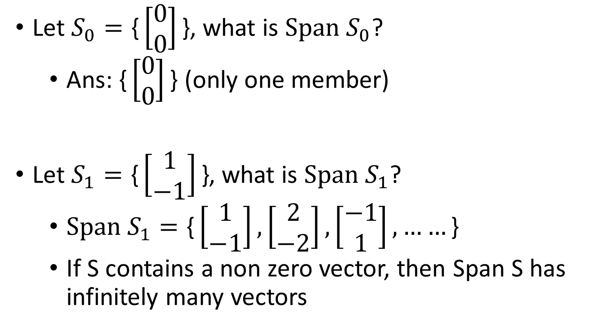


Span
$$c_{1}\left[\begin{matrix}0 \\ 0\end{matrix}\right]=\left[\begin{matrix}0 \\ 0\end{matrix}\right]$$
Let $S_{0}=\text{\{}\left[\begin{matrix}0 \\ 0\end{matrix}\right]\text{\}}$, what is $Span S_{0}$?
Ans: $\text{\{}\left[\begin{matrix}0 \\ 0\end{matrix}\right]\text{\}}$ (only one member)
Let $S_{1}=\text{\{}\left[\begin{matrix}1 \\ −1\end{matrix}\right]\text{\}}$, what is $Span S_{1}$?
$Span S_{1}=\text{\{}\left[\begin{matrix}1 \\ −1\end{matrix}\right]\text{,}\left[\begin{matrix}2 \\ −2\end{matrix}\right],\left[\begin{matrix}−1 \\ 1\end{matrix}\right],……\text{\}}$
If S contains a non zero vector, then Span S has infinitely many vectors
$$Span S_{1}$$
$$\left[\begin{matrix}1 \\ −1\end{matrix}\right]$$

Slide 4



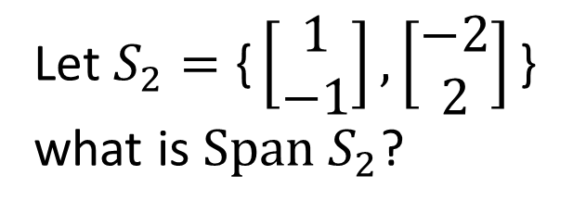

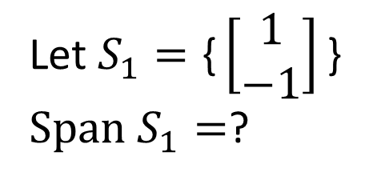


Span
Let $S_{1}=\text{\{}\left[\begin{matrix}1 \\ −1\end{matrix}\right]\text{\}}$
$Span S_{1}=$?
Let $S_{2}=\text{\{}\left[\begin{matrix}1 \\ −1\end{matrix}\right],\left[\begin{matrix}−2 \\ 2\end{matrix}\right]\text{\}}$
what is $Span S_{2}$?
$$Span S_{1}$$
$$Span S_{2}$$
$$\left[\begin{matrix}−2 \\ 2\end{matrix}\right]$$
$$\left[\begin{matrix}1 \\ −1\end{matrix}\right]$$
$$\left[\begin{matrix}1 \\ −1\end{matrix}\right]$$
$$Span S_{1}=Span S_{2}$$
(Different number of vectors can generate the same space.)

Slide 5
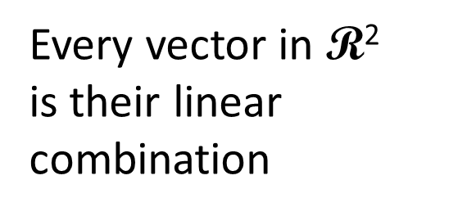






Span
Let $S_{3}=\text{\{}\left[\begin{matrix}1 \\ −1\end{matrix}\right],\left[\begin{matrix}−2 \\ 2\end{matrix}\right],\left[\begin{matrix}2 \\ 1\end{matrix}\right]\text{\}}$, what is $Span S_{3}$?
Every vector in $\text{R}\text{2}$
is their linear combination
$$\left[\begin{matrix}−2 \\ 2\end{matrix}\right]$$
$$\left[\begin{matrix}2 \\ 1\end{matrix}\right]$$
$$\left[\begin{matrix}1 \\ −1\end{matrix}\right]$$
$$Span S_{3}$$
$$=\text{R}\text{2}$$
Notes:
則編
角色重疊
(其中一個是冗員)

Slide 6








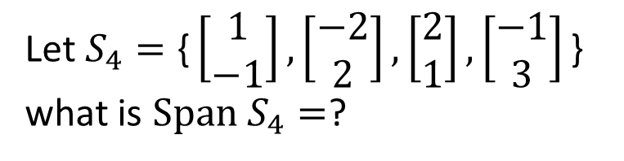



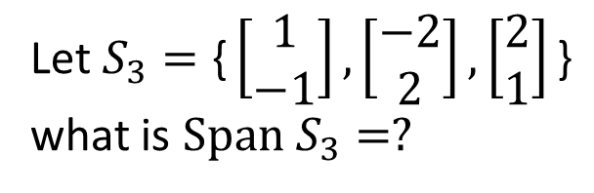
Span
Let $S_{3}=\text{\{}\left[\begin{matrix}1 \\ −1\end{matrix}\right],\left[\begin{matrix}−2 \\ 2\end{matrix}\right],\left[\begin{matrix}2 \\ 1\end{matrix}\right]\text{\}}$
what is $Span S_{3}=?$
Let $S_{4}=\text{\{}\left[\begin{matrix}1 \\ −1\end{matrix}\right],\left[\begin{matrix}−2 \\ 2\end{matrix}\right],\left[\begin{matrix}2 \\ 1\end{matrix}\right],\left[\begin{matrix}−1 \\ 3\end{matrix}\right]\text{\}}$
what is $Span S_{4}=$?
$$\left[\begin{matrix}−1 \\ 3\end{matrix}\right]$$
$$\left[\begin{matrix}−2 \\ 2\end{matrix}\right]$$
$$\left[\begin{matrix}2 \\ 1\end{matrix}\right]$$
$$\left[\begin{matrix}−2 \\ 2\end{matrix}\right]$$
$$\left[\begin{matrix}2 \\ 1\end{matrix}\right]$$
$$\left[\begin{matrix}1 \\ −1\end{matrix}\right]$$
$$\left[\begin{matrix}1 \\ −1\end{matrix}\right]$$
$$Span S_{3}$$
$$=\text{R}\text{2}$$
$$Span S_{4}$$
$$=\text{R}\text{2}$$

Slide 7
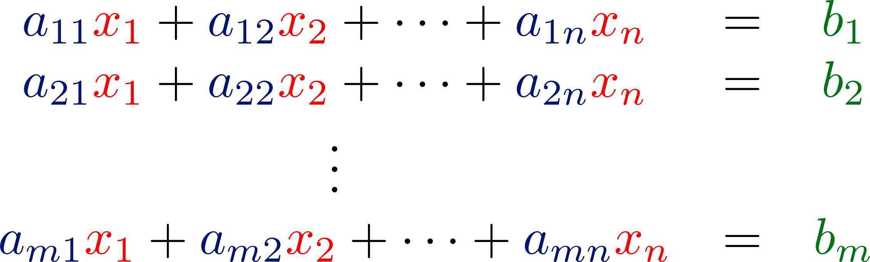

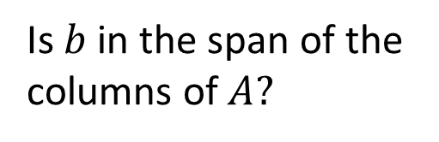
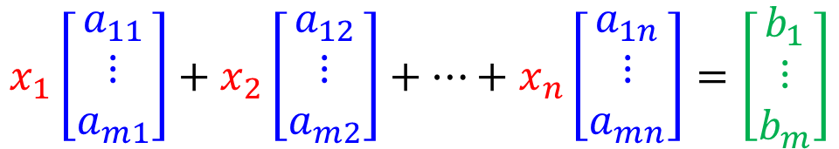
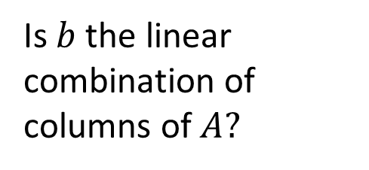
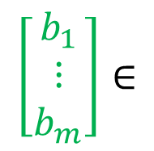
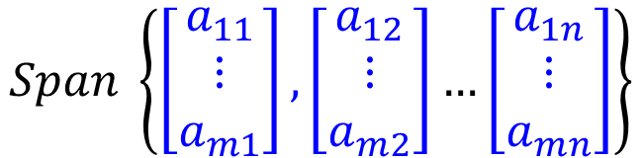
Has solution or not?
The same question
$$x_{1}\left[\begin{matrix}a_{11} \\ ⋮ \\ a_{m1}\end{matrix}\right]+x_{2}\left[\begin{matrix}a_{12} \\ ⋮ \\ a_{m2}\end{matrix}\right]+…+x_{n}\left[\begin{matrix}a_{1n} \\ ⋮ \\ a_{mn}\end{matrix}\right]=\left[\begin{matrix}b_{1} \\ ⋮ \\ b_{m}\end{matrix}\right]$$
Is $b$ the linear combination of columns of $A?$
The same question
$$\left[\begin{matrix}b_{1} \\ ⋮ \\ b_{m}\end{matrix}\right]∈$$
$$Span \left\{\left[\begin{matrix}a_{11} \\ ⋮ \\ a_{m1}\end{matrix}\right],\left[\begin{matrix}a_{12} \\ ⋮ \\ a_{m2}\end{matrix}\right]…\left[\begin{matrix}a_{1n} \\ ⋮ \\ a_{mn}\end{matrix}\right]\right\}$$
Is $b$in the span of the columns of $A?$

Slide 8
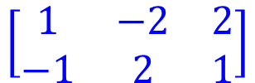

Span
$$\left[\begin{matrix}1 & −2 & 2 \\ −1 & 2 & 1\end{matrix}\right]$$
$$\left[\begin{aligned}1 \\ 2\end{aligned}\right]$$
Every b has solution
Let $S_{3}=\text{\{}\left[\begin{matrix}1 \\ −1\end{matrix}\right],\left[\begin{matrix}−2 \\ 2\end{matrix}\right],\left[\begin{matrix}2 \\ 1\end{matrix}\right]\text{\}}$, what is $Span S_{3}$?
Every vector in $\text{R}\text{2}$
is their linear combination
$$\left[\begin{matrix}−2 \\ 2\end{matrix}\right]$$
$$\left[\begin{matrix}2 \\ 1\end{matrix}\right]$$
$$\left[\begin{matrix}1 \\ −1\end{matrix}\right]$$
$$Span S_{3}$$
$$=\text{R}\text{2}$$

Slide 9







Summary
$$A:m×n$$
$$x∈R^{n}$$
$$b∈R^{m}$$
Is $b$ a linear combination of columns of $A$?
Is $b$ in the span of the columns of $A$?
NO
YES
No solution
The columns of $A$ are independent.
The columns of $A$ are dependent.
Rank A = n
Rank A < n
Nullity A = 0
Nullity A > 0
Unique solution
Infinite solution
Notes:
Check existence first
One or infinite soluiton

