Slide 1
Rank and Nullity
秩
零度
Notes:
次序、規則、條理。如：「秩序」。

Slide 2



Rank and Nullity
The rank of a matrix is defined as the maximum number of linearly independent columns
Nullity = Number of columns - rank
$$Rank A=4$$
$$A=$$
$$Nullity A=2$$
所有
登庸武將
maximum
Independent set
最大沒人
耍廢軍團
Notes:
就跟挑選武將依樣
Rank has many definition
(b) the maximum number of linearly independent row vectors in the matrix. Both definitions are equivalent.
The rank of a matrix would be zero only if the matrix had no non-zero elements. If a matrix had even one non-zero element, its minimum rank would be one.

Slide 3
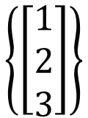

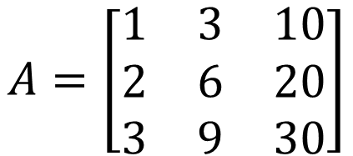
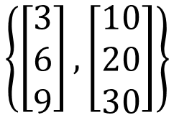

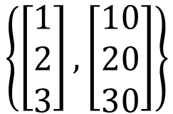

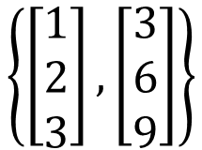

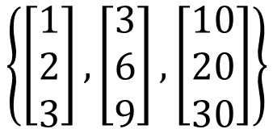
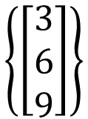
Rank and Nullity
$$A=\left[\begin{matrix}1 & 3 & 10 \\ 2 & 6 & 20 \\ 3 & 9 & 30\end{matrix}\right]$$
$$Rank A=?,Nullity A=?$$
以下是最土炮的作法
$$\left\{\left[\begin{aligned}1 \\ 2 \\ 3\end{aligned}\right],\left[\begin{aligned}3 \\ 6 \\ 9\end{aligned}\right],\left[\begin{aligned}10 \\ 20 \\ 30\end{aligned}\right]\right\}$$
$$\left\{\left[\begin{aligned}1 \\ 2 \\ 3\end{aligned}\right],\left[\begin{aligned}3 \\ 6 \\ 9\end{aligned}\right]\right\}$$
$$\left\{\left[\begin{aligned}1 \\ 2 \\ 3\end{aligned}\right], \left[\begin{aligned}10 \\ 20 \\ 30\end{aligned}\right]\right\}$$
$$\left\{\left[\begin{aligned}3 \\ 6 \\ 9\end{aligned}\right],\left[\begin{aligned}10 \\ 20 \\ 30\end{aligned}\right]\right\}$$
dependent
dependent
dependent
dependent
$$\left\{\left[\begin{aligned}1 \\ 2 \\ 3\end{aligned}\right]\right\}$$
$$\left\{\left[\begin{aligned}3 \\ 6 \\ 9\end{aligned}\right]\right\}$$
$$\left\{\left[\begin{aligned}10 \\ 20 \\ 30\end{aligned}\right]\right\}$$
$$Rank A=1$$
$$Nullity A=2$$
independent
independent
independent
Notes:
以下是最土炮的作法

Slide 4
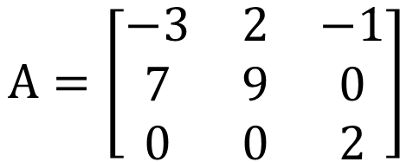


Rank and Nullity
$$A=\left[\begin{matrix}−3 & 2 & −1 \\ 7 & 9 & 0 \\ 0 & 0 & 2\end{matrix}\right]$$
$$Rank A=?3$$
$$Nullity A=?0$$
Assume the three columns are independent
If A is a mxn matrix (n columns)
Columns of A are independent
Rank A = n
Nullity A = 0
Notes:
(b) the maximum number of linearly independent row vectors in the matrix. Both definitions are equivalent.
The rank of a matrix would be zero only if the matrix had no non-zero elements. If a matrix had even one non-zero element, its minimum rank would be one.

Slide 5


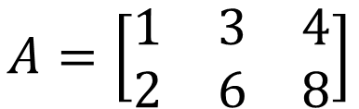


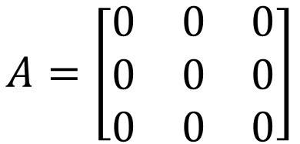

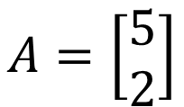


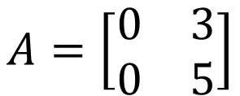


$$A=\left[\begin{matrix}1 & 3 & 4 \\ 2 & 6 & 8\end{matrix}\right]$$
$$Rank A=?1$$
$$Nullity A=?2$$
$$A=\left[\begin{matrix}0 & 0 & 0 \\ 0 & 0 & 0 \\ 0 & 0 & 0\end{matrix}\right]$$
$$\left\{\left[\begin{aligned}0 \\ 0 \\ 0\end{aligned}\right]\right\}$$
$$Rank A=?0$$
$$Nullity A=?3$$
$$A=\left[\begin{matrix}0 & 3 \\ 0 & 5\end{matrix}\right]$$
$$A=\left[\begin{matrix}5 \\ 2\end{matrix}\right]$$
$$Rank A=?1$$
$$Rank A=?1$$
$$Nullity A=?1$$
$$Nullity A=?0$$
Notes:
(b) the maximum number of linearly independent row vectors in the matrix. Both definitions are equivalent.
The rank of a matrix would be zero only if the matrix had no non-zero elements. If a matrix had even one non-zero element, its minimum rank would be one.

Slide 6








Summary
$$A:m×n$$
$$x∈R^{n}$$
$$b∈R^{m}$$
Is $b$ a linear combination of columns of $A$?
Is $b$ in the span of the columns of $A$?
NO
YES
No solution
The columns of $A$ are independent.
The columns of $A$ are dependent.
=
=
Rank A = n
Rank A < n
Nullity A = 0
Nullity A > 0
Unique solution
Infinite solution
Notes:
Check existence first
One or infinite soluiton

