Slide 1

Reduced Row Echelon Form (RREF)

Slide 2
Solving system of linear equation
A complex system of linear equations
A simple system of linear equations
Ax = b
R′x = b′
equivalent
A’=[ A b ]
A’’
A’’’
……
R=[ R′ b′ ]
Reduced Row Echelon Form (RREF)
elementary row operations:
1. Interchange any two rows of the matrix
2. Multiply every entry of some row by the same nonzero scalar
3. Add a multiple of one row of the matrix to another row
Notes:
Every elementary row operations are reversible.
For interchange operation it is obvious, for scaling operation
multiply the inverse of the nonzero constant, and for row addition
operation add the negative multiple of the row to the other row.

Slide 3
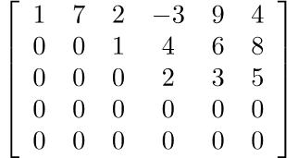
Reduced Row Echelon Form
階層
A system of linear equations is easily solvable if its augmented matrix is in reduced row echelon form
Row Echelon Form (REF)
1. Each nonzero row lies above every zero row
2. The leading entries are in echelon form
Notes:
Echelon 【軍】梯次編隊,階層
(Actually condition 3 is implied by 2.)

Slide 4
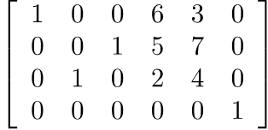
Reduced Row Echelon Form
A system of linear equations is easily solvable if its augmented matrix is in reduced row echelon form
Row Echelon Form (REF)
NO
1. Each nonzero row lies above every zero row
2. The leading entries are in echelon form
No zero rows
Notes:
Echelon 【軍】梯次編隊,階層
(Actually condition 3 is implied by 2.)

Slide 5


Reduced Row Echelon Form
A system of linear equations is easily solvable if its augmented matrix is in reduced row echelon form
Reduced Row Echelon Form (RREF)
1-2 The matrix is in row echelon form
3. The columns containing the leading entries are standard vectors.

Slide 6
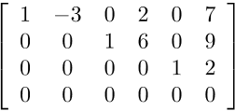
Reduced Row Echelon Form
A system of linear equations is easily solvable if its augmented matrix is in reduced row echelon form
Reduced Row Echelon Form (RREF)
1-2 The matrix is in row echelon form
3. The columns containing the leading entries are standard vectors.
Notes:
4. If a column contains the leading entry, then all the other entries are 0
5. The leading entries are 1

Slide 7
Reduced Row Echelon Form
Pivot 中樞
A
R
Leading Entry
The pivot positions of A are (1,1), (2,3) and (3,4).
The pivot columns of A are 1st, 3rd and 4th columns.
Notes:
Pi (闢) vət

Slide 8
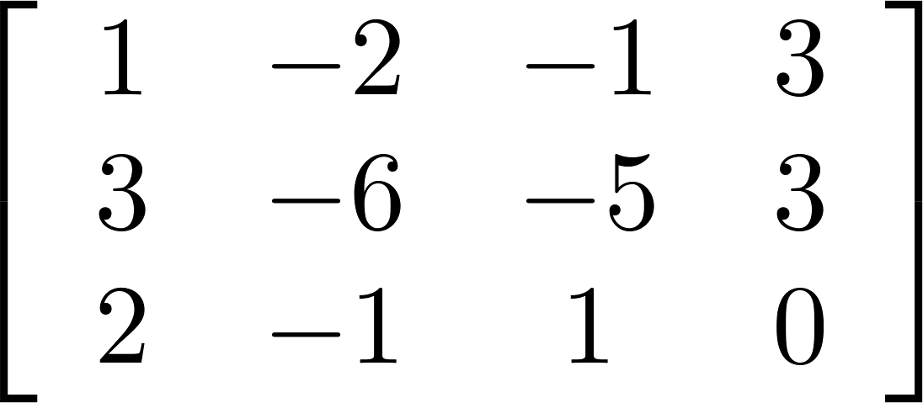
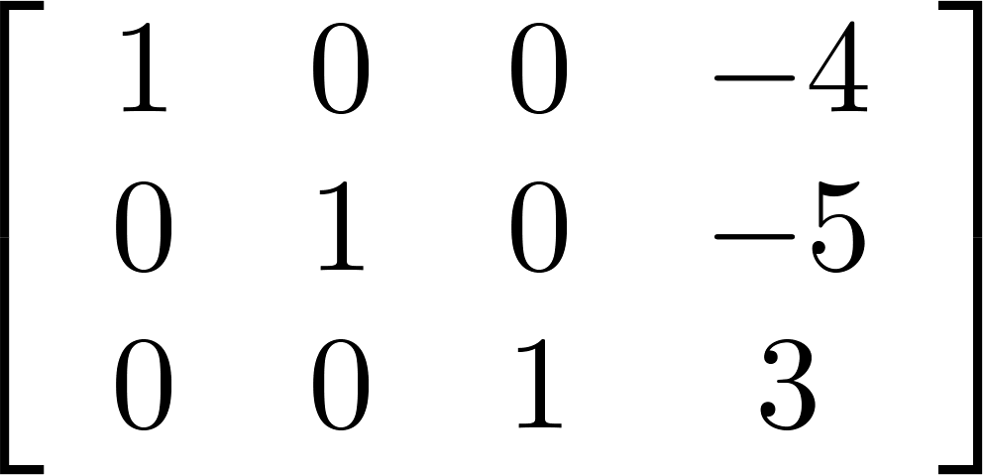



RREF is unique!
Not going to proof
A matrix can be transformed into multiple REF by row operation, but only one RREF
REF
$$\left[\begin{matrix}\begin{matrix}1 & −2 \\ 0 & 3 \\ 0 & 0\end{matrix} & \begin{matrix}−1 & 3 \\ 3 & −6 \\ 1 & 3\end{matrix}\end{matrix}\right]$$
RREF
REF
$$\left[\begin{matrix}\begin{matrix}1 & −2 \\ 0 & 3 \\ 0 & 0\end{matrix} & \begin{matrix}−1 & 3 \\ 3 & −6 \\ 3 & 9\end{matrix}\end{matrix}\right]$$
REF
$$\left[\begin{matrix}\begin{matrix}1 & −2 \\ 0 & 3 \\ 0 & 0\end{matrix} & \begin{matrix}−1 & 3 \\ 0 & −15 \\ 3 & 9\end{matrix}\end{matrix}\right]$$
Notes:
https://www.isical.ac.in/~arnabc/isivm2/rrefunique.pdf
===========
Can different matrices have the same RREF?

