Slide 1

How to find RREF

Slide 2
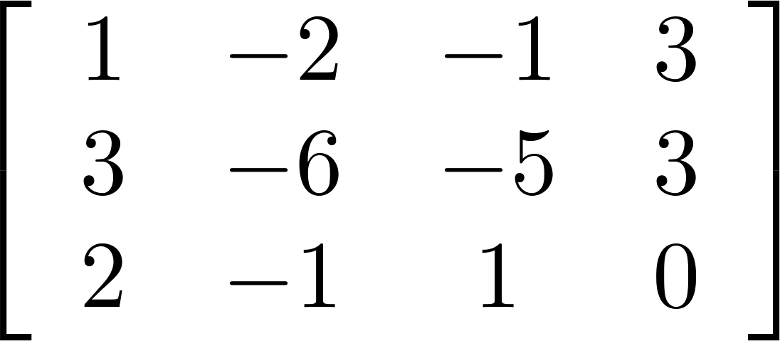
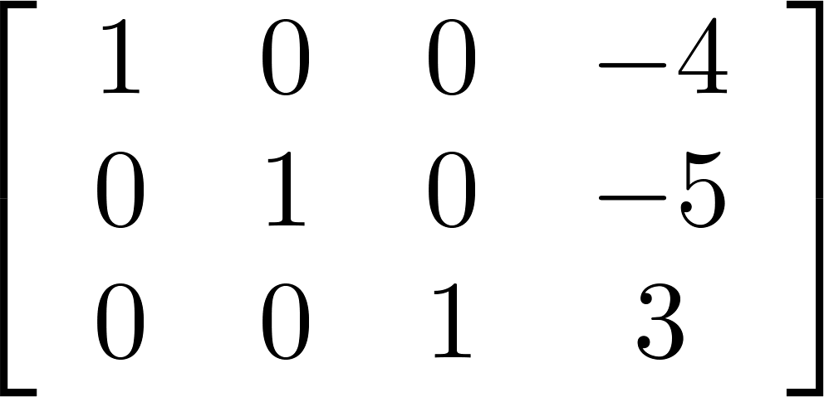
Reduced Row Echelon Form (RREF)
Gaussian elimination: an algorithm for finding the reduced row echelon form of a matrix.
Because RREF of a matrix is unique, the order of elementary row operations in not important.
Original augmented matrix
The reduced row echelon form
A row echelon form
Elementary row operations
Elementary row operations
Notes:
MATLAB
RREF of a matrix is unique.
Please refer to the steps of Gaussian Elimination in the textbook by yourself.
http://www.ams.org/notices/201106/rtx110600782p.pdf
http://www.dougbabcock.com/matrix.php

Slide 3
Example 1
1
-2
3

Slide 4
Example 1

Slide 5
Example 1
-1

Slide 6
Example 1
-2

Slide 7
Example 1
-2
2
1
1
2

Slide 8
Example 1
1
1
-3

Slide 9
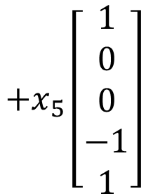
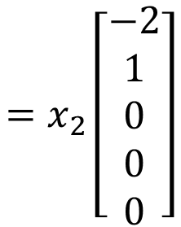
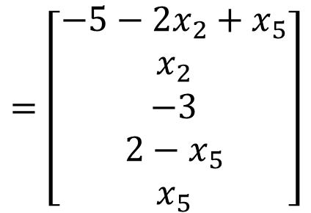

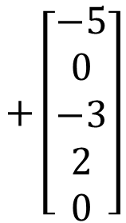
Example 1
x₁
x₂
x₃
x₄
x₅
b
$$\left[\begin{aligned}x_{1} \\ x_{2} \\ x_{3} \\ x_{4} \\ x_{5}\end{aligned}\right]$$
$$=\left[\begin{aligned}−5−2x_{2}+x_{5} \\ x_{2} \\ −3 \\ 2−x_{5} \\ x_{5}\end{aligned}\right]$$
$$=x_{2}\left[\begin{aligned}−2 \\ 1 \\ 0 \\ 0 \\ 0\end{aligned}\right]$$
$$+x_{5}\left[\begin{aligned}1 \\ 0 \\ 0 \\ −1 \\ 1\end{aligned}\right]$$
$$+\left[\begin{aligned}−5 \\ 0 \\ −3 \\ 2 \\ 0\end{aligned}\right]$$

Slide 10
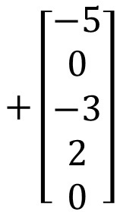
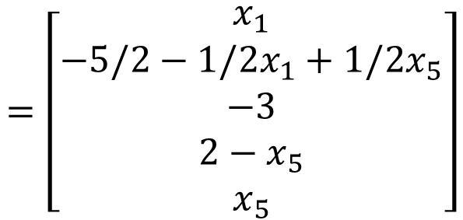
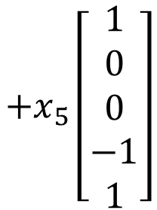

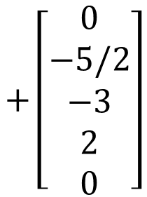
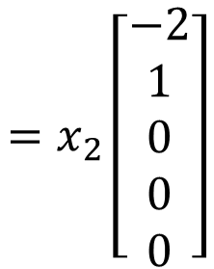

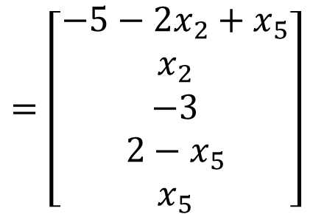
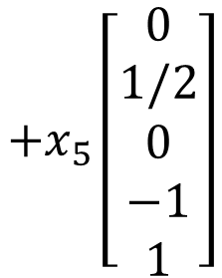
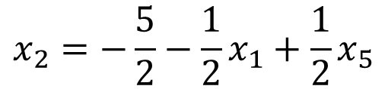

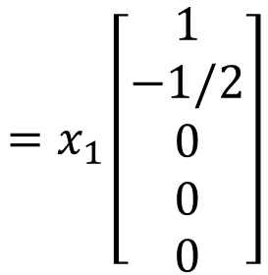
$$\left[\begin{aligned}x_{1} \\ x_{2} \\ x_{3} \\ x_{4} \\ x_{5}\end{aligned}\right]$$
$$=\left[\begin{aligned}−5−2x_{2}+x_{5} \\ x_{2} \\ −3 \\ 2−x_{5} \\ x_{5}\end{aligned}\right]$$
-8
$$+\left[\begin{aligned}−5 \\ 0 \\ −3 \\ 2 \\ 0\end{aligned}\right]$$
$$=x_{2}\left[\begin{aligned}−2 \\ 1 \\ 0 \\ 0 \\ 0\end{aligned}\right]$$
$$+x_{5}\left[\begin{aligned}1 \\ 0 \\ 0 \\ −1 \\ 1\end{aligned}\right]$$
1
1
-1
3
-1
$$x_{1} free$$
$$x_{2}=−\frac{5}{2}−\frac{1}{2}x_{1}+\frac{1}{2}x_{5}$$
-8
$$=\left[\begin{aligned}x_{1} \\ −5/2−1/2x_{1}+1/2x_{5} \\ −3 \\ 2−x_{5} \\ x_{5}\end{aligned}\right]$$
$$\left[\begin{aligned}x_{1} \\ x_{2} \\ x_{3} \\ x_{4} \\ x_{5}\end{aligned}\right]$$
1
$$=x_{1}\left[\begin{aligned}1 \\ −1/2 \\ 0 \\ 0 \\ 0\end{aligned}\right]$$
$$+x_{5}\left[\begin{aligned}0 \\ 1/2 \\ 0 \\ −1 \\ 1\end{aligned}\right]$$
$$+\left[\begin{aligned}0 \\ −5/2 \\ −3 \\ 2 \\ 0\end{aligned}\right]$$
-8
-1
3
-1

Slide 11








Example 2
$$\left[\begin{matrix}\begin{matrix}\begin{matrix}1 & 0 \\ 0 & 1\end{matrix} & \begin{matrix}−3 & 0 \\ 2 & 0\end{matrix} \\ \begin{matrix}0 & 0 \\ 0 & 0\end{matrix} & \begin{matrix}0 & 1 \\ 0 & 0\end{matrix}\end{matrix} \\ \begin{matrix}\begin{matrix}2 & 0 \\ 0 & 2\end{matrix} & \begin{matrix}−6 & 0 \\ 4 & 0\end{matrix} \\ \begin{matrix}0 & 0 \\ 0 & 0\end{matrix} & \begin{matrix}0 & 2 \\ 0 & 0\end{matrix}\end{matrix}\end{matrix}\right]$$
$$\left[\begin{matrix}\begin{matrix}\begin{matrix}1 & 0 \\ 0 & 1\end{matrix} & \begin{matrix}−3 & 0 \\ 2 & 0\end{matrix} \\ \begin{matrix}0 & 0 \\ 0 & 0\end{matrix} & \begin{matrix}0 & 1 \\ 0 & 0\end{matrix}\end{matrix} \\ \begin{matrix}\begin{matrix}0 & 0 \\ 0 & 0\end{matrix} & \begin{matrix}0 & 0 \\ 0 & 0\end{matrix} \\ \begin{matrix}0 & 0 \\ 0 & 0\end{matrix} & \begin{matrix}0 & 0 \\ 0 & 0\end{matrix}\end{matrix}\end{matrix}\right]$$
Find the RREF of
$$R=\left[\begin{matrix}\begin{matrix}1 & 0 \\ 0 & 1\end{matrix} & \begin{matrix}−3 & 0 \\ 2 & 0\end{matrix} \\ \begin{matrix}0 & 0 \\ 0 & 0\end{matrix} & \begin{matrix}0 & 1 \\ 0 & 0\end{matrix}\end{matrix}\right]$$
$$R$$
$$R$$
$$×\left(−2\right)$$
$$2R$$
$$O$$

Slide 12







Example 3
$$R=\left[\begin{matrix}\begin{matrix}1 & 0 \\ 0 & 1\end{matrix} & \begin{matrix}−3 & 0 \\ 2 & 0\end{matrix} \\ \begin{matrix}0 & 0 \\ 0 & 0\end{matrix} & \begin{matrix}0 & 1 \\ 0 & 0\end{matrix}\end{matrix}\right]$$
$$\left[\begin{matrix}R & 2R \\ R & −R\end{matrix}\right]$$
Find the RREF of
$$\left[\begin{matrix}R & 2R \\ R & −R\end{matrix}\right]$$
$$\left[\begin{matrix}R & 2R \\ O & −3R\end{matrix}\right]$$
$$\left[\begin{matrix}\begin{matrix}\begin{matrix}1 & 0 \\ 0 & 1\end{matrix} & \begin{matrix}−3 & 0 \\ 2 & 0\end{matrix} \\ \begin{matrix}0 & 0 \\ 0 & 0\end{matrix} & \begin{matrix}0 & 1 \\ 0 & 0\end{matrix}\end{matrix} & \begin{matrix}\begin{matrix}0 & 0 \\ 0 & 0\end{matrix} & \begin{matrix}0 & 0 \\ 0 & 0\end{matrix} \\ \begin{matrix}0 & 0 \\ 0 & 0\end{matrix} & \begin{matrix}0 & 0 \\ 0 & 0\end{matrix}\end{matrix} \\ \begin{matrix}\begin{matrix}0 & 0 \\ 0 & 0\end{matrix} & \begin{matrix}0 & 0 \\ 0 & 0\end{matrix} \\ \begin{matrix}0 & 0 \\ 0 & 0\end{matrix} & \begin{matrix}0 & 0 \\ 0 & 0\end{matrix}\end{matrix} & \begin{matrix}\begin{matrix}1 & 0 \\ 0 & 1\end{matrix} & \begin{matrix}−3 & 0 \\ 2 & 0\end{matrix} \\ \begin{matrix}0 & 0 \\ 0 & 0\end{matrix} & \begin{matrix}0 & 1 \\ 0 & 0\end{matrix}\end{matrix}\end{matrix}\right]$$
$$\left[\begin{matrix}R & O \\ O & −3R\end{matrix}\right]$$
$$\left[\begin{matrix}R & O \\ O & R\end{matrix}\right]$$
Notes:
Linear equation
System of linear equations
Solution
Solution set
Consistent and inconsistent system of linear equations
Equivalent systems of linear equations
Coefficient matrix and augmented matrix of systems of linear equations.
Basic variables and free variables
Elementary row operations
Row echelon form and reduced row echelon form.

Slide 13


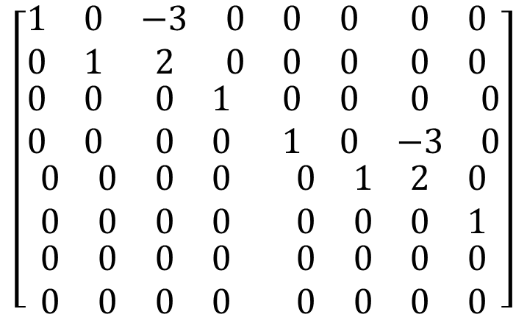
Example 3
This is RREF!
This is not RREF!
$$\left[\begin{matrix}\begin{matrix}\begin{matrix}1 & 0 \\ 0 & 1\end{matrix} & \begin{matrix}−3 & 0 \\ 2 & 0\end{matrix} \\ \begin{matrix}0 & 0 \\ 0 & 0\end{matrix} & \begin{matrix}0 & 1 \\ 0 & 0\end{matrix}\end{matrix} & \begin{matrix}\begin{matrix}0 & 0 \\ 0 & 0\end{matrix} & \begin{matrix}0 & 0 \\ 0 & 0\end{matrix} \\ \begin{matrix}0 & 0 \\ 1 & 0\end{matrix} & \begin{matrix}0 & 0 \\ −3 & 0\end{matrix}\end{matrix} \\ \begin{matrix}\begin{matrix}0 & 0 \\ 0 & 0\end{matrix} & \begin{matrix}0 & 0 \\ 0 & 0\end{matrix} \\ \begin{matrix}0 & 0 \\ 0 & 0\end{matrix} & \begin{matrix}0 & 0 \\ 0 & 0\end{matrix}\end{matrix} & \begin{matrix}\begin{matrix}0 & 1 \\ 0 & 0\end{matrix} & \begin{matrix}2 & 0 \\ 0 & 1\end{matrix} \\ \begin{matrix}0 & 0 \\ 0 & 0\end{matrix} & \begin{matrix}0 & 0 \\ 0 & 0\end{matrix}\end{matrix}\end{matrix}\right]$$
$$\left[\begin{matrix}\begin{matrix}\begin{matrix}1 & 0 \\ 0 & 1\end{matrix} & \begin{matrix}−3 & 0 \\ 2 & 0\end{matrix} \\ \begin{matrix}0 & 0 \\ 0 & 0\end{matrix} & \begin{matrix}0 & 1 \\ 0 & 0\end{matrix}\end{matrix} & \begin{matrix}\begin{matrix}0 & 0 \\ 0 & 0\end{matrix} & \begin{matrix}0 & 0 \\ 0 & 0\end{matrix} \\ \begin{matrix}0 & 0 \\ 0 & 0\end{matrix} & \begin{matrix}0 & 0 \\ 0 & 0\end{matrix}\end{matrix} \\ \begin{matrix}\begin{matrix}0 & 0 \\ 0 & 0\end{matrix} & \begin{matrix}0 & 0 \\ 0 & 0\end{matrix} \\ \begin{matrix}0 & 0 \\ 0 & 0\end{matrix} & \begin{matrix}0 & 0 \\ 0 & 0\end{matrix}\end{matrix} & \begin{matrix}\begin{matrix}1 & 0 \\ 0 & 1\end{matrix} & \begin{matrix}−3 & 0 \\ 2 & 0\end{matrix} \\ \begin{matrix}0 & 0 \\ 0 & 0\end{matrix} & \begin{matrix}0 & 1 \\ 0 & 0\end{matrix}\end{matrix}\end{matrix}\right]$$
Notes:
Linear equation
System of linear equations
Solution
Solution set
Consistent and inconsistent system of linear equations
Equivalent systems of linear equations
Coefficient matrix and augmented matrix of systems of linear equations.
Basic variables and free variables
Elementary row operations
Row echelon form and reduced row echelon form.

