Slide 1
What to learn in Linear Algebra?
Linear System

Slide 2

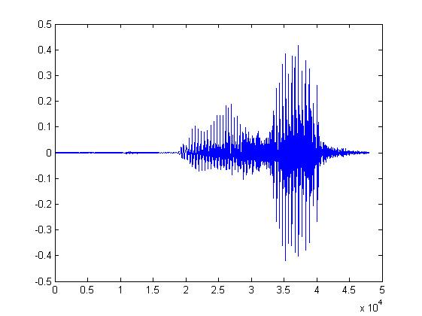

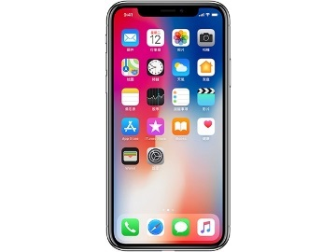
System
A system has input and output (function, transformation, operator)
Speech Recognition System
“How are you”
Dialogue System
(e.g. Siri, Alexa)
“How are you”
“I am fine”
Communication System
“Hello”
“Hello”
Notes:
Can have multiple inputs and outputs

Slide 3








Linear System
1. Persevering Multiplication
2. Persevering Addition
Linear
System
Linear
System
$$k$$
$$k$$
Linear
System
$$+$$
Linear
System
$$+$$
Linear
System
Notes:
我們用符號
可以是很多東西
但是要定義 X +
======
郭波拉第三定律說混合毒藥的解毒劑大於個別成分的解毒劑之
總合

Slide 4















Linear System
When the input and output are vectors
1. Persevering Multiplication
2. Persevering Addition
Linear
System
$$\left[\begin{aligned}3 \\ 4 \\ 5\end{aligned}\right]$$
Linear
System
$$k\left[\begin{aligned}3 \\ 4 \\ 5\end{aligned}\right]$$
$$\left[\begin{aligned}1 \\ 2\end{aligned}\right]$$
$$k\left[\begin{aligned}1 \\ 2\end{aligned}\right]$$
$$k=2$$
$$\left[\begin{aligned}6 \\ 8 \\ 10\end{aligned}\right]$$
$$\left[\begin{aligned}2 \\ 4\end{aligned}\right]$$
Linear
System
$$\left[\begin{aligned}3 \\ 4 \\ 5\end{aligned}\right]$$
$$\left[\begin{aligned}1 \\ 2\end{aligned}\right]$$
$$\left[\begin{aligned}3 \\ 4 \\ 5\end{aligned}\right]+\left[\begin{aligned}7 \\ 8 \\ 9\end{aligned}\right]$$
$$\left[\begin{aligned}1 \\ 2\end{aligned}\right]+\left[\begin{aligned}5 \\ 6\end{aligned}\right]$$
Linear
System
$$\left[\begin{aligned}5 \\ 6\end{aligned}\right]$$
Linear
System
$$\left[\begin{aligned}7 \\ 8 \\ 9\end{aligned}\right]$$
$$\left[\begin{aligned}6 \\ 8\end{aligned}\right]$$
$$\left[\begin{aligned}10 \\ 12 \\ 14\end{aligned}\right]$$
Notes:
我們用符號
可以是很多東西
但是要定義 X +

Slide 5
Are they Linear?

Slide 6



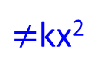




Linear?
System
NO
x
x²
1. Persevering Multiplication
2. Persevering Addition
System
System
x
x²
kx
k²x²
$≠$kx²
$$x_{1}$$
System
$${\left(x_{1}\right)}^{2}$$
$$x_{1}+x_{2}$$
System
$${\left(x_{1}+x_{2}\right)}^{2}$$
System
$$x_{2}$$
$${\left(x_{2}\right)}^{2}$$
$$≠{\left(x_{1}\right)}^{2}+{\left(x_{2}\right)}^{2}$$

Slide 7


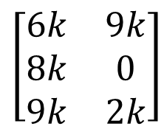

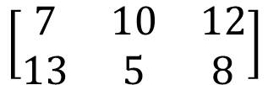


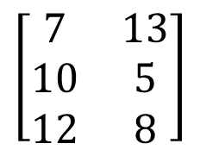


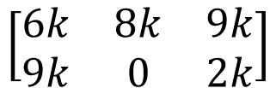

Linear?
以左上到右下的對角線為軸進行翻轉
$$\left[\begin{matrix}6 & 9 \\ 8 & 0 \\ 9 & 2\end{matrix}\right]$$
System
$$\left[\begin{matrix}6 & 8 & 9 \\ 9 & 0 & 2\end{matrix}\right]$$
Transpose
YES
$$×k$$
$$×k$$
$$\left[\begin{matrix}6k & 9k \\ 8k & 0 \\ 9k & 2k\end{matrix}\right]$$
System
$$\left[\begin{matrix}6k & 8k & 9k \\ 9k & 0 & 2k\end{matrix}\right]$$
$$\left[\begin{matrix}6 & 9 \\ 8 & 0 \\ 9 & 2\end{matrix}\right]$$
System
$$\left[\begin{matrix}6 & 8 & 9 \\ 9 & 0 & 2\end{matrix}\right]$$
$$\left[\begin{matrix}7 & 13 \\ 10 & 5 \\ 12 & 8\end{matrix}\right]$$
System
$$\left[\begin{matrix}1 & 4 \\ 2 & 5 \\ 3 & 6\end{matrix}\right]$$
System
$$\left[\begin{matrix}1 & 2 & 3 \\ 4 & 5 & 6\end{matrix}\right]$$
$$\left[\begin{matrix}7 & 10 & 12 \\ 13 & 5 & 8\end{matrix}\right]$$

Slide 8




Linear?
YES
Derivative
function f
function f’
$$f→f^{′}$$
x²
$$g→g^{′}$$
2x
$$kf→kf^{′}$$
$$f+g→f^{′}+g^{′}$$
3x
3
Notes:
導數

Slide 9

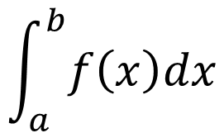
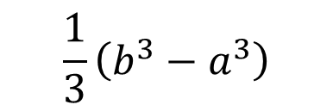

Linear?
$$\frac{1}{3}\left(b^{3}−a^{3}\right)$$
$$f\left(x\right)=x^{2}$$
Integral
(from a to b)
$$\int_{a}^{b}{f\left(x\right)dx}$$
Function $f\left(x\right)$
scalar
Area
a
b

Slide 10

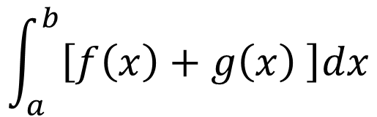



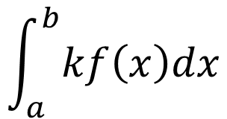





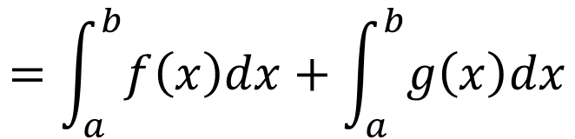
Linear?
$$\int_{a}^{b}{f\left(x\right)dx}$$
$$f\left(x\right)$$
YES
Persevering Multiplication
$$\int_{a}^{b}{kf\left(x\right)dx}$$
$$kf\left(x\right)$$
$$=k\int_{a}^{b}{f\left(x\right)dx}$$
Persevering Addition
$$\int_{a}^{b}{f\left(x\right)dx}$$
$$\int_{a}^{b}{g\left(x\right)dx}$$
$$f\left(x\right)$$
$$g\left(x\right)$$
$$\int_{a}^{b}{\left[f\left(x\right)+g\left(x\right) \right]dx}$$
$$f\left(x\right)+g\left(x\right)$$
$$=\int_{a}^{b}{f\left(x\right)dx}+\int_{a}^{b}{g\left(x\right)dx}$$

