Slide 1

Matrix Inverse
Notes:
Outline:
Inverse
Invertibility
elementary row operation
in generatl

Slide 2









Inverse of Function
Two functions f and g are inverse of each other
f=g⁻¹, g=f⁻¹
For $any v$
g
f
$$y=g\left(x\right)$$
$$x=f\left(v\right)$$
$$v$$
$$y=v$$
f
g
$$y=f\left(x\right)$$
$$x=g\left(v\right)$$
$$v$$
$$y=v$$
Notes:
Inverse of a function is unique

Slide 3








Inverse of Matrix
A and B are inverses to each other
$$AB=I$$
For $any v$
A
B
$$y=Ax$$
$$x=Bv$$
$$v$$
$$y=v$$
B
A
$$y=Bx$$
$$x=Av$$
$$v$$
$$y=v$$
$$BA=I$$
Notes:
If B is an inverse of A, then A is an inverse of B, i.e.,
Inverse of a function is unique
Compose is matrix multiplication

Slide 4
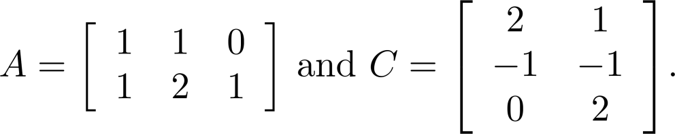
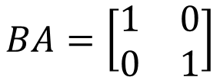
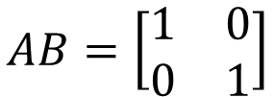
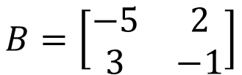
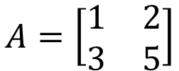



Inverse of Matrix
Invertible = Non-singular
Not Invertible = Singular
A is called invertible if there is a matrix B such that $AB=I$ and $BA=I$
B is an inverse of A
$$B=A^{−1}$$
$$A=B^{−1}$$
$$A=\left[\begin{matrix}1 & 2 \\ 3 & 5\end{matrix}\right]$$
$$B=\left[\begin{matrix}−5 & 2 \\ 3 & −1\end{matrix}\right]$$
$$AB=\left[\begin{matrix}1 & 0 \\ 0 & 1\end{matrix}\right]$$
$$BA=\left[\begin{matrix}1 & 0 \\ 0 & 1\end{matrix}\right]$$
Non-square matrix cannot be invertible
Notes:
No nxn
Inverse of a function is unique
Compose is matrix multiplication

Slide 5






Inverse of Matrix
Non-square matrix cannot be invertible?
2d
3d
2d
A
B
$$v$$
$$x=Bv$$
$$v$$
m dim
n dim
m dim
m x n
n x m
3d
2d
3d
B
A
$$v$$
$$x=Av$$
$$v$$
n dim
n x m
m dim
n dim
m x n

Slide 6









Inverse of Matrix
Not all the square matrix is invertible
Unique
$$AB=I$$
$$BA=I$$
$$AC=I$$
$$CA=I$$
$$B=BI$$
$$=B\left(AC\right)$$
$$=\left(BA\right)C$$
$$=IC$$
$$=C$$

Slide 7










Inverse for matrix product
yes
A and B are invertible nxn matrices, is AB invertible?
Let $A_{1},A_{2},⋯,A_{k}$ be nxn invertible matrices. The product $A_{1}A_{2}⋯A_{k}$ is invertible, and
$${\left(AB\right)}^{−1}=B^{−1}A^{−1}$$
$$B^{−1}A^{−1}\left(AB\right)$$
$${=B}^{−1}\left(A^{−1}A\right)B$$
$${=B}^{−1}B$$
$$=I$$
$$\left(AB\right)B^{−1}A^{−1}$$
$$=A\left(BB^{−1}\right)A^{−1}$$
$${=A A}^{−1}$$
$$=I$$
$${\left(A_{1}A_{2}⋯A_{k}\right)}^{−1}={\left(A_{k}\right)}^{−1}{\left(A_{k−1}\right)}^{−1}⋯{\left(A_{1}\right)}^{−1}$$

Slide 8









Inverse for matrix transpose
If A is invertible, is A^{T} invertible?
$${\left(A^{T}\right)}^{−1}=?$$
$${\left(A^{−1}\right)}^{T}$$
$${\left(AB\right)}^{T}=B^{T}A^{T}$$
$$A^{−1}A=I$$
$${\left(A^{−1}A\right)}^{T}=I$$
$$A^{T}{\left(A^{−1}\right)}^{T}=I$$
$${AA}^{−1}=I$$
$${\left({AA}^{−1}\right)}^{T}=I$$
$${\left(A^{−1}\right)}^{T}A^{T}=I$$

