Slide 1
Invertible
Notes:
Check by Theorem 2.6 (P126 ~ 127)
⬄ (b) Thm 2.5
➔ (e) x = A⁻¹ b. (e)➔(a) Suppose A = PR, where the last row of R is zero. Let b = Pen. Then Ax=b➔Rx=en
(c) ⬄ (f) Nullity = n – rank(A) = n- n = 0. (# of free variables = 0)
(g) ⬄ (c) Thm 1.8 (a)(d)
➔ (h) x = A⁻¹ 0 = 0; (h)➔(a)Suppose some x\neq 0 s.t. Ax=0
(i) ➔ (h) ➔ (a) : Let v be any vector in R^{n} such that Av = 0. Then
v = I_{n} v = (BA)v = B (Av) = B 0 = 0
(j) ➔ (e) ➔ (a): Let b be any vector in Rn and let v = Cb.
Then Av = A(Cb) = (AC) b = In b = b. ➔ (e)
(b) ➔ (k) In = Ek … E2 E1 A ➔ Ek⁻¹ = Ek…E2E1A ➔ A = E1⁻¹ E2⁻¹… Ek⁻¹

Slide 2
Summary
Let A be an n x n matrix. A is invertible if and only if
The columns of A span R^{n}
For every b in R^{n}, the system Ax=b is consistent
The rank of A is n
The columns of A are linear independent
The only solution to Ax=0 is the zero vector
The nullity of A is zero
The reduced row echelon form of A is I_{n}
A is a product of elementary matrices
There exists an n x n matrix B such that BA = I_{n}
There exists an n x n matrix C such that AC = I_{n}
Notes:
When A is square, one side is sufficient.

Slide 3
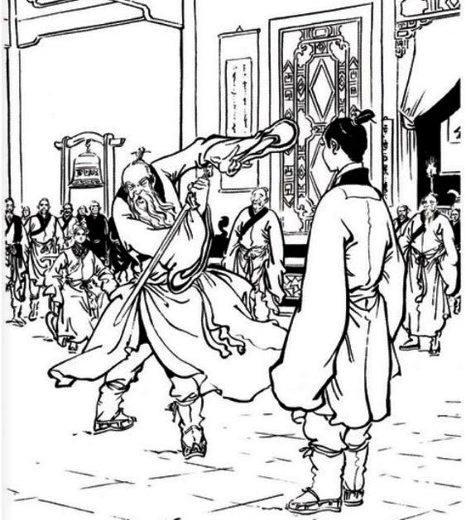
http://goo.gl/z3J5Rb
Notes:
張三豐使了一次太極劍，張無忌看清楚了，張三豐叫他想想，過了一會兒，張無忌已忘了一大半。 張三豐微笑演示了第二次，但這次和第一次竟沒一招相同，張無忌表示還有三招沒忘，沉思半晌後，滿臉喜色叫道: 這我可全忘了，忘得乾乾淨的。"

Slide 4






Review - Terminology
What actually come out of function f
Given a function f
Range (值域)
$$v_{1}$$
$$f\left(v_{1}\right)$$
$$v_{2}$$
$$f\left(v_{2}\right)$$
$$=f\left(v_{3}\right)$$
$$v_{3}$$
Domain (定義域)
Co-domain (對應域)
What can go into function f
What may possible come out of function f
Notes:
Co-domain
Range

Slide 5












Review - Terminology
one-to-one (一對一)
Onto (映成)
$$v_{1}$$
$$v_{1}$$
$$f\left(v_{1}\right)$$
$$f\left(v_{1}\right)$$
$$v_{2}$$
$$v_{2}$$
$$f\left(v_{2}\right)$$
$$f\left(v_{2}\right)$$
$$=f\left(v_{3}\right)$$
$$v_{3}$$
$$f\left(v_{3}\right)$$
$$v_{3}$$
Co-domain = range

Slide 6
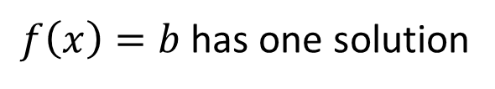







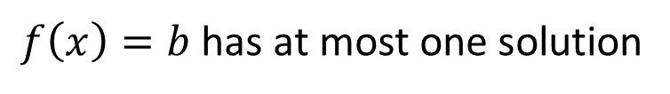
Review: One-to-one
2 x 3
A function f is one-to-one
If co-domain is “smaller” than the domain, f cannot be one-to-one.
$$v_{1}$$
$$f\left(v_{1}\right)$$
If a matrix A is 矮胖, it cannot be one-to-one.
$$v_{2}$$
$$f\left(v_{2}\right)$$
$$v_{3}$$
$$f\left(v_{3}\right)$$
The reverse is not true.
$$b$$
If a matrix A is one-to-one, its columns are independent.
$f\left(x\right)=b$ has one solution
$f\left(x\right)=b$ has at most one solution

Slide 7
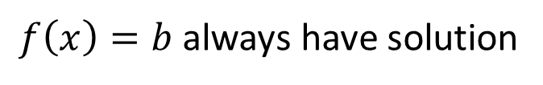

Review: Onto
3 x 2
A function f is onto
If co-domain is “larger” than the domain, f cannot be onto.
$$v_{1}$$
$$f\left(v_{1}\right)$$
$$v_{2}$$
If a matrix A is 高瘦, it cannot be onto.
$$f\left(v_{2}\right)$$
$$=f\left(v_{3}\right)$$
$$v_{3}$$
The reverse is not true.
If a matrix A is onto,
rank A = no. of rows.
Co-domain = range
$f\left(x\right)=b$ always have solution

Slide 8



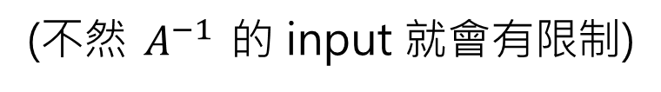






Invertible
A is called invertible if there is a matrix B such that $AB=I$ and $BA=I$ ($B=A^{−1}$)
$$A$$
$$A$$
$$Av$$
$$A^{−1}v$$
$$v$$
$$v$$
$$A^{−1}$$
$$A^{−1}$$
A must be one-to-one
A must be onto
(不然 $A^{−1}$ 的 input 就會有限制)
Notes:
So here, "singular" is not being taken in the sense of "single", but rather in the sense of "special", "not common". See the dictionary definition: it includes "odd", "exceptional", "unusual", "peculiar".
http://math.stackexchange.com/questions/42649/why-are-invertible-matrices-called-non-singular

Slide 9






One-to-one and onto
An invertible matrix A is always square.
A function f is one-to-one and onto
$$v_{1}$$
The domain and co-domain must have “the same size”.
$$f\left(v_{1}\right)$$
$$v_{2}$$
$$f\left(v_{2}\right)$$
The corresponding matrix A is square.
$$v_{3}$$
$$f\left(v_{3}\right)$$
One-to-one
Onto
在 Square 的前提下，要就都成立，要就都不成立

Slide 10
Summary
Let A be an n x n matrix. A is invertible if and only if
The columns of A span R^{n}
For every b in R^{n}, the system Ax=b is consistent
The rank of A is n
The columns of A are linear independent
The only solution to Ax=0 is the zero vector
The nullity of A is zero
The reduced row echelon form of A is I_{n}
A is a product of elementary matrices
There exists an n x n matrix B such that BA = I_{n}
There exists an n x n matrix C such that AC = I_{n}
Notes:
When A is square, one side is sufficient.

