Slide 1
Linear Algebra v.s. Compulsory Courses

Slide 2
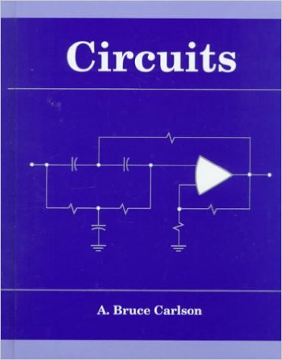


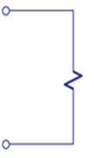
電路學
Input: voltage source, current source
Linear
output: voltage and current on the load (燈泡、引擎)
Circuit
+
-
(大一必修)
input
output
Linear System
Notes:
Desing filtering

Slide 3
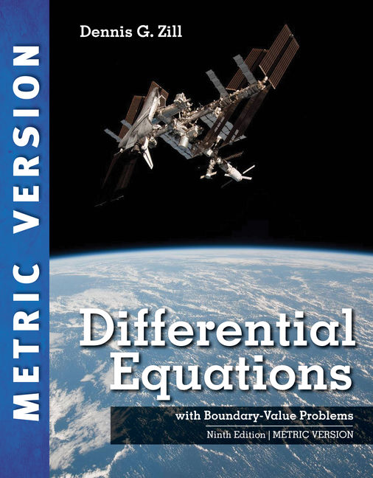
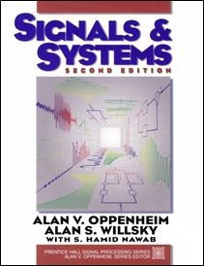
微分方程、信號與系統
(大二上必修)
(大二下必修)
Notes:
像無線通訊訊號在介質中的傳播就可以用線性系統來模擬

Slide 4
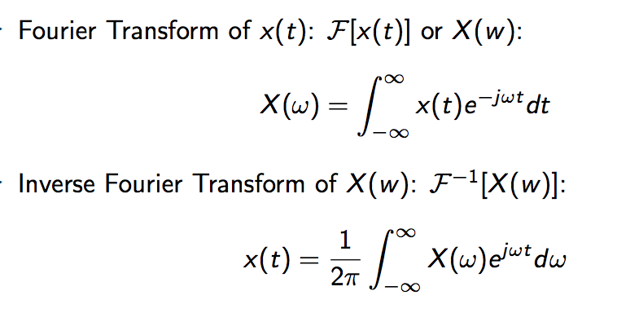
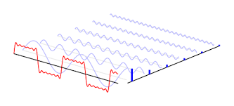
微分方程、信號與系統
time
frequency
Complex …
but linear
Fourier
Transform
Linear System

