Slide 1
Determinant
Hung-yi Lee
The determinant of a square matrix is a scalar that provides information about the matrix (e.g. invertible or not)
Notes:
Ref:
http://www.askamathematician.com/2013/05/q-why-are-determinants-defined-the-weird-way-they-are/
MIT OCW Linear Algebra:
Lecture 18: Properties of determinants
http://ocw.mit.edu/courses/mathematics/18-06-linear-algebra-spring-2010/video-lectures/lecture-18-properties-of-determinants/
Lecture 19: Determinant formulas and cofactors
http://ocw.mit.edu/courses/mathematics/18-06-linear-algebra-spring-2010/video-lectures/lecture-19-determinant-formulas-and-cofactors/
Lecture 20: Cramer's rule, inverse matrix, and volume
http://ocw.mit.edu/courses/mathematics/18-06-linear-algebra-spring-2010/video-lectures/lecture-20-cramers-rule-inverse-matrix-and-volume/
Textbook: Chapter 3

Slide 2






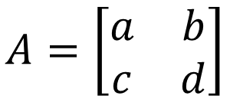







Determinants in High School
2 X 2
3 x 3
$$A=\left[\begin{matrix}a_{1} & a_{2} & a_{3} \\ a_{4} & a_{5} & a_{6} \\ a_{7} & a_{8} & a_{9}\end{matrix}\right]$$
$$A=\left[\begin{matrix}a & b \\ c & d\end{matrix}\right]$$
$$det\left(A\right)=$$
$$ad$$
$$−bc$$
$$det\left(A\right)=$$
$$a_{1}a_{5}a_{9}$$
$$+a_{2}a_{6}a_{7}$$
$$+a_{3}a_{4}a_{8}$$
$$\left[\begin{matrix}\begin{matrix}∗ & ∗ \\ ∗ & ∗\end{matrix} & \begin{matrix}∗ & ∗ \\ ∗ & ∗\end{matrix} \\ \begin{matrix}∗ & ∗ \\ ∗ & ∗\end{matrix} & \begin{matrix}∗ & ∗ \\ ∗ & ∗\end{matrix}\end{matrix}\right]$$
$$−a_{3}a_{5}a_{7}$$
$$−a_{2}a_{4}a_{9}$$
$$−a_{1}a_{6}a_{8}$$

Slide 3
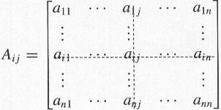
Cofactor Expansion
a_{ij}: scalar
A_{ij}: matrix
Suppose A is an n x n matrix. A_{ij} is defined as the submatrix of A obtained by removing the i-th row and the j-th column.
A
A_{ij}
i-th row
(n-1) x (n-1)
J-th column

Slide 4




Cofactor Expansion
$$A=\left[\begin{matrix}\begin{matrix}a_{11} & a_{12} \\ a_{21} & a_{22}\end{matrix} & \begin{matrix}⋯ & a_{1n} \\ ⋯ & a_{2n}\end{matrix} \\ \begin{matrix}⋮ & ⋮ \\ a_{m1} & a_{m2}\end{matrix} & \begin{matrix}⋱ & ⋮ \\ ⋯ & a_{mn}\end{matrix}\end{matrix}\right]$$
$$A_{11}$$
Pick row 1
Or pick row i
Or pick column j
$$detA=a_{11}c_{11}+a_{12}c_{12}+⋯+a_{1n}c_{1n}$$
c_{ij}: (i,j)-cofactor
$$detA=a_{i1}c_{i1}+a_{i2}c_{i2}+⋯+a_{in}c_{in}$$
$$detA=a_{1j}c_{1j}+a_{2j}c_{2j}+⋯+a_{nj}c_{nj}$$
$$c_{ij}={\left(−1\right)}^{i+j}detA_{ij}$$
Cofactor expansion again …
$$c_{11}={\left(−1\right)}^{1+1}detA_{11}$$
Notes:
Why they are the same???

Slide 5
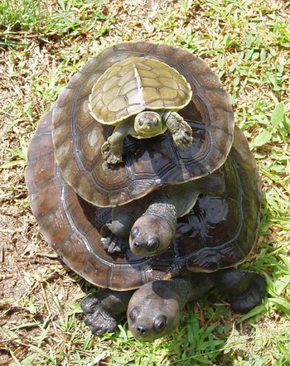

For 1x1 matrix, det([a]) = a
$$detA=a_{11}c_{11}+⋯+a_{1n}c_{1n}$$
$$c_{ij}={\left(−1\right)}^{i+j}detA_{ij}$$
Turtles all the way down?

Slide 6









2 x 2 matrix
$$c_{ij}={\left(−1\right)}^{i+j}detA_{ij}$$
Define det([a]) = a
$$A=\left[\begin{matrix}a & b \\ c & d\end{matrix}\right]$$
$$det\left(A\right)=ad−bc$$
Pick the first row
$$det\left(A\right)=ac_{11}+bc_{12}$$
$$=ad−bc$$
$$c_{11}={\left(−1\right)}^{1+1}det\left(\left[d\right]\right)$$
$$=d$$
$$c_{12}={\left(−1\right)}^{1+2}det\left(\left[c\right]\right)$$
$$=−c$$

Slide 7
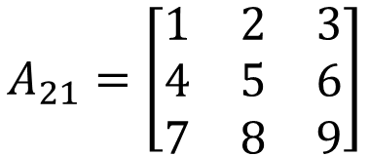
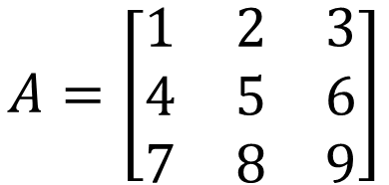



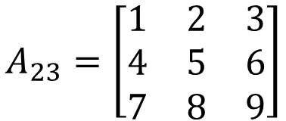
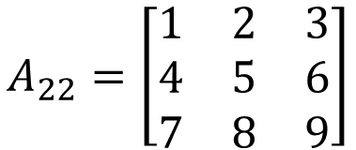
3 x 3 matrix
$$c_{ij}={\left(−1\right)}^{i+j}detA_{ij}$$
$$A=\left[\begin{matrix}1 & 2 & 3 \\ 4 & 5 & 6 \\ 7 & 8 & 9\end{matrix}\right]$$
Pick row 2
$$detA=a_{21}c_{21}+a_{22}c_{22}+a_{23}c_{23}$$
4
5
6
$${\left(−1\right)}^{2+1}detA_{21}$$
$${\left(−1\right)}^{2+2}detA_{22}$$
$${\left(−1\right)}^{2+3}detA_{23}$$
$$A_{21}=\left[\begin{matrix}1 & 2 & 3 \\ 4 & 5 & 6 \\ 7 & 8 & 9\end{matrix}\right]$$
$$A_{22}=\left[\begin{matrix}1 & 2 & 3 \\ 4 & 5 & 6 \\ 7 & 8 & 9\end{matrix}\right]$$
$$A_{23}=\left[\begin{matrix}1 & 2 & 3 \\ 4 & 5 & 6 \\ 7 & 8 & 9\end{matrix}\right]$$

Slide 8

Example
Given tridiagonal n x n matrix A
$$A=\left[\begin{matrix}\begin{matrix}\begin{matrix}1 & 1 \\ 1 & 1\end{matrix} & \begin{matrix}0 & ⋯ \\ 1 & ⋯\end{matrix} \\ \begin{matrix}0 & 1 \\ ⋮ & ⋮\end{matrix} & \begin{matrix}1 & ⋯ \\ ⋮ & ⋱\end{matrix}\end{matrix} & \begin{matrix}\begin{matrix}⋯ & 0 \\ ⋯ & 0\end{matrix} & \begin{matrix}0 & 0 \\ 0 & 0\end{matrix} \\ \begin{matrix}⋯ & 0 \\ ⋱ & ⋮\end{matrix} & \begin{matrix}0 & 0 \\ ⋮ & ⋮\end{matrix}\end{matrix} \\ \begin{matrix}\begin{matrix}⋮ & ⋮ \\ 0 & 0\end{matrix} & \begin{matrix}⋮ & ⋱ \\ 0 & ⋯\end{matrix} \\ \begin{matrix}0 & 0 \\ 0 & 0\end{matrix} & \begin{matrix}0 & ⋯ \\ 0 & ⋯\end{matrix}\end{matrix} & \begin{matrix}\begin{matrix}⋱ & ⋮ \\ ⋯ & 1\end{matrix} & \begin{matrix}⋮ & ⋮ \\ 1 & 0\end{matrix} \\ \begin{matrix}⋯ & 1 \\ ⋯ & 0\end{matrix} & \begin{matrix}1 & 1 \\ 1 & 1\end{matrix}\end{matrix}\end{matrix}\right]$$
Find det A when n = 999

Slide 9
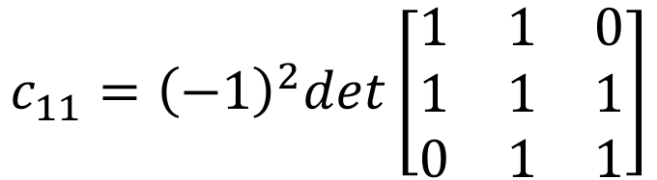



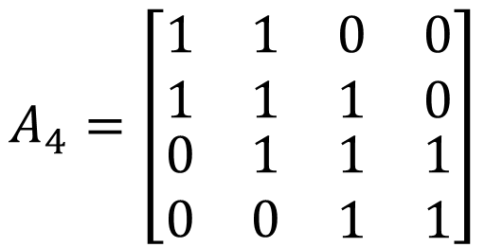
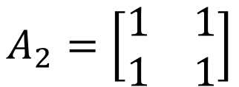

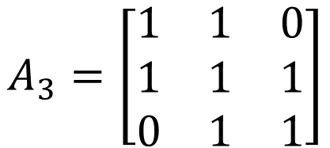
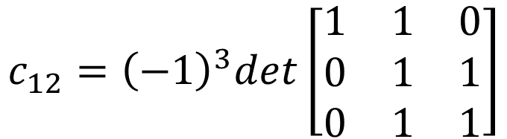
$$detA_{4}$$
$$A_{2}=\left[\begin{matrix}1 & 1 \\ 1 & 1\end{matrix}\right]$$
$$=a_{11}c_{11}+a_{12}c_{12}+a_{13}c_{13}+a_{14}c_{14}$$
1
1
0
0
$$A_{3}=\left[\begin{matrix}1 & 1 & 0 \\ 1 & 1 & 1 \\ 0 & 1 & 1\end{matrix}\right]$$
$$c_{11}={\left(−1\right)}^{2}det\left[\begin{matrix}1 & 1 & 0 \\ 1 & 1 & 1 \\ 0 & 1 & 1\end{matrix}\right]$$
$$A_{4}=\left[\begin{matrix}\begin{matrix}1 & 1 \\ 1 & 1\end{matrix} & \begin{matrix}0 & 0 \\ 1 & 0\end{matrix} \\ \begin{matrix}0 & 1 \\ 0 & 0\end{matrix} & \begin{matrix}1 & 1 \\ 1 & 1\end{matrix}\end{matrix}\right]$$
$$=det\left(A_{3}\right)$$
$$c_{12}={\left(−1\right)}^{3}det\left[\begin{matrix}1 & 1 & 0 \\ 0 & 1 & 1 \\ 0 & 1 & 1\end{matrix}\right]$$
$$=a_{11}c_{11}+a_{12}c_{12}+a_{13}c_{13}$$
$$=−det\left(A_{2}\right)$$
1
1
0
$$=det\left(A_{2}\right)$$
$$det\left(A_{4}\right)=det\left(A_{3}\right)−det\left(A_{2}\right)$$

Slide 10







$$det\left(A_{n}\right)=det\left(A_{n−1}\right)−det\left(A_{n−2}\right)$$
$$A_{n}=\left[\begin{matrix}\begin{matrix}\begin{matrix}1 & 1 \\ 1 & 1\end{matrix} & \begin{matrix}0 & ⋯ \\ 1 & ⋯\end{matrix} \\ \begin{matrix}0 & 1 \\ ⋮ & ⋮\end{matrix} & \begin{matrix}1 & ⋯ \\ ⋮ & ⋱\end{matrix}\end{matrix} & \begin{matrix}\begin{matrix}⋯ & 0 \\ ⋯ & 0\end{matrix} & \begin{matrix}0 & 0 \\ 0 & 0\end{matrix} \\ \begin{matrix}⋯ & 0 \\ ⋱ & ⋮\end{matrix} & \begin{matrix}0 & 0 \\ ⋮ & ⋮\end{matrix}\end{matrix} \\ \begin{matrix}\begin{matrix}⋮ & ⋮ \\ 0 & 0\end{matrix} & \begin{matrix}⋮ & ⋱ \\ 0 & ⋯\end{matrix} \\ \begin{matrix}0 & 0 \\ 0 & 0\end{matrix} & \begin{matrix}0 & ⋯ \\ 0 & ⋯\end{matrix}\end{matrix} & \begin{matrix}\begin{matrix}⋱ & ⋮ \\ ⋯ & 1\end{matrix} & \begin{matrix}⋮ & ⋮ \\ 1 & 0\end{matrix} \\ \begin{matrix}⋯ & 1 \\ ⋯ & 0\end{matrix} & \begin{matrix}1 & 1 \\ 1 & 1\end{matrix}\end{matrix}\end{matrix}\right]$$
$$\left[\begin{matrix}\begin{matrix}\begin{matrix}1 & 1 \\ 1 & 1\end{matrix} & \begin{matrix}0 & ⋯ \\ 1 & ⋯\end{matrix} \\ \begin{matrix}0 & 1 \\ ⋮ & ⋮\end{matrix} & \begin{matrix}1 & ⋯ \\ ⋮ & ⋱\end{matrix}\end{matrix} & \begin{matrix}\begin{matrix}⋯ & 0 \\ ⋯ & 0\end{matrix} & \begin{matrix}0 & 0 \\ 0 & 0\end{matrix} \\ \begin{matrix}⋯ & 0 \\ ⋱ & ⋮\end{matrix} & \begin{matrix}0 & 0 \\ ⋮ & ⋮\end{matrix}\end{matrix} \\ \begin{matrix}\begin{matrix}⋮ & ⋮ \\ 0 & 0\end{matrix} & \begin{matrix}⋮ & ⋱ \\ 0 & ⋯\end{matrix} \\ \begin{matrix}0 & 0 \\ 0 & 0\end{matrix} & \begin{matrix}0 & ⋯ \\ 0 & ⋯\end{matrix}\end{matrix} & \begin{matrix}\begin{matrix}⋱ & ⋮ \\ ⋯ & 1\end{matrix} & \begin{matrix}⋮ & ⋮ \\ 1 & 0\end{matrix} \\ \begin{matrix}⋯ & 1 \\ ⋯ & 0\end{matrix} & \begin{matrix}1 & 1 \\ 1 & 1\end{matrix}\end{matrix}\end{matrix}\right]$$
$$A_{n−1}$$
$$B=\left[\begin{matrix}\begin{matrix}\begin{matrix}1 & 1 \\ 0 & 1\end{matrix} & \begin{matrix}0 & ⋯ \\ 1 & ⋯\end{matrix} \\ \begin{matrix}0 & 1 \\ ⋮ & ⋮\end{matrix} & \begin{matrix}1 & ⋯ \\ ⋮ & ⋱\end{matrix}\end{matrix} & \begin{matrix}\begin{matrix}⋯ & 0 \\ ⋯ & 0\end{matrix} & \begin{matrix}0 & 0 \\ 0 & 0\end{matrix} \\ \begin{matrix}⋯ & 0 \\ ⋱ & ⋮\end{matrix} & \begin{matrix}0 & 0 \\ ⋮ & ⋮\end{matrix}\end{matrix} \\ \begin{matrix}\begin{matrix}⋮ & ⋮ \\ 0 & 0\end{matrix} & \begin{matrix}⋮ & ⋱ \\ 0 & ⋯\end{matrix} \\ \begin{matrix}0 & 0 \\ 0 & 0\end{matrix} & \begin{matrix}0 & ⋯ \\ 0 & ⋯\end{matrix}\end{matrix} & \begin{matrix}\begin{matrix}⋱ & ⋮ \\ ⋯ & 1\end{matrix} & \begin{matrix}⋮ & ⋮ \\ 1 & 0\end{matrix} \\ \begin{matrix}⋯ & 1 \\ ⋯ & 0\end{matrix} & \begin{matrix}1 & 1 \\ 1 & 1\end{matrix}\end{matrix}\end{matrix}\right]$$
$$\left[\begin{matrix}\begin{matrix}\begin{matrix}1 & 1 \\ 0 & 1\end{matrix} & \begin{matrix}0 & ⋯ \\ 1 & ⋯\end{matrix} \\ \begin{matrix}0 & 1 \\ ⋮ & ⋮\end{matrix} & \begin{matrix}1 & ⋯ \\ ⋮ & ⋱\end{matrix}\end{matrix} & \begin{matrix}\begin{matrix}⋯ & 0 \\ ⋯ & 0\end{matrix} & \begin{matrix}0 & 0 \\ 0 & 0\end{matrix} \\ \begin{matrix}⋯ & 0 \\ ⋱ & ⋮\end{matrix} & \begin{matrix}0 & 0 \\ ⋮ & ⋮\end{matrix}\end{matrix} \\ \begin{matrix}\begin{matrix}⋮ & ⋮ \\ 0 & 0\end{matrix} & \begin{matrix}⋮ & ⋱ \\ 0 & ⋯\end{matrix} \\ \begin{matrix}0 & 0 \\ 0 & 0\end{matrix} & \begin{matrix}0 & ⋯ \\ 0 & ⋯\end{matrix}\end{matrix} & \begin{matrix}\begin{matrix}⋱ & ⋮ \\ ⋯ & 1\end{matrix} & \begin{matrix}⋮ & ⋮ \\ 1 & 0\end{matrix} \\ \begin{matrix}⋯ & 1 \\ ⋯ & 0\end{matrix} & \begin{matrix}1 & 1 \\ 1 & 1\end{matrix}\end{matrix}\end{matrix}\right]$$
$$A_{n−2}$$
$$=0$$

Slide 11









Example
$$det\left(A_{n}\right)=det\left(A_{n−1}\right)−det\left(A_{n−2}\right)$$
$$det\left(A_{1}\right)=1$$
$$det\left(A_{2}\right)=0$$
$$det\left(A_{3}\right)=−1$$
$$det\left(A_{4}\right)=−1$$
$$det\left(A_{5}\right)=0$$
$$det\left(A_{6}\right)=1$$
$$det\left(A_{7}\right)=1$$
$$det\left(A_{8}\right)=0$$
$$……$$

