Slide 1

Eigenvalues and Eigenvectors
Hung-yi Lee
Notes:
那放橋的video 嗎?????
http://blog.stata.com/2011/03/09/understanding-matrices-intuitively-part-2/
http://www.slideshare.net/ChristopherGratton/eigenvectors-eigenvalues-the-road-to-diagonalization
http://www.cs.columbia.edu/~jebara/htmlpapers/UTHESIS/node65.html
http://sune.tistory.com/22
http://www.mathworks.com/matlabcentral/answers/246053-how-to-rconstruct-image-using-eigenvectors-and-eigenvalues

Slide 2
Chapter 5
In chapter 4, we already know how to consider a function from different aspects (coordinate system).
In chapter 5, we will learn how to find a “good” coordinate system for a function.
Scope: Chapter 5.1 – 5.4
Chapter 5.4 has *
Notes:
Chapter 5.4 is not included in the exam coverage, but still

Slide 3
Outline
What is Eigenvalue and Eigenvector?
Eigen (German word): "unique to”
How to find eigenvectors (given eigenvalues)?
Check whether a scalar is an eigenvalue
How to find all eigenvalues?
Reference: Textbook Chapter 5.1 and 5.2
Notes:
At the start of the 20th century, Hilbert studied the eigenvalues of integral operators by viewing the operators as infinite matrices.^{[16]} He was the first to use the German word eigen, which means "own", to denote eigenvalues and eigenvectors in 1904,^{[17]} though he may have been following a related usage by Helmholtz. For some time, the standard term in English was "proper value", but the more distinctive term "eigenvalue" is standard today
特有的，獨特的[F][（+to）]
The custom is proper to the island . 這個風俗是這個島上特有的。

Slide 4
Definition
Notes:
那放橋的video 嗎?????
http://blog.stata.com/2011/03/09/understanding-matrices-intuitively-part-2/
http://www.slideshare.net/ChristopherGratton/eigenvectors-eigenvalues-the-road-to-diagonalization
http://www.cs.columbia.edu/~jebara/htmlpapers/UTHESIS/node65.html
http://www.snrky.com/2012/07/so-long-as-my-eigenvalue-is-always-1.html
http://sune.tistory.com/22
http://www.mathworks.com/matlabcentral/answers/246053-how-to-rconstruct-image-using-eigenvectors-and-eigenvalues

Slide 5
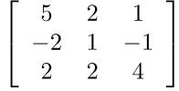

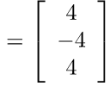
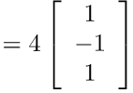


Eigenvalues and Eigenvectors
$$A0=λ0$$
If $Av=λv$ ($v$ is a vector, $λ$ is a scalar)
$v$ is an eigenvector of A
$λ$ is an eigenvalue of A that corresponds to $v$
excluding zero vector
A must be square
Eigen value
Eigen vector
Notes:
$A$ must be n x n

Slide 6
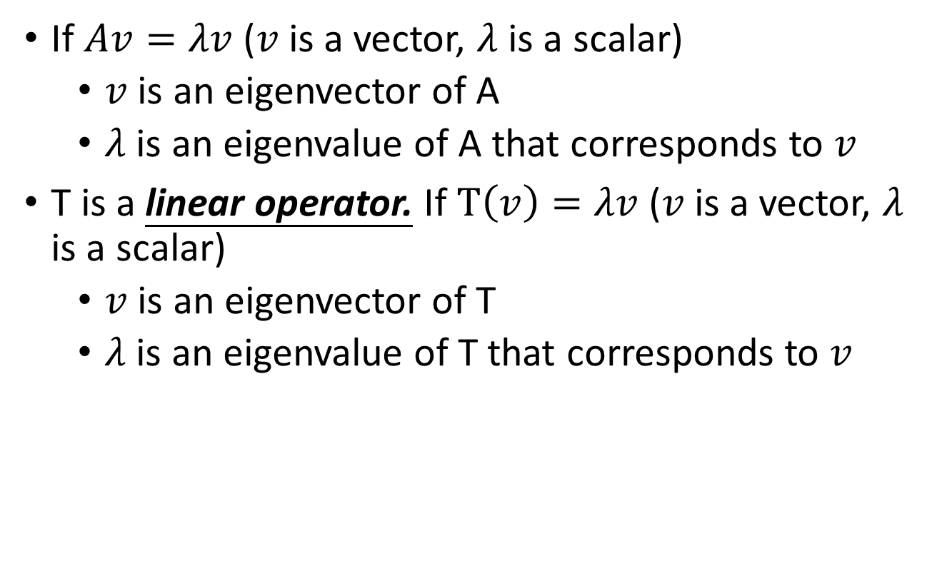
Eigenvalues and Eigenvectors
If $Av=λv$ ($v$ is a vector, $λ$ is a scalar)
$v$ is an eigenvector of A
$λ$ is an eigenvalue of A that corresponds to $v$
T is a linear operator. If $T\left(v\right)=λv$ ($v$ is a vector, $λ$ is a scalar)
$v$ is an eigenvector of T
$λ$ is an eigenvalue of T that corresponds to $v$
excluding zero vector
excluding zero vector
Notes:
$A$ must be n x n

Slide 7
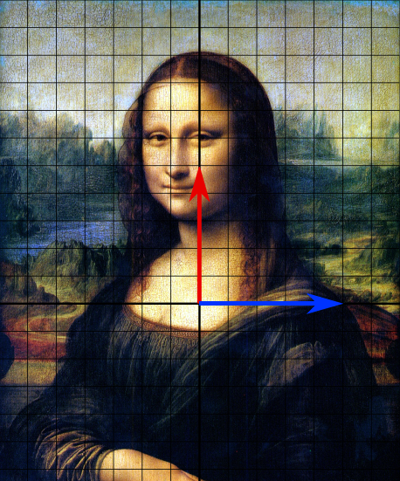
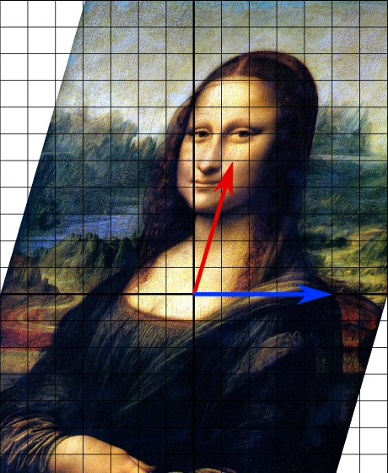
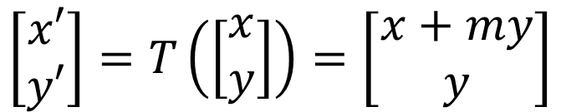
Eigenvalues and Eigenvectors
$$\left[\begin{aligned}x′ \\ y′\end{aligned}\right]=T\left(\left[\begin{aligned}x \\ y\end{aligned}\right]\right)=\left[\begin{aligned}x+my \\ y\end{aligned}\right]$$
Example: Shear Transform
(x,y)
(x’,y’)
This is an eigenvector.
Its eigenvalue is 1.

Slide 8




Eigenvalues and Eigenvectors
Example: Reflection
reflection operator T about the line y = (1/2)x
y = (1/2)x
b₁ is an eigenvector of T
$$b_{2}$$
$$b_{1}$$
Its eigenvalue is 1.
$$T\left(b_{1}\right)=b_{1}$$
b₂ is an eigenvector of T
Its eigenvalue is -1.
$$T\left(b_{2}\right)=−b_{2}$$

Slide 9




Eigenvalues and Eigenvectors
Example:
Eigenvalue is 2
Expansion and
Compression
$$\left[\begin{matrix}2 & 0 \\ 0 & 2\end{matrix}\right]$$
All vectors are eigenvectors.
$$\left[\begin{matrix}0.5 & 0 \\ 0 & 0.5\end{matrix}\right]$$
Eigenvalue is 0.5

Slide 10


Eigenvalues and Eigenvectors
Source of image: https://twitter.com/circleponiponi/status/1056026158083403776
Example: Rotation
Do any n x n matrix or linear operator have eigenvalues?

Slide 11
How to find eigenvectors (given eigenvalues)
Notes:
那放橋的video 嗎?????
http://blog.stata.com/2011/03/09/understanding-matrices-intuitively-part-2/
http://www.slideshare.net/ChristopherGratton/eigenvectors-eigenvalues-the-road-to-diagonalization
http://www.cs.columbia.edu/~jebara/htmlpapers/UTHESIS/node65.html
http://www.snrky.com/2012/07/so-long-as-my-eigenvalue-is-always-1.html
http://sune.tistory.com/22
http://www.mathworks.com/matlabcentral/answers/246053-how-to-rconstruct-image-using-eigenvectors-and-eigenvalues

Slide 12






Eigenvalues and Eigenvectors
An eigenvector of A corresponds to a unique eigenvalue.
An eigenvalue of A has infinitely many eigenvectors.
Example:
$$v=\left[\begin{matrix}1 \\ 0 \\ 0\end{matrix}\right]$$
$$u=\left[\begin{matrix}0 \\ 1 \\ −1\end{matrix}\right]$$
$$\left[\begin{matrix}−1 & 0 & 0 \\ 0 & 1 & 2 \\ 0 & 2 & 1\end{matrix}\right]\left[\begin{matrix}1 \\ 0 \\ 0\end{matrix}\right]$$
$$=\left[\begin{matrix}−1 \\ 0 \\ 0\end{matrix}\right]$$
$$\left[\begin{matrix}−1 & 0 & 0 \\ 0 & 1 & 2 \\ 0 & 2 & 1\end{matrix}\right]\left[\begin{matrix}0 \\ 1 \\ −1\end{matrix}\right]$$
$$=\left[\begin{matrix}0 \\ −1 \\ 1\end{matrix}\right]$$
Eigenvalue= -1
Eigenvalue= -1
Notes:
Cv
U + v

Slide 13





Do the eigenvectors correspond to the same eigenvalue form a subspace?
$Av=λv$
$A(cv)=λ(cv)$
$Au=λu$
$$A(u+v)=λ(u+v)$$

Slide 14

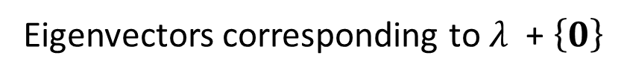

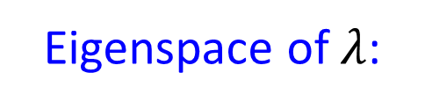

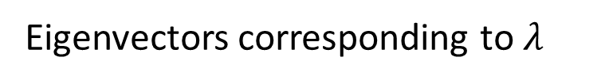
Eigenspace
Assume we know $λ$ is the eigenvalue of matrix A
Eigenvectors corresponding to $λ$
Eigenvectors corresponding to $λ$ are nonzero solution of
Av = λv
(A − λI_{n})v = 0
Av − λv = 0
Eigenvectors corresponding to $λ$
Av − λI_{n}v = 0
$$=Null\text{(}\text{A} \text{−} \text{λ}\text{I}\text{n}\text{)} \text{−} \left\{0\right\}$$
eigenspace
(A − λI_{n})v = 0
Eigenspace of $λ$:
matrix
Eigenvectors corresponding to $λ$ $\text{ + }\left\{0\right\}$

Slide 15
Check whether a scalar is an eigenvalue
Notes:
那放橋的video 嗎?????
http://blog.stata.com/2011/03/09/understanding-matrices-intuitively-part-2/
http://www.slideshare.net/ChristopherGratton/eigenvectors-eigenvalues-the-road-to-diagonalization
http://www.cs.columbia.edu/~jebara/htmlpapers/UTHESIS/node65.html
http://www.snrky.com/2012/07/so-long-as-my-eigenvalue-is-always-1.html
http://sune.tistory.com/22
http://www.mathworks.com/matlabcentral/answers/246053-how-to-rconstruct-image-using-eigenvectors-and-eigenvalues

Slide 16

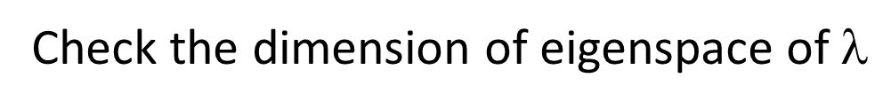
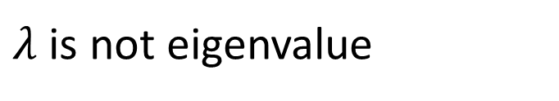
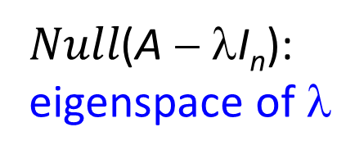
Check Eigenvalues
$Null\text{(}\text{A} \text{−} \text{λ}\text{I}\text{n}\text{)}$:
eigenspace of $\text{}$
How to know whether a scalar $\text{}$ is the eigenvalue of A?
Check the dimension of eigenspace of $\text{}$
If the dimension is 0
Eigenspace only contains {0}
No eigenvector
$λ$ is not eigenvalue
Notes:
[-3 -2]
[-3 -2]
[2 -2]
[-3 3]

Slide 17








Check Eigenvalues
$Null\text{(}\text{A} \text{−} \text{λ}\text{I}\text{n}\text{)}$:
eigenspace of $\text{}$
Example: to check 3 and −2 are eigenvalues of the linear operator T
$Null\text{(}\text{A} \text{−} \text{3}\text{I}\text{n}\text{)}\text{=?}$
$Null\text{(}\text{A} \text{+} \text{2}\text{I}\text{n}\text{)}\text{=?}$
$$\left[\begin{aligned}−6 \\ 9\end{aligned}\right]$$
$$\left[\begin{matrix}−3 & −2 \\ −3 & −2\end{matrix}\right]$$
$$\left[\begin{matrix}2 & −2 \\ −3 & 3\end{matrix}\right]$$
$$\left[\begin{aligned}1 \\ 1\end{aligned}\right]$$
$$\left[\begin{aligned}−2 \\ 3\end{aligned}\right]$$
$$\left[\begin{aligned}−2 \\ −2\end{aligned}\right]$$
Notes:
[-3 -2]
[-3 -2]
[2 -2]
[-3 3]

Slide 18


Check Eigenvalues
$Null\text{(}\text{A} \text{−} \text{λ}\text{I}\text{n}\text{)}$:
eigenspace of $\text{}$
Example: check that 3 is an eigenvalue of B and find a basis for the corresponding eigenspace
find the solution set of (B − 3I₃)x = 0
find the RREF of
B − 3I₃
=

Slide 19
Looking for Eigenvalues
Notes:
那放橋的video 嗎?????
http://blog.stata.com/2011/03/09/understanding-matrices-intuitively-part-2/
http://www.slideshare.net/ChristopherGratton/eigenvectors-eigenvalues-the-road-to-diagonalization
http://www.cs.columbia.edu/~jebara/htmlpapers/UTHESIS/node65.html
http://www.snrky.com/2012/07/so-long-as-my-eigenvalue-is-always-1.html
http://sune.tistory.com/22
http://www.mathworks.com/matlabcentral/answers/246053-how-to-rconstruct-image-using-eigenvectors-and-eigenvalues

Slide 20





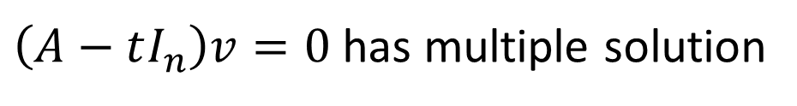


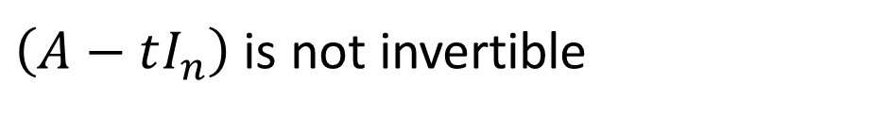


Looking for Eigenvalues
A scalar $t$ is an eigenvalue of A
Existing $v≠0$ such that
$$Av=tv$$
Existing $v≠0$ such that
$$Av−tv=0$$
Existing $v≠0$ such that
$$\left(A−tI_{n}\right)v=0$$
$\left(A−tI_{n}\right)v=0$ has multiple solution
The columns of $\left(A−tI_{n}\right)$ are independent
Dependent
$\left(A−tI_{n}\right)$ is not invertible
$$det\left(A−tI_{n}\right)=0$$
Notes:
$\left(A−tI_{n}\right)$ has non-zero null space

Slide 21


Looking for Eigenvalues
Example 1: Find the eigenvalues of
A scalar $t$ is an eigenvalue of A
$$det\left(A−tI_{n}\right)=0$$
=0
t = -3 or 5
The eigenvalues of A are -3 or 5.
Notes:
-3 + 5 = -4 + 6
Det = -4*6 – (-3) * 3 = -15
-3 * 5 = -15

Slide 22




Looking for Eigenvalues
Example 1: Find the eigenvalues of
The eigenvalues of A are -3 or 5.
Eigenspace of -3
$$Ax=−3x$$
$$\left(A+3I\right)x=0$$
find the solution
Eigenspace of 5
$$Ax=5x$$
$$\left(A−5I\right)x=0$$
find the solution
Notes:
[-3 1]^T
[1 -3]^T or [-1 3]
They are independent

Slide 23



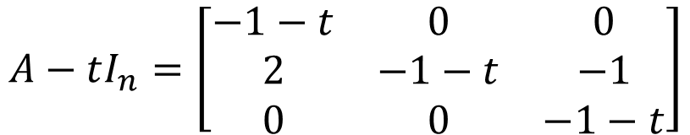
Looking for Eigenvalues
Example 2: find the eigenvalues of linear operator
standard
matrix
A scalar $t$ is an eigenvalue of A
$$det\left(A−tI_{n}\right)=0$$
$$A−tI_{n}=\left[\begin{matrix}−1−t & 0 & 0 \\ 2 & −1−t & −1 \\ 0 & 0 & −1−t\end{matrix}\right]$$
$$det\left(A−tI_{n}\right)={\left(−1−t\right)}^{3}$$

Slide 24


Looking for Eigenvalues
Example 3: linear operator on R² that rotates a vector by 90◦
A scalar $t$ is an eigenvalue of A
$$det\left(A−tI_{n}\right)=0$$
standard matrix of the 90◦-rotation:
No eigenvalues, no eigenvectors

Slide 25




Characteristic Polynomial
A scalar $t$ is an eigenvalue of A
$$det\left(A−tI_{n}\right)=0$$
A is the standard matrix of linear operator T
$$det\left(A−tI_{n}\right):$$
Characteristic polynomial of A
linear operator T
$$det\left(A−tI_{n}\right)=0:$$
Characteristic equation of A
linear operator T
Eigenvalues are the roots of characteristic polynomial or solutions of characteristic equation.
Notes:
t is the variable

Slide 26





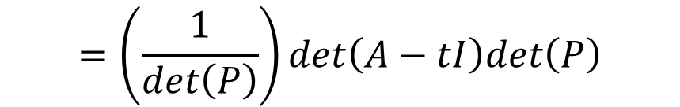
Characteristic Polynomial
In general, a matrix A and RREF of A have different characteristic polynomials.
Similar matrices have the same characteristic polynomials
Different Eigenvalues
The same Eigenvalues
$$det\left(B−tI\right)$$
$$=det\left(P^{−1}AP −P^{−1}\left(tI\right)P\right)$$
$$B=P^{−1}AP$$
$$=det\left(P^{−1}\left(A−tI\right)P \right)$$
$$=det\left(P^{−1}\right)det\left(A−tI\right)det\left(P\right)$$
$$=\left(\frac{1}{det\left(P\right)}\right)det\left(A−tI\right)det\left(P\right)$$
$$=det\left(A−tI\right)$$
Notes:
Question: Is the characteristic polynomial of A equal to its reduced row echelon form?
Use inv to explain it
RREF of A and A do not have the same eigne value
You cannot simply characteristic polynomial of A by finding RREF(A)

Slide 27

Characteristic Polynomial
Question: What is the order of the characteristic polynomial of an n×n matrix A?
The characteristic polynomial of an n×n matrix is indeed a polynomial with degree n
Consider det(A − tI_{n})
Question: What is the number of eigenvalues of an n×n matrix A?
Fact: An n x n matrix A have less than or equal to n eigenvalues
Consider complex roots and multiple roots
$$det\left[\begin{matrix}?−t & ⋯ & ? \\ ⋮ & ⋱ & ⋮ \\ ? & ⋯ & ?−t\end{matrix}\right]$$
Notes:
Can we “predict” the number of eigenvalues of A from its
characteristic polynomial?

Slide 28










Characteristic Polynomial v.s. Eigenspace
Characteristic polynomial of A is
$$det\left(A−tI_{n}\right)$$
Factorization
multiplicity
$$={\left(t−λ_{1}\right)}^{m_{1}}{\left(t−λ_{2}\right)}^{m_{2}}…{\left(t−λ_{k}\right)}^{m_{k}}\left(……\right)$$
Eigenvalue:
$$λ_{1}$$
$$λ_{2}$$
$$λ_{k}$$
Eigenspace:
$$d_{1}$$
$$d_{2}$$
$$d_{k}$$
(dimension)
$$≤m_{1}$$
$$≤m_{2}$$
$$≤m_{k}$$

Slide 29
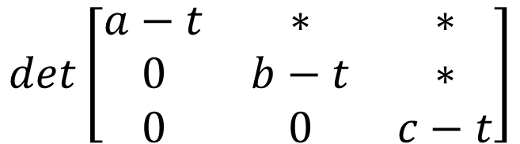


Characteristic Polynomial
The eigenvalues of an upper triangular matrix are its diagonal entries.
Characteristic Polynomial:
$$det\left[\begin{matrix}a−t & ∗ & ∗ \\ 0 & b−t & ∗ \\ 0 & 0 & c−t\end{matrix}\right]$$
$$\left[\begin{matrix}a & ∗ & ∗ \\ 0 & b & ∗ \\ 0 & 0 & c\end{matrix}\right]$$
$$=\left(a−t\right)\left(b−t\right)\left(c−t\right)$$
The determinant of an upper triangular matrix is the product of its diagonal entries.

Slide 30
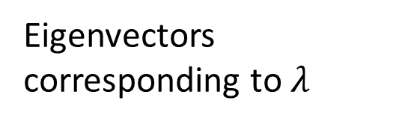

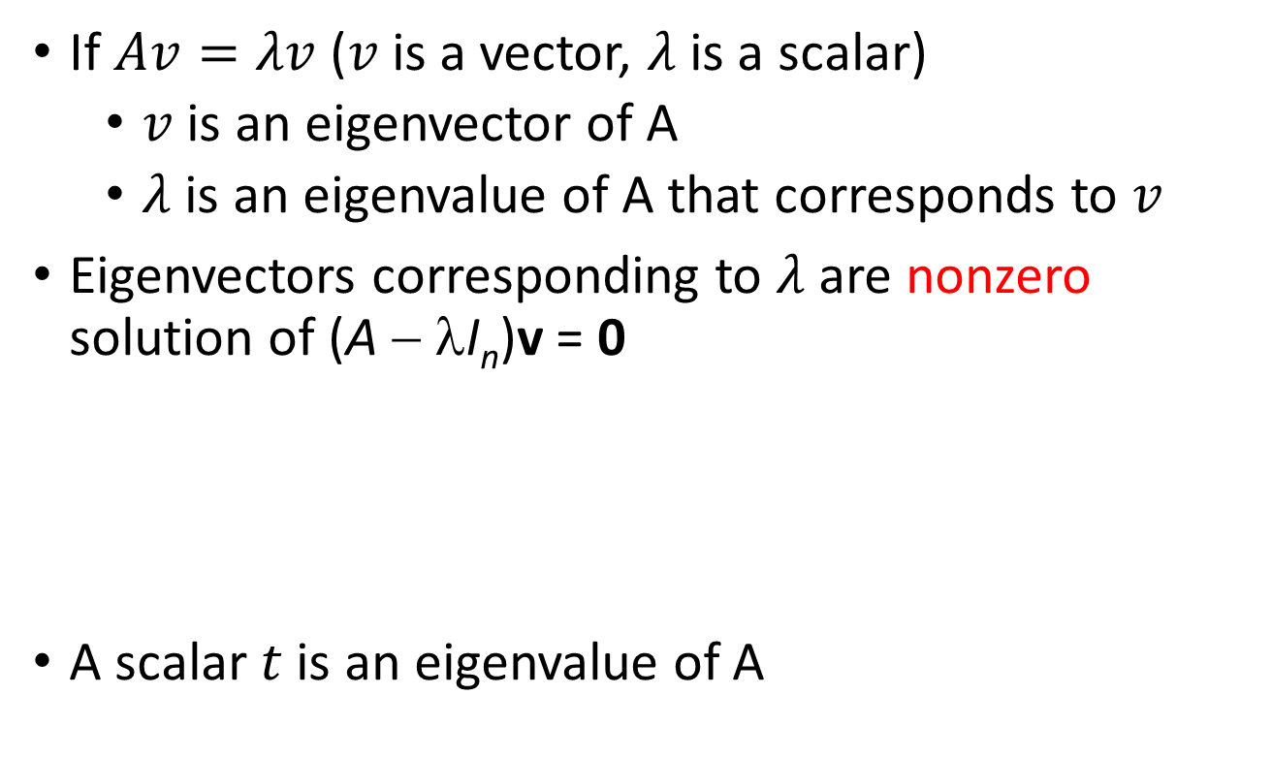
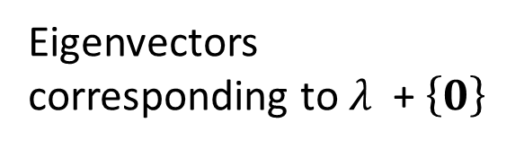


Summary
If $Av=λv$ ($v$ is a vector, $λ$ is a scalar)
$v$ is an eigenvector of A
$λ$ is an eigenvalue of A that corresponds to $v$
Eigenvectors corresponding to $λ$ are nonzero solution of (A − λI_{n})v = 0
A scalar $t$ is an eigenvalue of A
excluding zero vector
Eigenvectors corresponding to $λ$
Eigenspace of $λ$:
Eigenvectors corresponding to $λ$ $\text{ + }\left\{0\right\}$
$$=Null\text{(}\text{A} \text{−} \text{λ}\text{I}\text{n}\text{)} \text{−} \left\{0\right\}$$
eigenspace
$$det\left(A−tI_{n}\right)=0$$

