Slide 1
Diagonalization (對角化)
Hung-yi Lee

Slide 2


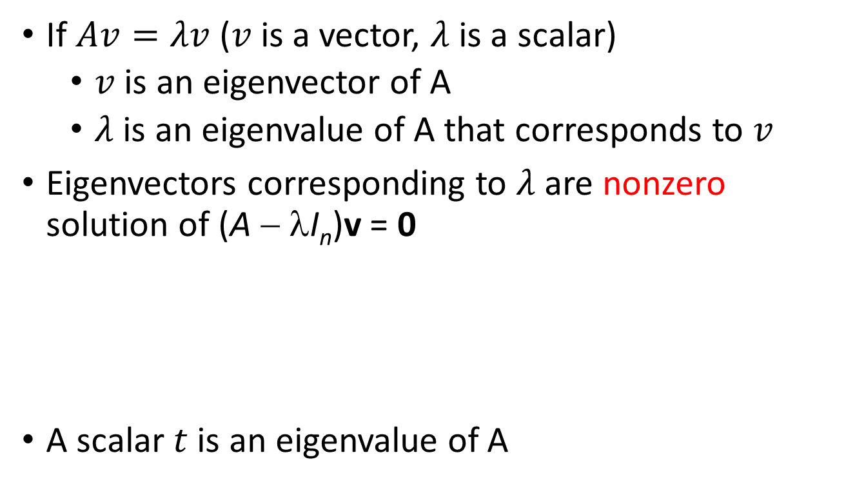



Review
If $Av=λv$ ($v$ is a vector, $λ$ is a scalar)
$v$ is an eigenvector of A
$λ$ is an eigenvalue of A that corresponds to $v$
Eigenvectors corresponding to $λ$ are nonzero solution of (A − λI_{n})v = 0
A scalar $t$ is an eigenvalue of A
excluding zero vector
Eigenvectors corresponding to $λ$
Eigenspace of $λ$:
Eigenvectors corresponding to $λ$ $\text{ + }\left\{0\right\}$
$$=Null\text{(}\text{A} \text{−} \text{λ}\text{I}\text{n}\text{)} \text{−} \left\{0\right\}$$
eigenspace
$$det\left(A−tI_{n}\right)=0$$

Slide 3

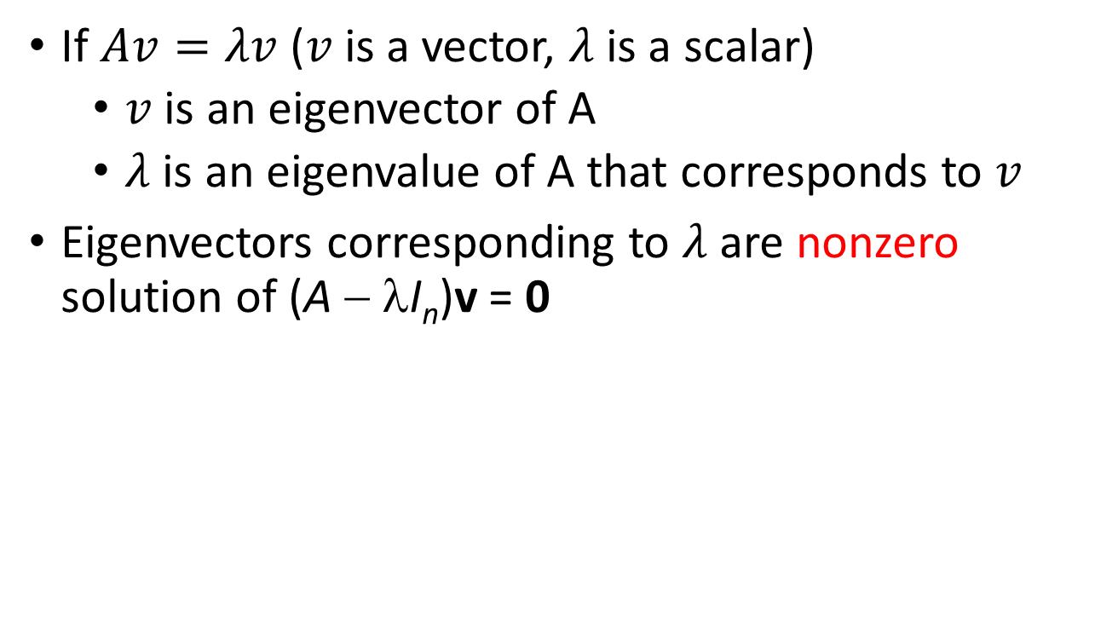








Review
Characteristic polynomial of A is
$$det\left(A−tI_{n}\right)$$
Factorization
multiplicity
$$={\left(t−λ_{1}\right)}^{m_{1}}{\left(t−λ_{2}\right)}^{m_{2}}…{\left(t−λ_{k}\right)}^{m_{k}}\left(……\right)$$
Eigenvalue:
$$λ_{1}$$
$$λ_{2}$$
$$λ_{k}$$
Eigenspace:
$$d_{1}$$
$$d_{2}$$
$$d_{k}$$
(dimension)
$$≤m_{1}$$
$$≤m_{2}$$
$$≤m_{k}$$

Slide 4
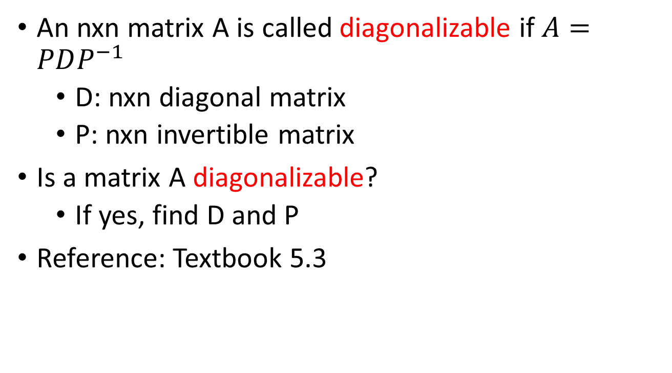
Outline
An nxn matrix A is called diagonalizable if $A=PDP^{−1}$
D: nxn diagonal matrix
P: nxn invertible matrix
Is a matrix A diagonalizable?
If yes, find D and P
Reference: Textbook 5.3
Notes:
Application 1: growth
Application 2: linear operator

Slide 5



Diagonalizable
(?)
A² = 0
Not all matrices are diagonalizable
If A = PDP⁻¹ for some invertible P and diagonal D
A² = PD²P⁻¹
= 0
D² = 0
D = 0
D is diagonal
A= 0
=0
=0
$$D=\left[\begin{matrix}d_{1} & ⋯ & 0 \\ ⋮ & ⋱ & ⋮ \\ 0 & ⋯ & d_{n}\end{matrix}\right]$$
$$D^{2}=\left[\begin{matrix}{\left(d_{1}\right)}^{2} & ⋯ & 0 \\ ⋮ & ⋱ & ⋮ \\ 0 & ⋯ & {\left(d_{n}\right)}^{2}\end{matrix}\right]$$
=0
=0

Slide 6












Diagonalizable
$$P=\left[\begin{matrix}p_{1} & ⋯ & p_{n}\end{matrix}\right]$$
$$D=\left[\begin{matrix}d_{1} & ⋯ & 0 \\ ⋮ & ⋱ & ⋮ \\ 0 & ⋯ & d_{n}\end{matrix}\right]$$
If A is diagonalizable
$$=\left[\begin{matrix}d_{1}e_{1} & ⋯ & d_{n}e_{n}\end{matrix}\right]$$
$$A=PDP^{−1}$$
$$AP=PD$$
$$AP=\left[\begin{matrix}Ap_{1} & ⋯ & Ap_{n}\end{matrix}\right]$$
$$PD=P\left[\begin{matrix}d_{1}e_{1} & ⋯ & d_{n}e_{n}\end{matrix}\right]$$
$$=\left[P\begin{matrix}d_{1}e_{1} & ⋯ & Pd_{n}e_{n}\end{matrix}\right]$$
$$=\left[\begin{matrix}d_{1}Pe_{1} & ⋯ & d_{n}Pe_{n}\end{matrix}\right]$$
$$=\left[\begin{matrix}{d_{1}p}_{1} & ⋯ & {d_{n}p}_{n}\end{matrix}\right]$$
$$Ap_{i}=d_{i}p_{i}$$
$p_{i}$ is an eigenvector of A corresponding to eigenvalue $d_{i}$

Slide 7



Diagonalizable
$$P=\left[\begin{matrix}p_{1} & ⋯ & p_{n}\end{matrix}\right]$$
$$D=\left[\begin{matrix}d_{1} & ⋯ & 0 \\ ⋮ & ⋱ & ⋮ \\ 0 & ⋯ & d_{n}\end{matrix}\right]$$
If A is diagonalizable
$p_{i}$ is an eigenvector of A corresponding to eigenvalue $d_{i}$
$$A=PDP^{−1}$$
=
There are n eigenvectors that form an invertible matrix
=
There are n independent eigenvectors
=
The eigenvectors of A can form a basis for R^{n}.

Slide 8
Diagonalizable
$$P=\left[\begin{matrix}p_{1} & ⋯ & p_{n}\end{matrix}\right]$$
$$D=\left[\begin{matrix}d_{1} & ⋯ & 0 \\ ⋮ & ⋱ & ⋮ \\ 0 & ⋯ & d_{n}\end{matrix}\right]$$
If A is diagonalizable
$p_{i}$ is an eigenvector of A corresponding to eigenvalue $d_{i}$
$$A=PDP^{−1}$$
How to diagonalize a matrix A?
Find n independent eigenvectors corresponding if possible, and form an invertible P
Step 1:
Step 2:
The eigenvalues corresponding to the eigenvectors in P form the diagonal matrix D.
Notes:
Is diagonalizable unique? No.
The eigen values can repeat in step 2.

Slide 9










Diagonalizable
A set of eigenvectors that correspond to distinct eigenvalues is linear independent.
$$det\left(A−tI_{n}\right)$$
Factorization
$$={\left(t−λ_{1}\right)}^{m_{1}}{\left(t−λ_{2}\right)}^{m_{2}}…{\left(t−λ_{k}\right)}^{m_{k}}\left(……\right)$$
Eigenvalue:
$$λ_{1}$$
$$λ_{2}$$
……
$$λ_{k}$$
Eigenspace:
$$d_{1}$$
$$≤m_{1}$$
$$d_{2}$$
$$≤m_{2}$$
……
$$d_{k}$$
$$≤m_{k}$$
(dimension)
Independent

Slide 10






Diagonalizable
A set of eigenvectors that correspond to distinct eigenvalues is linear independent.
Eigenvalue:
$$λ_{1}$$
$$λ_{2}$$
……
$$λ_{m}$$
Assume dependent
Eigenvector:
$$v_{1}$$
$$v_{2}$$
……
$$v_{m}$$
a contradiction
v_{k} = c₁v₁+c₂v₂+ … +c_{k−1}v_{k−1}
Av_{k} = c₁Av₁+c₂Av₂+ … +c_{k−1}Av_{k−1}
(λ_{k})
λ_{k}v_{k} = c₁λ₁v₁+c₂λ₂v₂+ … +c_{k−1}λ_{k−1}v_{k−1}
-
λ_{k}v_{k} = c₁λ_{k}v₁+c₂λ_{k}v₂+ … +c_{k−1}λ_{k}v_{k−1}
0 = c₁(λ₁−λ_{k}) v₁+c₂(λ₂−λ_{k})v₂+ … +c_{k−1}(λ_{k−1}−λ_{k})v_{k−1}
Not c₁ = c₂ = … = c_{k−1} = 0
Same eigenvalue
a contradiction
Notes:
This proof is not good …..

Slide 11







Diagonalizable
$$P=\left[\begin{matrix}p_{1} & ⋯ & p_{n}\end{matrix}\right]$$
$$D=\left[\begin{matrix}d_{1} & ⋯ & 0 \\ ⋮ & ⋱ & ⋮ \\ 0 & ⋯ & d_{n}\end{matrix}\right]$$
If A is diagonalizable
$p_{i}$ is an eigenvector of A corresponding to eigenvalue $d_{i}$
$$A=PDP^{−1}$$
$$det\left(A−tI_{n}\right)$$
$$={\left(t−λ_{1}\right)}^{m_{1}}{\left(t−λ_{2}\right)}^{m_{2}}…{\left(t−λ_{k}\right)}^{m_{k}}\left(……\right)$$
Eigenvalue:
$$λ_{1}$$
$$λ_{2}$$
……
$$λ_{k}$$
Eigenspace:
……
Basis for $λ_{1}$
Basis for $λ_{2}$
Basis for $λ_{3}$
Independent Eigenvectors
You can’t find more!
Notes:
Is diagonalizable unique? No.
The eigen values can repeat in step 2.

Slide 12
Diagonalizable - Example
Diagonalize a given matrix
characteristic polynomial is −(t + 1)²(t − 3)
eigenvalues: 3, −1
eigenvalue 3
A = PDP⁻¹, where
B₁ =
eigenvalue −1
B₂ =

Slide 13

Test for a Diagonalizable Matrix
An n x n matrix A is diagonalizable if and only if both the following conditions are met.
The characteristic polynomial of A factors into a product of linear factors.
$$det\left(A−tI_{n}\right)$$
Factorization
$$={\left(t−λ_{1}\right)}^{m_{1}}{\left(t−λ_{2}\right)}^{m_{2}}…{\left(t−λ_{k}\right)}^{m_{k}}\left(……\right)$$
For each eigenvalue λ of A, the multiplicity of λ equals the dimension of the corresponding eigenspace.

Slide 14











Independent Eigenvectors
An n x n matrix A is diagonalizable
=
The eigenvectors of A can form a basis for R^{n}.
=
$$det\left(A−tI_{n}\right)$$
$$={\left(t−λ_{1}\right)}^{m_{1}}{\left(t−λ_{2}\right)}^{m_{2}}…{\left(t−λ_{k}\right)}^{m_{k}}\left(……\right)$$
Eigenvalue:
$$λ_{1}$$
$$λ_{2}$$
……
$$λ_{k}$$
Eigenspace:
$$d_{1}$$
$$=m_{1}$$
$$d_{2}$$
$$=m_{2}$$
……
$$d_{k}$$
$$=m_{k}$$
(dimension)
$$d_{1}+d_{2}+…+d_{k}=n$$

Slide 15


Application of Diagonalization
If A is diagonalizable,
Example:
$$A=PDP^{−1}$$
$$A^{m}=PD^{m}P^{−1}$$
.15
.85
Study
IG
.97
.03
……
.85
.85
Study
Study
Study
.727
.15
.85
.15
.03
……
IG
IG
.273
.97
.15

Slide 16

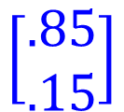





From Study IG
.15
.85
Study
IG
.97
To Study IG
.03
$$=A$$
……
.85
.85
Study
Study
Study
.727
.15
.85
.15
.03
……
IG
IG
.273
.97
.15
$$\left[\begin{aligned}.727 \\ .273\end{aligned}\right]$$
$$\left[\begin{aligned}.85 \\ .15\end{aligned}\right]$$
$$\left[\begin{aligned}1 \\ 0\end{aligned}\right]$$
$$A=PDP^{−1}$$
$$A^{m}=PD^{m}P^{−1}$$
Notes:
The following example shows that stochastic matrices do not need to be diagonalizable,
http://mathoverflow.net/questions/51887/non-diagonalizable-doubly-stochastic-matrices

Slide 17
Diagonalizable
Diagonalize a given matrix
RREF
(invertible)
RREF

Slide 18



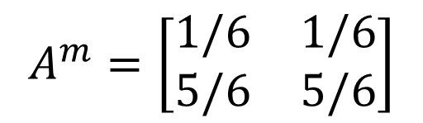


When $m→∞$,
The beginning condition does not influence.
$$A^{m}=\left[\begin{matrix}1/6 & 1/6 \\ 5/6 & 5/6\end{matrix}\right]$$
$$\left[\begin{matrix}1/6 & 1/6 \\ 5/6 & 5/6\end{matrix}\right]\left[\begin{aligned}1 \\ 0\end{aligned}\right]=\left[\begin{aligned}1/6 \\ 5/6\end{aligned}\right]$$
$$\left[\begin{matrix}1/6 & 1/6 \\ 5/6 & 5/6\end{matrix}\right]\left[\begin{aligned}0 \\ 1\end{aligned}\right]=\left[\begin{aligned}1/6 \\ 5/6\end{aligned}\right]$$

Slide 19

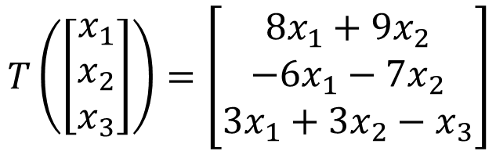


Diagonalization of Linear Operator
$$T\left(\left[\begin{aligned}x_{1} \\ x_{2} \\ x_{3}\end{aligned}\right]\right)=\left[\begin{aligned}8x_{1}+9x_{2} \\ −6x_{1}−7x_{2} \\ 3x_{1}+3x_{2}−x_{3}\end{aligned}\right]$$
Example 1:
det
-t
$$A=\left[\begin{matrix}8 & 9 & 0 \\ −6 & −7 & 0 \\ 3 & 3 & −1\end{matrix}\right]$$
The standard matrix is
-t
-t
⇒ the characteristic polynomial is −(t + 1)²(t − 2)
⇒ eigenvalues: −1, 2
Eigenvalue -1:
Eigenvalue 2:
$\text{B}\text{1}$=$\left\{\left[\begin{aligned}−1 \\ 1 \\ 0\end{aligned}\right],\left[\begin{aligned}0 \\ 0 \\ 1\end{aligned}\right]\right\}$
$\text{B}\text{2}$=$\left\{\left[\begin{aligned}3 \\ −2 \\ 1\end{aligned}\right]\right\}$
⇒ B₁ ∪ B₂ is a basis of R ³
⇒ T is diagonalizable.

Slide 20


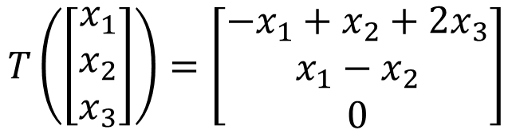



Diagonalization of Linear Operator
$$T\left(\left[\begin{aligned}x_{1} \\ x_{2} \\ x_{3}\end{aligned}\right]\right)=\left[\begin{aligned}−x_{1}+x_{2}+2x_{3} \\ x_{1}−x_{2} \\ 0\end{aligned}\right]$$
Example 2:
det
-t
$$A=\left[\begin{matrix}−1 & 1 & 2 \\ 1 & −1 & 0 \\ 0 & 0 & 0\end{matrix}\right]$$
The standard matrix is
-t
-t
⇒ the characteristic polynomial is −t²(t + 2)
⇒ eigenvalues: 0, −2
⇒ the reduced row echelon form of A − 0I₃ = A is
$$\left[\begin{matrix}1 & −1 & 0 \\ 0 & 0 & 1 \\ 0 & 0 & 0\end{matrix}\right]$$
$$x_{1}−x_{2}=0$$
$$\left[\begin{aligned}x_{1} \\ x_{2} \\ x_{3}\end{aligned}\right]=x_{1}\left[\begin{aligned}1 \\ 1 \\ 0\end{aligned}\right]$$
$$x_{3}=0$$
⇒ the eigenspaces corresponding to the eigenvalue 0 has the
dimension 1 < 2 = algebraic multiplicity of the eigenvalue 0
⇒ T is not diagonalizable.

Slide 21
Review
Simple Function
Another coordinate system
output’
Input’
Cartesian coordinate system
Input
Output
Complex Function
Notes:
Why we have to do that?

Slide 22











Flowchart
$${\left[T\right]}_{\text{B}}$$
$${\left[v\right]}_{\text{B}}$$
$${\left[T\left(v\right)\right]}_{\text{B}}$$
$\text{B}$coordinate system
$$B$$
Cartesian coordinate system
$$B^{−1}$$
$$\left[T\right]$$
$$v$$
$$T\left(v\right)$$
$$\left[T\right]=B{\left[T\right]}_{\text{B}}B^{−1}$$
$${\left[T\right]}_{\text{B}}=B^{−1}\left[T\right]B$$
similar
similar
Notes:
invertible n-by-n matrix P.

Slide 23

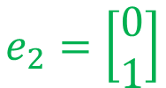


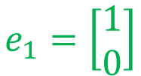


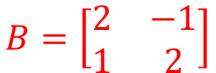

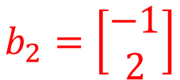


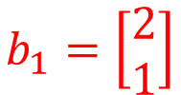


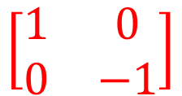
Example: reflection operator T about the line y = (1/2)x
$$B^{−1}=\left[\begin{matrix}0.4 & 0.2 \\ −0.2 & 0.4\end{matrix}\right]$$
$$B=\left[\begin{matrix}2 & −1 \\ 1 & 2\end{matrix}\right]$$
$$b_{2}=\left[\begin{aligned}−1 \\ 2\end{aligned}\right]$$
y = (1/2)x
$${\left[T\right]}_{\text{B}}$$
$${\left[v\right]}_{\text{B}}$$
$${\left[T\left(v\right)\right]}_{\text{B}}$$
$$b_{1}=\left[\begin{aligned}2 \\ 1\end{aligned}\right]$$
$$\left[\begin{matrix}1 & 0 \\ 0 & −1\end{matrix}\right]$$
$$B^{−1}$$
$$B$$
y = (1/2)x
$$e_{2}=\left[\begin{aligned}0 \\ 1\end{aligned}\right]$$
$$\left[T\right]=?$$
$$v$$
$$T\left(v\right)$$
$$e_{1}=\left[\begin{aligned}1 \\ 0\end{aligned}\right]$$
$$\left[T\right]=B{\left[T\right]}_{\text{B}}B^{−1}$$

Slide 24








Diagonalization of Linear Operator
Reference: Chapter 5.4
$${\left[T\right]}_{\text{B}}$$
$${\left[v\right]}_{\text{B}}$$
$${\left[T\left(v\right)\right]}_{\text{B}}$$
simple
$$B^{−1}$$
$$B$$
Properly selected
Properly selected
$$T$$
$$v$$
$$T\left(v\right)$$

Slide 25











Diagonalization of Linear Operator
If a linear operator T is diagonalizable
$$D$$
$${\left[T\right]}_{\text{B}}$$
$${\left[v\right]}_{\text{B}}$$
$${\left[T\left(v\right)\right]}_{\text{B}}$$
simple
$$P^{−1}$$
Eigenvectors form the good system
$$P$$
$$B^{−1}$$
$$B$$
Properly selected
Properly selected
$$A=PDP^{−1}$$
$$v$$
$$T\left(v\right)$$

Slide 26
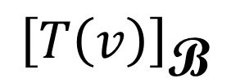
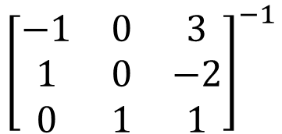
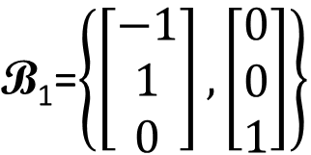
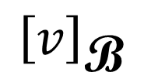
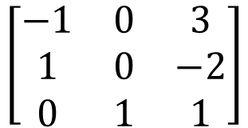
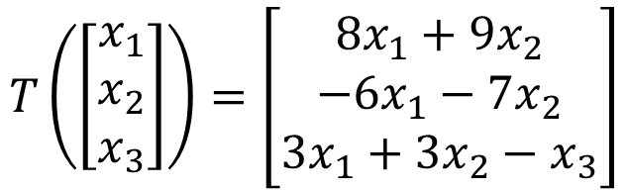

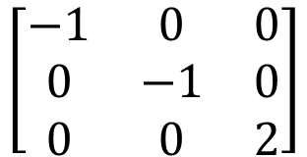

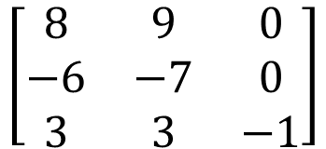
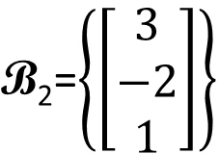

Diagonalization of Linear Operator
-1:
2:
$$T\left(\left[\begin{aligned}x_{1} \\ x_{2} \\ x_{3}\end{aligned}\right]\right)=\left[\begin{aligned}8x_{1}+9x_{2} \\ −6x_{1}−7x_{2} \\ 3x_{1}+3x_{2}−x_{3}\end{aligned}\right]$$
$\text{B}\text{1}$=$\left\{\left[\begin{aligned}−1 \\ 1 \\ 0\end{aligned}\right],\left[\begin{aligned}0 \\ 0 \\ 1\end{aligned}\right]\right\}$
$\text{B}\text{2}$=$\left\{\left[\begin{aligned}3 \\ −2 \\ 1\end{aligned}\right]\right\}$
$${\left[T\right]}_{\text{B}}$$
$${\left[v\right]}_{\text{B}}$$
$${\left[T\left(v\right)\right]}_{\text{B}}$$
$$\left[\begin{matrix}−1 & 0 & 0 \\ 0 & −1 & 0 \\ 0 & 0 & 2\end{matrix}\right]$$
$${\left[\begin{matrix}−1 & 0 & 3 \\ 1 & 0 & −2 \\ 0 & 1 & 1\end{matrix}\right]}^{−1}$$
$$\left[\begin{matrix}−1 & 0 & 3 \\ 1 & 0 & −2 \\ 0 & 1 & 1\end{matrix}\right]$$
$$\left[\begin{matrix}8 & 9 & 0 \\ −6 & −7 & 0 \\ 3 & 3 & −1\end{matrix}\right]$$
$$v$$
$$T\left(v\right)$$

