Slide 1


Matrix-Vector Product

Slide 2
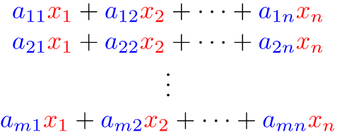
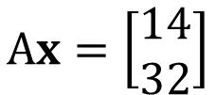

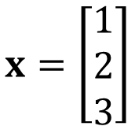
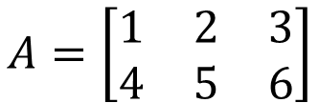

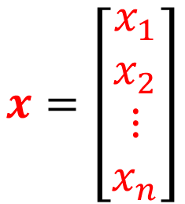
Matrix-Vector Product
$$A=\left[\begin{matrix}\begin{matrix}a_{11} & a_{12} \\ a_{21} & a_{22}\end{matrix} & \begin{matrix}⋯ & a_{1n} \\ ⋯ & a_{2n}\end{matrix} \\ \begin{matrix}⋮ & ⋮ \\ a_{m1} & a_{m2}\end{matrix} & \begin{matrix}⋱ & ⋮ \\ ⋯ & a_{mn}\end{matrix}\end{matrix}\right]$$
$$x=\left[\begin{matrix}\begin{matrix}x_{1} \\ x_{2}\end{matrix} \\ \begin{matrix}⋮ \\ x_{n}\end{matrix}\end{matrix}\right]$$
Inner Product
with Row
$$Ax=$$
$$x=\left[\begin{matrix}1 \\ 2 \\ 3\end{matrix}\right]$$
$$A=\left[\begin{matrix}1 & 2 & 3 \\ 4 & 5 & 6\end{matrix}\right]$$
$$Ax=\left[\begin{matrix}14 \\ 32\end{matrix}\right]$$

Slide 3
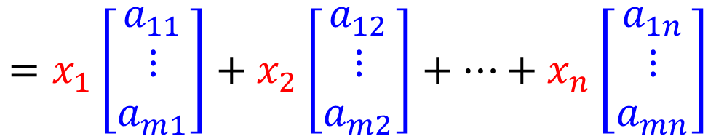
Matrix-Vector Product
$$A=\left[\begin{matrix}\begin{matrix}a_{11} & a_{12} \\ a_{21} & a_{22}\end{matrix} & \begin{matrix}⋯ & a_{1n} \\ ⋯ & a_{2n}\end{matrix} \\ \begin{matrix}⋮ & ⋮ \\ a_{m1} & a_{m2}\end{matrix} & \begin{matrix}⋱ & ⋮ \\ ⋯ & a_{mn}\end{matrix}\end{matrix}\right]$$
$$x=\left[\begin{matrix}\begin{matrix}x_{1} \\ x_{2}\end{matrix} \\ \begin{matrix}⋮ \\ x_{n}\end{matrix}\end{matrix}\right]$$
Inner Product
with Row
$$Ax=$$
$$=x_{1}\left[\begin{matrix}a_{11} \\ ⋮ \\ a_{m1}\end{matrix}\right]+x_{2}\left[\begin{matrix}a_{12} \\ ⋮ \\ a_{m2}\end{matrix}\right]+…+x_{n}\left[\begin{matrix}a_{1n} \\ ⋮ \\ a_{mn}\end{matrix}\right]$$
Weighted sum of Columns
Notes:
Linear combination of columns of A whose coefficients are the components in x

Slide 4


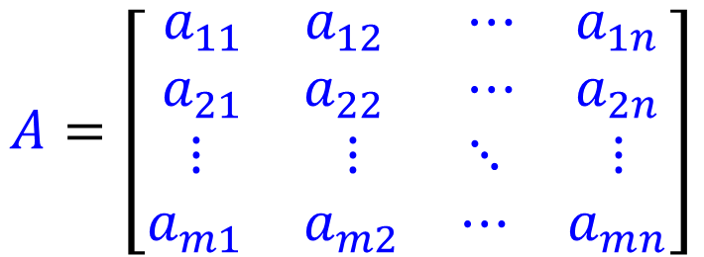



$$A=\left[\begin{matrix}\begin{matrix}a_{11} & a_{12} \\ a_{21} & a_{22}\end{matrix} & \begin{matrix}⋯ & a_{1n} \\ ⋯ & a_{2n}\end{matrix} \\ \begin{matrix}⋮ & ⋮ \\ a_{m1} & a_{m2}\end{matrix} & \begin{matrix}⋱ & ⋮ \\ ⋯ & a_{mn}\end{matrix}\end{matrix}\right]$$
$$x=\left[\begin{matrix}\begin{matrix}x_{1} \\ x_{2}\end{matrix} \\ \begin{matrix}⋮ \\ x_{n}\end{matrix}\end{matrix}\right]$$
$$x_{1}$$
Linear
System
$$x_{2}$$
……
$$x_{n}$$
$$Ax$$
Linear
System
$$x$$
$$b=Ax$$
The matrix $A$ represents the system.

Slide 5

$$x_{1}$$
Linear
System
$$b_{1}$$
$$x_{2}$$
$$b_{2}$$
……
……
$$x_{n}$$
$$b_{m}$$
Matrix-vector product:

Slide 6















Example
$$A=\left[\begin{matrix}1 & 4 \\ −3 & 2\end{matrix}\right]$$
$$x_{1}+4x_{2}=b_{1}$$
-2
$$x_{1}$$
A
$$b_{1}$$
$$=Ax$$
$$−3x_{1}+2x_{2}=b_{2}$$
0.5
$$x_{2}$$
$$b_{2}$$
Row 1
$$\left[\begin{matrix}−2 \\ 6\end{matrix}\right]$$
Row 2
column 2
$$\left[\begin{matrix}1 \\ 4\end{matrix}\right]$$
$$\left[\begin{matrix}−3 \\ 2\end{matrix}\right]$$
$$\left[\begin{matrix}4 \\ 2\end{matrix}\right]$$
$$\left[\begin{matrix}2 \\ 1\end{matrix}\right]$$
$$\left[\begin{matrix}−2 \\ 0.5\end{matrix}\right]$$
Column
Aspect
Row
Aspect
$$\left[\begin{matrix}1 \\ −3\end{matrix}\right]$$
column 1
Notes:
$$\left[\begin{matrix}0 \\ 7\end{matrix}\right]$$

