Slide 1

Properties of Matrix-Vector Product

Slide 2




Matrix-vector Product
The size of matrix and vector should be matched.
$$A=\left[\begin{matrix}2 & 3 & 5 \\ 3 & 1 & −1 \\ −2 & 1 & 1\end{matrix}\right]$$
$$x=\left[\begin{matrix}1 \\ −1\end{matrix}\right]$$
$$A^{′′}=\left[\begin{matrix}\begin{matrix}2 \\ 3\end{matrix} & \begin{matrix}1 \\ 2\end{matrix} \\ \begin{matrix}0 \\ 1\end{matrix} & \begin{matrix}−1 \\ −3\end{matrix}\end{matrix}\right]$$
$$A′=\left[\begin{matrix}1 & −1 \\ 2 & 3 \\ 1 & 4\end{matrix}\right]$$

Slide 3
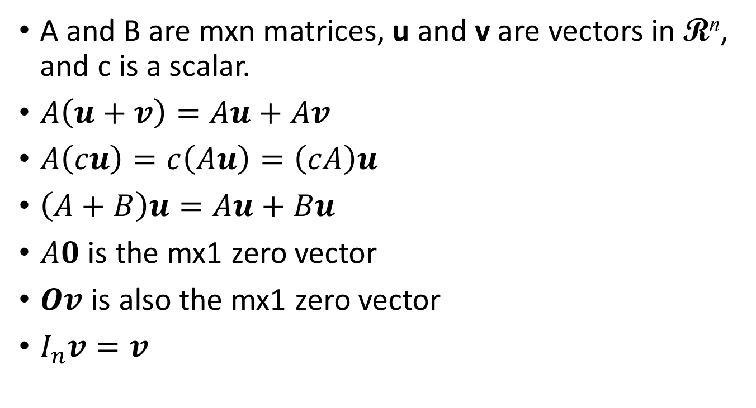



Properties of Matrix-vector Product
A and B are mxn matrices, u and v are vectors in R^{n}, and c is a scalar.
$A\left(u+v\right)=Au+Av$
$A\left(cu\right)=c\left(Au\right)=\left(cA\right)u$
$\left(A+B\right)u=Au+Bu$
$A0$ is the mx1 zero vector
$Ov$ is also the mx1 zero vector
$I_{n}v=v$
$$\left[\begin{matrix}1 & 0 & 0 \\ 0 & 1 & 0 \\ 0 & 0 & 1\end{matrix}\right]$$
$$\left[\begin{matrix}v_{1} \\ v_{2} \\ v_{3}\end{matrix}\right]$$
$$=\left[\begin{matrix}v_{1} \\ v_{2} \\ v_{3}\end{matrix}\right]$$
Notes:
The last one can say something.

Slide 4





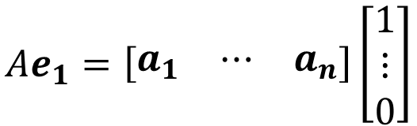






Properties of Matrix-vector Product
需要知道這麼多嗎?
A and B are mxn matrices. If $Aw=Bw$ for all $w$ in R^{n}. Is it true that $A=B$?
$Ae_{j}=a_{j}$, where $e_{j}$ is the j-th standard vector in R^{n}
$$e_{1}=\left[\begin{matrix}1 \\ ⋮ \\ 0\end{matrix}\right]$$
$$Ae_{1}=\left[\begin{matrix}a_{1} & ⋯ & a_{n}\end{matrix}\right]\left[\begin{matrix}1 \\ ⋮ \\ 0\end{matrix}\right]$$
Column Aspect
$$=1∙a_{1}+0∙a_{2}+⋯+0∙a_{n}$$
j
$$=a_{1}$$
j
$$Ae_{1}=Be_{1}$$
$$Ae_{2}=Be_{2}$$
$$Ae_{n}=Be_{n}$$
……
$$A=B$$
$$a_{1}=b_{1}$$
$$a_{2}=b_{2}$$
$$a_{n}=b_{n}$$
Notes:
http://betterexplained.com/articles/linear-algebra-guide/

